Slide 1
NAVKALPANA HACKATHON 2026
TITLE PAGE
Problem Statement Title- HealthTech Solution
Theme- Health
PS Category- Software
Team ID- RICR-NK-0029
Team Name-

Slide 2
WORKOUT MANAGEMENT SYSTEM USING MERN STACK
💡 Project Idea – Smart Workout Planner
The idea of this project is to develop a full-stack web application that helps users plan, manage, and track their daily workout routines in a simple and organized way. Many people struggle to maintain consistency in fitness because they do not have a structured workout plan or a centralized platform to track their exercises. This application solves that problem by providing a digital workout planning system.
The Smart Workout Planner allows users to create personalized workout plans, view all scheduled workouts, and manage their fitness activities through an interactive dashboard. The frontend is built using React and Tailwind CSS to provide a modern and responsive user interface, while the backend is developed using Node.js and Express to handle APIs and business logic. MongoDB is used as the database to store user and workout data efficiently.
The system follows a client-server architecture where the frontend communicates with the backend through REST APIs (such as fetching all workouts and adding new workout plans). This ensures scalability, fast performance, and real-time data handling.
Overall, the main goal of this project is to simplify fitness planning, improve user discipline, and demonstrate full-stack development skills using the MERN stack in a real-world application.
🛠️ Proposed Solution – Smart Workout Planner
The proposed solution is a full-stack web application that provides a structured and user-friendly platform for planning and managing workout routines. The system allows users to create, view, and organize their workout plans in one centralized dashboard, making fitness tracking more efficient and consistent.
The application is designed using a modern MERN-based architecture where the frontend (React with Tailwind CSS) provides an interactive and responsive interface, and the backend (Node.js and Express) handles API requests and business logic. MongoDB is used to store workout data such as workout title, duration, and calories, ensuring fast and scalable data management.
Users can add new workout plans, fetch all workouts through REST APIs (e.g., /api/workout/all), and manage their fitness schedule digitally instead of relying on manual tracking. Axios is used for seamless communication between the frontend and backend, enabling real-time data updates on the dashboard.
Additionally, the system includes proper routing, authentication-ready structure, and a modular backend design, making it scalable for future enhancements like progress tracking, analytics, and AI-based workout recommendations.
This solution not only improves workout organization and user productivity but also demonstrates practical implementation of full-stack development, REST API integration, and database management in a real-world fitness application.
⭐ Uniqueness of Smart Workout Planner
• Full-Stack MERN Architecture (React, Node.js, Express, MongoDB) • Real-time API Integration using Axios • Clean and Responsive UI with Tailwind CSS • Structured Workout Management System (Create, View, Manage) • Modular Backend Design (Models, Routes, Controllers) • Scalable Database Structure using MongoDB • REST API-based Client-Server Communication • Easy to Upgrade with Future Enhancements (AI Suggestions, Analytics) • User-Friendly Dashboard for Better Experience • Practical Real-World Fitness Problem Solution
Git-Hub Link:- Link
Project WorkFlow :- User → Frontend (React) → Axios API Call → Express Server → MongoDB → Response to UI

Slide 3
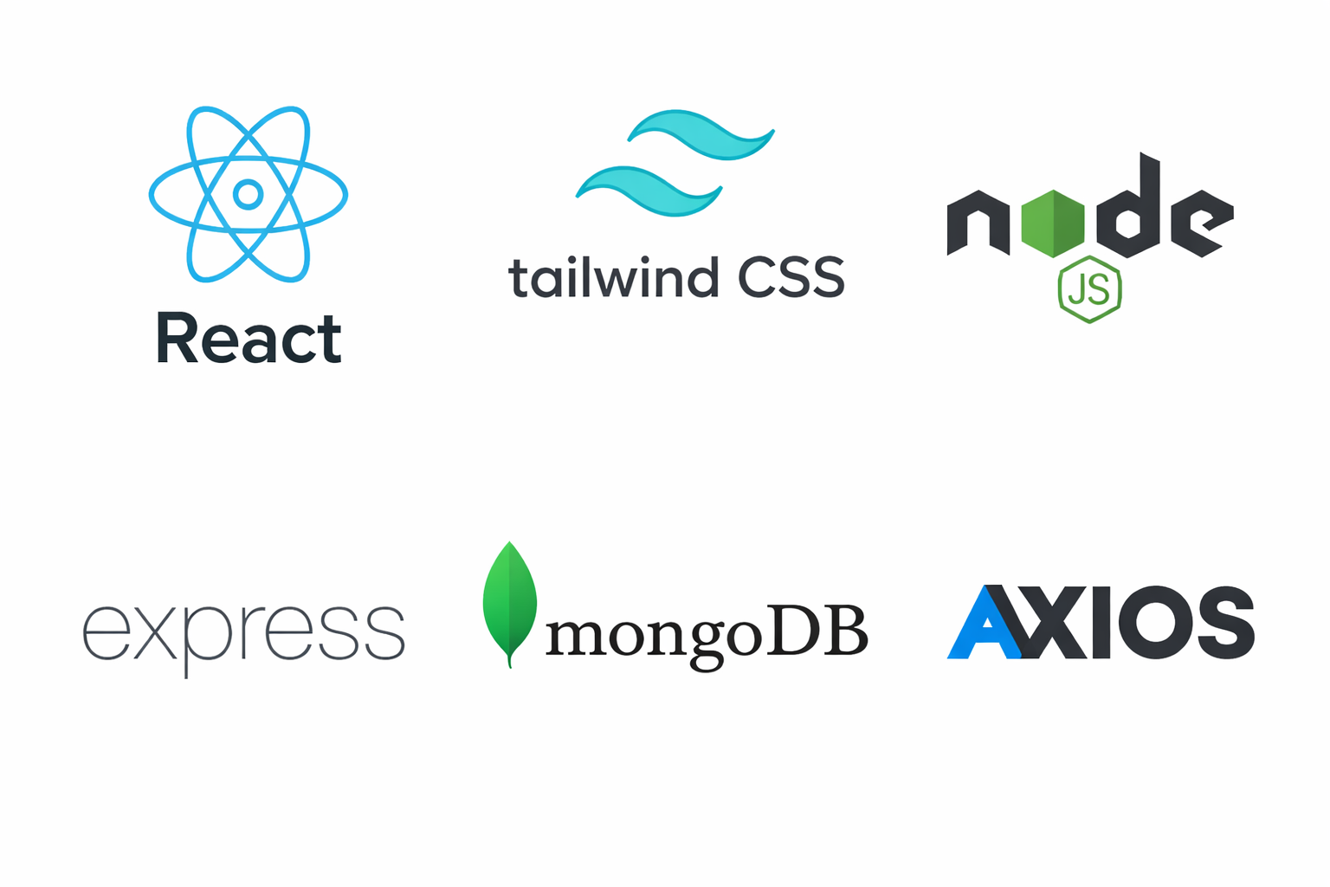
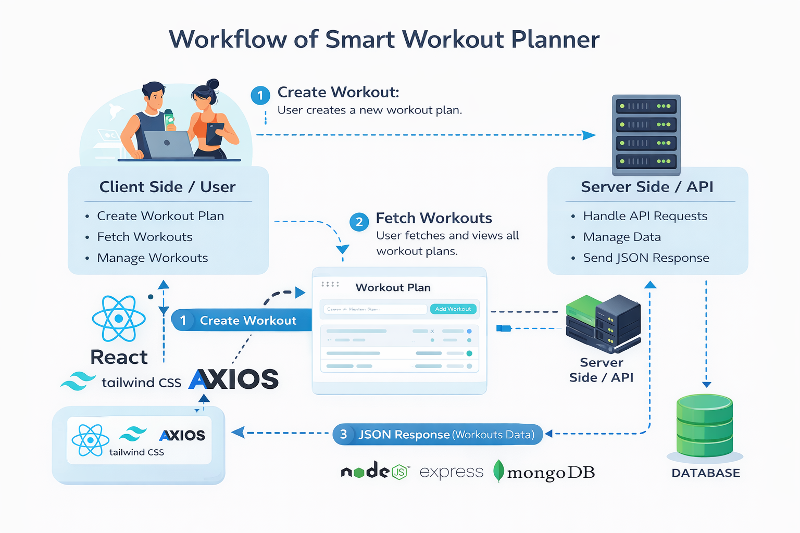
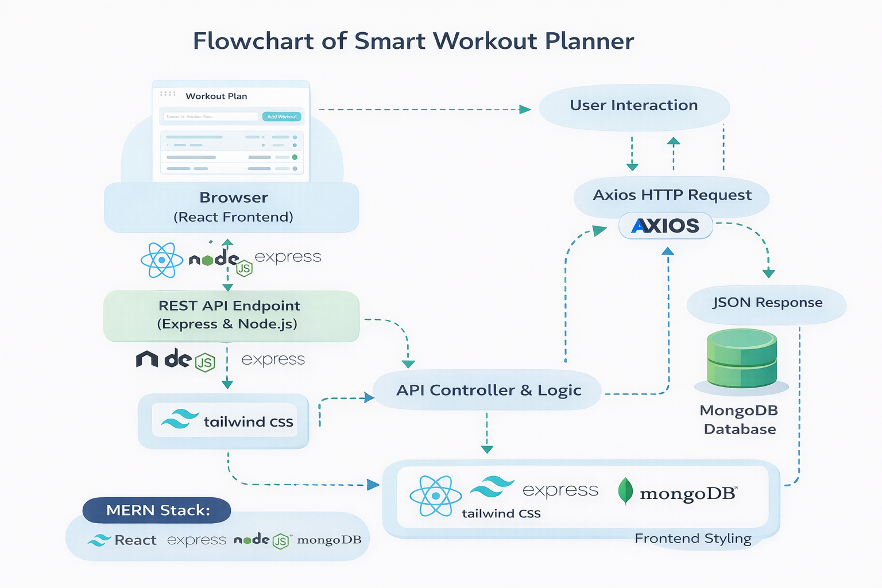
TECHNICAL APPROACH
TECHNOLOGY USED

Slide 4
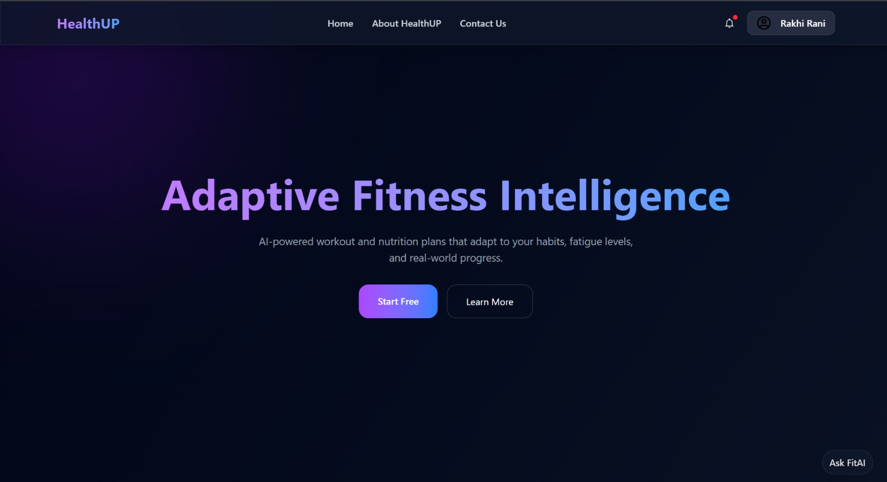
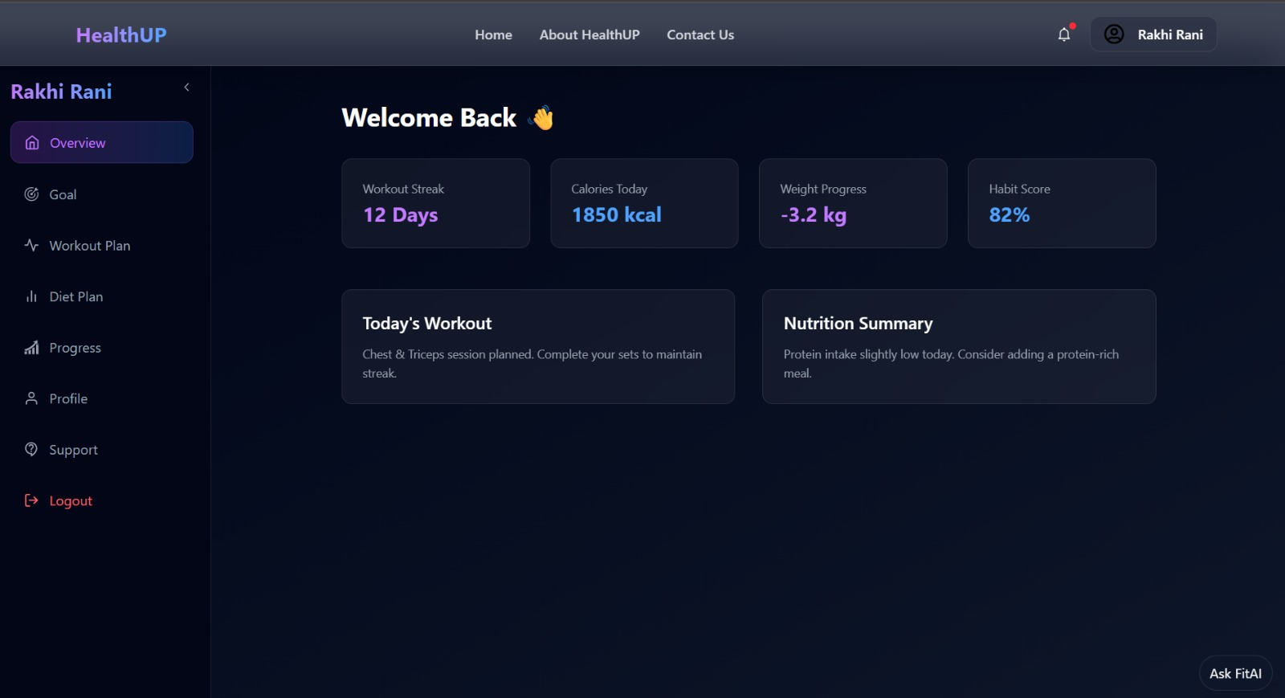
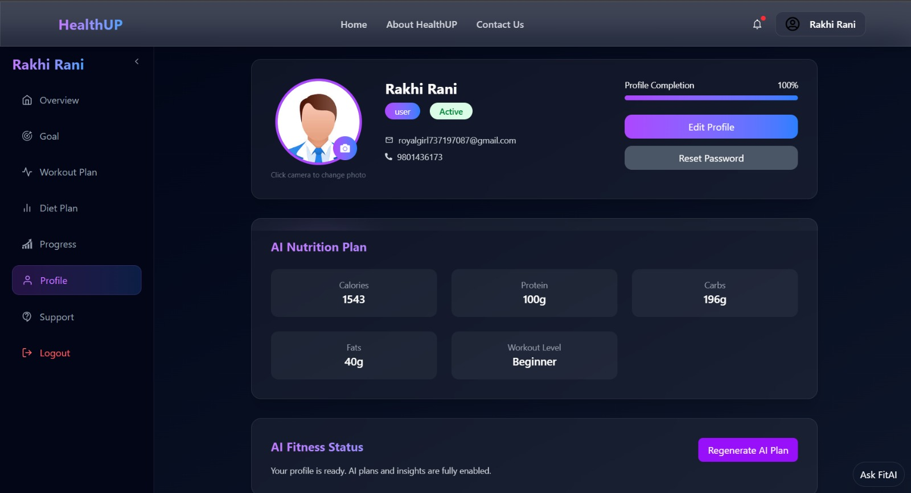
PROTOTYPE INTERNAL PIC

Slide 5
FEASIBILITY AND VIABILITY
✅ Feasibility Analysis – Smart Workout Planner
🔹 1. Technical Feasibility
• Built using widely used technologies (React, Node.js, Express, MongoDB) • Easy integration using REST APIs • Runs on standard systems (no special hardware required) • Open-source tools and libraries used • Scalable architecture for future upgrades
🔹 2. Economic Feasibility
• Low development cost (uses free and open-source technologies) • No expensive licenses required • Can be deployed on free hosting platforms • Minimal maintenance cost
🔹 3. Operational Feasibility
• Simple and user-friendly interface • Easy to learn and use • Requires minimal technical knowledge for users • Supports smooth daily workout management
🔹 4. Schedule Feasibility
• Can be developed within a short academic project timeline • Modular structure allows parallel frontend and backend development • Easy testing and debugging process
✅ Viability Analysis – Smart Workout Planner
🔹 1. Market Viability
• Increasing awareness about fitness and healthy lifestyle • Growing demand for personalized workout planning • Suitable for students, working professionals, and gym users • Can target local gyms and fitness trainers
🔹 2. User Viability
• Solves real problems like inconsistent workout tracking • Personalized workout suggestions improve engagement • Easy-to-use interface increases adoption • Saves time compared to manual planning
🔹 3. Financial Viability
• Can generate revenue through:
Premium subscription model
Advertisements
Trainer partnerships • Low operational cost ensures long-term sustainability
🔹 4. Scalability & Growth Viability
• Can expand to include:
Diet planning
AI-based recommendations
Wearable device integration • Cloud-based deployment supports growth • Can scale to multiple cities or globally

Slide 6
IMPACT AND BENEFITS
🌍 Impact (Smart Workout Planner)
🔹 1. Health & Lifestyle Impact
• Encourages a healthy and active lifestyle • Helps users maintain regular workout routines • Reduces sedentary habits among students and professionals
🔹 2. User Productivity Impact
• Saves time by providing automated workout plans • Removes confusion in planning daily exercises • Improves consistency and discipline in fitness goals
🔹 3. Social Impact
• Promotes awareness about fitness and well-being • Can be used by beginners who lack proper guidance • Supports inclusive fitness for all age groups
🔹 4. Technological Impact
• Demonstrates use of AI/automation in fitness planning • Encourages adoption of smart health applications • Shows integration of modern technology in daily life
🔹 5. Economic Impact
• Reduces dependency on expensive personal trainers • Affordable fitness solution for students • Potential for startup and business opportunities
🔹 6. Educational Impact
• Useful for learning about health, fitness, and technology • Enhances awareness of personalized training systems • Demonstrates real-world application of software development concepts
🔹 7. Long-Term Impact
• Improves overall physical and mental well-being • Builds sustainable fitness habits • Scalable to include diet plans, wearable tracking, and advanced AI features
✅ Benefits of Smart Workout Planner
🔹 1. Personalized Workout Plans
• Generates workout routines based on user preferences • Suitable for beginners and intermediate users • Adapts according to fitness goals
🔹 2. Time Saving
• Eliminates manual workout planning • Quick access to structured routines • Reduces confusion about what to train daily
🔹 3. Cost Effective
• Free or low-cost alternative to personal trainers • No need for expensive fitness consultation • Affordable solution for students
🔹 4. Easy to Use
• Simple and user-friendly interface • Accessible anytime, anywhere • Requires minimal technical knowledge
🔹 5. Improved Consistency
• Encourages regular workout tracking • Helps build discipline • Increases motivation through structured plans
🔹 6. Progress Monitoring
• Tracks completed workouts • Helps users analyze improvement • Keeps users accountable
🔹 7. Scalable & Future Ready
• Can integrate diet planning • Can connect with wearable devices • Supports AI-based enhancements

Slide 7
RESEARCH AND REFERENCES
🔹 1. Importance of Regular Physical Activity
World Health Organization (WHO) highlights that regular physical activity reduces risk of chronic diseases and improves mental health. 🔗 https://www.who.int/news-room/fact-sheets/detail/physical-activity
🔹 2. Benefits of Personalized Workout Programs
Research shows personalized training programs improve adherence and performance outcomes. 🔗 American College of Sports Medicine (ACSM) https://www.acsm.org
Research Article (NIH): 🔗 https://www.ncbi.nlm.nih.gov/pmc/articles/PMC6019055/
🔹 3. Digital Health & Fitness Applications Growth
Global fitness app market is growing due to rising health awareness and smartphone penetration. 🔗 https://www.statista.com/topics/2924/fitness-apps/
🔹 4. Impact of Fitness Tracking Applications
Study shows fitness apps increase motivation and consistency in users. NIH Research Paper: 🔗 https://www.ncbi.nlm.nih.gov/pmc/articles/PMC4309173/
🔹 5. Use of AI in Health & Fitness
AI-based recommendations improve personalization and engagement in digital health systems. 🔗 https://www.sciencedirect.com/science/article/pii/S1532046419301268
🔹 6. Technical References (Development Technologies)
• React Documentation 🔗 https://react.dev
• Node.js Documentation 🔗 https://nodejs.org
• MongoDB Documentation 🔗 https://www.mongodb.com/docs/

