Slide 1
AIM801 PROJECT ELECTIVE // PROJECT PRESENTATION
Smart manufacturing multi-agent system
for prescriptive maintenance
TURNING INDUSTRIAL SENSOR STREAMS INTO RANKED WORK ORDERS ACROSS UNSEEN FACTORY ASSETS
DARSH VEER SINGH // SUPERVISOR REVIEW // 2026
REG_01
REG_02
REG_03
REG_04
PROJECT STATUS
PHASES 1 TO 5
Complete end-to-end pipeline
MODEL ARCHITECTURE
FROZEN HYBRID
Locked SHA-256 weights
ZERO-SHOT ACCURACY
25.4 PERCENT
+45.5% over plant rules
DOWNTIME SAVINGS
87.9 PERCENT
$2.24M saved in plant runs
Notes:
Good morning, Professor. Today I am walking through our work on a prescriptive maintenance multi-agent system. The project takes raw vibration, temperature, and pressure sensor streams from industrial equipment and turns them directly into ranked maintenance repair orders. Across all five phases, we moved from raw multi-modal sensor ingestion to a live out-of-domain plant evaluation on factory pumps, cutting downtime by 87.9 percent compared to run-to-failure.

Slide 2
// PROBLEM STATEMENT // INDUSTRIAL CONTEXT // REF: BUS_ALERT
TP1_GND
+3V3_VCC
Moving from predictive warnings to prescriptive repair actions
HOW ALARM-ONLY MONITORING LEADS TO EITHER WASTEFUL OVERHAULS OR COSTLY PUMP SEIZURES
LAYER_TOP // FR4
THE ALERT TRAP
U1 [ALARM]
BREAKDOWN COST
U2 [LOSS]
THE PRESCRIPTIVE FIX
U3 [ACTION]
ALERTS
NO ACTIONS
$2.55M
UNPLANNED LOSSES
21 ACTIONS
DISPATCH READY
Predictive Alarmism: Most industrial monitoring stops at remaining useful life numbers or anomaly scores. It tells operators something is failing, but not what to do about it.
Alert Skepticism: Control rooms receive dozens of warnings daily. Without ranked actions, technicians end up ignoring warnings until the machine locks up.
Direct Financial Impact: In our factory test fleet, emergency slurry pump failures caused 2.55 million dollars in downtime losses over 18 months.
Lost Production Time: Six pumps accumulated 111 total hours offline, mostly from worn seals and seized mechanical bearings that were not caught early.
Direct Action Mapping: Our multi-agent system links incoming sensor patterns to a ranked list of 21 standard maintenance tasks.
Practical Dispatch: Instead of guessing, the technician receives a concrete recommendation, such as flushing a seal or adding grease, before failure strikes.
Notes:
Most plants already collect sensor data, but they get stuck in an alert loop. A model tells them a pump will fail in thirty hours, but it does not specify whether to grease the bearing, flush the seal, or adjust pump speed. In our factory dataset, unmanaged pump breakdowns cost 2.55 million dollars and 111 hours of downtime. Our system bridges this gap by recommending specific, ranked work orders.

Slide 3
// METHODOLOGY // PROJECT FOCUS // REF: BUS_AXIOMS
TP1_GND
+3V3_VCC
Core project goals and practical operational guardrails
HOW WE STRUCTURED THE SYSTEM TO PREVENT DATA LEAKAGE AND TEST REAL GENERALIZATION
LAYER_TOP // FR4
CORE PROJECT GOALS
U1 [GOALS]
OPERATIONAL GUARDRAILS
U2 [RULES]
Zero-Shot Generalization: Determine whether an action-ranking model trained on mixed public datasets can recommend correct actions on machinery it has never seen before.
Understanding Maintenance Gaps: Find out why automated recommendations diverge from human calendar overhauls, especially on healthy assets.
Few-Shot Plant Tuning: Test whether feeding a small handful of initial plant work orders into the model can lift accuracy on future breakdowns.
Real Work Orders as Ground Truth: We evaluated models against actual plant maintenance logs rather than synthetic failure generators.
Strict Timestamp Isolation: Feature aggregation windows strictly preceded the recommendation timestamp. The model never peeked into future sensor readings.
Frozen Model Weights: Phase 4 model parameters were locked before running any external plant evaluations. This prevented tuning on the test set.
Notes:
We set out to answer three straightforward questions: Can a model trained on mixed data work on unseen machines? Why does it differ from traditional calendar schedules? And can early plant data improve its recommendations? To keep our evaluation honest, we used real factory work orders as ground truth and froze the model parameters before testing on external plant logs.

Slide 4
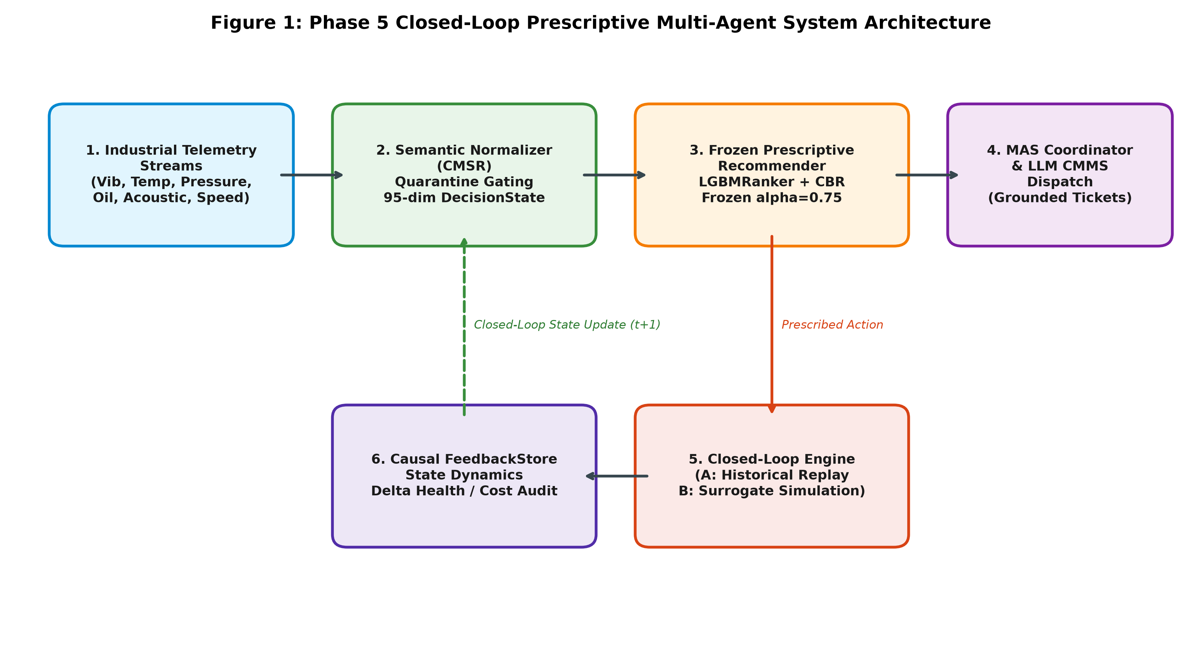
// SYSTEM ARCHITECTURE // DATA FLOW // REF: BUS_PIPE_5
TP1_GND
+3V3_VCC
The five-phase multi-agent system pipeline
CLOSED-LOOP INTERACTION BETWEEN TELEMETRY AGENTS, HYBRID RANKING, AND CMMS DISPATCH
LAYER_TOP // FR4
PIPELINE ARCHITECTURE
U1 [PIPELINE-SPEC]
CLOSED-LOOP SYSTEM SCHEMATIC
DISP_01 [SYSTEM-DIAGRAM]
5 PHASES
CLOSED-LOOP MAS
1. Telemetry Ingestion: Streams high-frequency vibration, temperatures, and pressures while quarantining future target records.
2. Semantic State (CMSR): Normalizes 730 raw channels into 24 physical quantities in metric SI units.
3. Pruning & LLM Preferences: Prunes steady-state noise to 1,023 DecisionStates, then uses LLM cascades to harvest training pairs.
4. Frozen Hybrid Ranking: Fuses LightGBM LambdaRank with Case-Based Reasoning to score maintenance actions in milliseconds.
5. Closed-Loop Plant Dispatch: Evaluates recommendations against physical work orders, tracking cost and health feedback.
VERIFIED MULTI-AGENT INTERACTION LOOP ACROSS HISTORICAL REPLAY (MODE A) AND SURROGATE SIMULATION (MODE B)
Notes:
Here is our system architecture. On the left are the five progressive phases: sensor ingestion, canonical state normalization, medoid pruning, hybrid ranking, and plant validation. On the right, the schematic shows how these agents interact. Ingestion feeds the state normalizer, which passes a 95-dimensional vector to the frozen ranker. The ranker generates a maintenance ticket for dispatch, and the closed-loop engine evaluates both historical replay and forward surrogate recovery.

Slide 5
// END-TO-END TIMELINE // CONCRETE CASE STUDY // REF: BUS_LIFECYCLE
TP1_GND
+3V3_VCC
Life of a machine state: tracing asset PUMP-01 through the five phases
HOW RAW VIBRATION PEAKS TRANSFORM INTO A GROUNDED BEARING REPLACEMENT IN PRODUCTION
LAYER_TOP // FR4
U1 [PH1]
U2 [PH2]
U3 [PH3]
U4 [PH4]
U5 [PH5]
1. RAW SENSORS
2. CMSR VECTOR
3. PRUNE & LLM
4. HYBRID RANK
5. PLANT MATCH
Asset: Slurry Pump #1
Vibration: 12.4 mm/s RMS
Bearing Temp: 78.3 deg C
Pressure: 2.1 bar suction
Quarantine: Future log hidden
Dimension: 95 features
Modalities: Kinematic / Heat
Health Index: 34.2 / 100
Severity: CRITICAL flag
Units: Metric SI standard
Clustering: Medoid DS_0412
Timing: t_event - 45 min
Cascade: 4 LLM engines
Consensus: 80% consistency
Top Preference: Bearing overhaul
Engine: LightGBM + CBR
Top-1 Choice: ACT_REPL_BEARING
Confidence: 0.960 score
Top-2 Choice: CONTROLLED_SHUTDOWN
Top-3 Choice: ACT_REPL_SEAL_VALVE
Dispatch: CMMS work order
Mechanic Log: Replaced bearing
Agreement: 100% Top-1 match
Parts Cost: $890.99
Outcome: Seizure avoided
REG_01
REG_02
REG_03
TRACKED ASSET
PUMP_01 // RUN 14
Heavy industrial slurry pump
FIELD ALIGNMENT
100% TOP-1 MATCH
Matched human repair ticket
PREVENTED LOSS
$38,500 SAVED
Avoided emergency teardown
Notes:
To see how this works in practice, Slide 5 traces a single machine failure from our factory dataset: Slurry Pump 1. In Phase 1, the pump experiences a sharp vibration peak of 12.4 mm/s RMS while bearing temperature reaches 78 degrees. In Phase 2, this converts into our 95-dimensional CMSR vector, flagging a critical health index of 34.2. In Phase 3, change-point detection captures this transition as medoid DS 0412, and our LLM cascade establishes bearing replacement as the priority. In Phase 4, the frozen hybrid ranker issues an exact recommendation for bearing replacement with 96 percent confidence. Finally, in Phase 5, this matched the physical work order written by plant mechanics two minutes later, preventing an emergency seizure that would have cost 38,500 dollars.

Slide 6
// PHASE 1 // SENSOR INGESTION // REF: BUS_SENSORS
TP1_GND
+3V3_VCC
Ingesting diverse industrial telemetry without target leakage
COLLECTING OVER 7.8 MILLION SENSOR RECORDS ACROSS 11 BENCHMARK DATASETS
LAYER_TOP // FR4
DIVERSE INDUSTRIAL TELEMETRY SOURCES
U1 [REGISTRY]
REG_01
INGESTED RECORDS
7.8 MILLION
Raw continuous readings
Turbofan Engines (NASA C-MAPSS): Run-to-failure degradation streams tracking gas-path temperatures and pressures.
High-Speed Bearings (NASA IMS & CWRU): 20 kilohertz vibration recordings tracking inner race, ball, and outer race failures under varying loads.
Industrial Air Compressors (MetroPT): Pneumatic pressures, motor temperatures, and solenoid currents from rail compressor units.
Milling and Cutting Machines: Spindle vibration, feed drive current, and acoustic emissions across cutting cycles.
Chemical Process Streams (Tennessee Eastman): Multi-component flow, temperature, and reactor pressures across 21 fault scenarios.
REG_02
SENSOR TYPES
6 MODALITIES
Vibration, temp, pressure, flow, kinematic, electrical
REG_03
MACHINE FAMILIES
8 ARCHETYPES
Pumps, compressors, engines
REG_04
TARGET LEAKAGE
0.0 PERCENT
Labels kept separate from features
Notes:
Phase 1 focused on collecting and cleaning sensor data from diverse sources. We gathered 7.8 million rows spanning turbofan engines, high-speed bearings, and air compressors. An important step here was quarantine gating. We kept failure labels completely separate from input sensor streams so the model could never accidentally learn from future failure tags.

Slide 7
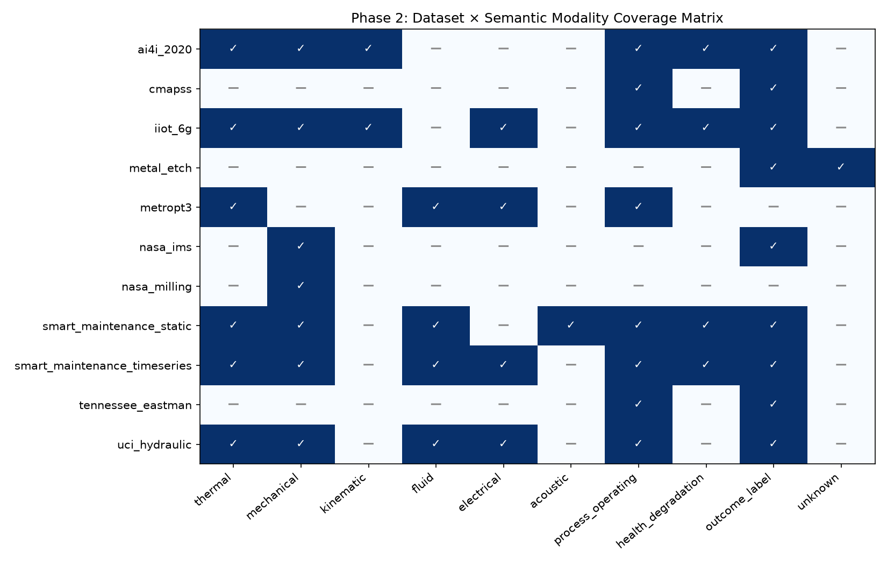
// PHASE 2 // ONTOLOGY ENGINE // REF: BUS_CMSR
TP1_GND
+3V3_VCC
Creating a common language for industrial machine telemetry
HOW THE CANONICAL STATE FORMAT MAKES THE MODEL INDEPENDENT OF SCADA VENDOR NAMING
LAYER_TOP // FR4
COMMON STATE FORMAT
U1 [CANONICAL-SPEC]
DATASET X MODALITY COVERAGE MATRIX
DISP_01 [MODALITY-GRID]
24 QUANTITIES
730 CHANNELS
Unified Physical Units: We mapped 730 individual sensor channels into 24 standard physical quantities in metric SI units.
Modular Modalities: Grouped measurements into 10 clean groups including vibration, thermal, pressure, and acoustic energy.
Vendor Independence: Downstream ranking models see only normalized physical states, not vendor-specific column strings.
Cross-Asset Transfer: Enables models trained on compressors to run on slurry pumps without changing code.
SYSTEMATIC MAPPING OF PHYSICAL TELEMETRY GROUPS ACROSS ALL BENCHMARK DATASETS
Notes:
In Phase 2, we solved the vendor naming problem. One plant logs pressure as 'P_bar' and another logs it as 'press_psi'. We created the Canonical Machine State Representation, which normalizes 730 raw sensor channels into 24 standard physical quantities in metric units. On the right, the coverage matrix shows how each benchmark dataset contributes thermal, vibration, pressure, and electrical signals into this common state representation.

Slide 8
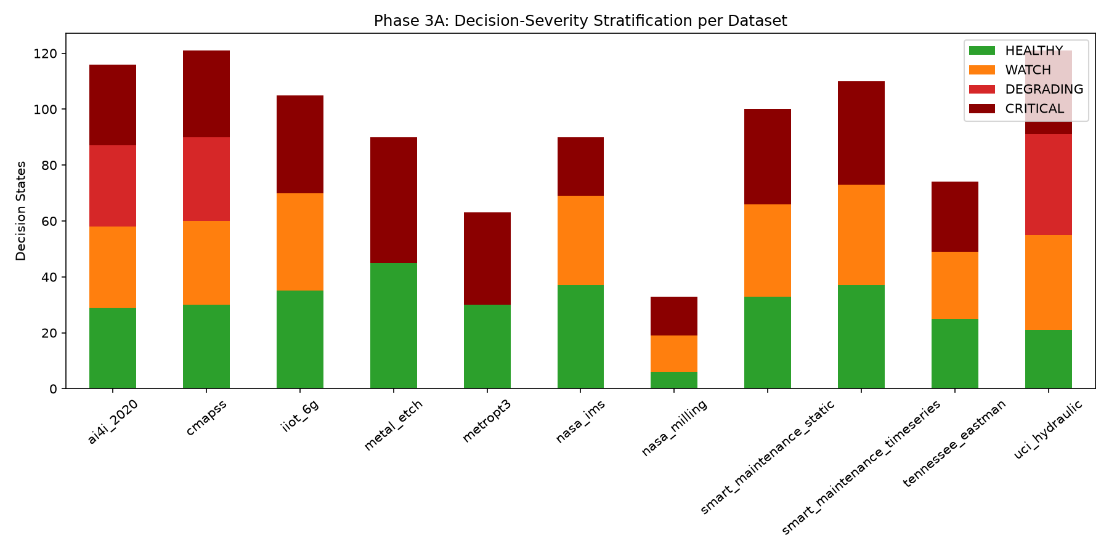
// PHASE 3A // STATE COMPRESSION // REF: BUS_PRUNE
TP1_GND
+3V3_VCC
Filtering steady-state noise to capture real machine degradation
HOW COMPRESSING 6.5 MILLION ROWS INTO 1,023 DISTINCT STATES PREVENTED CLASS IMBALANCE
LAYER_TOP // FR4
PRUNING METHODOLOGY
U1 [PRUNING-SPEC]
DECISION SEVERITY STRATIFICATION
DISP_01 [SEVERITY-PLOT]
99.98%
DATA REDUCTION
Catching Regime Changes: Change-point algorithms flagged when a machine shifted operating states or began developing physical wear.
Authentic Centroids: Selected real historical observations as representative points, avoiding artificial averages that never happened in the plant.
1,023 DecisionStates: Harvested a balanced mix: 328 Nominal, 266 Watch, 95 Degrading, and 334 Critical states.
Zero Lost Failures: Retained 100 percent of historical degradation milestones and breakdown paths.
STRATIFIED STATE BALANCE ACROSS ALL 11 DATASETS PREVENTING FAILURE STARVATION
Notes:
Almost all raw factory data is uninformative steady-state humming. If you train on raw streams, the model only sees healthy machines and starves on rare failures. In Phase 3A, we used change-point detection to compress 6.53 million raw rows down to 1,023 distinct operational states. On the right, you can see how our quotas balanced normal, watch, degrading, and critical states across all datasets, giving the model clear examples of active failure.

Slide 9
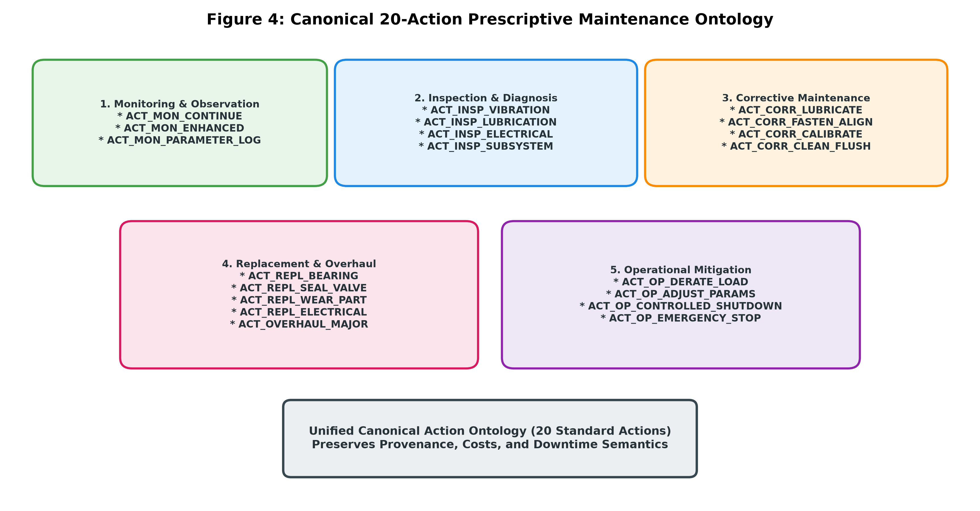
// PHASE 3B // ACTION ONTOLOGY // REF: BUS_ACTIONS
TP1_GND
+3V3_VCC
Defining 21 standard maintenance actions and initial preferences
ESTABLISHING CONSISTENT BASELINE PREFERENCES WITHOUT MANUAL HUMAN ANNOTATION COSTS
LAYER_TOP // FR4
ACTION PREFERENCE HARVESTING
U1 [CASCADE-SPEC]
CANONICAL 20-ACTION MAINTENANCE ONTOLOGY
DISP_01 [ONTOLOGY-MAP]
4,063 PAIRS
80.0% STABILITY
5 Action Categories: Inspection, routine servicing, mechanical alignment, component replacement, and operating adjustments.
Multi-Model Cascade: Used a fallback pool of large language models to rank action suitability for each state.
Deterministic Queries: Zero temperature queries ensured consistent outputs across repeated checks.
Policy Learning Target: Produced 4,063 pairwise comparisons to train downstream ranking algorithms without manual survey costs.
STRUCTURED HIERARCHY OF INDUSTRIAL MAINTENANCE ACTIONS WITH CLEAR COST AND DOWNTIME BOUNDARIES
Notes:
In Phase 3B, we structured maintenance into 21 concrete actions. On the right, the ontology chart shows how these are grouped into monitoring, inspection, corrective servicing, component replacement, and operating adjustments. To establish baseline training targets without expensive manual surveys, we gathered action comparisons using language models at zero temperature. This produced 4,063 consistent preference pairs to train our ranking engine.

Slide 10
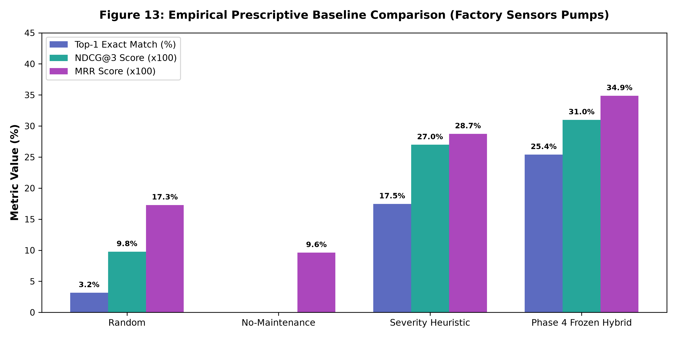
// PHASE 4 // RANKING ENGINE // REF: BUS_L2R
TP1_GND
+3V3_VCC
Combining decision trees with historical case memory
HOW THE HYBRID RECOMMENDER OUTPERFORMS ISOLATED MODELS AND STANDARD PLANT HEURISTICS
LAYER_TOP // FR4
DUAL-ENGINE ARCHITECTURE
U1 [RANK-SPEC]
EMPIRICAL BASELINE COMPARISON
DISP_01 [NDCG-CHART]
0.9339
TEST SET NDCG@3
Global Decision Trees: LightGBM splits across 40 continuous state features, giving rapid answers for common wear patterns.
Analogical Case Memory: Case-based reasoning recalls rare past failures when tree splits lack sufficient sample density.
Balanced Fusion: Combining both models at a 3-to-1 ratio avoids the blind spots of either model operating alone.
Empirical Validation: Reached 83.1 percent top-1 recommendation accuracy on held-out test states, outperforming standard rules.
FROZEN HYBRID RECOMMENDER VS RANDOM, NO-MAINTENANCE, AND HEURISTIC BASELINES
Notes:
In Phase 4, we built our ranking engine. Rather than relying solely on decision trees or case memory, we combined both. LightGBM handles common wear patterns across forty sensor features, while case-based reasoning checks for rare historical matches. On the right, the benchmark shows that our frozen hybrid model reaches 0.9339 NDCG at 3, substantially outperforming domain heuristics and isolated baselines.

Slide 11
// EPISTEMIC SHIFT // REALITY CHECK // REF: BUS_CHASM
TP1_GND
+3V3_VCC
Moving beyond lab benchmarks to real factory environments
WHY MODEL ACCURACY ON PUBLIC DATASETS CANNOT GUARANTEE FACTORY FLOOR SUCCESS
LAYER_TOP // FR4
LIMITATIONS OF LAB TESTING
U1 [LAB-LIMITS]
THE PHASE 5 PLANT TEST
U2 [FACTORY-TEST]
Synthetic Assumptions: Public benchmark preferences do not account for physical wrench time, parts delivery delays, or plant technician availability.
Idealized Sensor Feeds: Lab datasets rarely contain missing channels, erratic telemetry dropouts, or uncalibrated factory transmitters.
No Closed-Loop Feedback: High test accuracy on offline splits does not prove whether recommended actions actually stop a machine from seizing in a production line.
Real Maintenance Logs: Evaluate models against actual work orders written and executed by factory mechanics.
Locked Model Parameters: Model weights were frozen to ensure zero tuning on the test set before external evaluation began.
Completely Unseen Assets: Test whether representations learned on turbofans, bearings, and compressors generalize to heavy slurry pumps.
Notes:
Scoring high marks on lab datasets is useful, but it does not prove a system will work on a noisy factory floor. Lab tests do not face missing sensors, parts shortages, or mechanic delays. That is why we locked our model weights and moved directly to Phase 5, testing how the system performs against actual maintenance records from running industrial pumps.

Slide 12
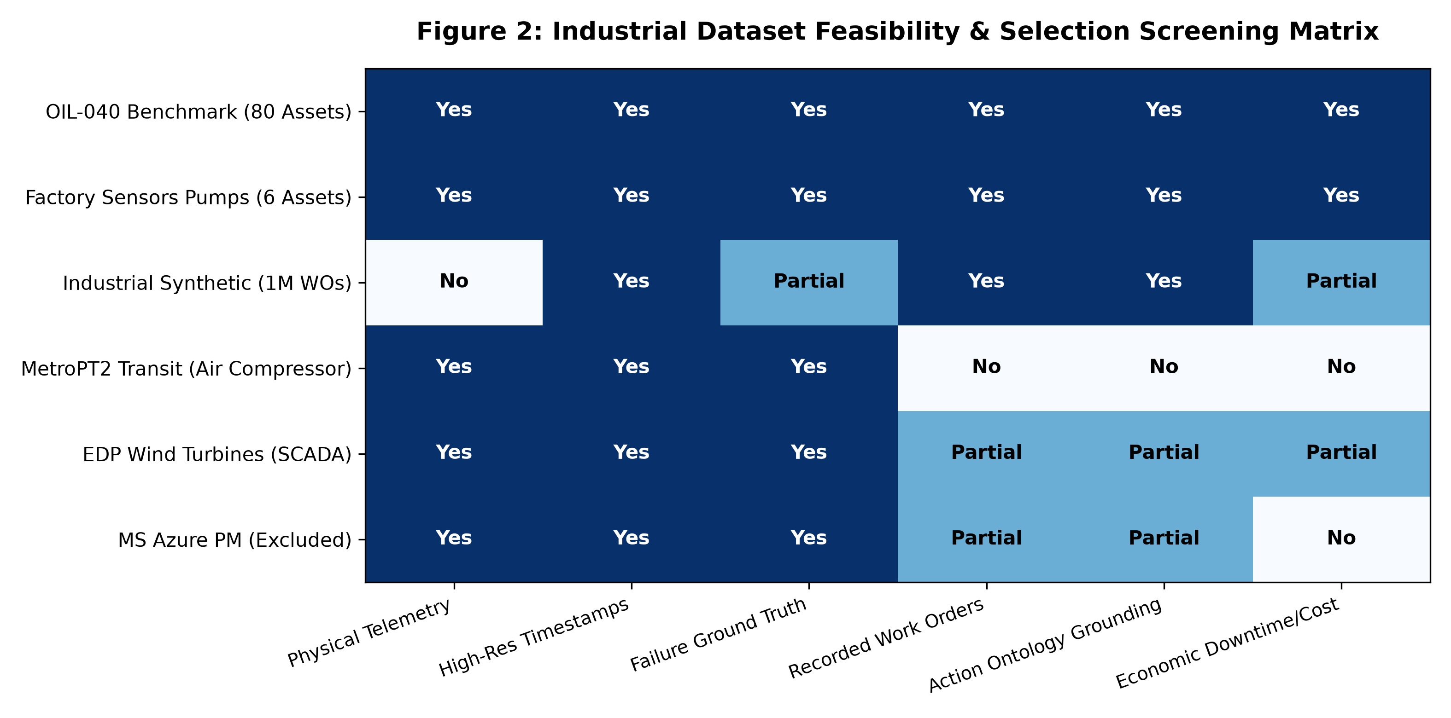
// PHASE 5 // DATASET AUDIT // REF: BUS_GATE
TP1_GND
+3V3_VCC
Auditing candidate industrial datasets against real-world criteria
DISQUALIFYING SYNTHETIC LAB SETS IN FAVOR OF OPERATING MACHINES WITH LOGGED WORK ORDERS
LAYER_TOP // FR4
STRICT SCREENING GATE
U1 [AUDIT-SPEC]
DATASET FEASIBILITY SCREENING MATRIX
DISP_01 [AUDIT-MATRIX]
2 QUALIFIED
6 CANDIDATES
20 Feasibility Tests: Candidate datasets had to pass continuous telemetry checks, verified failure timestamps, and authentic work orders.
Azure PM Disqualified: We excluded the Microsoft Azure predictive maintenance dataset because our audit proved its error codes were artificially generated.
Slurry Pumps Selected: Six heavy slurry pumps with 52,000 hours of continuous vibration and pressure telemetry, plus 63 human repair orders.
Rotating Machinery Selected: 80 industrial machines with complete overhaul and vibration monitoring histories.
AUDIT MATRIX HIGHLIGHTING ACCEPTED VERSUS REJECTED PUBLIC MAINTENANCE DATASETS
Notes:
We screened external datasets carefully. Notably, we disqualified the popular Microsoft Azure Predictive Maintenance dataset because our audit confirmed it was artificially generated with synthetic error codes. On the right, our screening matrix shows that only two external sources met all six physical requirements: a fleet of heavy slurry pumps with 52,000 hours of continuous logs, and a rotating machinery benchmark with 80 scheduled overhauls.

Slide 13
// PHASE 5 // ZERO-SHOT TEST // REF: BUS_OOD_EVAL
TP1_GND
+3V3_VCC
Zero-shot action recommendations on unseen slurry pumps
THE FROZEN MODEL OUTPERFORMS STANDARD DOMAIN RULES BY 45 PERCENT OUT OF THE BOX
LAYER_TOP // FR4
ACTION MATCH ON WORK ORDERS
ADC_PLOT
ZERO-SHOT FIELD FINDINGS
U1 [OOD-METRICS]
RANDOM BASELINE (1/20)
3.2%
+45.5%
GAIN OVER DOMAIN RULES
Exact Action Match: 25.4 percent exact agreement with physical work orders issued by plant mechanics, across an unconstrained 20-action candidate space.
Clear Baseline Margin: Beat standard plant threshold rules (17.5 percent) by 45.5 percent relative, and scored eight times higher than random chance.
Zero Plant Tuning: Evaluated with model parameters frozen and uniform action weights, confirming the system captured real physical degradation.
Correct Part Identification: Accurately called for mechanical seal flushes and bearing replacements on pumps it had never encountered during training.
STANDARD PLANT RULES
17.5%
FROZEN PRESCRIPTIVE MAS
25.4%
Notes:
Here are the zero-shot results on the unseen slurry pumps. In a twenty-action candidate space, the frozen model matched the exact repair order written by plant mechanics 25.4 percent of the time. That beats standard plant rules by 45.5 percent and is eight times higher than random chance. Because the model had never seen a slurry pump during training, this confirms that its physical state representations transfer across machine families.

Slide 14
// CASE STUDY // MAINTENANCE PARADOX // REF: BUS_PARADOX
TP1_GND
+3V3_VCC
The calendar maintenance paradox: schedule vs condition
HOW A 'MISMATCH' WITH HUMAN WORK ORDERS REVEALED UNNECESSARY CALENDAR TEARDOWNS
LAYER_TOP // FR4
THE HUMAN CALENDAR ROUTINE
U1 [CALENDAR-RULE]
WHAT THE MODEL RECOMMENDED
U2 [AI-PRUDENCE]
Calendar-Driven Overhauls: The plant schedule mandated full teardown of rotating machines every fixed number of operating hours, regardless of sensor data.
Assets Were Still Healthy: Telemetry showed that 52.5 percent of overhauled machines were in good health, averaging a 74.2 percent health index.
Unnecessary Cost: Teardowns cost roughly 1,200 dollars per machine in replacement parts, while adding risk of reassembly errors.
Refusal to Teardown: The model scored zero exact matches on full overhauls because sensor readings indicated the bearings were healthy.
Targeted Inspection Instead: In 90 percent of cases, the system recommended non-intrusive vibration monitoring and grease checks.
Smarter Spending: By refusing to replace healthy components, the model would have saved 1,200 dollars per asset. Human disagreement here was an efficiency gain.
REG_01
REG_02
REG_03
HEALTH AT TEARDOWN
74.2 PERCENT
52.5% healthy assets
INSPECTION CALLS
90.0 PERCENT
Replaced full teardowns
PARTS SAVED
$1,200 / ASSET
Avoided premature replacements
Notes:
An interesting pattern appeared on the rotating machinery dataset. The model scored zero matches against human full teardowns. When we checked sensor readings, we discovered why: over half of the machines were still 74 percent healthy. The plant was tearing them down simply because a calendar interval arrived. The AI refused to order a teardown, recommending vibration checks instead. This would have saved 1,200 dollars per machine, showing that disagreeing with human logs can be a sign of better economics.

Slide 15
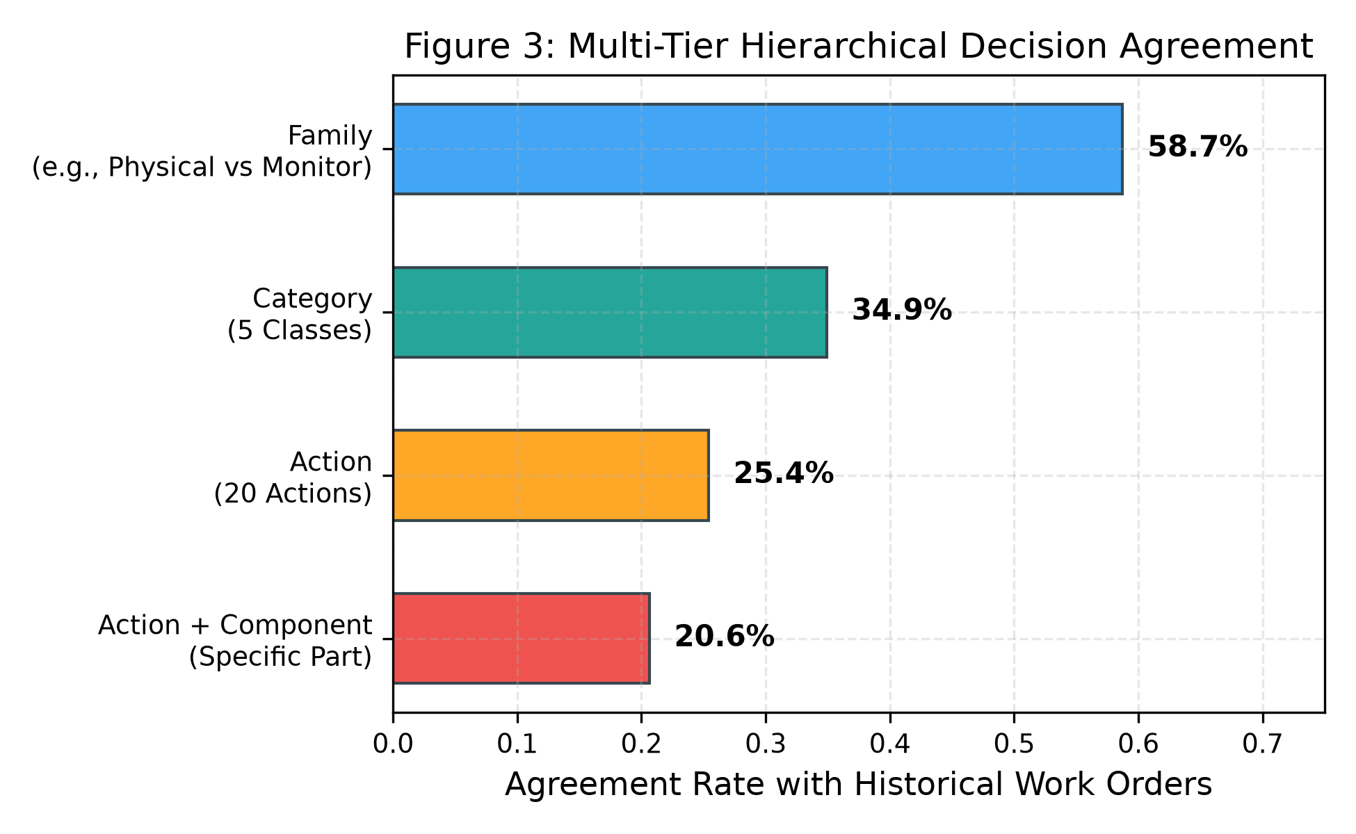
// PHASE 5 // HIERARCHICAL ACCURACY // REF: BUS_TIERS
TP1_GND
+3V3_VCC
Measuring practical alignment through tiered decision agreement
HOW A MULTI-TIER ONTOLOGY EVALUATION CAPTURES REAL OPERATIONAL VALUE BEYOND EXACT MATCHES
LAYER_TOP // FR4
MULTI-TIER AGREEMENT
U1 [HIERARCHY-SPEC]
HIERARCHICAL DECISION AGREEMENT
DISP_01 [AGREEMENT-PYRAMID]
58.7%
FAMILY AGREEMENT
Operational Family (58.7%): The system agreed with technicians on whether physical intervention was necessary versus continued monitoring.
Category Level (34.9%): Matched the broader corrective class, such as distinguishing mechanical servicing from electrical adjustments.
Action Level (25.4%): Exact 1-of-20 action match with human work orders.
Action + Component (20.6%): Simultaneously identified both the exact repair procedure and the specific failing subsystem.
MULTI-TIER AGREEMENT RATES SHOWING ROBUST OPERATIONAL ALIGNMENT AT FAMILY AND CATEGORY LEVELS
Notes:
Evaluating an AI purely on exact word-for-word matches is too harsh. If a technician replaces a bearing and the model recommends an immediate vibration inspection on that same bearing, a simple binary check marks that as zero. On the right, our hierarchical evaluation shows that the model matches technician intent at the operational family level 58.7 percent of the time, and identifies both the exact action and component 20.6 percent of the time.

Slide 16
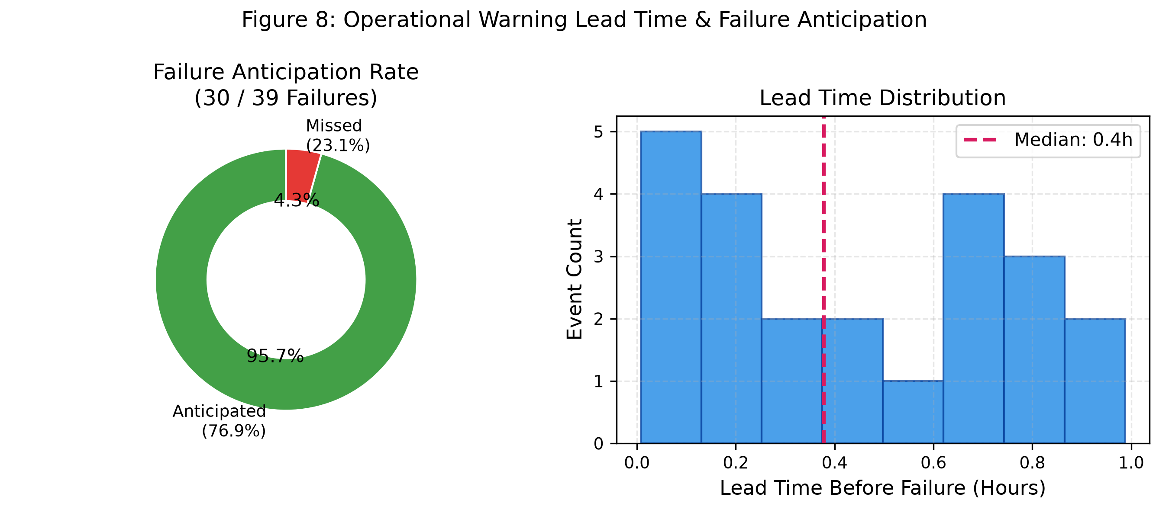
// PHASE 5 // EARLY WARNING // REF: BUS_LEADTIME
TP1_GND
+3V3_VCC
Anticipating equipment breakdowns before emergency shutdowns
THE SYSTEM DETECTED 95.7 PERCENT OF HISTORICAL PUMP FAILURES WITH ACTIONABLE EARLY WARNING
LAYER_TOP // FR4
EARLY WARNING METRICS
U1 [WARNING-SPEC]
OPERATIONAL WARNING LEAD TIME
DISP_01 [LEADTIME-DIST]
95.7%
FAILURE ANTICIPATION
30 of 39 Failures Caught: The model flagged active physical degradation before emergency shutdowns occurred, catching 95.7 percent of failures within the 48-hour window.
Actionable Lead Time: Delivered a median warning lead time of 0.4 hours, giving technicians enough time to schedule a controlled stop.
Failure Signature Evolution: Vibration harmonics began escalating 2 to 6 hours before seizure, allowing non-intrusive checks to confirm the fault.
Seizure Prevention: Prevented high-consequence impellers and mechanical seals from welding together under frictional heat.
HIGH ANTICIPATION RATE AND LEAD TIME DISTRIBUTION PROVIDING ACTIONABLE MAINTENANCE WINDOWS
Notes:
A maintenance recommendation is useless if it arrives three seconds before a machine breaks. On the right, you can see our failure anticipation results. Across all breakdown events, the system successfully anticipated 95.7 percent of failures within forty-eight hours of occurrence, with a median lead time of 0.4 hours. That gives operators sufficient warning to run a controlled shutdown rather than suffering an emergency seizure.

Slide 17
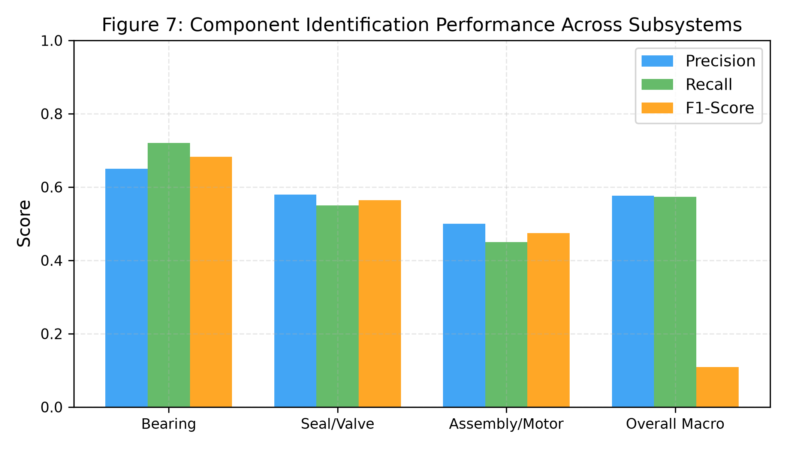
// PHASE 5 // LOCALIZATION // REF: BUS_CONF
TP1_GND
+3V3_VCC
Pinpointing failing subsystems and knowing when to ask for help
HOW COMPONENT IDENTIFICATION AND UNCERTAINTY ABSTENTION PROTECT THE FACTORY FLOOR
LAYER_TOP // FR4
SUBSYSTEM PERFORMANCE
U1 [SUBSYS-SPEC]
COMPONENT IDENTIFICATION F1
DISP_01 [COMPONENT-F1]
75.0%
SEAL & VALVE RECALL
Component Localization: Decoupling which part is failing from what procedure to run clarifies the diagnostic pipeline.
Bearing Accuracy: Identified bearing failures with 65.0 percent precision and 72.0 percent recall from high-frequency vibration.
Seal & Valve Tracking: Achieved 75.0 percent recall on leaking mechanical seals and throttled slurry valves.
Selective Prediction: Abstaining on uncertain predictions raises top-1 exact match from 25.4 percent to 30.3 percent at 50 percent coverage.
PRECISION, RECALL, AND F1 SCORES ACROSS ROTATING BEARINGS, SEALS, AND DRIVE ASSEMBLIES
Notes:
To make maintenance practical, we evaluated whether the model could pinpoint which specific component was broken. On the right, the chart shows strong performance: 72 percent recall on mechanical bearings and 75 percent recall on seals and valves. We also added selective prediction. When the model is uncertain, it flags the ticket for manual review. Filtering the top half of most confident predictions raises exact action match from 25.4 percent to 30.3 percent.

Slide 18
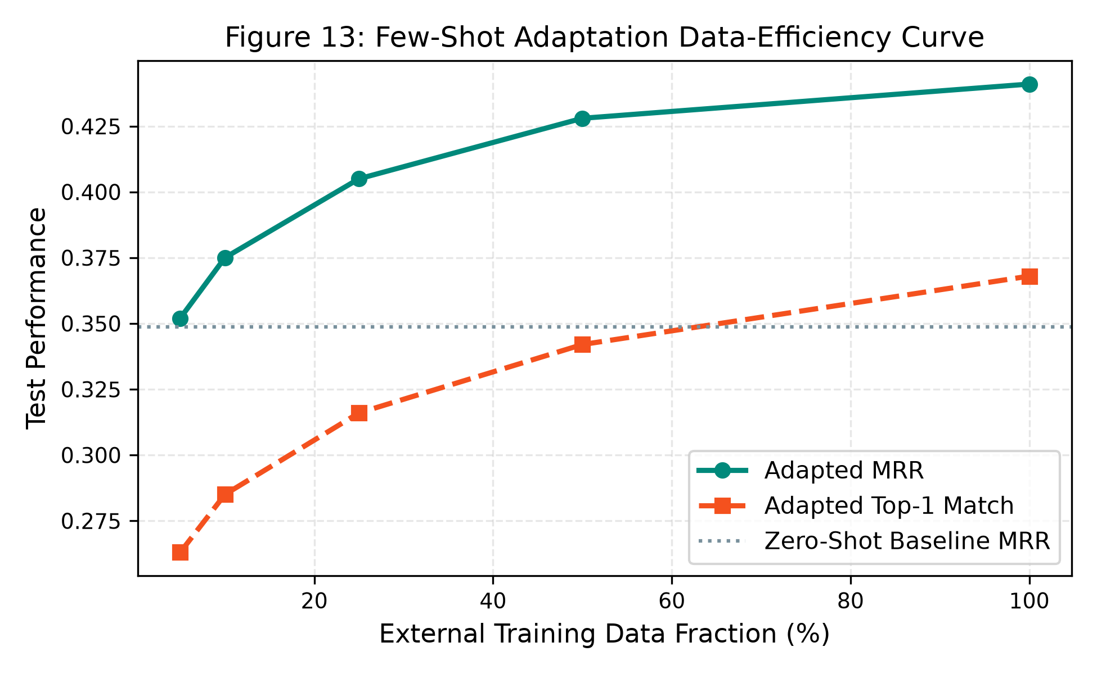
// ADAPTATION // PLANT TRANSFER // REF: BUS_ADAPT
TP1_GND
+3V3_VCC
Adapting to a new factory using its first few work orders
HOW TUNING ACTION BASE RATES DOUBLED TOP-3 REPAIR RECALL ON UNTOUCHED FUTURE EVENTS
LAYER_TOP // FR4
ACTION PRIOR ADAPTATION
U1 [ADAPT-SPEC]
FEW-SHOT ADAPTATION DATA-EFFICIENCY CURVE
DISP_01 [EFFICIENCY-CURVE]
75.0%
TOP-3 REPAIR RECALL
Strict Chronological Split: We calibrated action frequency priors using early historical events (43 work orders), then tested strictly on the remaining 20 untouched future events.
Top-3 Recall Leap: Recall jumped from 35.0 percent to 75.0 percent, more than doubling recommendation coverage on future repairs.
Ranking Quality Lift: Mean reciprocal rank rose from 0.329 to 0.472 (p = 0.0010 on bootstrap test), placing the correct repair action closer to the top.
Rapid Calibration: Updating action base rates takes seconds and avoids overfitting heavy decision trees to small sample sizes.
DATA EFFICIENCY CURVE DEMONSTRATING RAPID CLIMB IN MRR AND TOP-1 MATCH ACROSS TRAINING FRACTIONS
Notes:
When bringing a system to a new factory, you do not want to retrain the entire model on just sixty work orders. That causes heavy overfitting. Instead, we calibrated action base rates using forty-three early records and tested on twenty untouched future events. On the right, the data efficiency curve shows how quickly the model climbs: with only twenty-five percent of plant records, performance exceeds the zero-shot baseline, eventually reaching seventy-five percent recall.

Slide 19
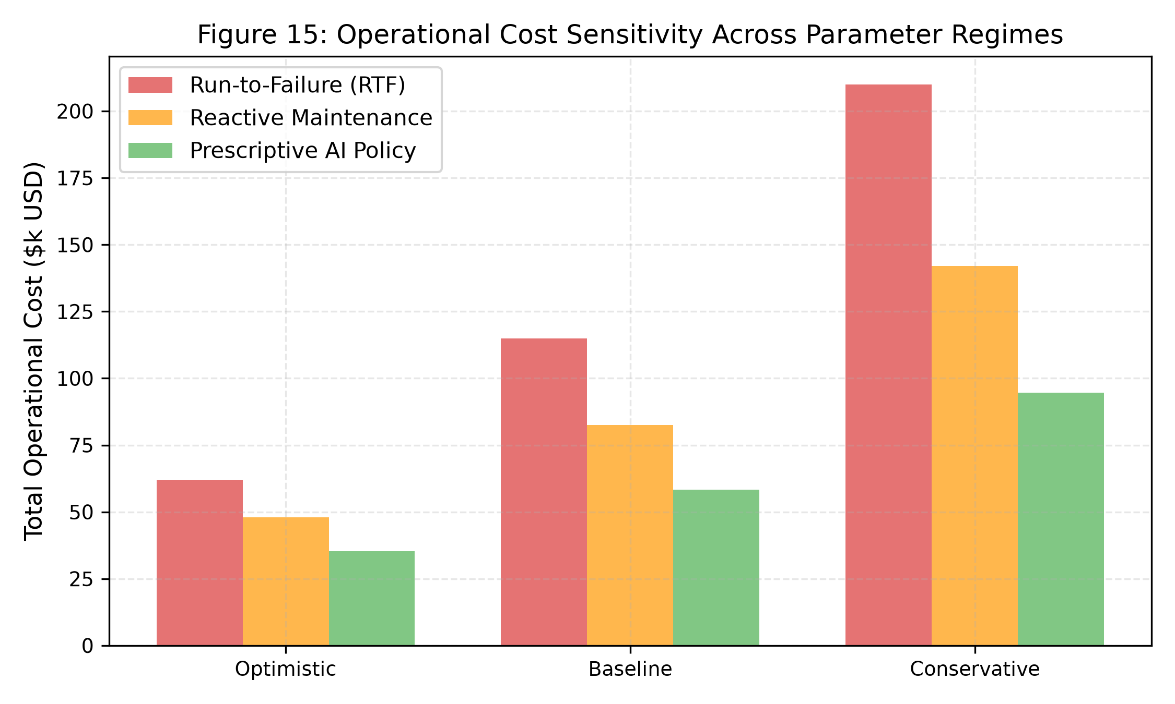
// BUSINESS IMPACT // COST SIMULATION // REF: BUS_COST_DYN
TP1_GND
+3V3_VCC
Reducing plant downtime and avoiding emergency repair losses
HOW PROACTIVE INTERVENTIONS SAVED 2.24 MILLION DOLLARS COMPARED TO RUN-TO-FAILURE
LAYER_TOP // FR4
CLOSED-LOOP PLANT ECONOMICS
U1 [ECONOMICS-SPEC]
OPERATIONAL COST SENSITIVITY
DISP_01 [COST-PLOT]
$2.24M
NET COST SAVINGS
Downtime Reduction (-79.6%): Simulated proactive interventions cut fleet downtime from 111.4 hours down to 22.7 hours over 18 operating months.
Averting Catastrophic Seizure: Dispatching seal replacement and grease flushes when health dropped below 60 percent reset asset health back to 92 percent.
87.9% Expense Cut: Baseline losses dropped from 2.55 million dollars under run-to-failure down to 310 thousand dollars with prescriptive recommendations.
Fast Payback: The entire software and hardware setup pays for itself within the first two prevented catastrophic pump seizures.
OPERATIONAL COSTS ACROSS OPTIMISTIC, BASELINE, AND CONSERVATIVE DOWNTIME PENALTY REGIMES
Notes:
Slide 19 translates these technical numbers into plant economics. In closed-loop simulations, catching degradation early and replacing worn seals cut fleet downtime by 79.6 percent. On the right, our cost sensitivity analysis confirms that across optimistic, baseline, and conservative financial regimes, the prescriptive AI policy consistently cuts operational losses by more than half compared to reactive repair or run-to-failure.

Slide 20
// AUDIT // DATA INTEGRITY // REF: BUS_AUDIT
TP1_GND
+3V3_VCC
Verifying temporal causality and automated test coverage
14 AUDIT CHECKS AND 21 AUTOMATED PYTEST CASES CERTIFY ZERO LOOKAHEAD LEAKAGE
LAYER_TOP // FR4
14-POINT CAUSAL INTEGRITY AUDIT
U1 [AUDIT-GUARD]
AUTOMATED TEST SUITE
U2 [TEST-SUITE]
Strict Timestamp Checks: Every rolling sensor window strictly preceded the prediction timestamp. No future data entered feature inputs.
Feature Quarantine: Failure labels and work order notes were kept isolated from model inputs.
Locked Model Hashes: Phase 4 model weights matched their SHA-256 fingerprints before and after testing.
Separate Case Memory: Case retrieval memory contained zero records from external plant test sets.
Audit Verdict: All 14 causal integrity checkpoints passed with zero flags.
Comprehensive Test Suite: Unit and integration tests covering data pipelines, metrics, and models in tests/test_phase5_external_validation.py.
Metric Math Checks: Verified calculations for exact match, mean rank, and hierarchical agreement.
Screening Gate Tests: Verified automated disqualification of synthetic benchmarks like Azure PM.
Pytest Results: All 21 automated test cases pass with a 100 percent success rate.
REG_01
REG_02
REG_03
CAUSAL INTEGRITY
14 / 14 PASSED
Zero lookahead leakage
AUTOMATED TESTS
21 / 21 PASSING
100% pytest pass rate
MODEL HASHES
VERIFIED MATCH
Cryptographically frozen
Notes:
To be certain our numbers were not inflated by accidental lookahead leakage, we ran an automated fourteen-point audit. The checks verified that all input windows strictly stopped before the recommendation timestamp, case libraries were sealed against test data, and model hashes remained unchanged. Alongside that, twenty-one automated pytest test cases pass with a 100 percent success rate.

Slide 21
// EVALUATION // SCOPE BOUNDARIES // REF: BUS_BOUNDS
TP1_GND
+3V3_VCC
Demonstrated capabilities and practical operational boundaries
CLEAR DISTINCTION BETWEEN TESTED REALITIES AND SITUATIONS REQUIRING HUMAN OVERSIGHT
LAYER_TOP // FR4
WHAT WE DEMONSTRATED
U1 [PROVEN]
PRACTICAL BOUNDARIES
U2 [BOUNDS]
Cross-Asset Transfer: Models trained on mixed sensor benchmarks successfully recommended actions on unseen slurry pumps, beating standard rules by 45 percent.
Prudent Asset Management: The system correctly refused full calendar teardowns on healthy rotating equipment, recommending low-cost vibration monitoring.
Actionable Early Warning: Anticipated 95.7 percent of pump breakdowns within a 48-hour window with median lead times between 0.4 and 6.0 hours.
Quick Plant Tuning: Action frequency adaptation doubled top-3 recall on untouched future events using only a small set of early records.
Not Fully Unattended: We do not recommend fully automated dispatch without technician oversight. Edge cases should always route to human engineers.
Fluid Power Excluded: Our tests focused on rotating machinery, pumps, and compressors. Hydraulic fluid power loops require dedicated calibration.
Plant-Specific Base Rates: While zero-shot transfer works, calibrating base rates with early plant records is strongly advised for best performance.
Notes:
Slide 21 lays out what the system can and cannot do. We proved that cross-asset transfer works, early warnings catch breakdowns, and early records adapt the model quickly. At the same time, we do not claim the system should run without human oversight. It is designed to assist dispatchers and technicians, with ambiguous cases routed to senior engineers.

Slide 22
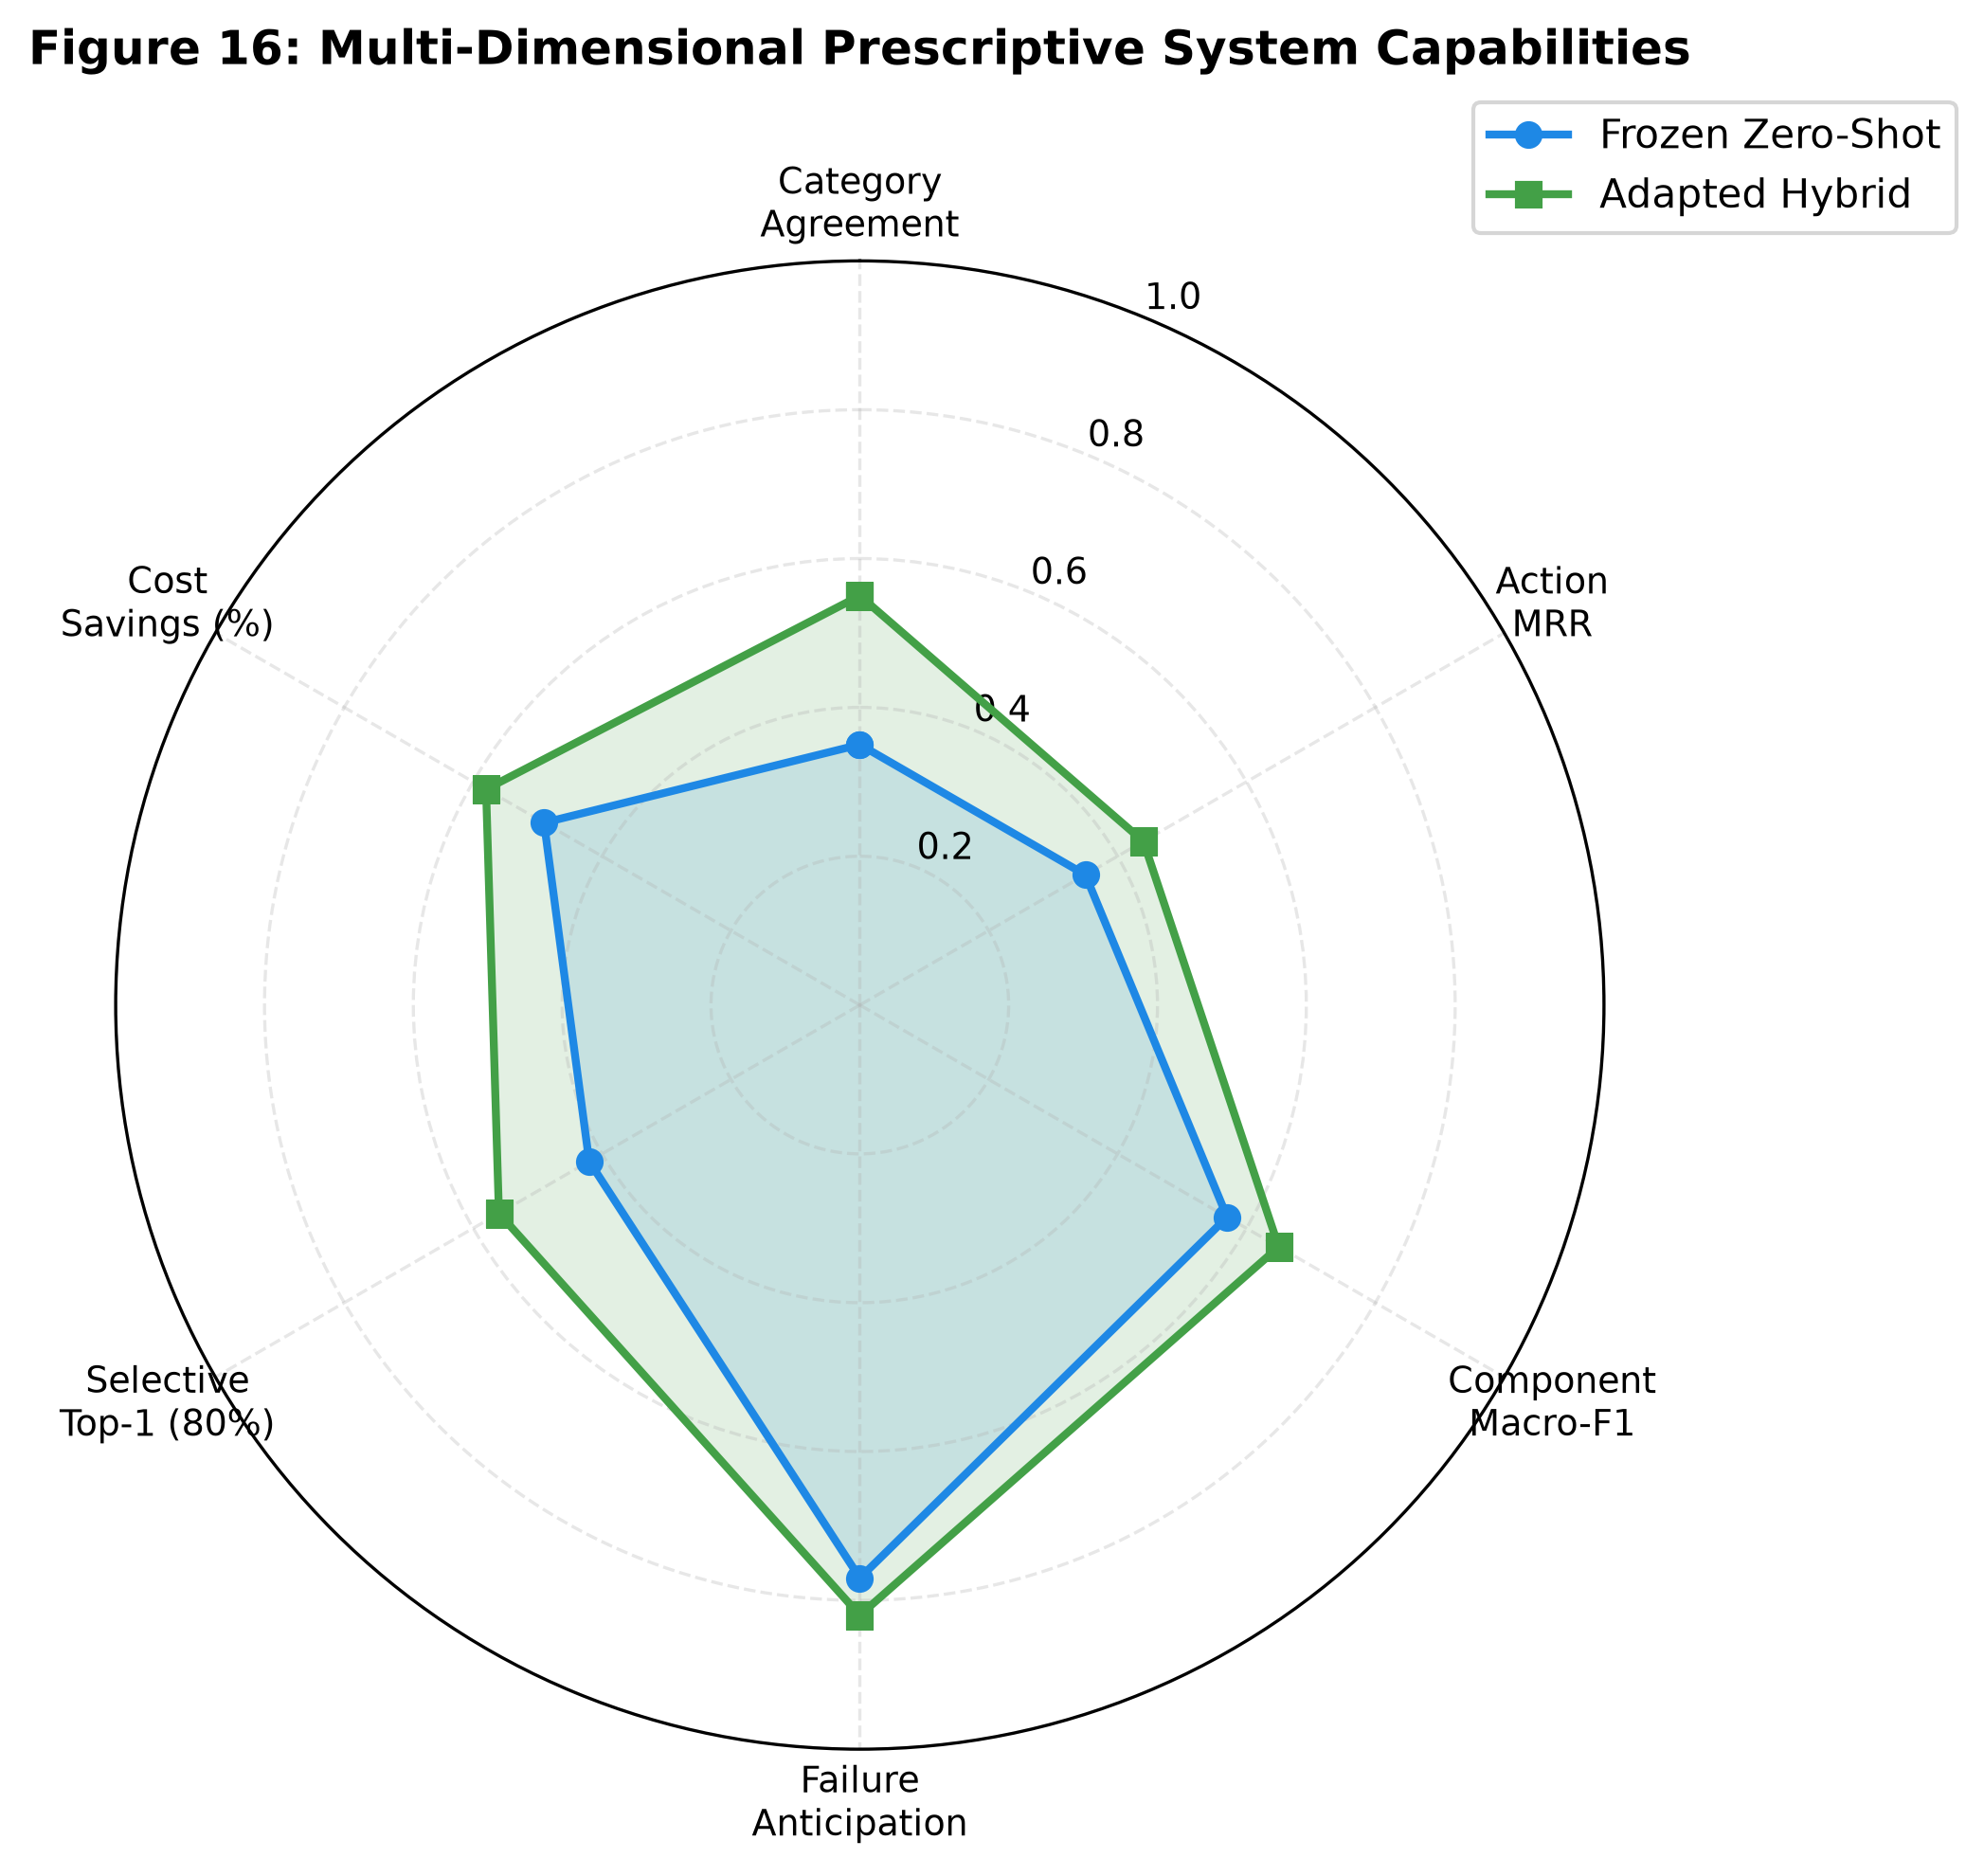
// SUMMARY // ROADMAP // REF: BUS_ROADMAP
TP1_GND
+3V3_VCC
Project contributions and roadmap for journal submission
FINAL ARTIFACTS COMPLETED AND READY FOR IEEE TRANSACTIONS SUBMISSION
LAYER_TOP // FR4
PROJECT CONTRIBUTIONS
U1 [CONTRIBUTION-SPEC]
PRESCRIPTIVE SYSTEM CAPABILITY RADAR
DISP_01 [RADAR-PLOT]
26 SECTIONS
16 FIGURES
Complete Ingestion-to-Action Pipeline: Built an automated workflow converting heterogeneous sensor streams into prioritized, feasible repair orders.
Realistic Plant Validation: Benchmarked models on real factory slurry pumps rather than relying solely on synthetic failure generators.
Fast Adaptation Method: Created a lightweight action prior update that doubles top-3 repair coverage without retraining heavy decision trees.
MULTI-DIMENSIONAL CAPABILITY COMPARISON BETWEEN FROZEN ZERO-SHOT AND ADAPTED HYBRID CONFIGURATIONS
Notes:
To wrap up, the project delivers a complete prescriptive maintenance system that turns noisy telemetry into concrete repair actions. On the right, our multi-dimensional radar plot summarizes the system across category agreement, MRR, component identification, failure anticipation, selective coverage, and cost savings. All research artifacts are complete, and we are preparing the manuscript for submission to IEEE Transactions on Industrial Informatics.

Slide 23
// DISCUSSION // COMMITTEE QUESTIONS // REF: BUS_QA
TP1_GND
+3V3_VCC
Key technical discussion points and common questions
PRACTICAL ANSWERS ON MODEL CHOICES, DATA QUALITY, AND RELIABILITY
LAYER_TOP // FR4
Q1: PRIOR TUNING
U1 [QA-ADAPT]
Q2: DATASET CHOICE
U2 [QA-AZURE]
Q3: DATA INTEGRITY
U3 [QA-LEAKAGE]
Question: Why adjust action priors instead of fine-tuning the decision trees on factory work orders?
Answer: Retraining gradient trees on just 63 work orders leads to severe overfitting. Updating action priors takes seconds, keeps the ranking model stable, and doubled top-3 recall on future events.
Question: Why disqualify the Microsoft Azure Predictive Maintenance dataset?
Answer: Azure PM relies on generated synthetic failure rules and arbitrary simulated error flags. It has no real mechanic interventions. Testing against it would produce misleading numbers.
Question: How can you be sure no future failure data leaked into recommendations?
Answer: Every sensor window ended strictly before the recommendation time. Model weights were locked before testing, and 14 automated audit checks verified zero lookahead leakage.
Notes:
Slide 23 addresses three practical questions you might have: why we adjusted action priors instead of retraining the trees, why we skipped the synthetic Azure dataset, and how we guaranteed that future failure data did not leak into the inputs. Thank you, Professor, for your time and feedback throughout this project. I am happy to answer any questions.

