Slide 1
Clusters
Step-1: Select the number K to decide the number of clusters.
Elbow Method
In the Elbow method, we are varying the number of clusters ( K ) from 1 – 10. For each value of K, we are calculating WCSS ( Within-Cluster Sum of Square). WCSS is the sum of squared distance between each point and the centroid in a cluster.
Step-2: Select random K points or centroids. (It can be other from the input dataset).
Step-3: Assign each data point to their closest centroid, which will form the predefined K clusters.
Step-4: Calculate the variance and place a new centroid of each cluster.
Step-5: Repeat the third steps, which means reassign each datapoint to the new closest centroid of each cluster.
Step-6: If any reassignment occurs, then go to step-4 else go to FINISH.
Step-7: The model is ready.

Slide 2
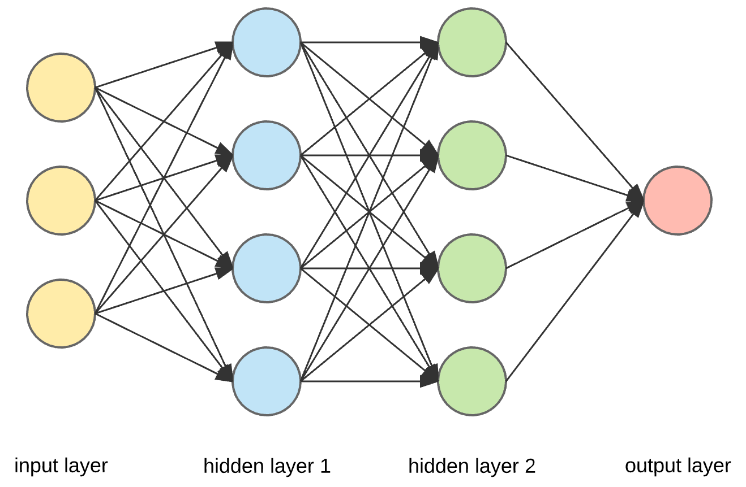
ANN
It intended to simulate the behavior of biological systems composed of “neurons”. ANNs are computational models inspired by an animal’s central nervous systems. It is capable of machine learning as well as pattern recognition.
Input layer – The activity of the input units represents the raw information that can feed into the network.
Hidden layer – To determine the activity of each hidden unit. The activities of the input units and the weights on the connections between the input and the hidden units. There may be one or more hidden layers.
Output layer – The behavior of the output units depends on the activity of the hidden units and the weights between the hidden and output units.

