Slide 1


Intro to C
C is for cookie, that’s good enough for me...

Slide 2
C Programming Language
Created in 1972
Many languages were built on C
C++, Java, Objective-C
Many languages were built on languages that trace roots back to C
C#, Javascript, Matlab, Python

Slide 3

Fire up MPLABx
Make a new project
PIC18F4520
Simulator
Create a .c file from the template

Slide 4
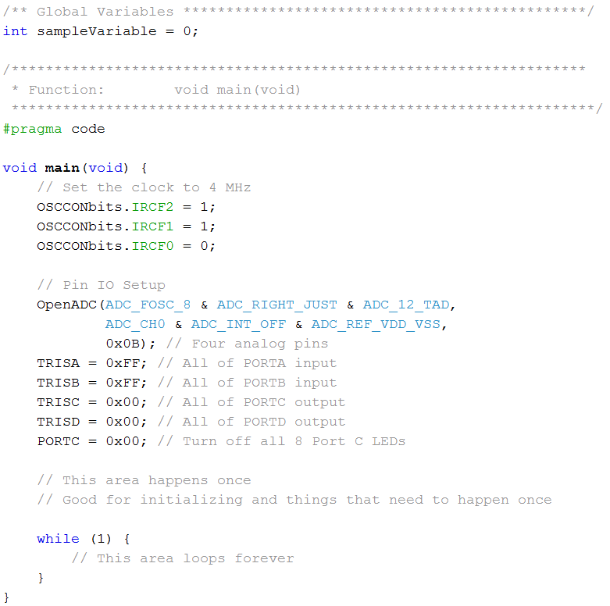
Comments
// Single line comment
/*
Comment out
multiple
lines
*/
Notes:
Add comment next to #include: // our PIC!
Add #include <stdlib.h>
Add #define TIMER_TICKS 10
Add ADCON1 = 0x0F; TRISB = 0x00; PORTB = 0b0001; , then in loop, toggle the light:
PORTB = 1; Delay10KTCYx(TIMER_TICKS); PORTB = 0; Delay10KTCYx(TIMER_TICKS);

Slide 5
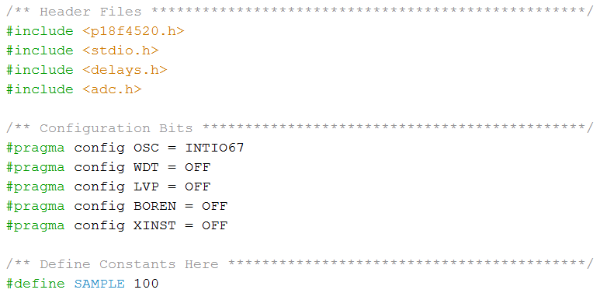
Preprocessor directives (things with #)
Not really our focus today (but very necessary). If it starts in a #, then it doesn’t end in a ;

Slide 6
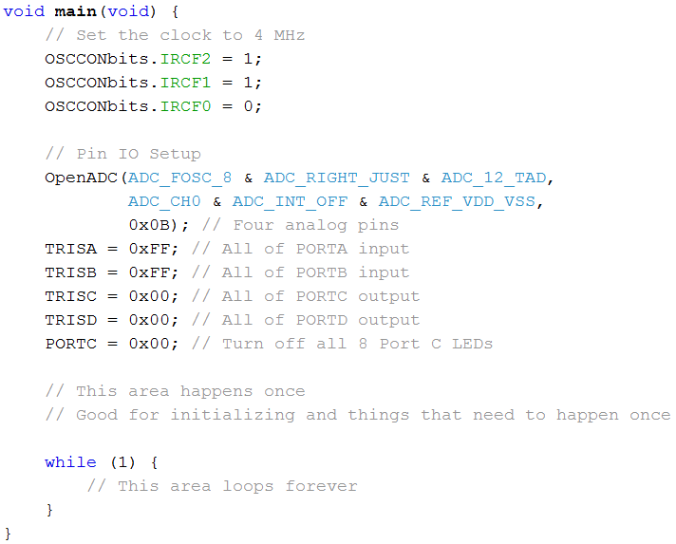
Code starts with the main function

Slide 7
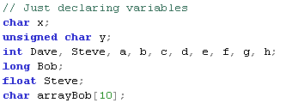

Declaring variables is required in C
Declaring variables
Initializing (defining) a variable at declaration

Slide 8
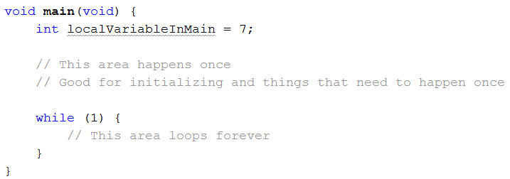
Global vs local variables
(variable scope)
Outside any function. Visible to the entire .c file (module).
Within a function (first thing). Visible within function.

Slide 9
Variable scope details for later reference
Global variables (Module level variables)
- Defined outside of any function (within Global variables section)
- Variable can be used anywhere within the .c file
- Variable does not need to be passed to functions
- Excellent for interrupts (explain interrupts later in course)
Local variables
- Defined within functions (must always FIRST thing in function!)
- Causes a syntax error if you try declaring variable mid function
- Need to be passed by functions
- Helps organize your code
- Better programming practice BUT the debugger sometimes doesn’t handle well

Slide 10
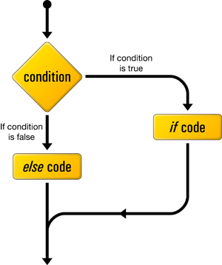
Control structures - if and switch

Slide 11
Control structures
Concepts you know, syntax is new
if conditional statement
switch conditional statement (may be new)
Next time
for loops
while loops

Slide 12
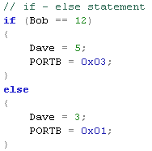
if – Standard if else structure

Slide 13
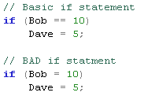
if – Beware common errors

Slide 14

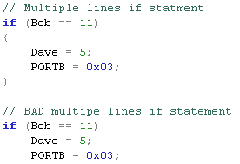
if – Beware common errors

Slide 15
if – Your turn
Make a variable age
char age = 10;
Make an if-else statement that prints
“age = %d which is greater than 15\n” or
“age = %d which is less than or equal to 15\n”
Then change the variable age to 20
Rerun the program

Slide 16
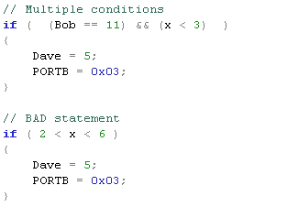

if – Multiple Conditions

Slide 17
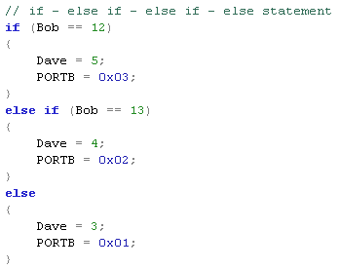
else if – Runs first match only

Slide 18
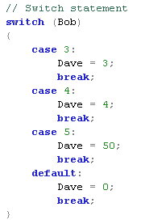
switch – Same as else if (using only ==)
Convenience function with
weird syntax. Handy for
discrete value conditions
Can ALWAYS be done with
an else if series of statements. :(

Slide 19
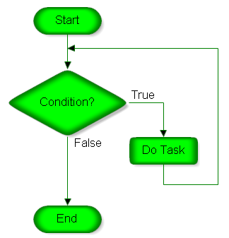
Loops - for and while

Slide 20
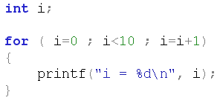
for
for ( initialization ; conditional statement ; update variable statement )
{
}

Slide 21
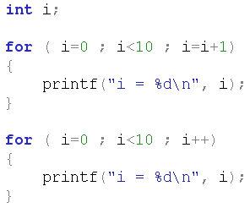
for – Standard shortcut
Basic for loop
Same loop using shortcut operator
Shortcut only useful for for loops
that increment the variable by 1.
Very common though.

Slide 22
for – Your turn
Write a for loop
runs from age = 20 to age = 0
decrements age by 5 each time
i.e. age should be 20, 15, 10, 5, and 0
Inside the for loop, put an “if”-“else if”–“else” that prints (as appropriate)
age = %d which is greater than 15
age = %d which is equal to 15
age = %d which is less than 15

Slide 23

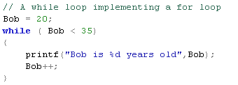
while

Slide 24
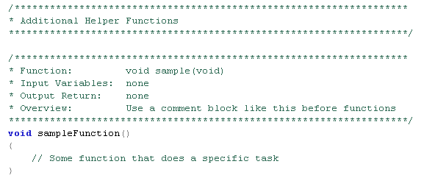
Functions (not today)

Slide 25
C programming references
CSSE120 videos (uses Eclipse not MPLABx)
http://www.youtube.com/watch?v=iT1Z7p7OFYI&list=PLBK7yyieyrAYzgXY9nXwl_5CYQvnzpWCp
Essential C: An introduction
http://cslibrary.stanford.edu/101/EssentialC.pdf
Programming in C (4th Edition) – Steve Kochan
Thousands more on the web
Plenty of time since 1972 for posts!

Slide 26
References
http://muppet.wikia.com/wiki/C_is_for_Cookie
http://ucan.us/doyetech/images/if-then-else-flowchart.png
http://www.rff.com/flowchart_structure_loop.png

