Slide 1



An Introduction to
Brad Urani
Chief Software Architect
Pushup Social
@BradUrani
linkedin.com/in/bradurani

Slide 2
Database Popularity
Rank | Name | Score
1. | Oracle | 1617.19
2. | MySql | 1254.27
3. | SQL Server | 1234.46
4. | PostgreSQL | 190.83
5. | DB2 | 165.9
6. | MongoDB | 161.87
7. | Microsoft Access | 141.6
8. | SQLite | 78.78
9. | Sybase | 77.75
http://db-engines.com/en/ranking

Slide 3
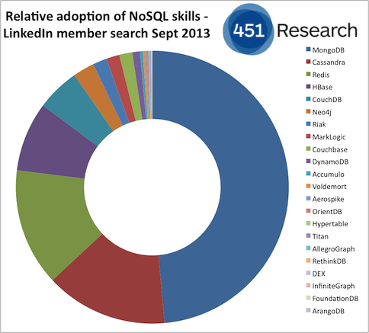

Slide 4
History
2004 - Google BigTable Paper
NoSql becomes mainstream technology
Kicks off movement to create “web scale” databases
2007 - 10Gen releases MongoDB
Bridges gap between key-values and RDBMS
2009 - Open Sourced - GitHub

Slide 5
Support
10Gen -> MongoDB Company
Sells enterprise version
Security and backup tools
Training
Integration
Support
Just raised $150,000,000
Documention - MongoDB.org

Slide 6
Drivers
JavaScript
Python
Ruby
PHP
Perl
Java
Scala
C#
C
C++
Haskell
Erlang
Plus numerous 3rd party tools and libraries!

Slide 7
Major Deployments
Groupon
Craigslist
Bit.ly
eBay
eHarmony
Answers.com (St. Louis)
CarFax (St. Louis)

Slide 8
Primary Benefits
Speed Speed Speed!
Rich Dynamic Queries
Lazy Creation
Schema-less
Returns JSON
Easy Replication and Failover
Auto-Sharding
MapReduce

Slide 9
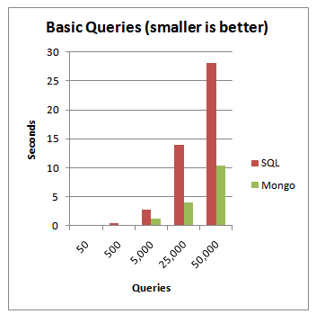
How Fast?

Slide 10
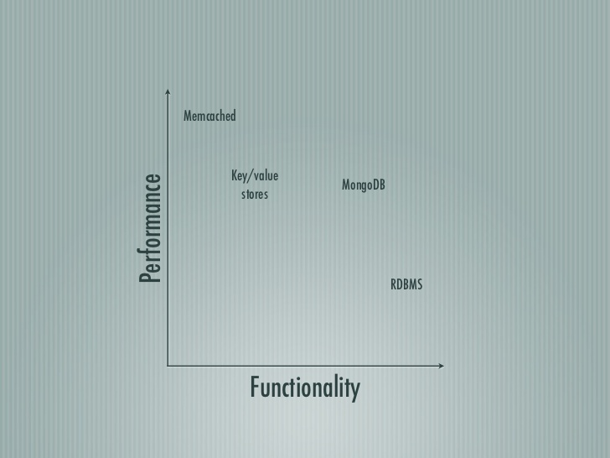

Slide 11
A BSON (binary JSON) document
{
"_id" : ObjectId("52832eb59f36fe144eeea8dc"),
"baseprice" : 8.99,
"category" : "toys",
"colors" : [ "red", "green", "cosmic purple"],
"name" : "Cosmic Yo-yo",
"promotions" : [
{ "coupon" : "XY678", "saleprice" : 7.99, "expires" : ISODate("2013-12-12T00:00:00Z") },
{ "coupon" : "AB8888", "saleprice" : 7.49, "expires" : ISODate("2014-01-01T00:00:00Z") }
]
}

Slide 12
Terminology
Database -> Database
Table -> Collection
Record / Row -> Document
Field -> Field

Slide 13
find()
db.products.findOne()
db.products.find()
db.products.find().pretty()
db.products.find({ _id : ObjectId("52832eb59f36fe144eeea8dc") })
db.products.find({ name : "Cosmic Yo-yo" })
db.products.find({ name : /^hack/i }).pretty()
Index fields used for find!

Slide 14
Projections
db.products.find({ "name" : "Hacky Sack Maxx" },{ baseprice : 1 } )
db.products.find({ "name": "Hacky Sack Maxx" },{ baseprice: 1, category : 1 } )
db.products.find( { }, { promotions : 1 } )
db.products.find( { }, { promotions : 1 } )[0].promotions

Slide 15
Ids
ObjectId is a 12-byte BSON type, constructed using:
a 4-byte value representing the seconds since the Unix epoch,
a 3-byte machine identifier,
a 2-byte process id, and
a 3-byte counter, starting with a random value
Show with .getTimestamp()

Slide 16
Shell
Runs native JavaScript
Google V8
Can run native functions, but not recommended in production

Slide 17
Queries
db.products.find().sort( { baseprice : -1 }).pretty()
db.products.find().limit(1).pretty()
db.products.find().limit(1).skip(1).pretty()

Slide 18
Conditions
db.products.find({ baseprice : { $gt : 4.99 }})
db.products.find({ baseprice : { $lte : 4.99 }})
db.products.find({ promotions : { $lte : 4.99 }})
db.products.find( { colors : { $in : ["red"] }})
db.products.find( { "promotions.coupon" : { $in : [ "XY678" ] }}).pretty()
db.products.find({ $and : [{ category : "toys"},{ baseprice : { $gt : 4.99 }}]}

Slide 19
Other Queries
db.products.count()
db.products.find({ baseprice : { $gt : 2.99 }}).count()
db.products.insert({ name : "Juggle-O-rama", baseprice : 11.99 })
db.products.update({ name : "Juggle-O-rama" }, { $set : { category : "toys" }})
db.products.update({ name: “Juggle-O-rama” }, { $set : { colors : ["silver", "gold"]}})
db.products.update({ name: "Juggle-O-rama" }, { $push : { colors : "sea foam green"}})
Don’t forget $set!

Slide 20
Aggregation
db.products.aggregate({ $group : { _id : "$category", totalprice : { $sum : "$baseprice" }}})

Slide 21
Indexes
Single
Compound
Nested Elements
In Array
Whole Document!
db.products.ensureIndex({ name : 1})

Slide 22
Geospatial Indexes
{
_id : ObjectId(...), name : "Brad Urani", addresses : [
{ context : "home" , loc : [ 55.5, 42.3 ] }, { context : "office", loc : [ -74 , 44.74 ] } ]
}
Can Query
Within Certain Distance
Within Polygons
Where Polygons Intersect
Others

Slide 23
Temporary Records
Time to Live (TTL)
db.log.events.ensureIndex( { "status": 1 }, { expireAfterSeconds: 3600 } )
Capped Collections
Set a maximum number of records in the collection
Provides very fast writing

Slide 24
Primary Benefits
Speed Speed Speed!
Rich Dynamic Queries
Lazy Creation
Flexible Schema
Returns JSON
Easy Replication and Failover
Auto-Sharding
MapReduce

Slide 25
Lazy Creation
Lazy Creation Saves Developer Time
Instant Set-up
No Change Scripts
Easier Data Migration
Great for Data Warehousing

Slide 26
Flexible Schemas
I.E. Different data for different for different product types
Flexible nesting rules
Simplifies Internationalization
Easy Custom Fields

Slide 27
JSON Front-to-Back!
Queries return JSON
Dirt simple APIs
No Data Manipulation Needed
Ditch the ORM
Easy JavaScript Integration
Fits perfectly with KnockoutJS, AngularJS etc.

Slide 28
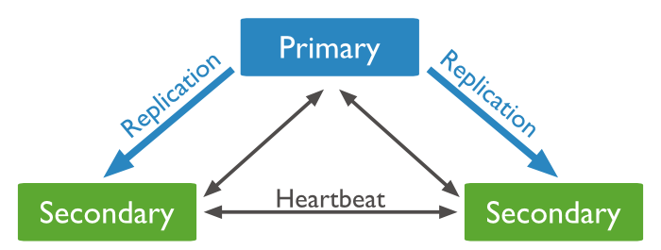
Replica Sets
Master / Slave

Slide 29
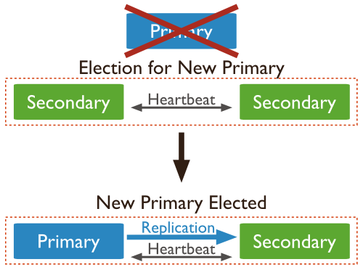
Replica Set Election
If a primary fails, the secondaries automatically elect a new primary

Slide 30
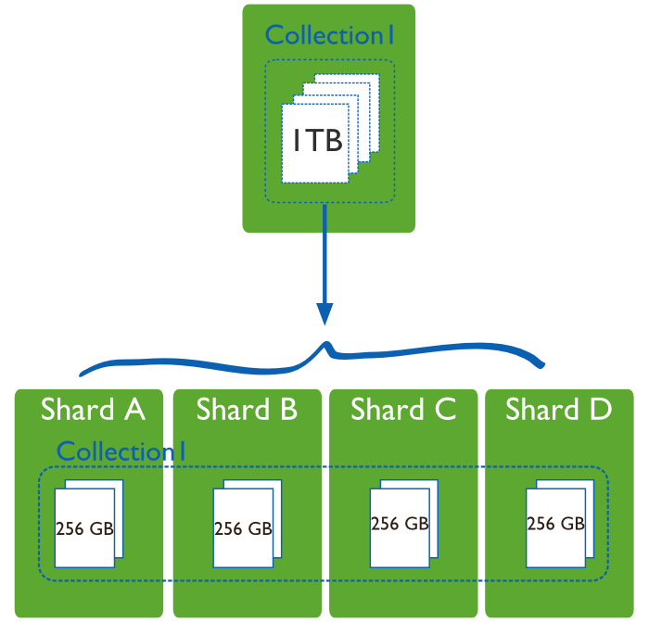
Sharding
Collections are split amongst multiple servers by a shard key
Used to scale writes

Slide 31
Limitations
No Transactions
No Joins
RAM intensive
No referential integrity
Eventual Consistency

Slide 32
Design Considerations
Embed vs. Reference
Instead of joining junction tables, embed subdocuments in documents
90% of the time choose embed over reference
You may have to store the same data twice

Slide 33
Denormalized Data
{
_id : ObjectId(...),
Name: “November Specials”,
Promotions : [
{ Title: “20% off all Yo-yos”, Coupon: “AB345” },
{ Title: “Free shipping on Hacky Sacks”, Coupon : “XY456” }
],
Dates : [ ISODate(“2013-11-01”), ISODate(“2013-11-31) ]
}, { _id : ObjectId(...),
Name: “December Specials”,
Promotions : [
{ Title: “10% off all frisbees”, Coupon: “BA445” },
{ Title: “Free overnight shipping on all jump ropes”, Coupon : “XY456” }

Slide 34
Schema Design
SQL: Optimizing how data is stored
MongoDB: Optimize how data is used
SQL: What answers do I have?
MongoDB: What questions do I have?

Slide 35
Choices
{
OrderId(“....”)
Items : [
{ _id : ObjectId(“...”), name : “Cosmic Yo-yo”, color : “red”, qty : 1 },
{ _id : ObjectId(“...”), name : Hackey Sack Maxx”, color : “tiger orange”, qty: 2 }
]
Promotions : [
{ _id : ObjectId(“...”), Coupon : “AB456” : 6.99 }
]
}

Slide 36
Use Cases
Anything with user generated data
Social Media
CMS
Blogs
Product Data (Ecommerce)
Games
Location services
Logging
Clickstream
Analytics
Real-Time
Data Warehouses

Slide 37
Not Great For
Transaction Critical Data
Purchases
Banking
Inventory Control

Slide 38
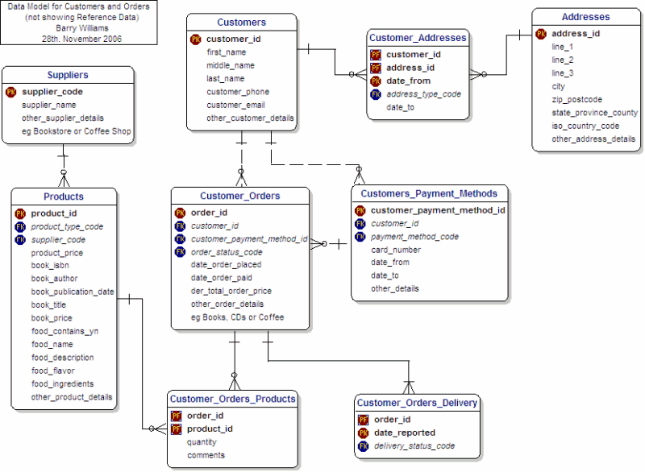
Use Both!
Products in MongoDB
Orders in SQL
{
"_id" : ObjectId("52833435add826d9da839268"),
"baseprice" : 4.99,
"category" : "toys",
"colors" : [ "tiger orange", " canary yellow" ],
"name" : "Hacky Sack Maxx",
"promotions" : [ { "coupon" : "ZY678", "saleprice" : 4.49, "expires" 13-12-12T00:00:00Z") },
{ "coupon" : "CD8888", "promo" : "free shipping", "expires"
]
}

Slide 39
Architect for Scalability
Databases need to handle peak load, not average load
Avoid Unnecessary Data Transformations
Developer productivity is part of scalability

Slide 40

Contacts
http://pushup.com
@BradUrani
linkedin.com/in/bradurani

