Slide 1
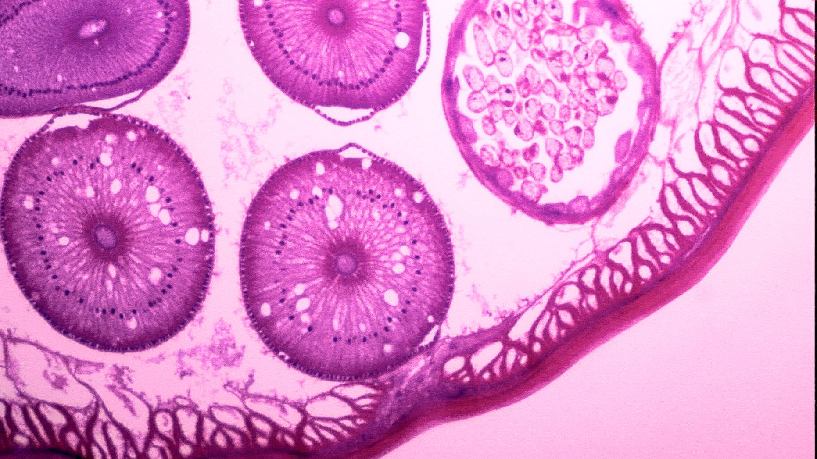
Lightweight Deep Learning Models for Histopathological Cancer Cell Classification
1905034- Abdullah Nayem Wasi Emran 1905047-Rakib Abdullah

Slide 2
Problem Statement : Using Lightweight Model to accurately classify histopathological cancer cells
Exploring lightweight models with transfer learning and data augmentation to improve classification accuracy of histopathological cancer cells on small or imbalanced annotated datasets.
Literature Review:
A deep learning ICDNET architecture for efficient classification of histopathological cancer cells using Gaussian noise images
Breast cancer histopathological image classification using a hybrid deep neural network
NCT-CRC-HE: Not All Histopathological Datasets Are Equally Useful
Histopathological Image Classification with Cell Morphology Aware Deep Neural Networks

Slide 3
Datasets
NCT-CRC-VAL-HE-7K (https://zenodo.org/records/1214456)
This is a set of 7180 image patches from N=50 patients of human colorectal cancer (CRC) and normal tissue.
All images are 224x224 pixels (px) at 0.5 microns per pixel (MPP). All images are color-normalized using Macenko's method
Tissue classes are: Adipose (ADI), background (BACK), debris (DEB), lymphocytes (LYM), mucus (MUC), smooth muscle (MUS), normal colon mucosa (NORM), cancer-associated stroma (STR), colorectal adenocarcinoma epithelium (TUM).
PathMNIST
Based on a prior study^{16,17} for predicting survival from colorectal cancer histology slides, providing a dataset (NCT-CRC-HE-100K) of 100,000 non-overlapping image patches from hematoxylin & eosin stained histological images, and a test dataset (CRC-VAL-HE-7K) of 7,180 image patches from a different clinical center.
The dataset is comprised of 9 types of tissues, resulting in a multi-class classification task. We resize the source images of 3 × 224 × 224 into 3 × 28 × 28, and split NCT-CRC-HE-100K into training and validation set with a ratio of 9:1. The CRC-VAL-HE-7K is treated as the test set.

Slide 4
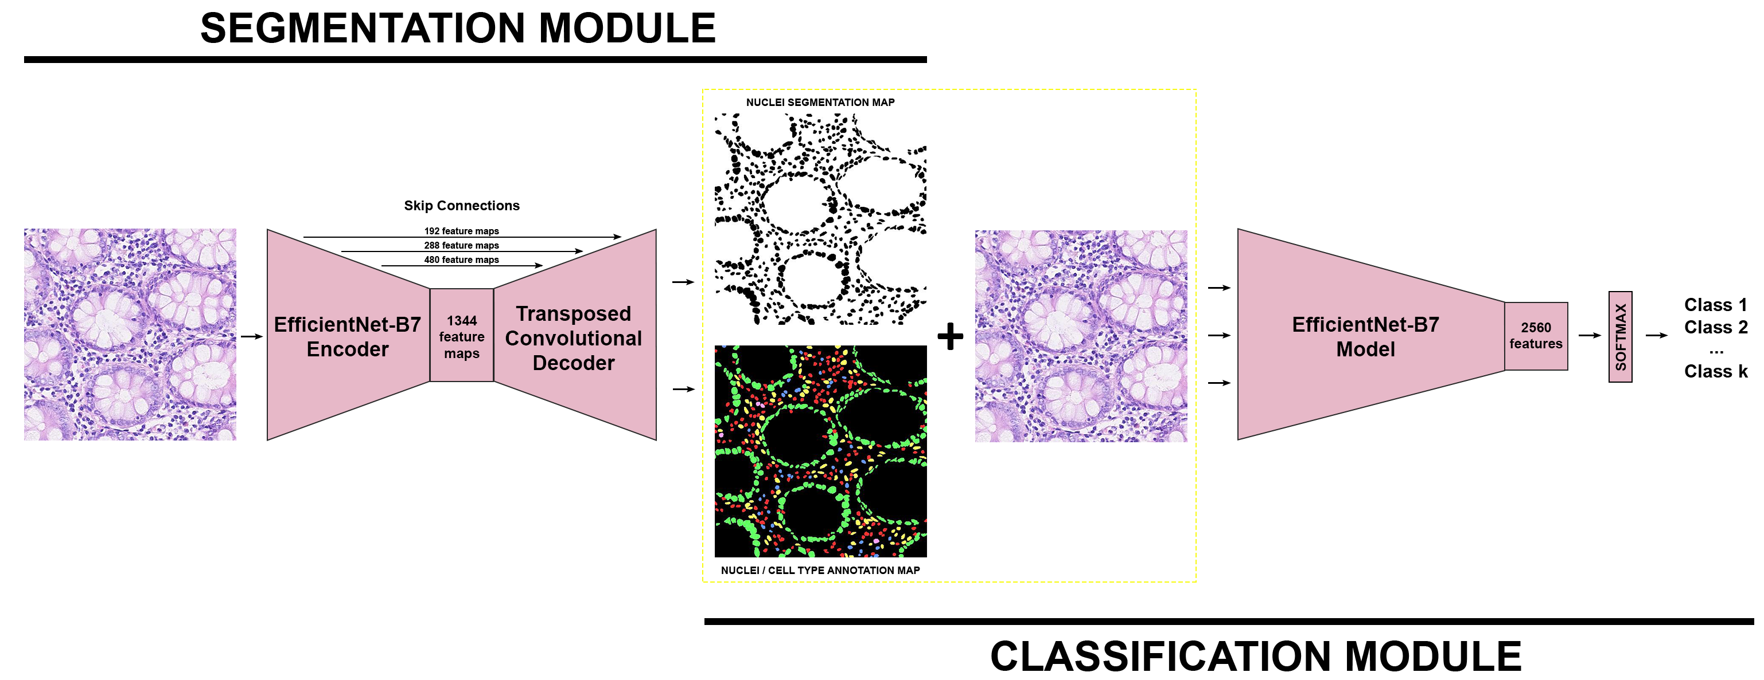
Proposed Solution
We remove the segmentation module (original paper) and work only with the classification module for simplicity.
We propose 3 different models by adding attention mechanisms :
Modified EfficientNet-B0 with SEBlock Integration
Modified EfficientNet-B0 with Multi-Scale Feature Fusion (MSFF)
Modified EfficientNet-B0 with CBAM Integration
Notes:
https://openaccess.thecvf.com/content/CVPR2024W/CVMI/papers/Ignatov_Histopathological_Image_Classification_with_Cell_Morphology_Aware_Deep_Neural_Networks_CVPRW_2024_paper.pdf

Slide 5
Modified EfficientNet-B0 with SEBlock Integration
Objective: Enhance EfficientNet-B0 by adding Squeeze-and-Excitation (SE) blocks to improve feature recalibration and focus on the most critical channels.
Key Features:
EfficientNet-B0 Backbone: A lightweight and high-performance convolutional neural network serving as the feature extractor.
SE Blocks: Integrated at four key points in the network: after blocks with output channels 24, 80, 320, and 1280.
SE Functionality:
Global Average Pooling (GAP) captures spatial information.
Fully Connected (FC) layers reduce and expand channels with a reduction ratio to highlight important features.
Outputs a scaling factor to recalibrate feature maps dynamically.
Classifier: The final linear layer maps the output to 9 classes.
Strengths:
SE blocks allow the model to focus on the most informative features, improving classification performance while keeping the computational cost relatively low.

Slide 6
Modified EfficientNet-B0 with Multi-Scale Feature Fusion (MSFF)
Objective: Improve EfficientNet-B0’s ability to capture multi-scale information by adding feature fusion modules at different stages.
Key Features:
EfficientNet-B0 Backbone: Similar to the first model, it acts as the base feature extractor.
Multi-Scale Feature Fusion (MSFF): Added after specific stages (channels 24, 80, 320, and 1280) to learn from features at multiple scales.
MSFF Functionality:
Adaptive Average Pooling generates features at scales of 1x1, 2x2, and 4x4.
These features are concatenated and passed through a Fully Connected (FC) layer.
The fused features are reshaped and added back to the original feature maps for better representation.
Classifier: The final linear layer outputs the predictions for 9 classes.
Strengths:
MSFF improves the model’s ability to learn features at multiple spatial resolutions, enhancing the understanding of both local and global contexts.

Slide 7
Modified EfficientNet-B0 with CBAM Integration
Objective: Improve feature learning by using the Convolutional Block Attention Module (CBAM), which combines channel and spatial attention to focus on both critical features and spatial regions.
Key Features:
EfficientNet-B0 Backbone: Acts as the lightweight feature extractor.
CBAM Blocks: Replaces SE blocks with CBAM modules at four stages: after blocks with output channels 24, 80, 320, and 1280.
Channel Attention:
Utilizes Global Average Pooling (GAP) and two Conv2D layers to focus on the most critical channels.
Outputs a channel-wise attention map using a sigmoid function.
Spatial Attention:
Combines mean and max pooling along the channel dimension to capture spatial details.
Applies a Conv2D operation to generate a spatial attention map.
Combined Effect: Channel attention and spatial attention are sequentially applied to recalibrate the feature maps.

Slide 8
Modified EfficientNet-B0 with CBAM Integration-2
Classifier: A linear layer maps the final output to the 9 target classes.
Strengths:
CBAM enhances both channel-wise and spatial feature refinement, leading to improved performance by attending to relevant features and spatial regions simultaneously.

Slide 9
Comparison to Simplified Models
Model | Segmentation | Attention Mechanism | Key Strengths
Original Model (DeepCMorph) | Yes | None | Combines segmentation and classification for better results.
EfficientNet-B0 + SE | No | Squeeze-and-Excitation (SE) | Enhances critical channels for focus.
EfficientNet-B0 + MSFF | No | Multi-Scale Feature Fusion (MSFF) | Captures multi-scale spatial features.
EfficientNet-B0 + CBAM | No | CBAM (Channel + Spatial) | Combines channel and spatial attention.

Slide 10
Experimentation with EfficientNet-B0 + SE
Experiment 1 (Uniform Transformations):
Achieved 94% accuracy, with good generalization.
BACK and NORM classes exhibited lower scores.
Experiment 2 (Augmented Training):
Data augmentation improved overall performance to 96% accuracy.
Significant improvement in BACK and NORM classes.
Experiment 3 (Pretraining + Fine-Tuning):
Pretraining on PathMNIST followed by fine-tuning achieved 93% accuracy.
Moderate performance in STR, DEB, and MUS classes suggests challenges in transfer learning.

Slide 11
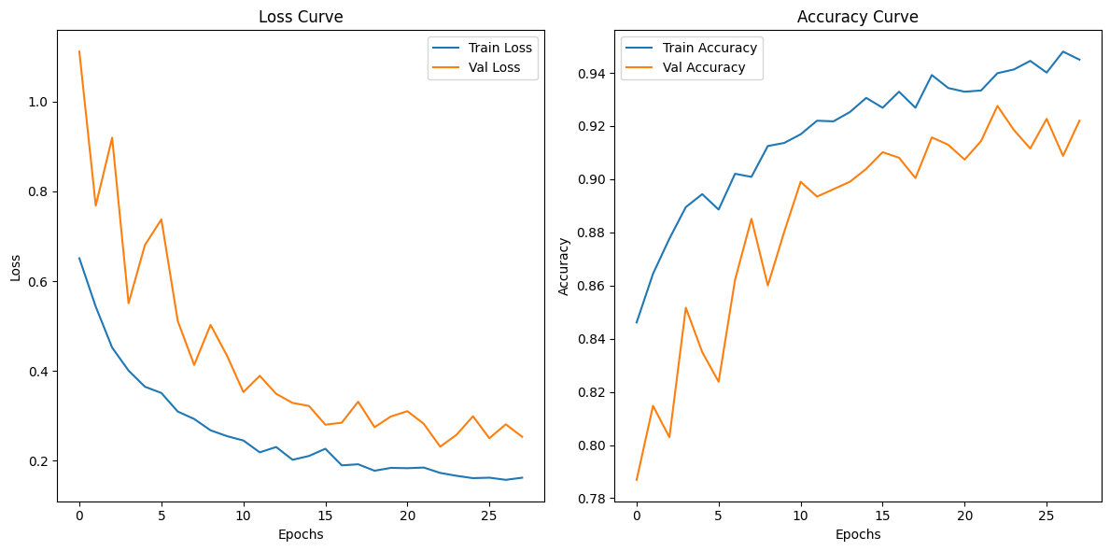
Experimentation with EfficientNet-B0 + SE

Slide 12
Experimentation with EfficientNet-B0 + CBAM
Experiment 1 (Uniform Transformations):
Achieved 98% accuracy, with good generalization.
Experiment 2 (Augmented Training):
Boosted overall performance, achieving 99% accuracy and strong F1-scores across all classes.
Experiment 3 (Pretraining + Fine-Tuning):
Pretraining on PathMNIST improved generalization but did not translate perfectly to the NCT-CRC-VAL-7K dataset.
Slight underperformance for MUS (F1 = 0.91) and STR (F1 = 0.83), with STR showing a recall of 0.71.
Challenges in classes like DEB, STR, and MUS suggest domain adaptation issues.

Slide 13
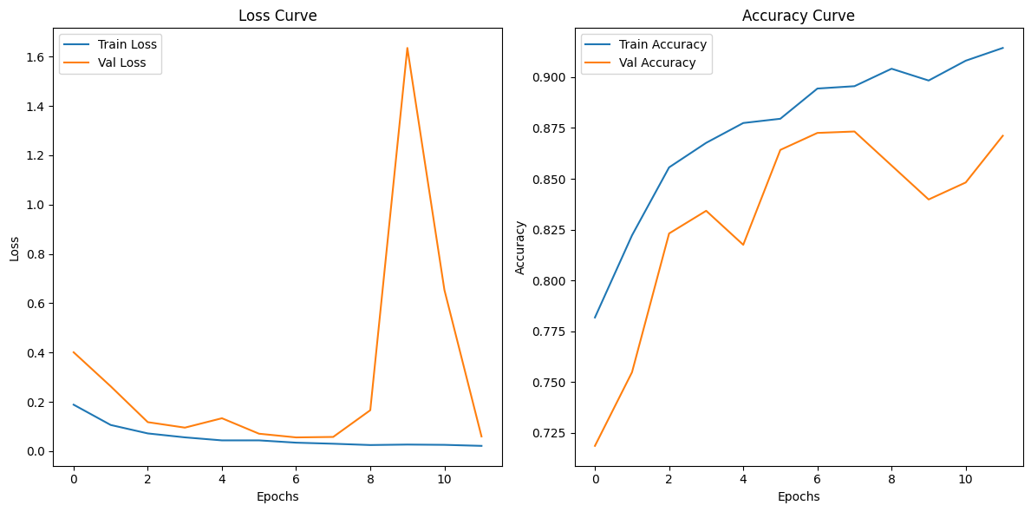
Experimentation with EfficientNet-B0 + CBAM

Slide 14
Experimentation with EfficientNet-B0 + MSFF
Experiment 1 (Uniform Transformations):
Achieved 91% accuracy, with good generalization.
Experiment 2 (Augmented Training):
Improved overall accuracy to 97%, resolving many class-specific challenges.
Experiment 3 (Pretraining + Fine-Tuning):
Pretraining on PathMNIST boosted initial performance but failed to generalize perfectly to MUS, DEB, and STR classes.
Struggled with MUS, NORM, and STR classes.
Notable gains in STR and MUS, but STR still lags compared to other classes.
Performance (accuracy ~90%) suggests limited domain adaptation.

Slide 15
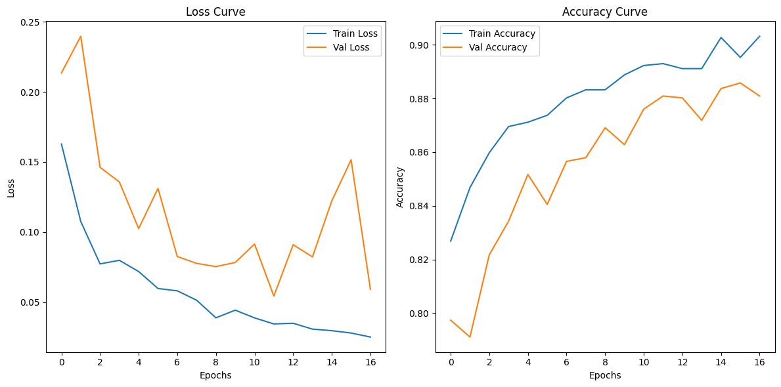
Experimentation with EfficientNet-B0 + MSFF

Slide 16
Summary of Performance Differences
Model | Experiment 1 | Experiment 2 | Experiment 3 | Reasoning
SE | Good (91% accuracy) | Improved (97% accuracy) | Best (93% accuracy) | SE’s channel recalibration generalizes well across datasets and domain shifts.
MSFF | Moderate (91% accuracy) | Best (97% accuracy) | Poor (90% accuracy) | MSFF struggles with domain shifts but benefits most from data augmentation.
CBAM | Best (98% accuracy) | Best (99% accuracy) | Poor (87% accuracy) | CBAM’s spatial attention is sensitive to domain shifts but thrives with augmentation.

Slide 17
Original DeepCMorph Model with only Classification Module
Frozen Segmentation Module:
By default, the segmentation module in DeepCMorph is frozen (freeze_segmentation_module=True), meaning its weights are not updated.
It functions as a preprocessing step, providing segmentation and classification maps for the classification module.
The training mechanism here is a classification-only task, as the CRC-VAL-HE-7K dataset does not include segmentation annotations.

Slide 18
Original DeepCMorph Model with only Classification Module- Experiment 1
Overall Metrics:
Accuracy: 88%
Macro Average F1-Score: 0.80 (indicates performance across all classes, including underrepresented ones).
Weighted Average F1-Score: 0.87 (accounts for class imbalance, weighted by support).
Struggles with underrepresented ones (DEB, STR)
The segmentation-free classification pipeline may not fully utilize the model's potential.

Slide 19
Modified DeepCMorph Model with only Classification Module
Residual Block in the Segmentation Module:
Purpose: The ResidualBlock enhances feature learning by allowing the network to learn identity mappings. This helps mitigate the vanishing gradient problem and promotes efficient learning of complex representations.
Impact: Provides better feature refinement in the segmentation pipeline, which likely improves the quality of the segmentation and classification maps used by the classification module.
Squeeze-and-Excitation (SE) Block in the Segmentation Module:
Purpose: Adds channel-wise attention to focus on the most important features.
Impact: Improves the discriminative power of features, which enhances classification accuracy, especially for difficult classes (e.g., class 2 with a significant recall improvement from 0.25 to 0.92).
Dropout for Regularization:
Purpose: The addition of dropout layers reduces the risk of overfitting by randomly zeroing out a fraction of features during training.
Impact: Stabilizes the model's performance, especially when the dataset is small (e.g., CRC-VAL-HE-7K with only 7,000 images).

Slide 20
Modified DeepCMorph Model with only Classification Module- Experiment 1
Overall Metrics:
Accuracy: 98%
Macro Average F1-Score: 0.97 (Enhanced performance across all classes.).
Weighted Average F1-Score: 0.98 (Performs well even on the minority and challenging classes).]
The updated DeepCMorph model demonstrates a significant performance boost due to the addition of residual blocks, SE attention, and dropout.

Slide 21
Performance Comparison: Original vs. Updated Model
Metric | Original Model | Updated Model | Improvement
Accuracy | 0.88 | 0.98 | Significant boost in overall accuracy.
Macro Average F1 | 0.80 | 0.97 | Enhanced performance across all classes.
Weighted Average F1 | 0.87 | 0.98 | Drastically improved balance in performance.

Slide 22
Morphological Features Extraction
Segmentation:
The DeepCMorph model generates segmentation maps for each image.
Segmentation maps are converted into binary masks (threshold > 0.5).
The features extracted here are:
Area: Size of the segmented nucleus (region).
Eccentricity: Deviation of the nucleus shape from circularity.
Perimeter: The boundary length of the segmented nucleus.
Density: A ratio derived from the area and perimeter, indicating compactness.

Slide 23
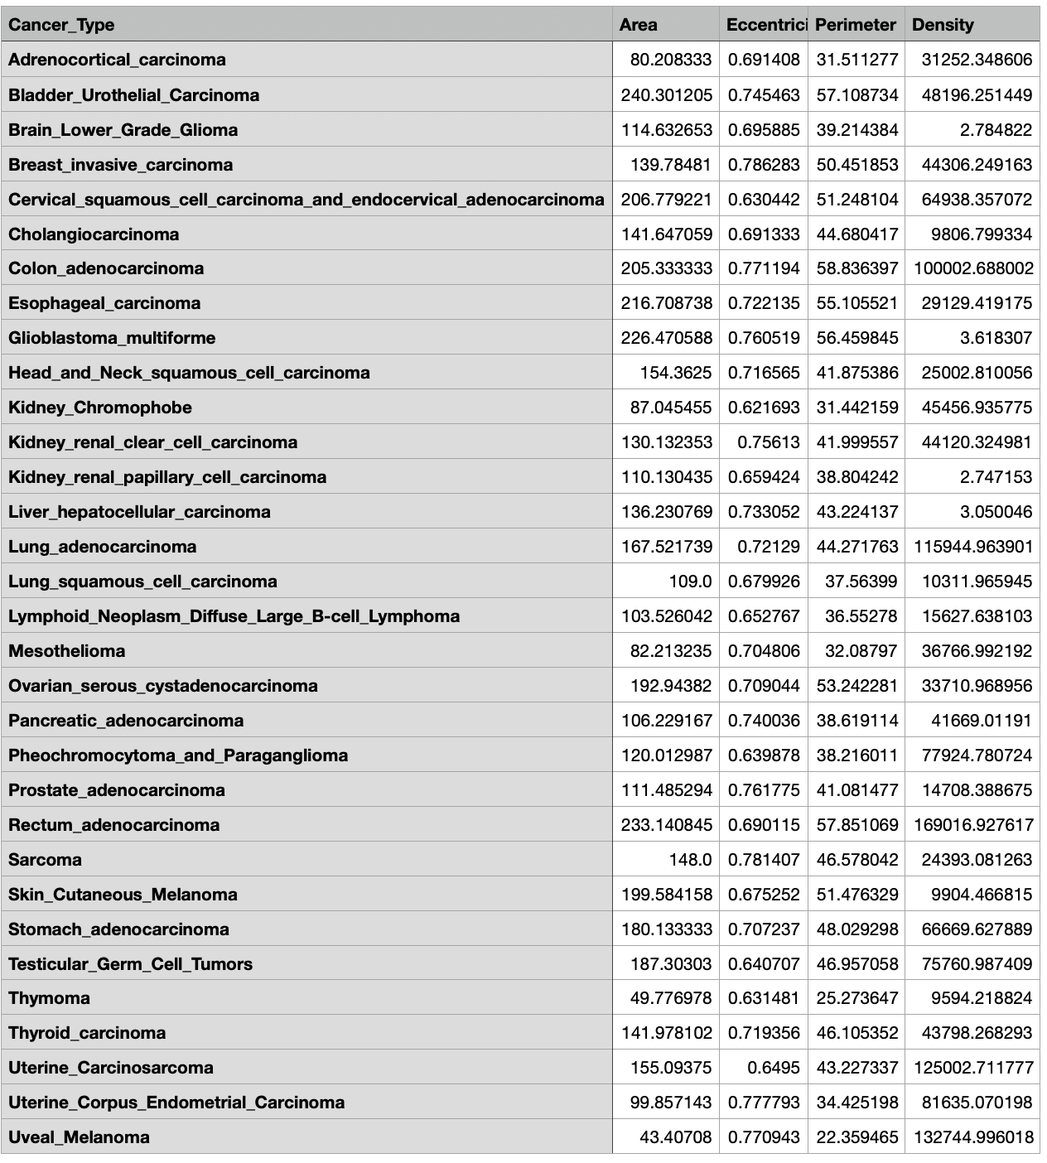
Nuclei Features by Cancer type

Slide 24
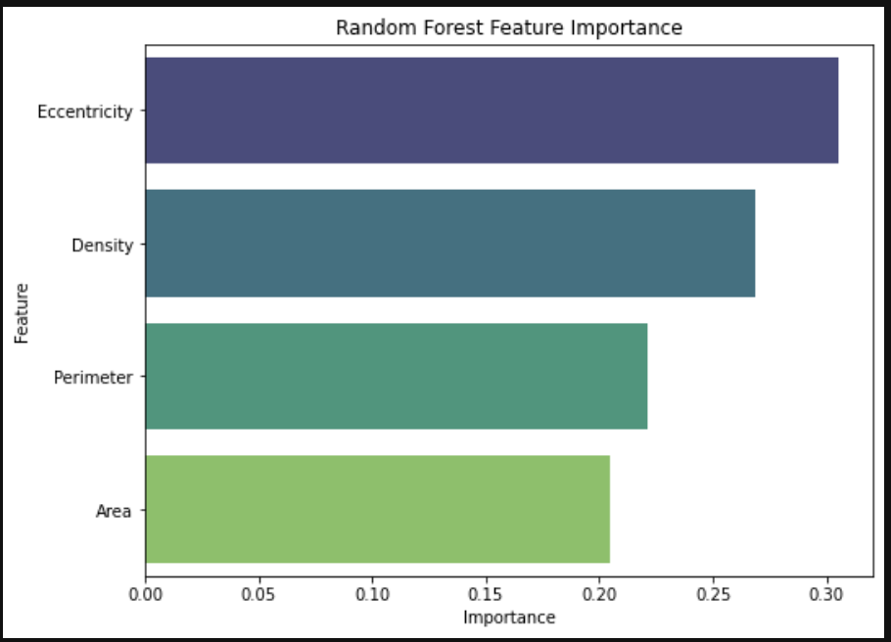
Feature Importance of Nuclei

Slide 25
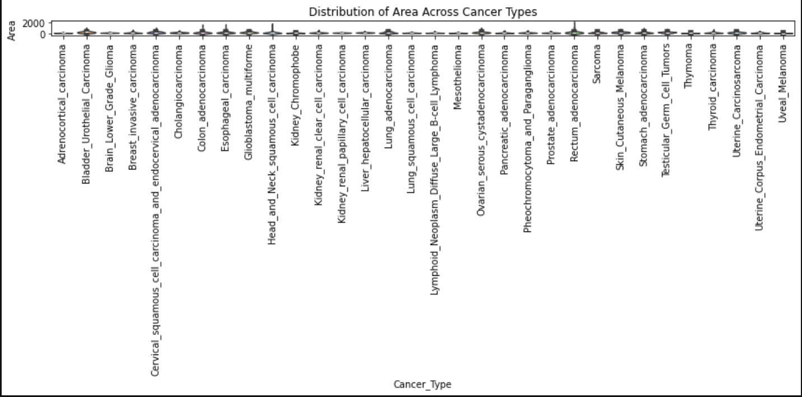
Distribution of Features across Cancer types

Slide 26
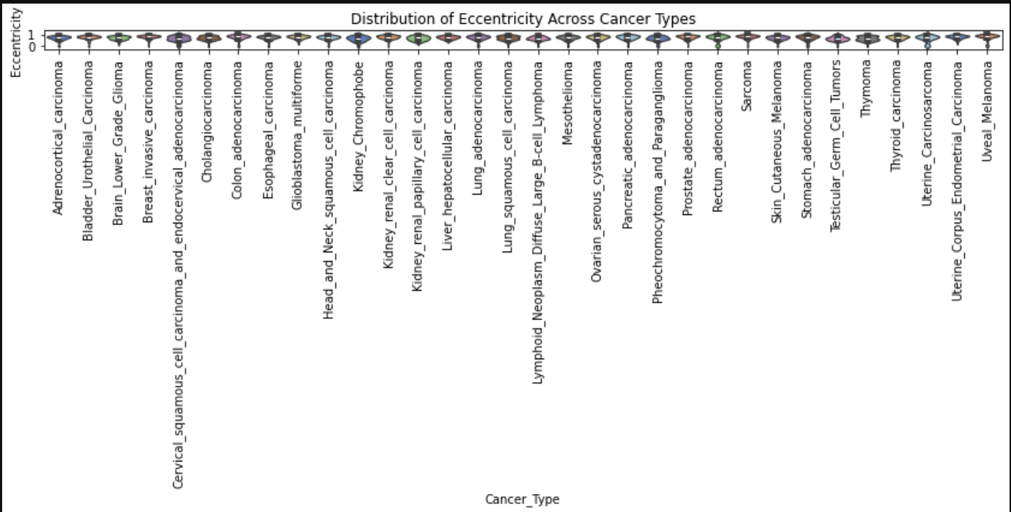
Distribution of Features across Cancer types

Slide 27
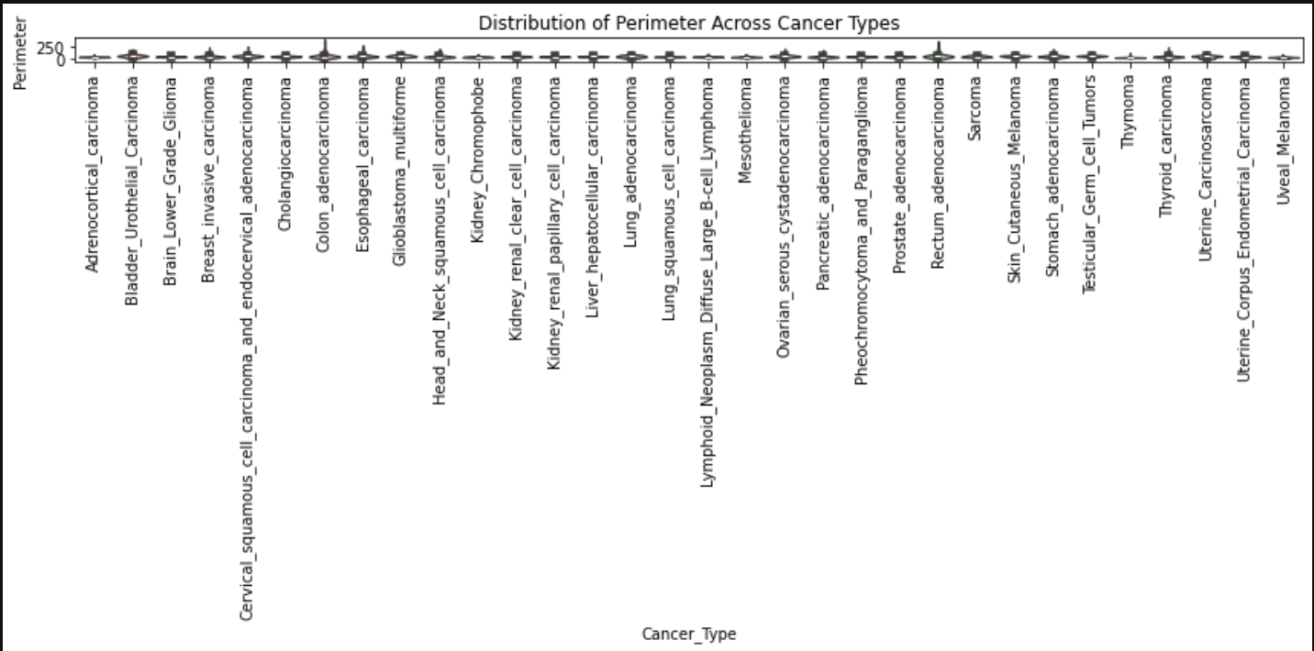
Distribution of Features across Cancer types

Slide 28
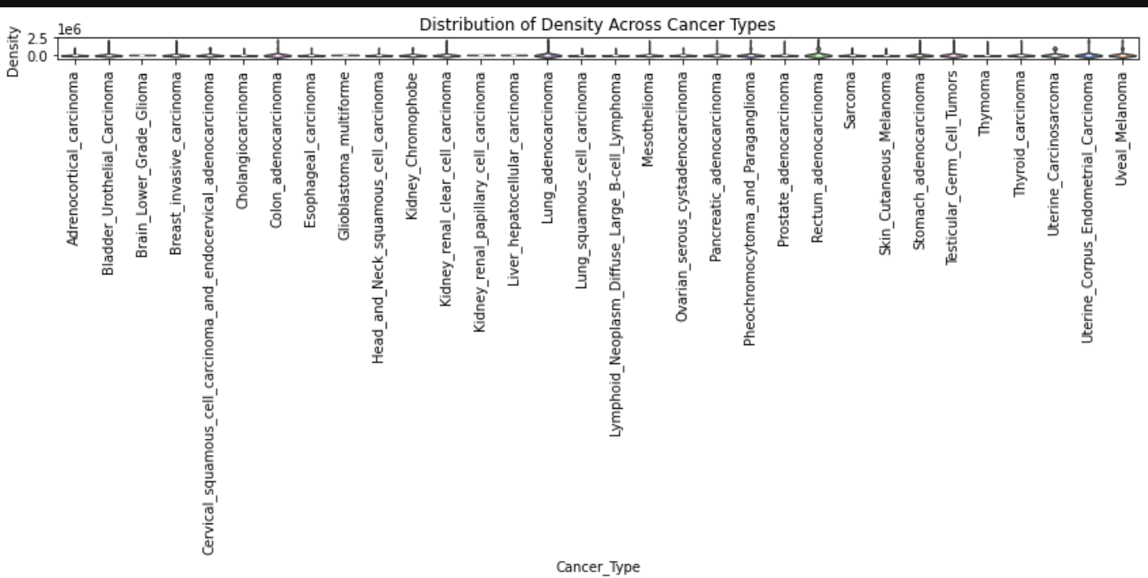
Distribution of Features across Cancer types

Slide 29
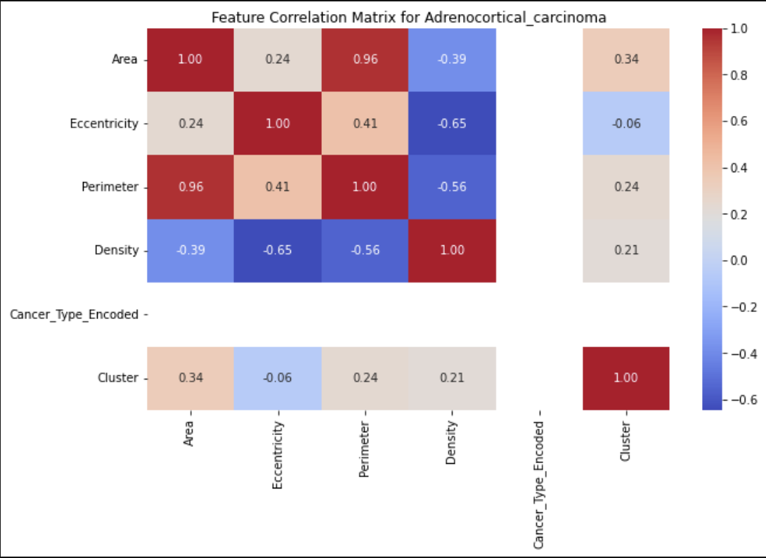
Feature Correlation across Cancer types

Slide 30
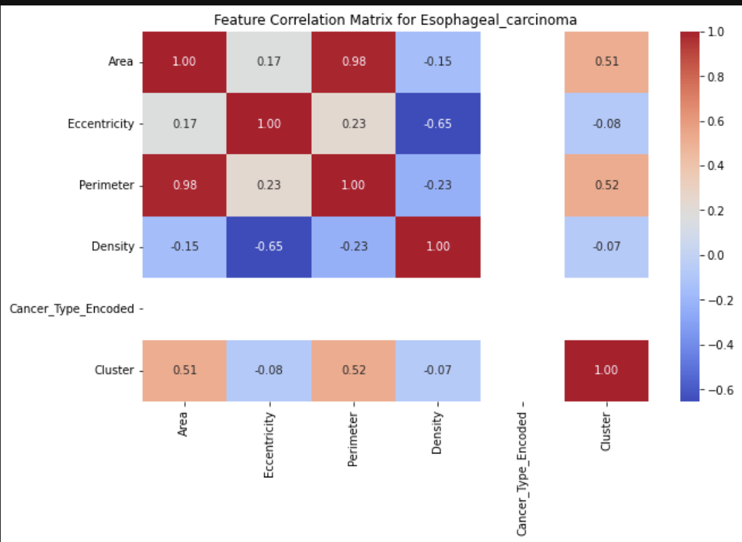
Feature Correlation across Cancer types

Slide 31
Thank you

