Slide 1
Node Js
Md Rakib Hassan

Slide 2

Course Module

Slide 3





Course Module

Slide 4
Topics(Js)
Variable & Data Types
Operators
Introduction
Statements
Object

Slide 5
Topics(Js)
Class
Function
OOP
Algorithm
Array

Slide 6
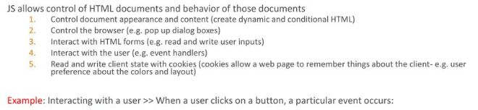
Js Intro
1995
Netscape
1996
JScript at Microsoft
1998
ECMAScript

Slide 7
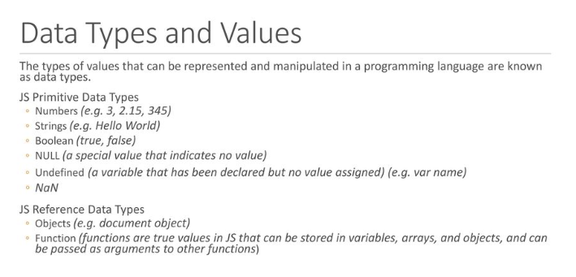
Variable & Data Types

Slide 8
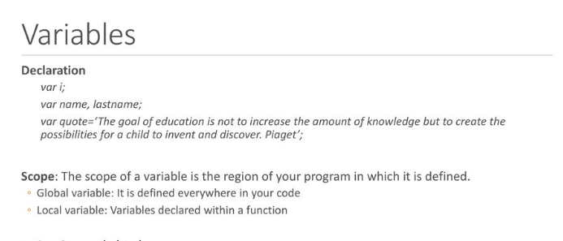
Variable & Data Types

Slide 9
Variable & Data Types
Var
var declarations are globally scoped or function/locally scoped.
Let
let is block scoped
Const
Const cannot be updated or re-declared

Slide 10
Variable & Data Types
Practicale Example

Slide 11
Variable & Data Types
NaN
Special number: Not a Number Result of undefined or erroneous operations
NaN is not equal to anything, including NaN
Null
A value that isn't anything

Slide 12
Variable & Data Types
Practicale Example

Slide 13
Variable & Data Types
Comments
// slashslash line comment
/*
slashstar
block
comment
*/

Slide 14
Variable & Data Types
String Methods
charAt
concat
indexOf
lastIndexOf
match
replace
search
slice
split
substring
toLowerCase
toUpperCase

Slide 15
Operator
Arithmetic
+ - * / %
Comparison
== != < > <= >=
Logical
&& || !
Bitwise
& | ^ >> >>> <<
Ternary
?:

Slide 16
Operator
Addition and concatenation(+)
'$' + 3 + 4 = '$34‘
+"42" = 42
Number("42") = 42
parseInt("42", 10) = 42
+"3" + (+"4") = 7

Slide 17
Operator
Equal and not equal
(==,!=)
Practicale Example

Slide 18
Operator
The guard operator, aka logical and
(&&)
Practicale Example

Slide 19
Operator
The default operator, aka logical or
(||)
Practicale Example

Slide 20
Operator
Statements
if
switch
while
do
for
Break
Continue
Return
try/throw

Slide 21
Variable & Data Types
Objects

