Slide 1
Node JS
Md Rakib Hassan

Slide 2

Course Module

Slide 3
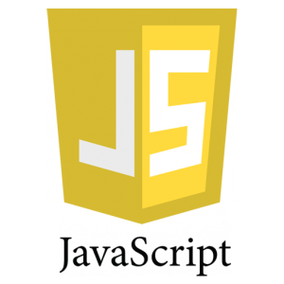



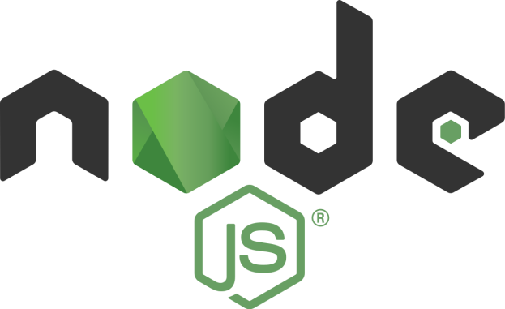

Course Module

Slide 4
Topics(Js)
Variable & Data Types
Operators
Introduction
Statements
Object

Slide 5
Topics(Js)
Class
Function
OOP
Algorithm
Array

Slide 6
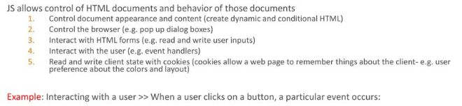
Js Intro
1995
Netscape
1996
JScript at Microsoft
1998
ECMAScript

Slide 7
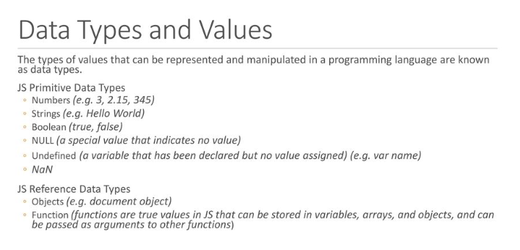
Variable & Data Types

Slide 8
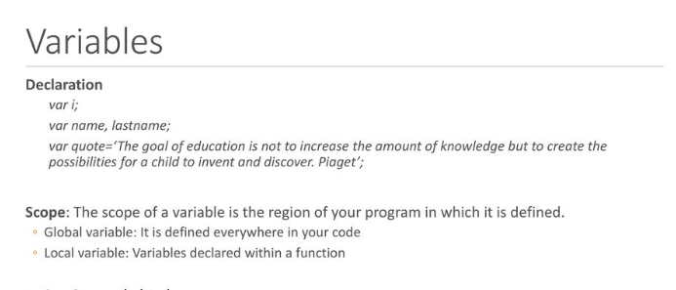
Variable & Data Types

Slide 9
Variable & Data Types
Var
var declarations are globally scoped or function/locally scoped.
Let
let is block scoped
Const
Const cannot be updated or re-declared

Slide 10
Variable & Data Types
Practicale Example

Slide 11
Variable & Data Types
NaN
Special number: Not a Number Result of undefined or erroneous operations
NaN is not equal to anything, including NaN
Null
A value that isn't anything

Slide 12
Variable & Data Types
Practicale Example

Slide 13
Variable & Data Types
Comments
// slashslash line comment
/*
slashstar
block
comment
*/

Slide 14
Operator
Arithmetic
+ - * / %
Comparison
== != < > <= >=
Logical
&& || !
Bitwise
& | ^ >> >>> <<
Ternary
?:

Slide 15
Operator
Addition and concatenation(+)
'$' + 3 + 4 = '$34‘
+"42" = 42
Number("42") = 42
parseInt("42", 10) = 42
+"3" + (+"4") = 7

Slide 16
Operator
Equal and not equal
(==,!=)
Practicale Example

Slide 17
Operator
The guard operator, aka logical and
(&&)
Practicale Example

Slide 18
Operator
The default operator, aka logical or
(||)
Practicale Example

Slide 19
Operator
Statements
if
switch
while
do
for
Break
Continue
Return
try/throw

Slide 20
Variable & Data Types
Objects
Practicale Example

Slide 21
Variable & Data Types
String Methods
charAt
concat
indexOf
lastIndexOf
match
replace
search
slice
split
substring
toLowerCase
toUpperCase

Slide 22
Class Assessment & Group

Slide 23
Node JS
Introduction
Node.js is an open-source, cross-platform, back-end JavaScript runtime environment that runs on a JavaScript Engine (i.e. V8 engine) and executes JavaScript code outside a web browser, which was designed to build scalable network applications. Node.js lets developers use JavaScript to write command line tools and for server-side scripting—running scripts server-side to produce dynamic web page content before the page is sent to the user's web browser.

Slide 24
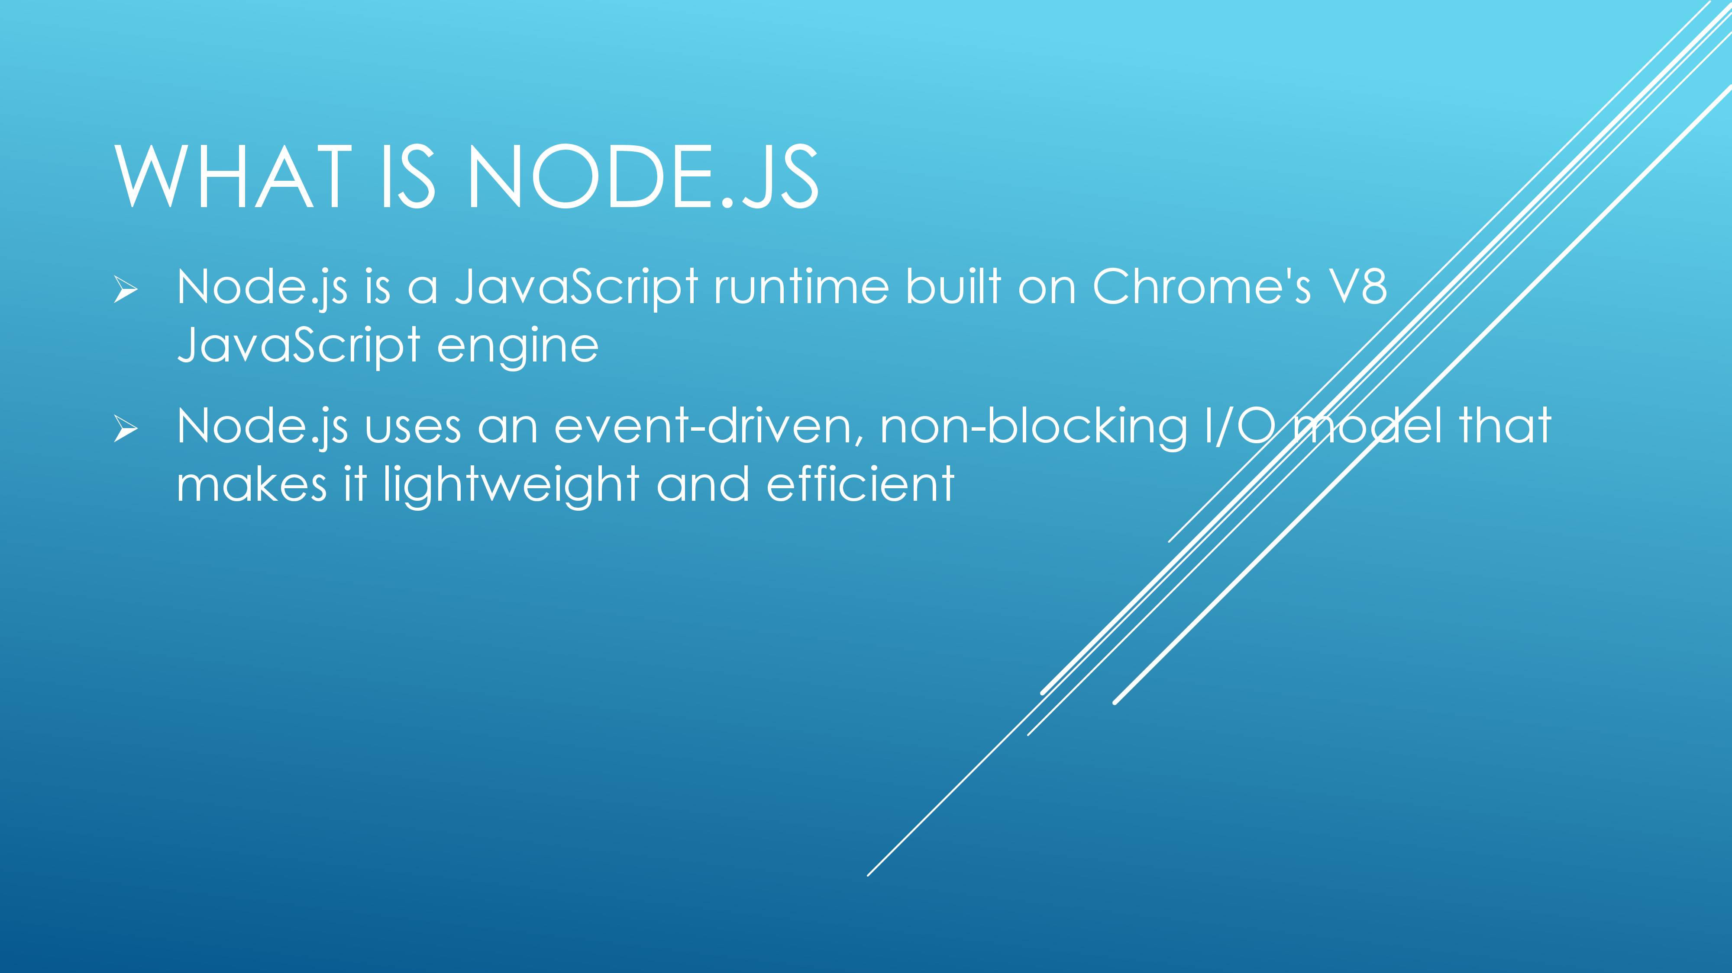
Node JS

Slide 25
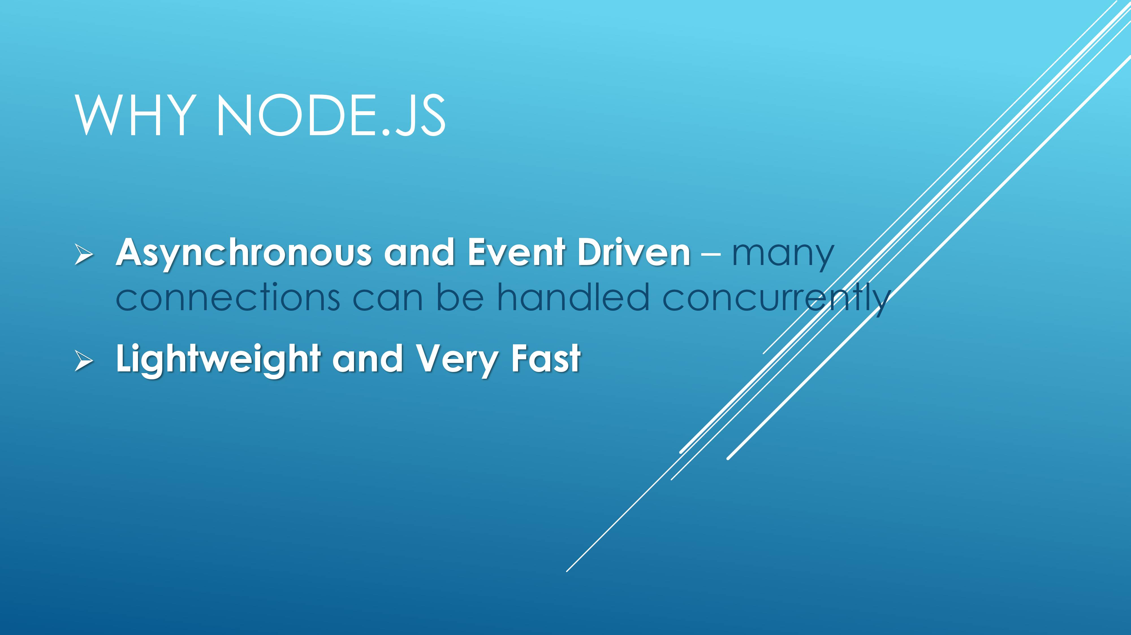
Node JS

Slide 26
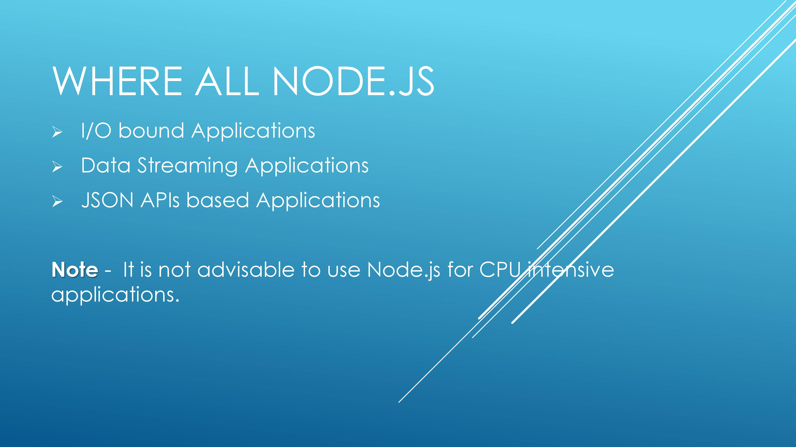
Node JS

Slide 27
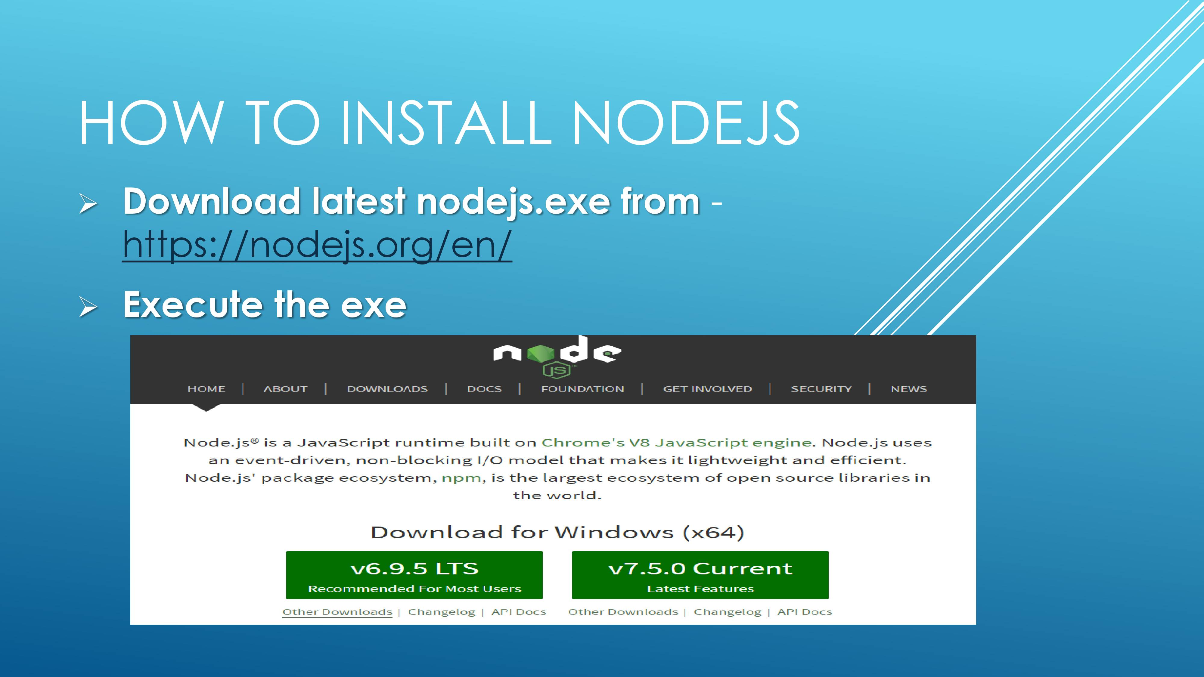
Node JS

Slide 28
Node JS
When to use it ?
• Chat/Messaging
• Real-time Applications
• Intelligent Proxies
• High Concurrency Applications
• Communication Hubs
• Coordinators

Slide 29
Node JS
Node.js for….
● Web application
● WebSocket server
● Ad server
● Proxy server
● Streaming server
● Fast file upload client
● Any Real-time data apps
● Anything with high I/O

Slide 30
Node JS
What is Express JS?
Node JS is a fast JavaScript runtime environment that we use to build server-side applications, but it does not know how to perform serving files, handling requests, and handling HTTP methods, so this is where express js comes in.
Express JS is a Node.js framework designed to build API's web applications cross-platform mobile apps quickly and make node js easy.
Express is a node js web application framework that provides broad features for building web and mobile applications. It is used to build a single page, multipage, and hybrid web application.
It's a layer built on the top of the Node js that helps manage servers and routes.

Slide 31
Node JS
Why Express JS?
Express was created to make APIs and web applications with ease,
It saves a lot of coding time almost by half and still makes web and
mobile applications are efficient.
Another reason for using express is that it is written in javascript as javascript is an easy language even if you don't have a previous
knowledge of any language. Express lets so many new developers enter the field of web development.
The reason behind creating an express framework for node js is:
Time-efficient
Fast
Economical
Easy to learn
Asynchronous

Slide 32
Node JS
Features of Express JS
Middleware
Middleware is a request handler that has access to the application's request-response cycle.
Routing
It refers to how an application's endpoint's URLs respond to client requests.
Templating
It provides templating engines to build dynamic content on the web pages by creating HTML templates on the server.
Debugging
Express makes it easier as it identifies the exact part where bugs are.

Slide 33
Node Project
Hello World
Create with express
Express generator
Express project structure
Create without express

Slide 34
Node Project
Controllers
Routes
Templating(express handlebars)
Environment setup & config
NPM Package installation(Nodemon)

Slide 35
Node Project
Models
Database Connection
Validation
CRUD operations
MongoDB Installation

Slide 36
Node Project
Handlebars-helpers
Work with views
Project Demonstration
Passport Authentication
API & Postman

Slide 37
Node JS
Middleware
Middleware functions are functions that have access to the request object (req), the response object (res), and the next middleware function in the application’s request-response cycle. The next middleware function is commonly denoted by a variable named next.
If the current middleware function does not end the request-response cycle, it must call next() to pass control to the next middleware function. Otherwise, the request will be left hanging.
An Express application can use the following types of middleware:
Application-level middleware
Router-level middleware
Error-handling middleware
Built-in middleware
Third-party middleware

Slide 38
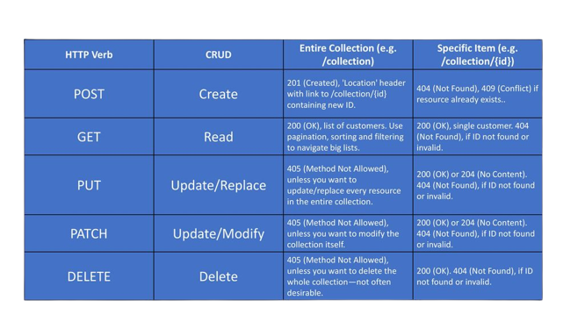
Node JS
Routes
REST HTTP Methods:

Slide 39
Node JS
Where to Host a Node.js App
Simplest option over local tunnel.
Codepen
Glitch
Serverless environments
Google Cloud Platform
VPS Hosting
Vercel
Heroku
Microsoft Azure
Standard Server

Slide 40
Node JS Project Exam
Note: (Make sure everything is installed on your computer)
Create an “Express” project with “hbs” template engine
Install “Nodemon” inside the project
Configure “.env” . Add project “Name” & “Port”
Install “Mongose” inside the project and configure the database.
Create a route file “frontend.js” and create a route named “my-page” using “get” method.
Create a controller “frontendController.js” and write a function which will render “.env” credentials to the view file.

Slide 41
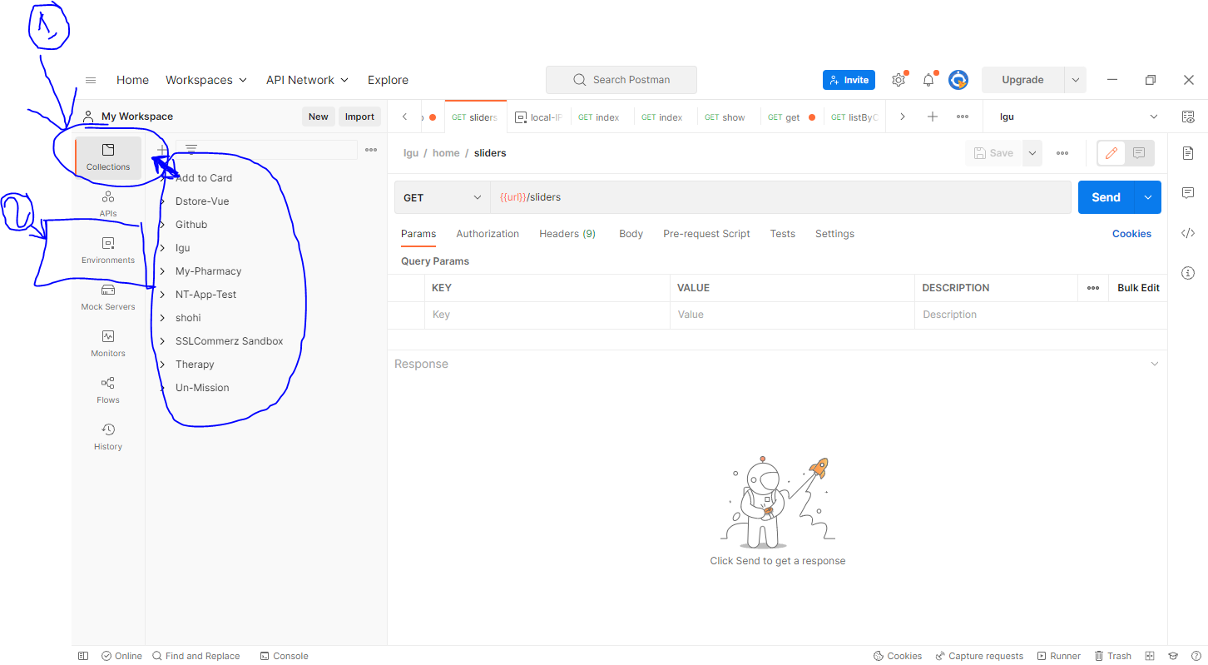
Node JS
Postman API

Slide 42
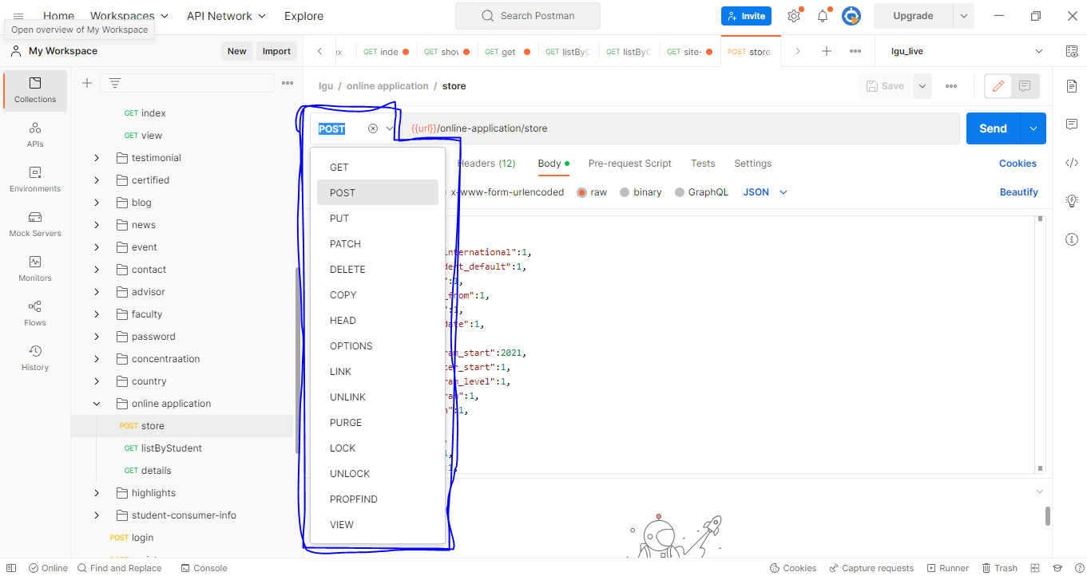
Node JS
Postman API

Slide 43
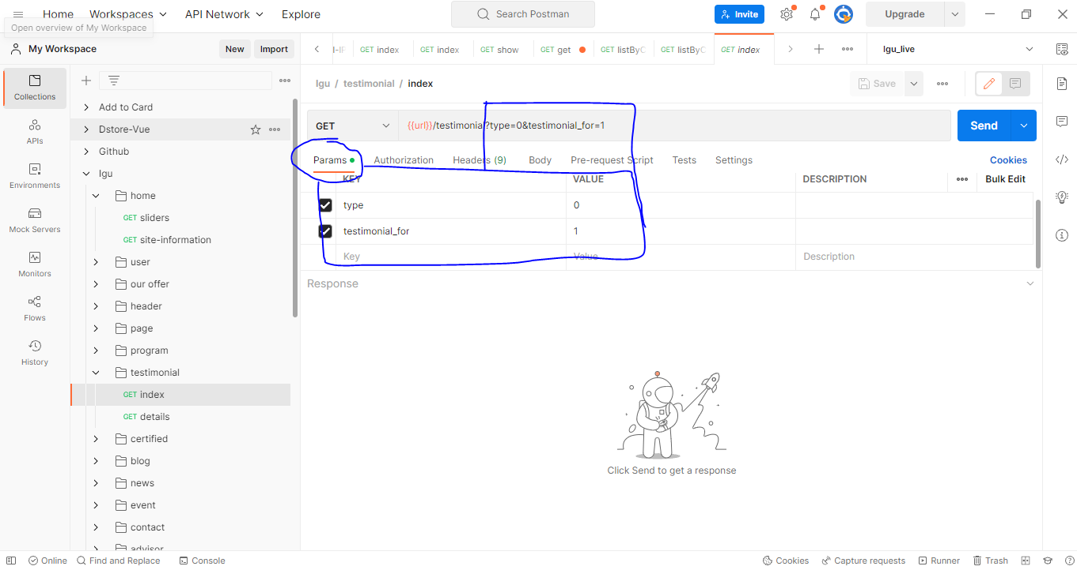
Node JS
Postman API

Slide 44
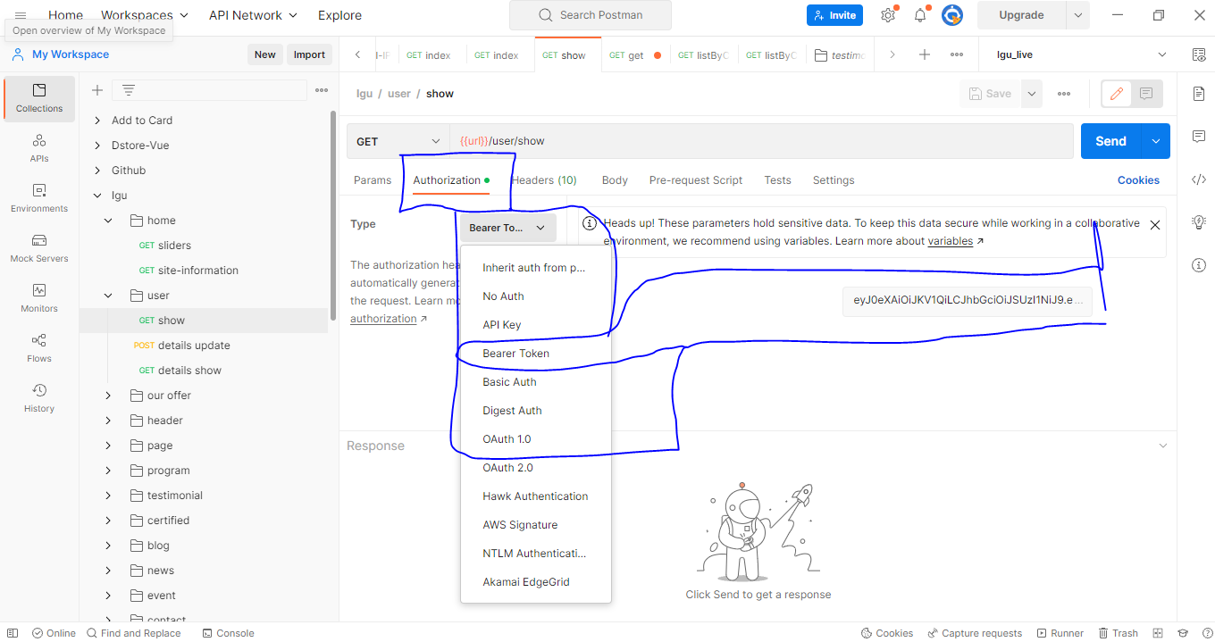
Node JS
Postman API

Slide 45
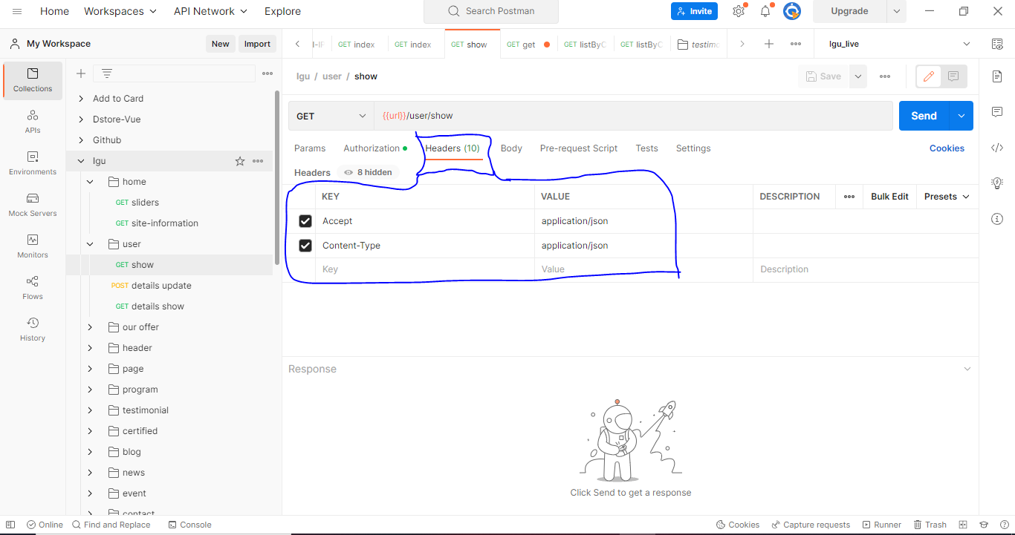
Node JS
Postman API

Slide 46
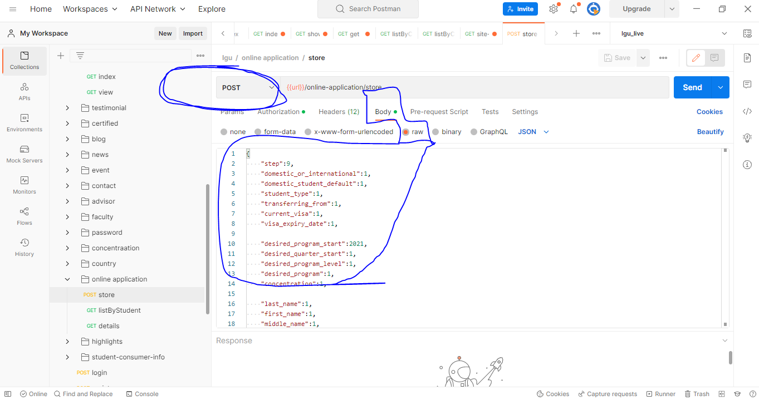
Node JS
Postman API

Slide 47
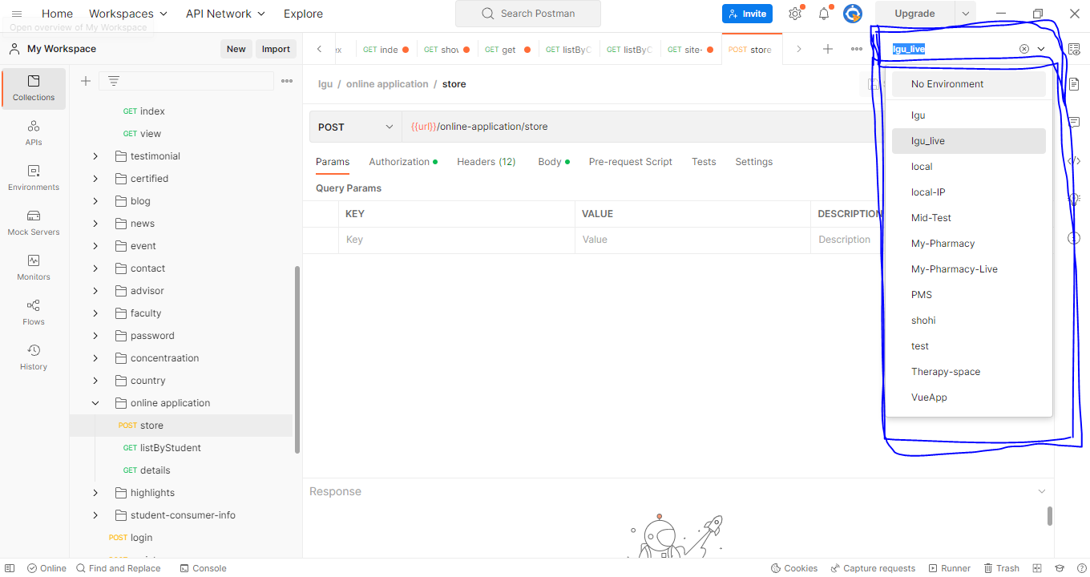
Node JS
Postman API

