Slide 1
Chapter 3: Introduction to SQL

Slide 2
Outline
Overview of The SQL Query Language
SQL Data Definition
Basic Query Structure of SQL Queries
Additional Basic Operations
Set Operations
Null Values
Aggregate Functions
Nested Subqueries
Modification of the Database
Notes:
1

Slide 3
Relation / Table
Table is a bucket where you pour data.
In a table, there are basically 3 things-
Rows / Records / Tuples
Columns / Attributes / Fields
Data
Roll | Name | Department
1507169 | Karim | CSE
1607196 | Rahim | ME

Slide 4
Relation / Table
In relational data model, the table is also called relation. There are set of rules that are applied on the relations. You must have to know them.
A database contains many relations. Every relations in a database must have distinct names
Every column in a relation must have distinct names
Every entries in a column must be in the same domain
The ordering of columns in a relation is insignificant
Duplicate rows are not allowed in a relation
The ordering of rows is insignificant
Multiple values are not allowed in the cells of a relation
2 rows in a relation may contain the same value for 1 columns but not in all (deviation of 5)
The number of rows in a table is called Cardinality
The number of columns in a table is called Degree

Slide 5
SQL Parts
DML -- provides the ability to query information from the database and to insert tuples into, delete tuples from, and modify tuples in the database.
Used to insert, view, and modify database data
INSERT
UPDATE
DELETE
SELECT
DDL -- Used to create and modify the structure of database objects
CREATE
ALTER
DROP
DDL commands execute as soon as they are issued, and do not need to be explicitly saved

Slide 6
SQL Parts
integrity – the DDL includes commands for specifying integrity constraints.
View definition -- The DDL includes commands for defining views.
Transaction control –includes commands for specifying the beginning and ending of transactions.
Authorization – includes commands for specifying access rights to relations and views.

Slide 7
Domain Types in SQL
char(n). Fixed length character string, with user-specified length n.
varchar(n). Variable length character strings, with user-specified maximum length n.
The fundamental difference between CHAR and VARCHAR is that the CHAR data type is fixed in length, while the VARCHAR data type supports variable-length columns of data. But they are also similar.
Number.
General declaration format:
variable_name NUMBER(precision, scale)
item_price NUMBER(5, 2)
Number type (integer, fixed point, floating point) specified by precision and scale
Precision: total number of digits on either side of the decimal point
Scale: number of digits to right of decimal point
s_age NUMBER (2)
s_GPA NUMBER
Date. s_dob DATE

Slide 8
Create Table Construct
An SQL relation is defined using the create table command:
create table r
(A₁ D₁, A₂ D₂, ..., A_{n} D_{n}, (integrity-constraint₁), ..., (integrity-constraint_{k}))
r is the name of the relation
each A_{i} is an attribute name in the schema of relation r
D_{i} is the data type of values in the domain of attribute A_{i}
Example:
create table instructor ( ID char(5), name varchar(20), dept_name varchar(20), salary number(8,2))

Slide 9
Integrity Constraints in Create Table
Types of integrity constraints
primary key (A₁, ..., A_{n} )
no tuple can have a null value for a primary-key attribute, and no two tuples in the relation can be equal on all the primary-key attributes.
foreign key (A_{m}, ..., A_{n} ) references r
The values of attributes (A_{m}, ..., A_{n} ) for any tuple in the relation must correspond to values of the primary key attributes of some tuple in relation r.
not null
SQL prevents any update to the database that violates an integrity constraint.

Slide 10
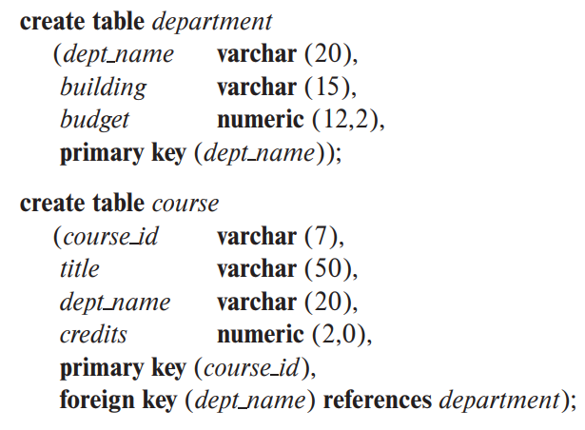
dept_name | building | budget
CSE | 3 | 120.23
EEE | 4 | 110.14
ME | 1 | 115.16
course_id | title | dept_name | credits
CSE 32 | ABC | CSE | 3.0
CSE 22 | ACD | MME | 3.0
CSE12 | ANM | ME | 1.5
SQL prevents any update to the database that violates an integrity constraint. For example, if a newly inserted or modified tuple in a relation has null values for any primary-key attribute, or if the tuple has the same value on the primary-key attributes as does another tuple in the relation, SQL flags an error and prevents the update. Similarly, an insertion of a course tuple with a dept name value that does not appear in the department relation would violate the foreign-key constraint on course, and SQL prevents such an insertion from taking place.

Slide 11
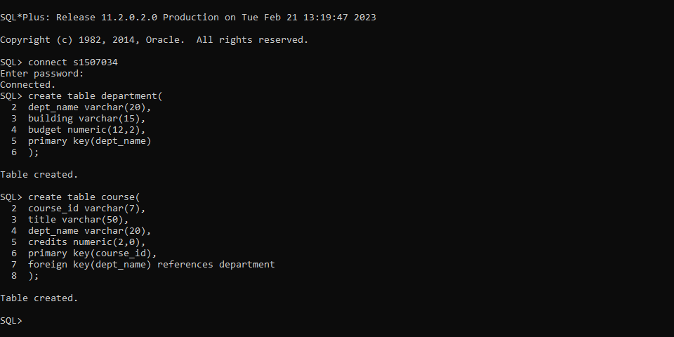
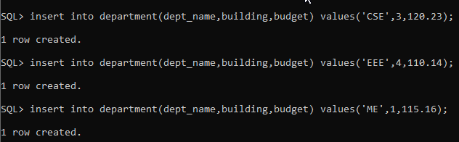
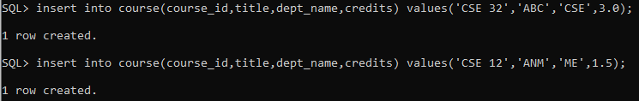
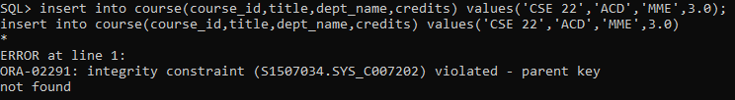

Slide 12
And a Few More Relation Definitions
create table student ( ID varchar(5), name varchar(20) not null, dept_name varchar(20), tot_cred number(3,0), primary key (ID),
foreign key (dept_name) references department);
create table takes ( ID varchar(5), course_id varchar(8), sec_id varchar(8), semester varchar(6), year number(4,0), grade varchar(2),
primary key (ID, course_id, sec_id, semester, year) ,
foreign key (ID) references student, foreign key (course_id, sec_id, semester, year) references section);

Slide 13
And more still
create table course ( course_id varchar(8), title varchar(50), dept_name varchar(20), credits numeric(2,0),
primary key (course_id),
foreign key (dept_name) references department);

Slide 14
Updates to tables
Insert
insert into instructor values ('10211', 'Smith', 'Biology', 66000);
Delete
Remove all tuples from the student relation
delete from student
Drop Table
drop table r
Alter
alter table r add A D
where A is the name of the attribute to be added to relation r and D is the domain of A.
All exiting tuples in the relation are assigned null as the value for the new attribute.
alter table r drop A
where A is the name of an attribute of relation r
Dropping of attributes not supported by many databases.

Slide 15
Basic Query Structure
A typical SQL query has the form: select A₁, A₂, ..., A_{n} from r₁, r₂, ..., r_{m} where P
A_{i} represents an attribute
R_{i} represents a relation
P is a predicate.
The result of an SQL query is a relation.
Notes:
2

Slide 16
The select Clause
The select clause lists the attributes desired in the result of a query
corresponds to the projection operation of the relational algebra
Example: find the names of all instructors: select name from instructor
NOTE: SQL names are case insensitive (i.e., you may use upper- or lower-case letters.)
E.g., Name ≡ NAME ≡ name
Some people use upper case wherever we use bold font.
Notes:
3

Slide 17
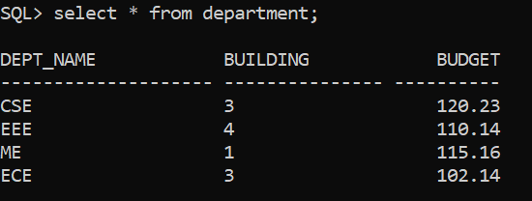

Slide 18
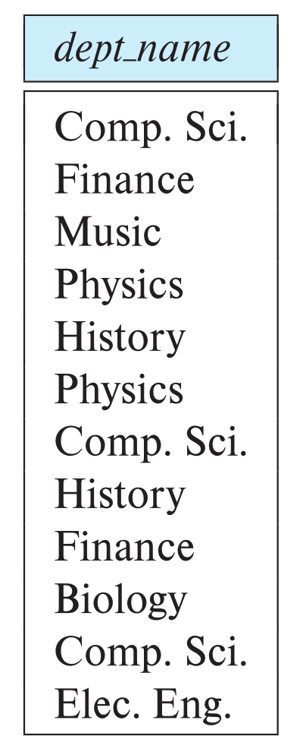
The select Clause (Cont.)
SQL allows duplicates in relations as well as in query results.
To force the elimination of duplicates, insert the keyword distinct after select.
Find the department names of all instructors, and remove duplicates
select distinct dept_name from instructor
The keyword all specifies that duplicates should not be removed.
select all dept_name from instructor
Notes:
4

Slide 19
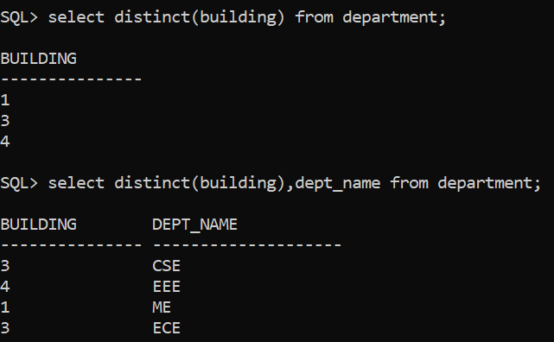

Slide 20
The select Clause (Cont.)
The select clause can contain arithmetic expressions involving the operation, +, –, ∗, and /, and operating on constants or attributes of tuples.
The query:
select ID, name, salary/12 from instructor
would return a relation that is the same as the instructor relation, except that the value of the attribute salary is divided by 12.
Can rename “salary/12” using the as clause:
select ID, name, salary/12 as monthly_salary
Notes:
5

Slide 21
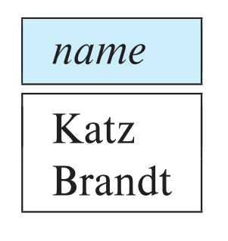
The where Clause
The where clause specifies conditions that the result must satisfy
Corresponds to the selection predicate of the relational algebra.
To find all instructors in Comp. Sci. dept
select name from instructor where dept_name = 'Comp. Sci.'
SQL allows the use of the logical connectives and, or, and not
The operands of the logical connectives can be expressions involving the comparison operators <, <=, >, >=, =, and <>.
Comparisons can be applied to results of arithmetic expressions
To find all instructors in Comp. Sci. dept with salary > 70000
select name from instructor where dept_name = 'Comp. Sci.' and salary > 70000
Notes:
6

Slide 22
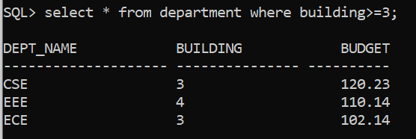

Slide 23
The from Clause
The from clause lists the relations involved in the query
Corresponds to the Cartesian product operation of the relational algebra.
Find the Cartesian product instructor X teaches
select ∗ from instructor, teaches
generates every possible instructor – teaches pair, with all attributes from both relations.
For common attributes (e.g., ID), the attributes in the resulting table are renamed using the relation name (e.g., instructor.ID)
Cartesian product not very useful directly, but useful combined with where-clause condition (selection operation in relational algebra).
Notes:
8

Slide 24
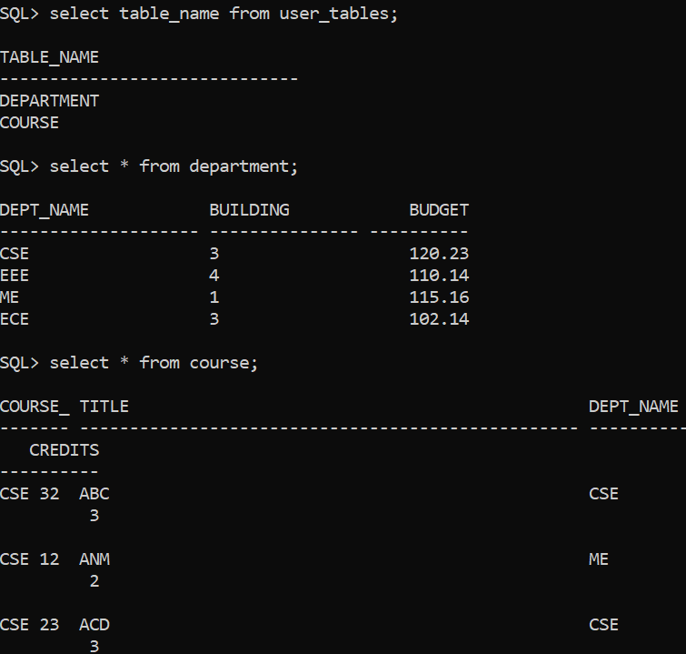
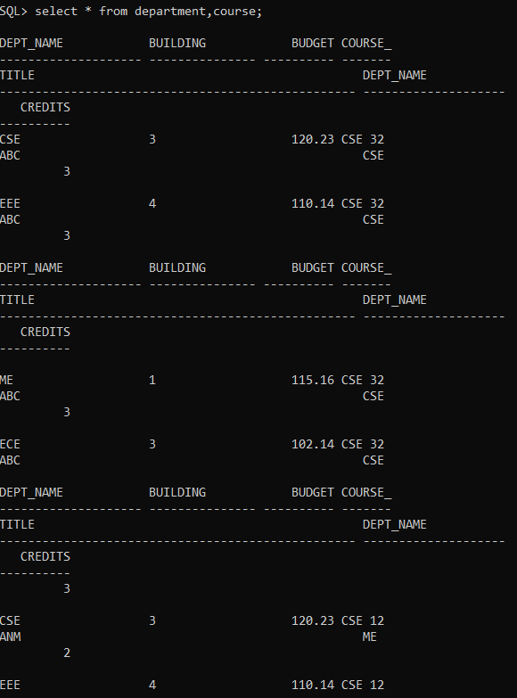

Slide 25
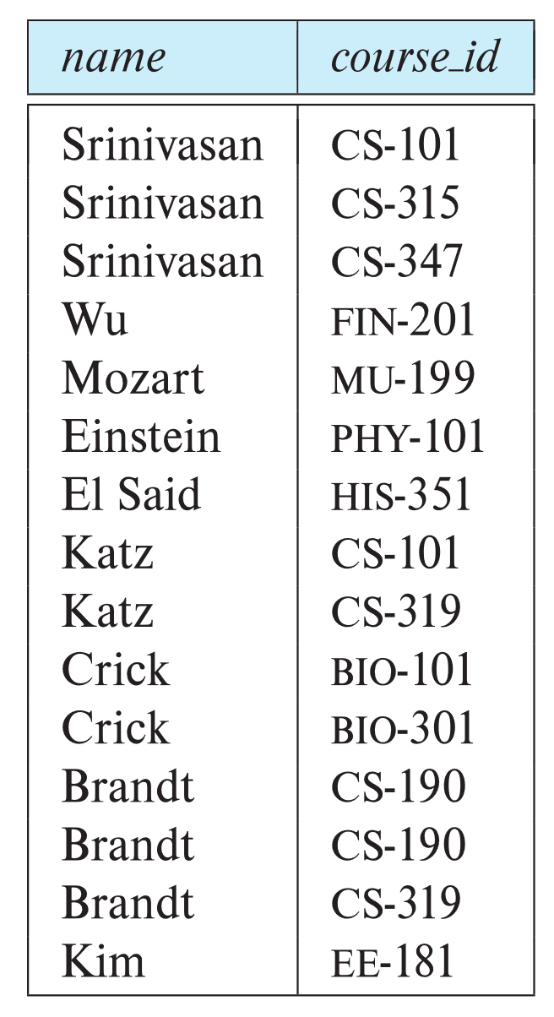
Examples
Find the names of all instructors who have taught some course and the course_id
select name, course_id from instructor , teaches where instructor.ID = teaches.ID
Find the names of all instructors in the Art department who have taught some course and the course_id
select name, course_id from instructor , teaches where instructor.ID = teaches.ID and instructor. dept_name = 'Art'
Notes:
9

Slide 26
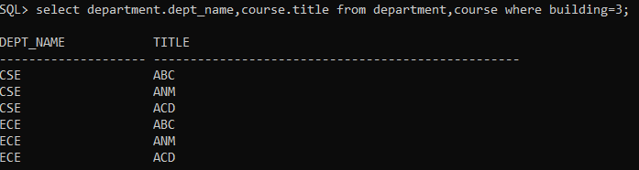

Slide 27
The Rename Operation
The SQL allows renaming relations and attributes using the as clause:
old-name new-name
Find the names of all instructors who have a higher salary than some instructor in 'Comp. Sci'.
select distinct T.name from instructor T, instructor S where T.salary > S.salary and S.dept_name = 'Comp. Sci.’
Keyword as is optional and may be omitted instructor as T ≡ instructor T
Notes:
9

Slide 28
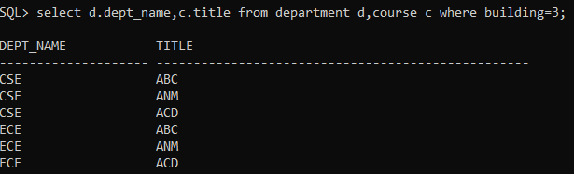

Slide 29
String Operations
SQL includes a string-matching operator for comparisons on character strings. The operator like uses patterns that are described using two special characters:
percent ( % ). The % character matches any substring.
underscore ( _ ). The _ character matches any character.
Find the names of all instructors whose name includes the substring “dar”.
select name from instructor where name like '%dar%'
Match the string “100%”
like '100 \%' escape '\'
in that above we use backslash (\) as the escape character.

Slide 30
String Operations (Cont.)
Patterns are case sensitive.
Pattern matching examples:
'Intro%' matches any string beginning with “Intro”.
'%Comp%' matches any string containing “Comp” as a substring.
'_ _ _' matches any string of exactly three characters.
'_ _ _ %' matches any string of at least three characters.
SQL supports a variety of string operations such as
concatenation (using “||”)
converting from upper to lower case (and vice versa)
finding string length, extracting substrings, etc.

Slide 31
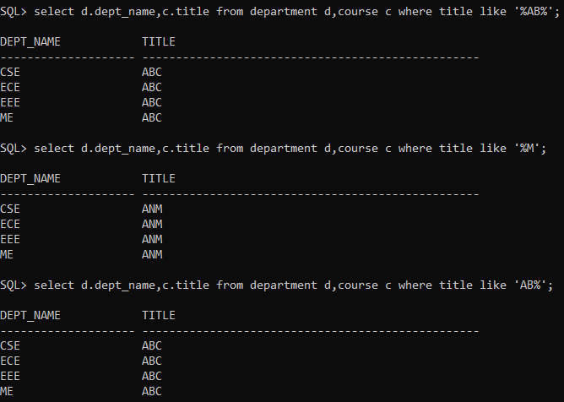

Slide 32
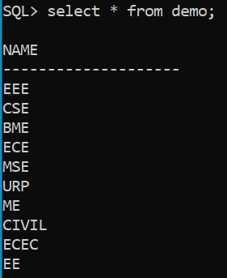
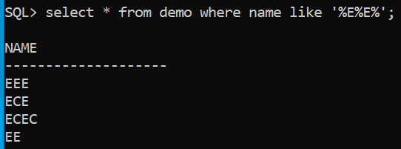
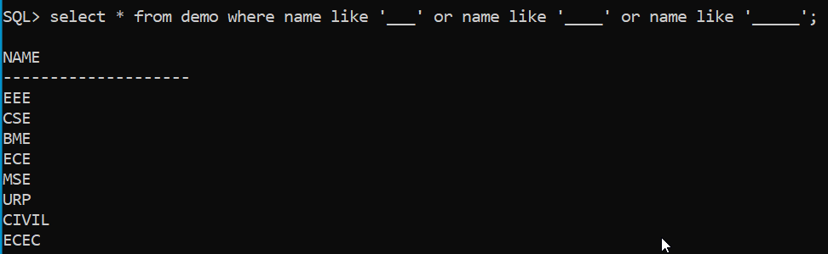
Data → case sensitive.

Slide 33


SELECT * FROM TEST WHERE NAME LIKE 'E_E%'

Slide 34
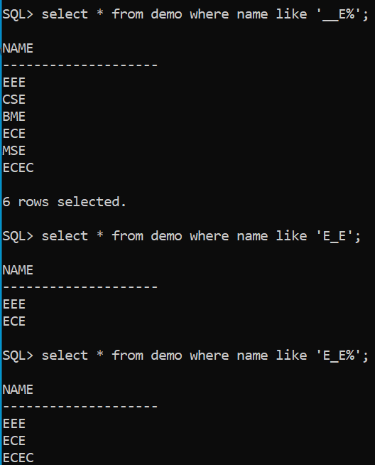

Slide 35
Ordering the Display of Tuples
List in alphabetic order the names of all instructors
select distinct name from instructor order by name
We may specify desc for descending order or asc for ascending order, for each attribute; ascending order is the default.
Example: order by name desc
Can sort on multiple attributes
Example: order by dept_name, name

Slide 36
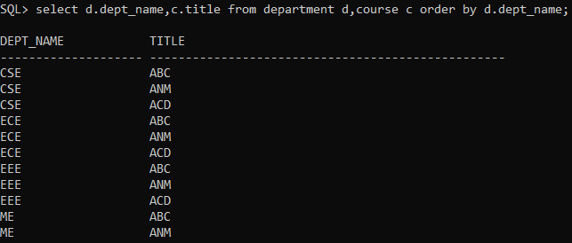

Slide 37
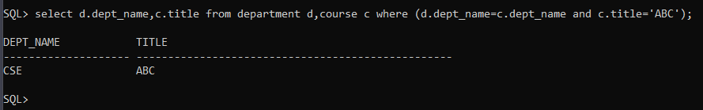
Where Clause Predicates
SQL includes a between comparison operator
Example: Find the names of all instructors with salary between $90,000 and $100,000 (that is, ≥ $90,000 and ≤ $100,000)
select name from instructor where salary between 90000 and 100000
Notes:
7

Slide 38
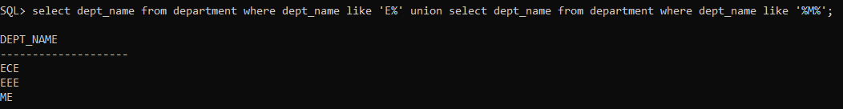




Set Operations
Find courses that ran in Fall 2017 or in Spring 2018
(select course_id from section where sem = 'Fall' and year = 2017) union (select course_id from section where sem = 'Spring' and year = 2018)
Find courses that ran in Fall 2017 and in Spring 2018
(select course_id from section where sem = 'Fall' and year = 2017) intersect (select course_id from section where sem = 'Spring' and year = 2018)
Find courses that ran in Fall 2017 but not in Spring 2018
(select course_id from section where sem = 'Fall' and year = 2017) except (select course_id from section where sem = 'Spring' and year = 2018)

Slide 39
Set Operations (Cont.)
Set operations union, intersect, and except
Each of the above operations automatically eliminates duplicates
To retain all duplicates use the
union all,
intersect all
except all.

Slide 40
Null Values
It is possible for tuples to have a null value, denoted by null, for some of their attributes
null signifies an unknown value or that a value does not exist.
The result of any arithmetic expression involving null is null
Example: 5 + null returns null
The predicate is null can be used to check for null values.
Example: Find all instructors whose salary is null.
select name from instructor where salary is null
The predicate is not null succeeds if the value on which it is applied is not null.

Slide 41
Null Values (Cont.)
SQL treats as unknown the result of any comparison involving a null value (other than predicates is null and is not null).
Example: 5 < null or null <> null (<> not equal to) or null = null
The predicate in a where clause can involve Boolean operations (and, or, not); thus the definitions of the Boolean operations need to be extended to deal with the value unknown.
and : (true and unknown) = unknown, (false and unknown) = false, (unknown and unknown) = unknown
or: (unknown or true) = true, (unknown or false) = unknown (unknown or unknown) = unknown
Result of where clause predicate is treated as false if it evaluates to unknown

Slide 42
Aggregate Functions
These functions operate on the multiset of values of a column of a relation, and return a value
avg: average value min: minimum value max: maximum value sum: sum of values count: number of values

Slide 43
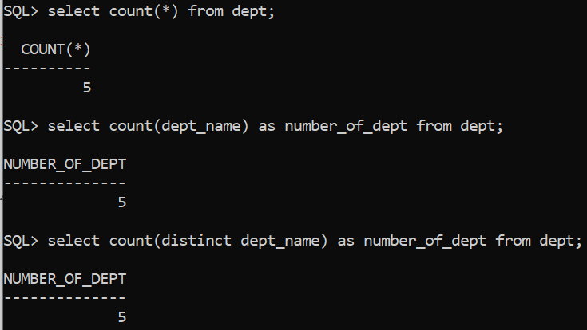
Aggregate Functions Examples

Slide 44
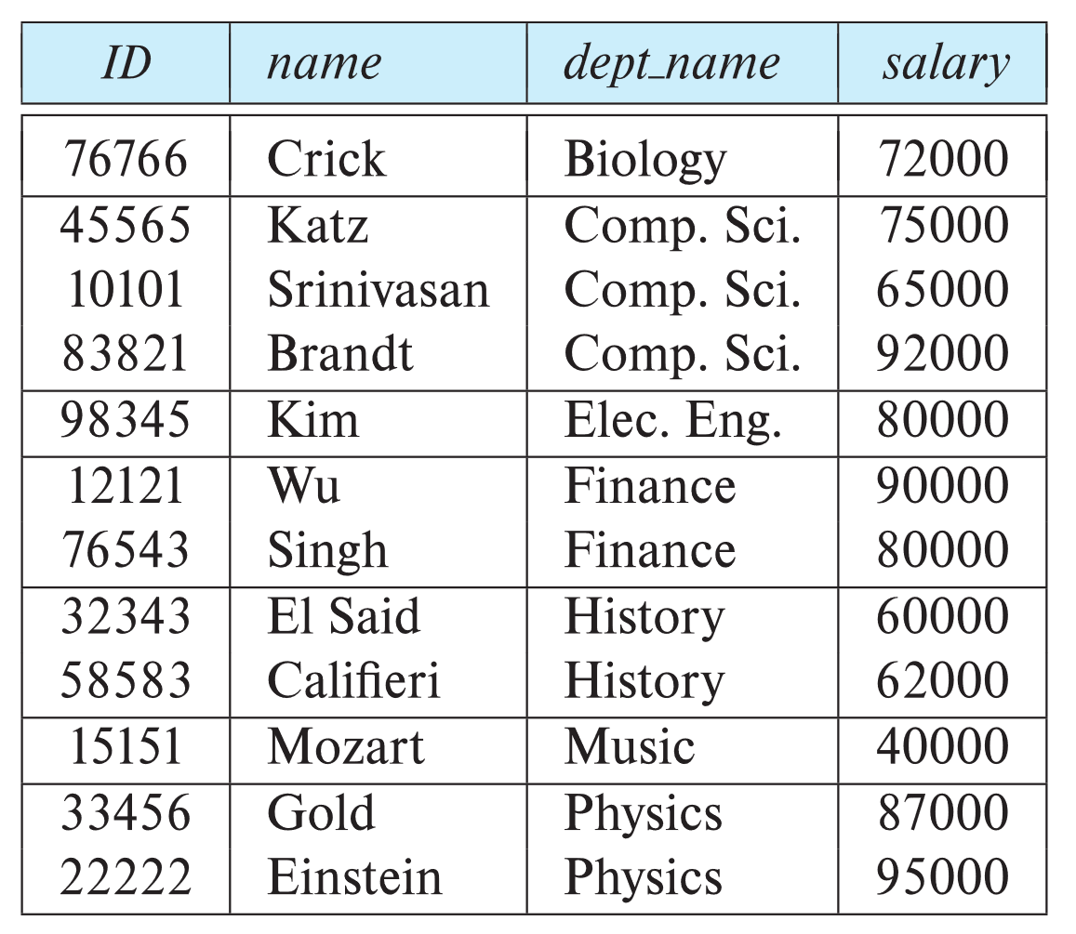
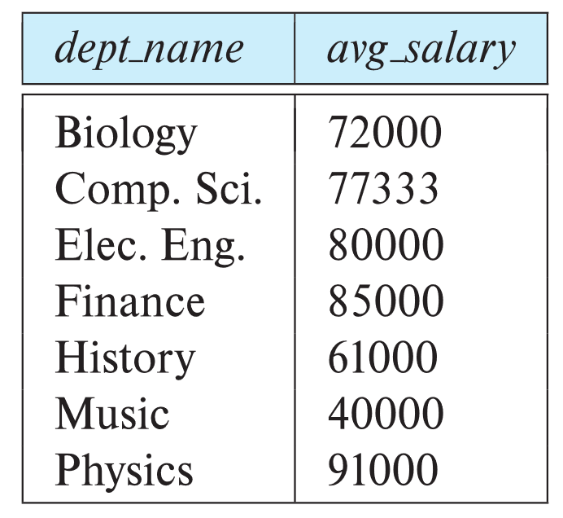
Aggregate Functions – Group By
Find the average salary of instructors in each department
select dept_name, avg (salary) as avg_salary from instructor group by dept_name;

Slide 45
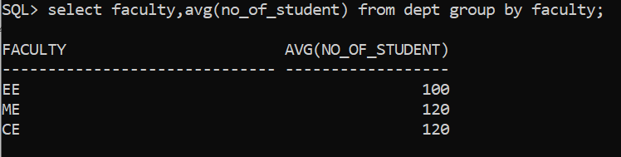
Aggregation (Cont.)

Slide 46
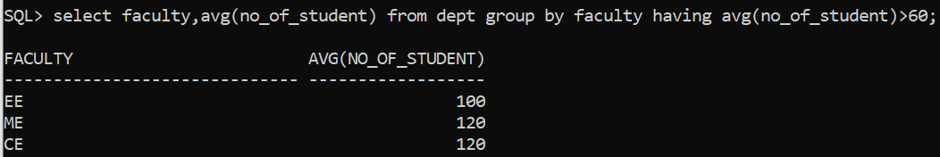
Aggregate Functions – Having Clause
Find the names and average salaries of all departments whose average salary is greater than 42000
Note: predicates in the having clause are applied after the formation of groups whereas predicates in the where clause are applied before forming groups
select dept_name, avg (salary) as avg_salary
from instructor
group by dept_name
having avg (salary) > 42000;

Slide 47
Nested Subqueries
SQL provides a mechanism for the nesting of subqueries. A subquery is a select-from-where expression that is nested within another query.
The nesting can be done in the following SQL query select A₁, A₂, ..., A_{n} from r₁, r₂, ..., r_{m} where P
as follows:
From clause: r_{i} can be replaced by any valid subquery
Where clause: P can be replaced with an expression of the form:
B <operation> (subquery)
B is an attribute and <operation> to be defined later.
Select clause:
A_{i} can be replaced be a subquery that generates a single value.

Slide 48
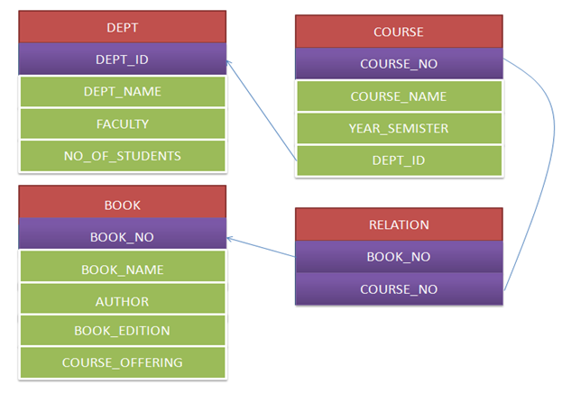
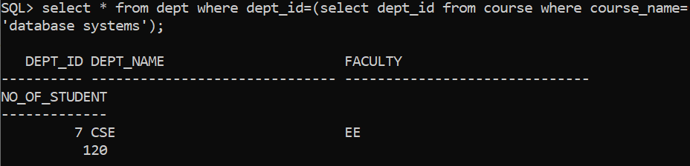

Slide 49
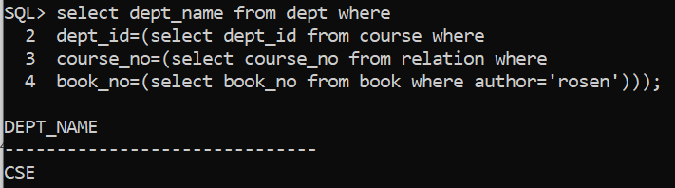
Find the department name where the “rosen”(author) book is taught.

Slide 50
Set Membership

Slide 51
Set Membership
Find courses offered in Fall 2017 and in Spring 2018
Find courses offered in Fall 2017 but not in Spring 2018
select distinct course_id
from section
where semester = 'Fall' and year= 2017 and course_id in (select course_id
from section
where semester = 'Spring' and year= 2018);
select distinct course_id
from section
where semester = 'Fall' and year= 2017 and course_id not in (select course_id
from section
where semester = 'Spring' and year= 2018);

Slide 52
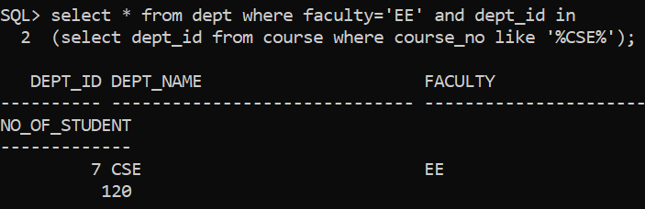

Slide 53
Set Comparison

Slide 54
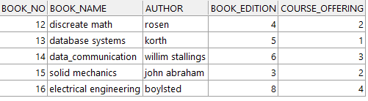
Set Comparison – “some” Clause
Find names of instructors with salary greater than that of some (at least one) instructor in the Biology department.
Same query using > some clause
select distinct T.name
from instructor as T, instructor as S
where T.salary > S.salary and S.dept name = 'Biology';
select name
from instructor
where salary > some (select salary
from instructor
where dept name = 'Biology');
select * from book where book_edition> some(select course_offering from book);

Slide 55
Definition of “some” Clause
F <comp> some r ⇔ ∃ t ∈ r such that (F <comp> t ) Where <comp> can be: <, ≤, >, =, ≠
0
(5 < some
5
) = true
(read: 5 < some tuple in the relation)
6
0
(5 < some
5
) = false
0
(5 = some
) = true
5
0
(5 ≠ some
5
) = true (since 0 ≠ 5)
(= some) ≡ in
However, (≠ some) ≡ not in

Slide 56

Set Comparison – “all” Clause
Find the names of all instructors whose salary is greater than the salary of all instructors in the Biology department.
select * from book where book_edition> all(select course_offering from book);

Slide 57
Definition of “all” Clause
F <comp> all r ⇔ ∀ t ∈ r (F <comp> t)
0
(5 < all
5
) = false
6
6
(5 < all
) = true
10
4
(5 = all
) = false
5
4
(5 ≠ all
) = true (since 5 ≠ 4 and 5 ≠ 6)
6
(≠ all) ≡ not in
However, (= all) ≡ in

Slide 58
Test for Empty Relations
The exists construct returns the value true if the argument subquery is nonempty.
exists r ⇔ r ≠ Ø
not exists r ⇔ r = Ø

Slide 59

Use of “exists” Clause
Yet another way of specifying the query “Find all courses taught in both the Fall 2017 semester and in the Spring 2018 semester”
select course_id from section as S where semester = 'Fall' and year = 2017 and exists (select * from section as T where semester = 'Spring' and year= 2018 and S.course_id = T.course_id);
select * from book where course_offering>=3 and exists (select * from book where book_edition>=5);

Slide 60
Use of “not exists” Clause
Find all students who have taken all courses offered in the Biology department.
Note that X – Y = Ø ⇔ X ⊆ Y
Note: Cannot write this query using = all and its variants
select distinct S.ID, S.name
from student as S
where not exists ( (select course_id
from course
where dept_name = 'Biology')
except
(select T.course_id
from takes as T
where S.ID = T.ID));
First nested query lists all courses offered in Biology
Second nested query lists all courses a particular student took

Slide 61
select * from book where course_offering>=3 and not exists (select * from book where book_edition>8);

Slide 62
Subqueries in the From Clause

Slide 63
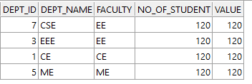
With Clause
The with clause provides a way of defining a temporary relation whose definition is available only to the query in which the with clause occurs.
Find all departments with the maximum budget with max_budget (value) as (select max(budget) from department) select department.name from department, max_budget where department.budget = max_budget.value;
with max_student(value) as (select max(no_of_student) from dept) select * from dept,max_student where dept.no_of_student=max_student.value;

Slide 64
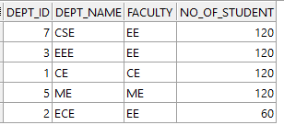
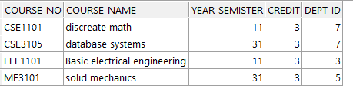
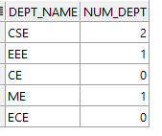
Scalar Subquery
Scalar subquery is one which is used where a single value is expected
List all departments along with the number of instructors in each department
select dept_name, ( select count(*) from instructor where department.dept_name = instructor.dept_name) as num_instructors from department;
Runtime error if subquery returns more than one result tuple
select dept_name ,(select count(*) from course where dept.dept_id=course.dept_id) as num_dept from dept;

Slide 65
Modification of the Database
Deletion of tuples from a given relation.
Insertion of new tuples into a given relation
Updating of values in some tuples in a given relation

Slide 66
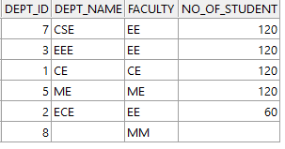
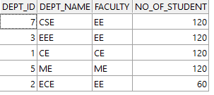
Deletion
Delete all instructors
delete from instructor
Delete all instructors from the Finance department delete from instructor where dept_name= 'Finance’;
delete from dept where dept_id=8;

Slide 67
Deletion (Cont.)
Delete all instructors whose salary is less than the average salary of instructors
Problem: as we delete tuples from instructor, the average salary changes
Solution used in SQL:
First, compute avg (salary) and find all tuples to delete
Next, delete all tuples found above (without recomputing avg or retesting the tuples)
delete from instructor
where salary < (select avg (salary)
from instructor);

Slide 68
Insertion
Add a new tuple to course
insert into course values ('CS-437', 'Database Systems', 'Comp. Sci.', 4);
or equivalently
insert into course (course_id, title, dept_name, credits) values ('CS-437', 'Database Systems', 'Comp. Sci.', 4);
Add a new tuple to student with tot_creds set to null
insert into student values ('3003', 'Green', 'Finance', null);

Slide 69
Insertion (Cont.)
Make each student in the Music department who has earned more than 144 credit hours an instructor in the Music department with a salary of $18,000.
insert into instructor select ID, name, dept_name, 18000 from student where dept_name = 'Music' and total_cred > 144;
The select from where statement is evaluated fully before any of its results are inserted into the relation.
Otherwise queries like
insert into table1 select * from table1
would cause problem

Slide 70
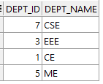
create table dept_120(dept_id number,dept_name varchar(20));
insert into dept_120 select dept_id,dept_name from dept where no_of_student=120;
select * from dept_120;

Slide 71
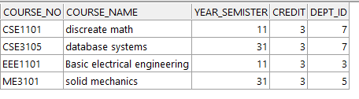
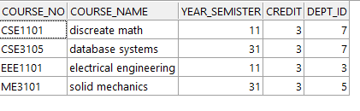
Updates
update course set course_name='electrical engineering' where course_no='EEE1101';

Slide 72
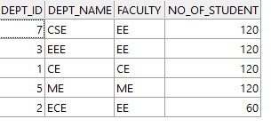
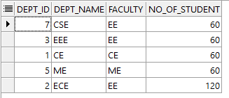
Case Statement for Conditional Updates
Same query as before but with case statement
update dept set no_of_student=case when no_of_student=120 then 60 else 120 end;

Slide 73
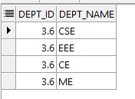
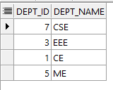
Updates with Scalar Subqueries
Recompute and update tot_creds value for all students
UPDATE DEPT_120 SET DEPT_ID= (SELECT AVG(DEPT_ID) FROM DEPT);

Slide 74
End of Chapter 3

