Slide 1
Chapter 4 : Intermediate SQL

Slide 2
Outline
Join Expressions
Views
Transactions
Integrity Constraints
SQL Data Types and Schemas
Index Definition in SQL
Authorization
Notes:
1

Slide 3
Joined Relations
Join operations take two relations and return as a result another relation.
A join operation is a Cartesian product which requires that tuples in the two relations match (under some condition). It also specifies the attributes that are present in the result of the join
The join operations are typically used as subquery expressions in the from clause
Three types of joins:
Natural join
Inner join
Outer join

Slide 4
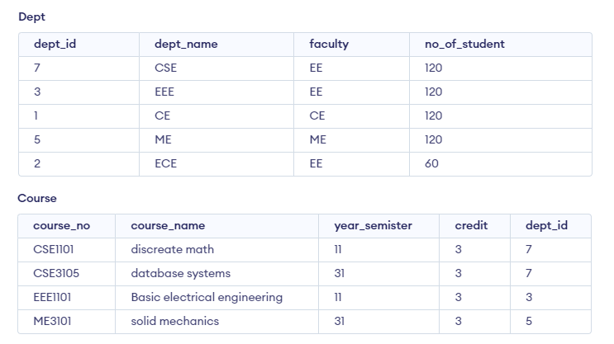
Natural Join in SQL
Natural join matches tuples with the same values for all common attributes, and retains only one copy of each common column.
Natural Join joins two tables based on same attribute name and datatypes.

Slide 5

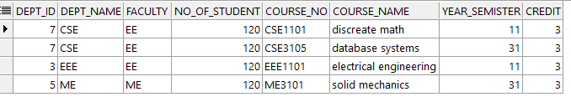
Natural Join in SQL (Cont.)
The from clause can have multiple relations combined using natural join:
select A₁, A₂, … A_{n} from r₁ natural join r₂ natural join .. natural join r_{n} where P ;
select * from dept natural join course where dept_id=7;
select * from dept natural join course;

Slide 6
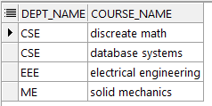
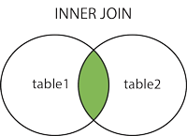
Join Condition
The on condition allows a general predicate over the relations being joined
This predicate is written like a where clause predicate except for the use of the keyword on
select dept_name,course_name from dept join course using(dept_id);
select dept_name,course_name from dept join course on dept.dept_id=course.dept_id;

Slide 7
Join Condition (Cont.)
The on condition allows a general predicate over the relations being joined.
This predicate is written like a where clause predicate except for the use of the keyword on.

Slide 8
Outer Join
An extension of the join operation that avoids loss of information.
Computes the join and then adds tuples form one relation that does not match tuples in the other relation to the result of the join.
Uses null values.
Three forms of outer join:
left outer join
right outer join
full outer join

Slide 9
Outer Join Examples

Slide 10
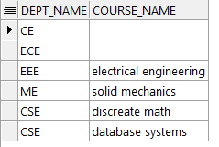
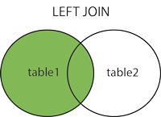
Left Outer Join
dept left outer join course
In relational algebra: dept ⟕ course
select dept_name,course_name from dept left outer join course using(dept_id);

Slide 11
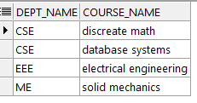
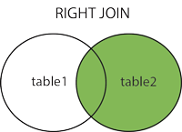
Right Outer Join
dept right outer join course
In relational algebra: dept ⟖ course
select dept_name,course_name from dept right outer join course using(dept_id);

Slide 12
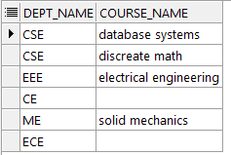
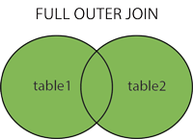
Full Outer Join
dept full outer join course
In relational algebra: dept ⟗ course
select dept_name,course_name from dept full outer join course using(dept_id);

Slide 13
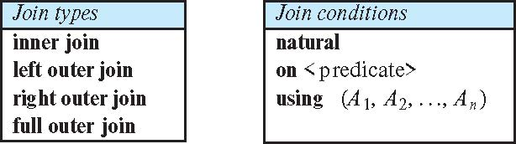
Joined Types and Conditions
Join operations take two relations and return as a result another relation.
These additional operations are typically used as subquery expressions in the from clause
Join condition – defines which tuples in the two relations match.
Join type – defines how tuples in each relation that do not match any tuple in the other relation (based on the join condition) are treated.
select dept_name,course_name from dept join course on dept.dept_id=course.dept_id;
select dept_name,course_name from dept join course using(dept_id);

Slide 14
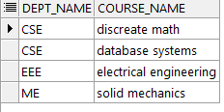
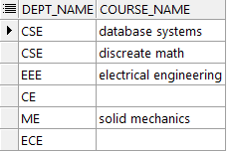
Joined Relations – Examples
dept right outer join course using (course_id)
dept full outer join course using (course_id)

Slide 15
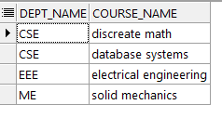
inner join and join are the same
select dept_name,course_name from dept inner join course on dept.dept_id=course.dept_id;
select dept_name,course_name from dept join course on dept.dept_id=course.dept_id;

Slide 16
Views
In some cases, it is not desirable for all users to see the entire logical model (that is, all the actual relations stored in the database.)
Consider a person who needs to know an dept_name name and faculty, but not the no_of_student. This person should see a relation described, in SQL, by select dept_name,faculty from dept
A view provides a mechanism to hide certain data from the view of certain users.
Any relation that is not of the conceptual model but is made visible to a user as a “virtual relation” is called a view.

Slide 17
View Definition
A view is defined using the create view statement which has the form
create view v as < query expression >
where <query expression> is any legal SQL expression. The view name is represented by v.
Once a view is defined, the view name can be used to refer to the virtual relation that the view generates.
View definition is not the same as creating a new relation by evaluating the query expression
Rather, a view definition causes the saving of an expression; the expression is substituted into queries using the view.

Slide 18
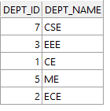

View Definition and Use
A view of dept without their faculty,no_of_student
create view dept_details as select dept_id,dept_name from dept;
Find all course in the CSE department
create view CSE_DEPT_COURSE as select course_name from course where dept_id=(select dept_id from dept where dept_name='CSE');

Slide 19
Views Defined Using Other Views
One view may be used in the expression defining another view
A view relation v₁ is said to depend directly on a view relation v₂ if v₂ is used in the expression defining v₁
A view relation v₁ is said to depend on view relation v₂ if either v₁ depends directly to v₂ or there is a path of dependencies from v₁ to v₂
A view relation v is said to be recursive if it depends on itself.

Slide 20
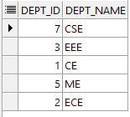
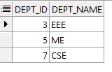
Views Defined Using Other Views
create view dept_details as select dept_id,dept_name from dept;
create view custom as select * from dept_details where dept_id>=3;

Slide 21
Update of a View
Add a new tuple to faculty view which we defined earlier
insert into dept_details values(10,'BME’);
This insertion must be represented by the insertion into the dept relation
Must have a value for no_of_student,faculty
Two approaches
Reject the insert
Insert the tuple
(10,'BME’,NULL,NULL)
into the dept relation
Because of problems such as these, modifications are generally not permitted on view relations, except in limited cases.

Slide 22
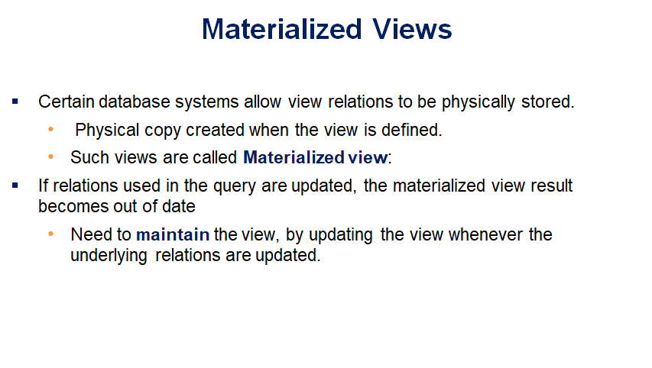
For example, consider the view departments total salary. If that view is materialized, its results would be stored in the database, allowing queries that use the view to potentially run much faster by using the precomputed view result, instead of recomputing it
The process of keeping the materialized view up-to-date is called materialized view maintenance

Slide 23
View Updates in SQL
An SQL view is said to be updatable (i.e., inserts, updates, or deletes can be applied on the view) if the following conditions are all satisfied by the query defining the view
The from clause has only one database relation.
The select clause contains only attribute names of the relation, and does not have any expressions, aggregates, or distinct specification.
Any attribute not listed in the select clause can be set to null; that is, it does not have a not null constraint and is not part of a primary key.
The query does not have a group by or having clause.
update dept_details set dept_name='EEE2' where dept_id=3;

Slide 24
Transactions
A transaction consists of a sequence of query and/or update statements and is a “unit” of work
The SQL standard specifies that a transaction begins implicitly when an SQL statement is executed.
The transaction must end with one of the following statements:
Commit work. The updates performed by the transaction become permanent in the database.
Rollback work. All the updates performed by the SQL statements in the transaction are undone. Once a transaction has executed commit work, its effects can no longer be undone by rollback work.
Atomic transaction
either fully executed or rolled back as if it never occurred
Isolation from concurrent transactions
Enclosed between the keywords begin atomic … end.
All the statements between the keywords then form a single transaction, which is committed by default if execution reaches the end statement.
If you use a database such as Oracle, where the automatic commit is not the default for DML statements, be sure to issue a commit command after adding or modifying data

Slide 25
Integrity Constraints
Integrity constraints guard against accidental damage to the database, by ensuring that authorized changes to the database do not result in a loss of data consistency.
dept_id can not be null.
dept_id in course table must exist in dept table
A book must have a (non-null) book_no.

Slide 26
Constraints on a Single Relation
not null
primary key
unique
check (P), where P is a predicate

Slide 27
Not Null Constraints
not null
Declare name and budget to be not null
name varchar(20) not null budget number(12,2) not null

Slide 28
Unique Constraints
unique ( A₁, A₂, …, A_{m})
The unique specification states that the attributes A₁, A₂, …, A_{m} form a candidate key.
no two tuples in the relation can be equal on all the listed attributes.
Candidate keys are permitted to be null (in contrast to primary keys).

Slide 29
The check clause
The check (P) clause specifies a predicate P that must be satisfied by every tuple in a relation.
Example: ensure that semester is one of fall, winter, spring or summer
create table section
(course_id varchar (8),
sec_id varchar (8),
semester varchar (6),
year numeric (4,0),
building varchar (15),
room_number varchar (7),
time slot id varchar (4),
primary key (course_id, sec_id, semester, year),
check (semester in ('Fall', 'Winter', 'Spring', 'Summer')))

Slide 30
Referential Integrity
Ensures that a value that appears in one relation for a given set of attributes also appears for a certain set of attributes in another relation.
Example: If “Biology” is a department name appearing in one of the tuples in the instructor relation, then there exists a tuple in the department relation for “Biology”.
Let A be a set of attributes. Let R and S be two relations that contain attributes A and where A is the primary key of S. A is said to be a foreign key of R if for any values of A appearing in R these values also appear in S.

Slide 31
Referential Integrity (Cont.)
Foreign keys can be specified as part of the SQL create table statement
foreign key (dept_name) references department
By default, a foreign key references the primary-key attributes of the referenced table.
SQL allows a list of attributes of the referenced relation to be specified explicitly.
foreign key (dept_name) references department (dept_name)
The specified list of attributes must, however, be declared as a superkey of the referenced relation, using either a primary key constraint or a unique constraint.

Slide 32
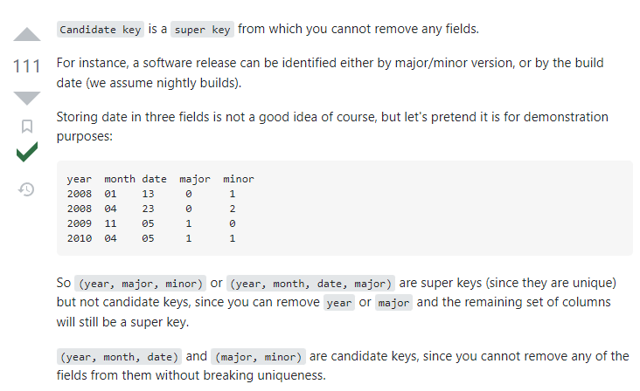

Slide 33
Cascading Actions in Referential Integrity
When a referential-integrity constraint is violated, the normal procedure is to reject the action that caused the violation.
A foreign key clause can specify that if a delete or update action on the referenced relation violates the constraint, then, instead of rejecting the action, the system must take steps to change the tuple in the referencing relation to restore the constraint.
An alternative, in case of delete or update is to cascade
create table course ( (… dept_name varchar(20), foreign key (dept_name) references department on delete cascade on update cascade, . . .)
Instead of cascade we can use :
set null,
set default

Slide 34
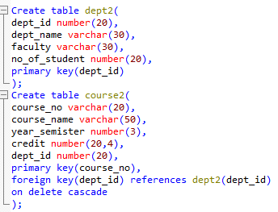
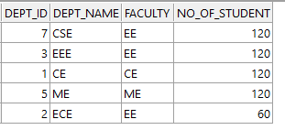
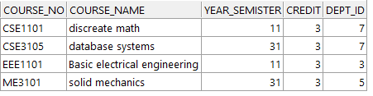

Slide 35
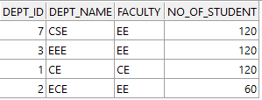

delete from dept2 where dept_id=5;

Slide 36
Integrity Constraint Violation During Transactions
Consider:
create table person ( ID char(10), name char(40), mother char(10), father char(10), primary key ID, foreign key father references person, foreign key mother references person)
How to insert a tuple without causing constraint violation?
Insert father and mother of a person before inserting person
OR, set father and mother to null initially, update after inserting all persons (not possible if father and mother attributes declared to be not null)
OR defer constraint checking

Slide 37
Complex Check Conditions
The predicate in the check clause can be an arbitrary predicate that can include a subquery.
check (time_slot_id in (select time_slot_id from time_slot))
The check condition states that the time_slot_id in each tuple in the section relation is actually the identifier of a time slot in the time_slot relation.
The condition has to be checked not only when a tuple is inserted or modified in section , but also when the relation time_slot changes

Slide 38
Assertions
An assertion is a predicate expressing a condition that we wish the database always to satisfy.
The following constraints, can be expressed using assertions:
For each tuple in the student relation, the value of the attribute tot_cred must equal the sum of credits of courses that the student has completed successfully.
An instructor cannot teach in two different classrooms in a semester in the same time slot
An assertion in SQL takes the form:
create assertion <assertion-name> check (<predicate>);

Slide 39
CREATE TABLE orders (
order_id INT PRIMARY KEY,
customer_id INT,
order_date DATE,
total_amount DECIMAL(10, 2)
);
CREATE ASSERTION check_total_amount
CHECK (
NOT EXISTS (
SELECT 1 FROM orders WHERE total_amount <= 0
)
);

Slide 40
In this example, we have a table called orders with columns for order_id, customer_id, order_date, and total_amount. We've defined an assertion called check_total_amount that ensures that the total_amount column is always greater than zero.
The CHECK clause of the assertion contains a subquery that checks for the existence of any rows in the orders table where the total_amount column is less than or equal to zero. If any such rows are found, the assertion will fail and an error will be raised.
Once the assertion has been created, any attempt to insert or update data in the orders table that violates the assertion will fail and raise an error.

Slide 41
Built-in Data Types in SQL
date: Dates, containing a (4 digit) year, month and date
Example: date '2005-7-27'
time: Time of day, in hours, minutes and seconds.
Example: time '09:00:30' time '09:00:30.75'
timestamp: date plus time of day
Example: timestamp '2005-7-27 09:00:30.75'
interval: period of time
Example: interval '1' day
Subtracting a date/time/timestamp value from another gives an interval value
Interval values can be added to date/time/timestamp values

Slide 42
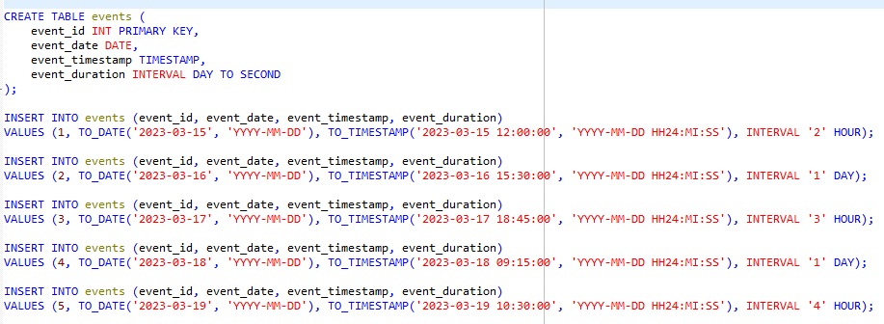

Slide 43
Large-Object Types
Large objects (photos, videos, CAD files, etc.) are stored as a large object:
blob: binary large object -- object is a large collection of uninterpreted binary data (whose interpretation is left to an application outside of the database system)
clob: character large object -- object is a large collection of character data
When a query returns a large object, a pointer is returned rather than the large object itself.

Slide 44
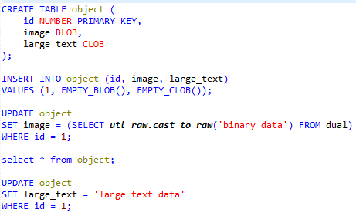

Slide 45
In this example, we create a table called my_table with three columns: id (a primary key column), image (a BLOB column), and text (a CLOB column).
We then insert a row into my_table with an ID of 1 and empty BLOB and CLOB values using the EMPTY_BLOB() and EMPTY_CLOB() functions, respectively.
We then update the image column with some binary data using the utl_raw.cast_to_raw function to convert a string to raw binary data, and the text column with some large text data using a simple string value.
Note that the utl_raw.cast_to_raw function is used to convert the string 'binary data' to raw binary data because the image column is of type BLOB. If you were inserting text data into a BLOB column, you would need to use a different method to convert the text to binary data.
Also note that there are other methods for inserting data into BLOB and CLOB columns, such as the EMPTY_BLOB() and EMPTY_CLOB() functions that we used to insert the empty values. These functions can be useful if you want to insert a row with a default value for a BLOB or CLOB column.

Slide 46
What is ‘DUAL’?
In Oracle, DUAL is a special one-row, one-column table that is often used in SQL statements where no table needs to be specified. It can be used to generate constant values or to execute functions that return a single value.
SELECT 'Hello, World!' FROM DUAL;
SELECT SYSDATE FROM DUAL;
In both cases, the result will be a single row with the specified value or function result.
DUAL is included with every Oracle database and is automatically created when the database is created. It can be accessed by any user with the necessary privileges, and is usually located in the SYS schema.

Slide 47
User-Defined Types
create type construct in SQL creates user-defined type
CREATE TYPE Dollars AS OBJECT (value integer );
Example:
create table department (dept_name varchar (20), building varchar (15), budget Dollars);

Slide 48
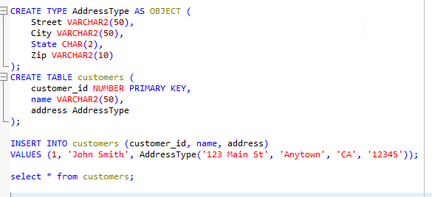

Slide 49
Index Creation
Many queries reference only a small proportion of the records in a table.
It is inefficient for the system to read every record to find a record with particular value
An index on an attribute of a relation is a data structure that allows the database system to find those tuples in the relation that have a specified value for that attribute efficiently, without scanning through all the tuples of the relation.
We create an index with the create index command
create index <name> on <relation-name> (attribute);

Slide 50
Index Creation Example
create table student (ID varchar (5), name varchar (20) not null, dept_name varchar (20), tot_cred numeric (3,0) default 0, primary key (ID))
create index studentID_index on student(ID)
The query:
select * from student where ID = '12345'
can be executed by using the index to find the required record, without looking at all records of student
Note that creating an index can improve query performance for certain types of queries, but it can also have drawbacks. Indexes take up space on disk and require additional processing time to maintain as data is inserted, updated, and deleted from the table. Therefore, it's important to carefully consider which columns to index and when to create indexes, based on the specific requirements of your application

Slide 51
Authorization
We may assign a user several forms of authorizations on parts of the database.
Read - allows reading, but not modification of data.
Insert - allows insertion of new data, but not modification of existing data.
Update - allows modification, but not deletion of data.
Delete - allows deletion of data.
Each of these types of authorizations is called a privilege. We may authorize the user all, none, or a combination of these types of privileges on specified parts of a database, such as a relation or a view.

Slide 52
Authorization (Cont.)
Forms of authorization to modify the database schema
Index - allows creation and deletion of indices.
Resources - allows creation of new relations.
Alteration - allows addition or deletion of attributes in a relation.
Drop - allows deletion of relations.

Slide 53
Authorization Specification in SQL
The grant statement is used to confer authorization
grant <privilege list> on <relation or view > to <user list>
<user list> is:
a user-id
public, which allows all valid users the privilege granted
A role (more on this later)
Example:
grant select on department to Amit, Satoshi
Granting a privilege on a view does not imply granting any privileges on the underlying relations.
The grantor of the privilege must already hold the privilege on the specified item (or be the database administrator).

Slide 54
Privileges in SQL
select: allows read access to relation, or the ability to query using the view
Example: grant users U₁, U₂, and U₃ select authorization on the instructor relation:
grant select on instructor to U₁, U₂, U₃
grant [privileges] on [table_name] to [user]
insert: the ability to insert tuples
update: the ability to update using the SQL update statement
delete: the ability to delete tuples.
all privileges: used as a short form for all the allowable privileges

Slide 55
Revoking Authorization in SQL
The revoke statement is used to revoke authorization.
revoke <privilege list> on <relation or view> from <user list>
Example:
revoke select on student from U₁, U₂, U₃
<privilege-list> may be all to revoke all privileges the revoke may hold.
If <revokee-list> includes public, all users lose the privilege except those granted it explicitly.
If the same privilege was granted twice to the same user by different grantees, the user may retain the privilege after the revocation.
All privileges that depend on the privilege being revoked are also revoked.

Slide 56
Roles
A role is a way to distinguish among various users as far as what these users can access/update in the database.
To create a role we use:
create a role <name>
Example:
create role instructor
Once a role is created we can assign “users” to the role using:
grant <role> to <users>

Slide 57
Roles Example
CREATE ROLE statement. Here's an example:
CREATE ROLE my_role;
This statement creates a new role named "my_role" in the database. By default, the role has no privileges assigned to it. You can then grant privileges to the role using the GRANT statement. For example:
GRANT SELECT, INSERT, UPDATE ON my_table TO my_role;
This statement grants the SELECT, INSERT, and UPDATE privileges on the "my_table" table to the "my_role" role. You can also grant system privileges, such as CREATE SESSION or CREATE TABLE, to the role using the same syntax.
Once the role has been created and granted privileges, you can assign the role to users using the GRANT statement. For example:
GRANT my_role TO my_user;

Slide 58
Authorization on Views
create view geo_instructor as (select * from instructor where dept_name = 'Geology’);
grant [privileges] on [table_name] to [user]
grant select on geo_instructor to geo_staff
Suppose that a geo_staff member issues
select * from geo_instructor;
What if
geo_staff does not have permissions on instructor?
Creator of view did not have some permissions on instructor?

Slide 59
Other Authorization Features
references privilege to create foreign key
grant reference (dept_name) on department to Mariano;
"grant reference (dept_name) on department to Mariano" is granting the REFERENCES privilege on the "dept_name" column in the "department" table to the user "Mariano". This would allow Mariano to create a foreign key constraint on another table that references the "dept_name" column in the "department" table.
Why is this required?
transfer of privileges
grant select on department to Amit with grant option;
The "with grant option" clause in the "grant select on department to Amit with grant option" statement allows the user "Amit" to transfer the SELECT privilege on the "department" table to other users. This means that Amit can grant the SELECT privilege to other users without requiring direct access to the "department" table. This can be useful for managing complex access control scenarios.

Slide 60
revoke select on department from Amit, Satoshi cascade;
The "revoke select on department from Amit, Satoshi cascade" statement revokes the SELECT privilege on the "department" table from the users "Amit" and "Satoshi", as well as any other users who were granted the privilege by "Amit" or "Satoshi". The "cascade" option ensures that any privileges granted by "Amit" or "Satoshi" on the "department" table are also revoked.
revoke select on department from Amit, Satoshi restrict;
The "revoke select on department from Amit, Satoshi restrict" statement revokes the SELECT privilege on the "department" table from the users "Amit" and "Satoshi". The "restrict" option ensures that if any objects (such as views or stored procedures) depend on the SELECT privilege being revoked, the revoke operation will fail. This option is useful when you want to ensure that dependent objects are not accidentally broken by revoking a privilege.
There are many other SQL privileges and options available for managing database access and security, and their usage will depend on the specific needs of the database and its users.

Slide 61
End of Chapter 4

