Slide 1
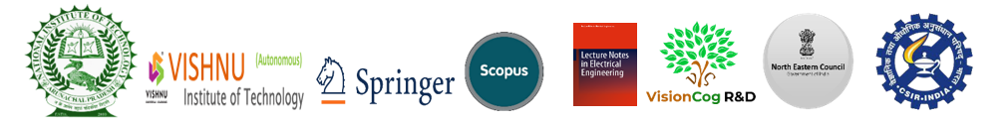
Recognize Meaningful Words and Idioms from the Images Based on OCR Tesseract Engine and NLTK
Presented by
Md. Rakib Mia
Comilla University, Cumilla - 3506, Bangladesh
Partha Chakraborty^{1*,} Md. Rakib Mia¹, Humayun Kabir Sumon¹, Aditi Sarker¹, Al Imtiaz², Md. Mahbubur Rahman³, Mohammad Abu Yousuf⁴, and Tanupriya Choudhury⁵
] Department of Computer Science & Engineering, Comilla University, Cumilla - 3506, Bangladesh
^{[2]}Department of CSE, University of Information Technology and Sciences, Bangladesh
^{[3]} Software Engineer, Crowdrealty, Tokyo, Japan
^{[4]} Institute of Information Technology, Jahangirnagar University, Savar, Dhaka-1342,Bangladesh
^{[5]} Department of Informatics, School of Computer Science, UPES, Dehradun, India
Session Name (Date, Time, and Hall):
Speech and Text Analytics-I (Sept 23, 2021, 15:00-17:00, Hall 3)
Session ID: 3
Paper ID : 129

Slide 2
Presentation Outline
Introduction
Motivation
Objectives
Methodology
Experimental Results
Conclusion and Future Work

Slide 3
Introduction
One of the most common applications of Image Processing is Optical Character Recognition (OCR).
By extracting text data, OCR systems typically convert non-editable, non-searchable documents into editable, searchable files.

Slide 4
Motivation
This proposal's goal is to make document handling and finding for users by allowing them to query through pictures or non-text content.
This project creates an OCR technology that allows users to search for sheet-based information very quickly instead of for hours.
It cuts time-consuming data input by mechanically retrieving info from paper and placing it as it is needed.
This project is helpful for Bangla speakers and writers since it displays the meaning of a word in Bangla from OCR-extracted texts.

Slide 5
Objectives
Capture words, text or sentences from the input image and convert them into human readable, editable text and sentences.
It will also provide the Bangla meaning of the output text/sentence.
It will also Identify Phrases with Bangla Meaning.

Slide 6
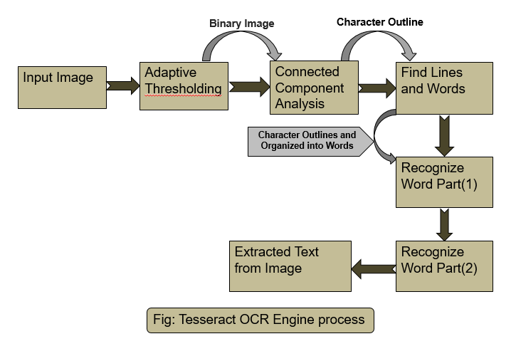
OCR
Fig: CNN Architecture

Slide 7
Why OCR?
Tesseract is an OCR engine with support for unicode and the ability to recognize more than 100 languages out of the box. It can be trained to recognize other languages.
Tesseract is considered the best open source OCR engine. The Tesseract OCR accuracy is fairly high out of the box and can be increased significantly with a well designed Tesseract image preprocessing pipeline.
Besides it is easy access, time saver, data usability and conversion, cost effective, improve productivity, speed and accuracy and finally data utility.
7

Slide 8
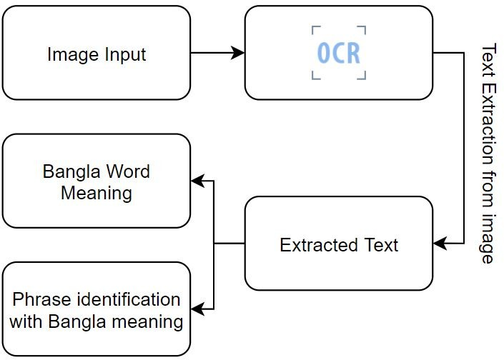
Methodology
Fig: Workflow of Recognize Meaningful Words and Idioms using OCR

Slide 9
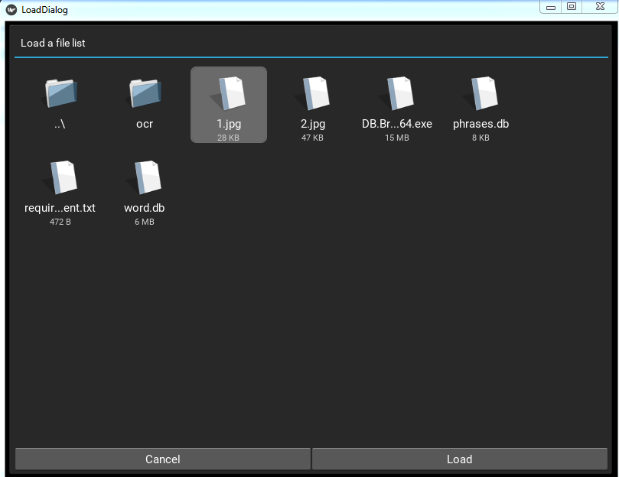
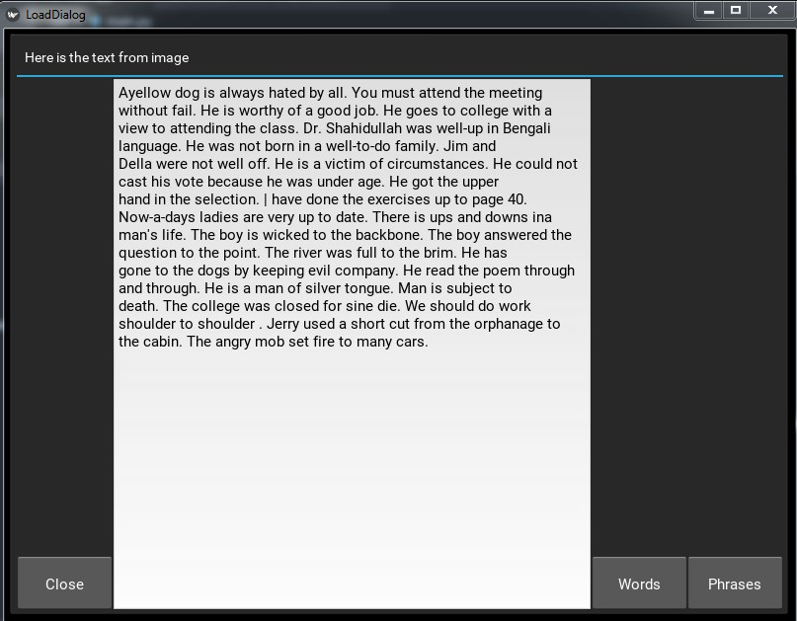
Experimental Result
(a)Input image file Insertation
(b) Extracted Text Format from Image File.
Fig: Primary output of our research

Slide 10
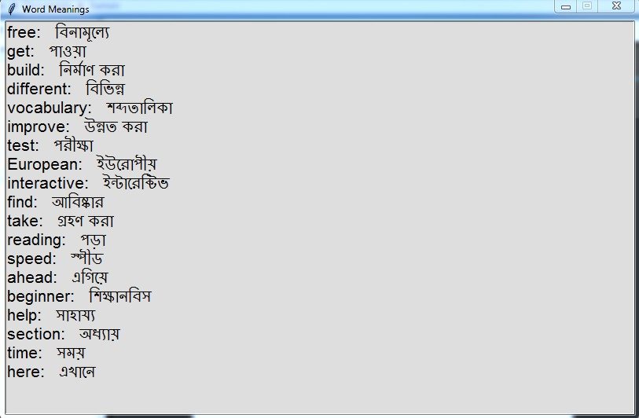
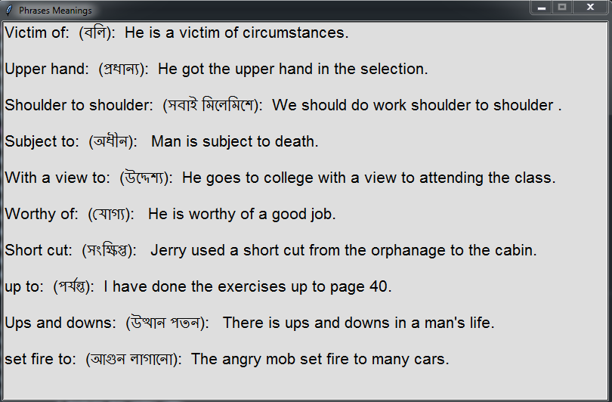
Experimental Result (Cont.)
(a) Extracted text shows Bangla Meaning
(b) Phrases Identification and Bangla Meaning.
Fig: Primary output of our research

Slide 11
Result Analysis
Font Name | Accuracy(Size 12) | Size | Accuracy
Times | 39% | 14 | 77%
Courier New | 64% | 13 | 69%
Arial | 60% | 12 | 60%
Consolas | 62% | 11 | 52%
'Courier New' had a maximum efficiency of 64 percent and 'Times' font had the lowest accuracy, at 39%.With a larger font size, such as 14pt, the OCR engine achieved the highest level of correctness, whereas with a smaller font size, such as 11pt, it achieved the lowest level of accuracy

Slide 12
Conclusion :
This research introduces a model which is a useful technique for extracting data from photos and also from scanned documents that aren't editable or searchable.
Limitation:
Our Proposed model only work with photos.
Future Work:
For Bengali character recognition, we will develop our own Tesseract engine in the upcoming months.
We also aim to find the result from a running video.
We will be able to add many more languages to translate into.

Slide 13
Reference
Arshad, H., Abidin, R.Z., Obeidy, W.K.: Identification of vehicle plate number using optical character recognition: A mobile application. Pertanika Journal of Science and Technology 25, 173–180 (2017)
Baek, Y., Lee, B., Han, D., Yun, S., Lee, H.: Character region awareness for text detec- tion. 2019 IEEE/CVF Conference on Computer Vision and Pattern Recognition (CVPR) pp. 9357–9366 (2019)
Blesser, B., Kuklinski, T., Shillman, R.: Empirical tests for feature selection based on a psy- chological theory of character recognition. Pattern Recognit. 8, 77–85 (1976)
Carter, R., Meggs, P.B., Day, B.: Typographic design: Form and communication. John Wiley and Sons (2011)
Dhiman, S., Singh, A.: Tesseract vs gocr a comparative study. International Journal of Recent Technology and Engineering 2 (2013)
Khormi, A., Alahmadi, M., Haiduc, S.: A study on the accuracy of ocr engines for source code transcription from programming screencasts p. 65–75 (2020)
Kumar, M., Jindal, M., Sharma, R.: Segmentation of isolated and touching characters in offline handwritten gurmukhi script recognition. International Journal of Information Tech- nology and Computer Science 6, 58–63 (2014)
Kumar, R., Singh, A.: Algorithm to detect and segment gurmukhi handwritten text into lines, words and characters. International Journal of Engineering and Technology (2011)

Slide 14
Reference (Cont.)
Pozo, Albert Parra, et al. "A method for translating printed documents using a hand-held device." 2011 IEEE International Conference on Multimedia and Expo. IEEE, 2011.
Pramanik, R., Bag, S.: Shape decomposition-based handwritten compound character recog- nition for bangla ocr. J. Vis. Commun. Image Represent. 50, 123–134 (2018)
Rice, S., Jenkins, F., Nartker, T.: The fourth annual test of ocr accuracy. Information Science Research Institute (2012)
Shi, B., Bai, X., Yao, C.: An end-to-end trainable neural network for image-based sequence recognition and its application to scene text recognition. IEEE Transactions on Pattern Anal- ysis and Machine Intelligence 39, 2298–2304 (2017)
Shillman, R.: Character recognition based on phenomenological attributes: Theory and meth- ods (1974)
Smith, R.: An overview of the tesseract ocr engine. Ninth International Conference on Doc- ument Analysis and Recognition (ICDAR 2007) 2, 629–633 (2007)
Smith, R.: The extraction and recognition of text from multimedia document images (1987) 16.Smith, R.: A simple and efficient skew detection algorithm via text row accumulation. Proc. of the 3rd Int. Conf. on Document Analysis and Recognition (1995)
Thakkar, A., Shah, V.: Review on tesseract ocr engine and performance. International Journal of Innovative and Emerging Research in Engineering 4 (2017)
Smith, Ray, Daria Antonova, and Dar-Shyang Lee. "Adapting the Tesseract open source OCR engine for multilingual OCR." Proceedings of the International Workshop on Multilingual OCR. 2009.
Badla, Sahil. "Improving the efficiency of Tesseract OCR Engine." (2014).

Slide 15
Thank You

