Slide 2
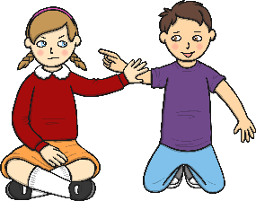
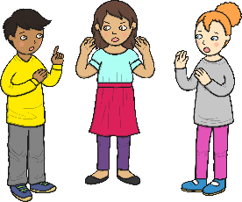
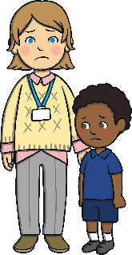
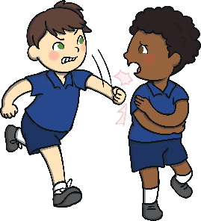
Appropriate Ways to Touch People
Sometimes at school I might touch my teachers or other children.
They might not like it.
This can make my friends and teachers sad.
What do you think might be an inappropriate touch?

Slide 3
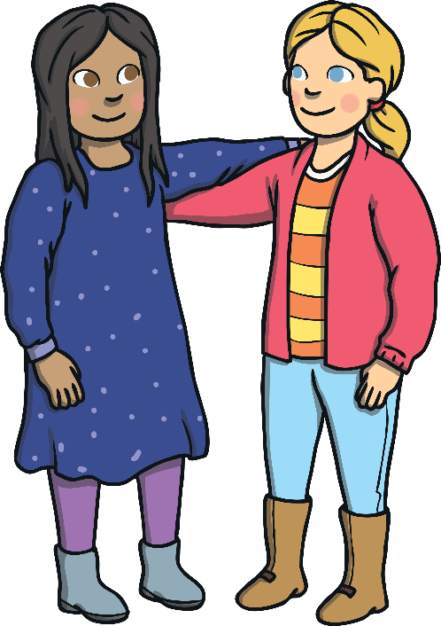

What Should I Do?
Think about the appropriate ways
to touch other people.
Touch my friend
or the teacher
whatever way I want to.

Slide 4
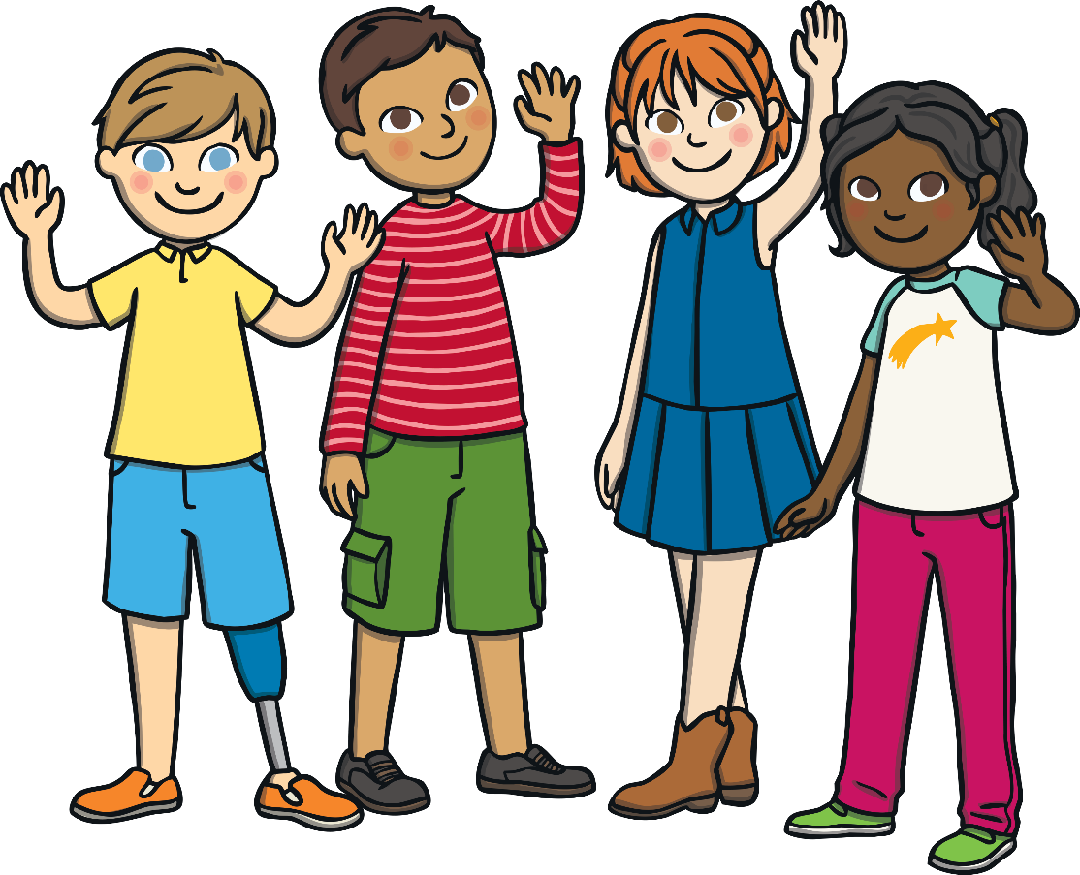
Well Done! Great Choice!
I can think about what is the most appropriate way to touch someone.
I can:
tap someone gently on the shoulder
and say, “Excuse me”;
shake hands with people
and say, “Hello”;
give a high five when I
am happy about something.

Slide 5

Hmmm... Let’s Think About What Happens If I Touch Other People When They Do Not Want to Be Touched
If I touch other people when they do not
want to be touched, I can annoy and
upset them.
This might make my teachers or
friends feel sad.
I might get in trouble.
How would you feel if your friend
touched you and you did not like it?

Slide 6

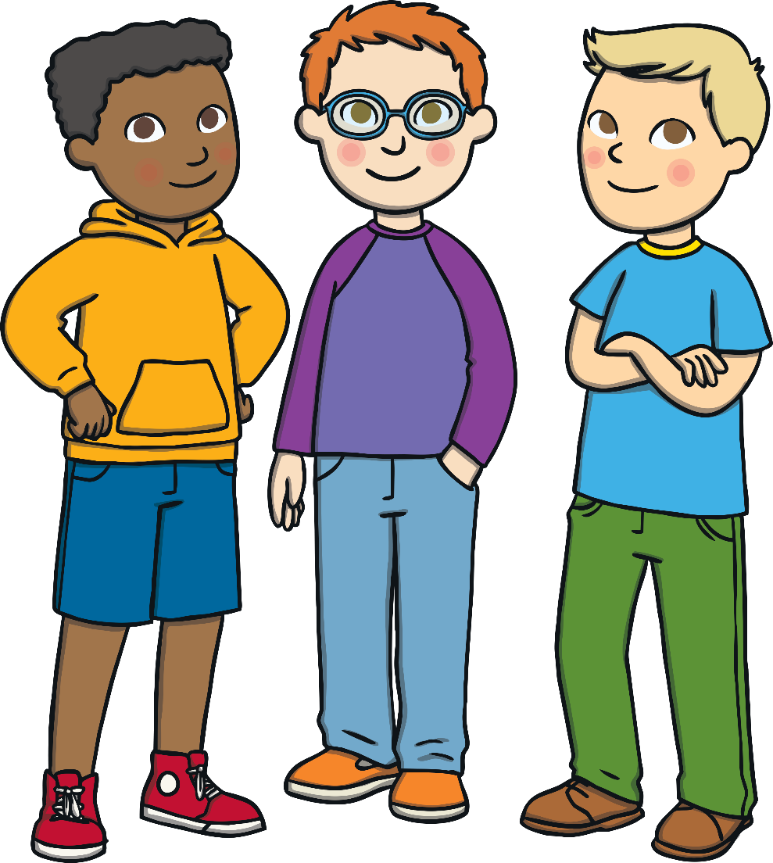
Appropriate Ways to Touch People
I will think about whether I need to touch the other
person or not.
I will try to remember to keep my hands to myself.
I can learn about the appropriate
ways to touch other people.
My teacher will help me with this.
My friends will feel happy and
we can all play together.

