Slide 1




04 February 2026
Econet AI Website Monthly Report Analysis

Slide 2


04 February 2026
This report aims to analyze the website's performance for February 2026, focusing on traffic, user flow, traffic sources, demographics, behaviors, and security.
What Is The Purpose Of This Report?
Key metrics
Traffic overview
Audience demographics
Behavior analysis
Acquisition channels
Conversion tracking
Areas Of Focus:

Slide 3

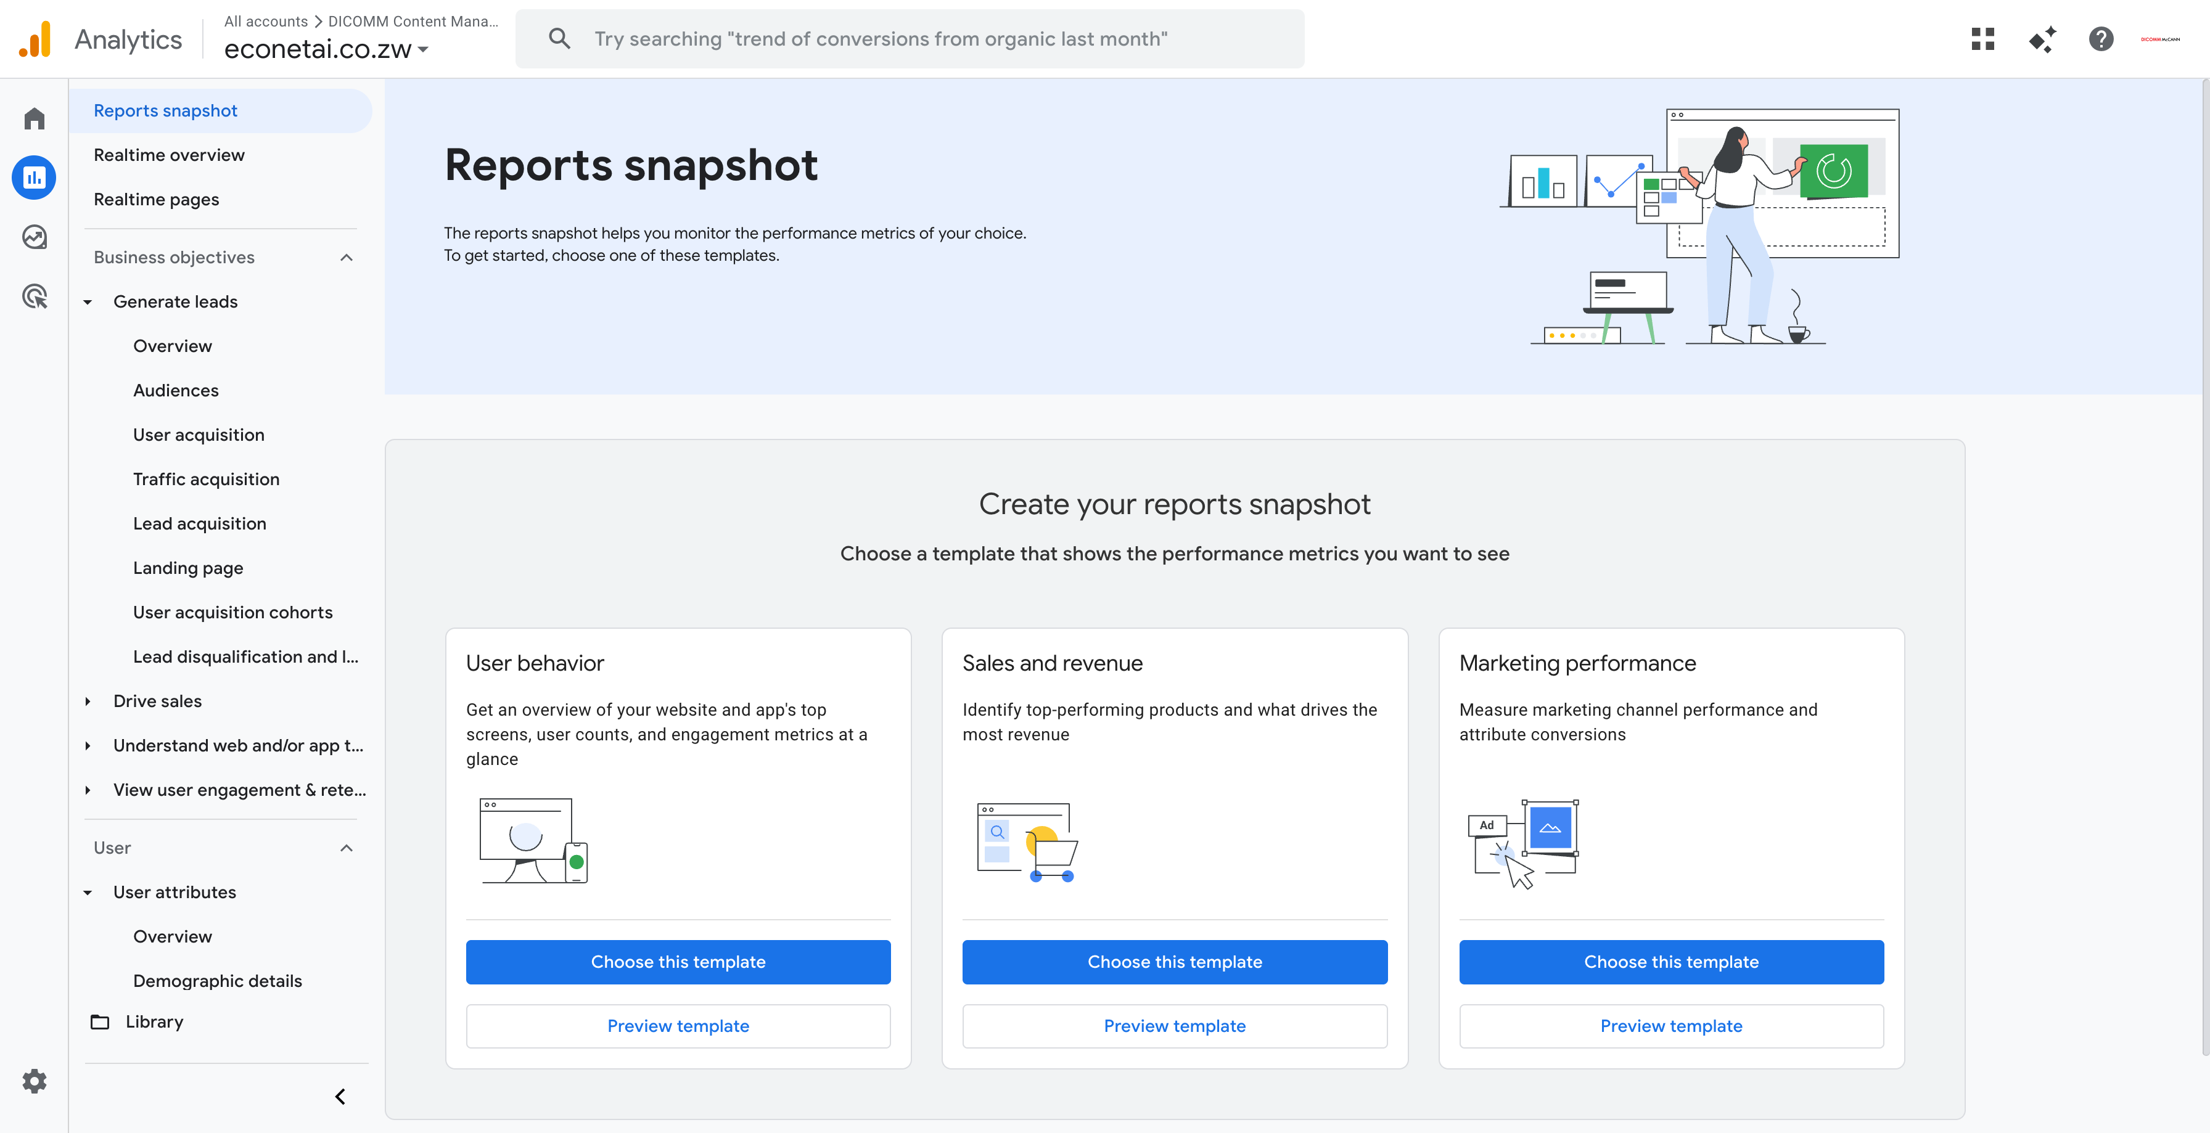
Summary
Performance of the website based on data insights
During the past month, the Econet AI Website recorded a total of 78 active users. Of this total, 76 were new users, complemented by 20 returning users who made multiple visits to the site. The primary acquisition channel was organic search, accounting for 57 users, with direct search contributing a smaller segment of 18 users. Geographically, Zimbabwe generated the highest volume of traffic, totaling 55 users. The average session duration for user engagement was 1m 14s.

Slide 4
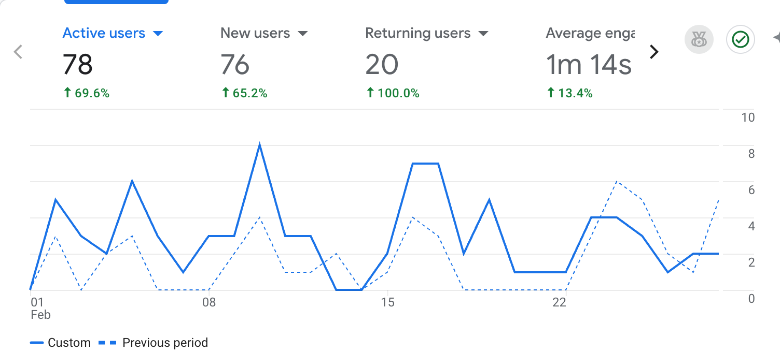
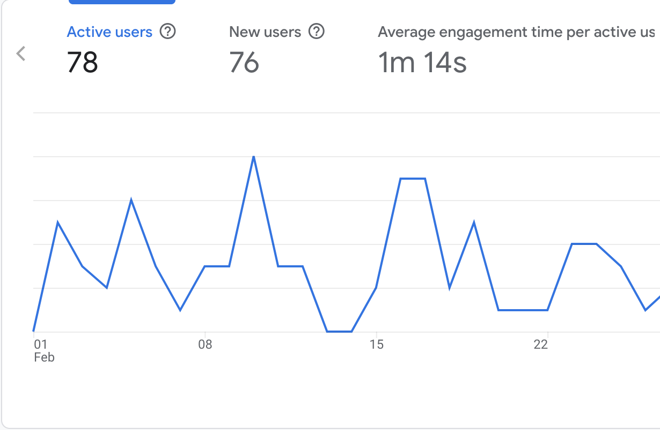
Site Overview
The large line chart on the right visually presents the key metrics for the Econet AI website from the previous month, highlighting critical numerical data.
It shows:
A total of 78 users visited the site.
76 new users were recorded, indicating that the majority of visitors were first-time users.
The average engagement time for users on the site was 1m 14s.

Slide 5
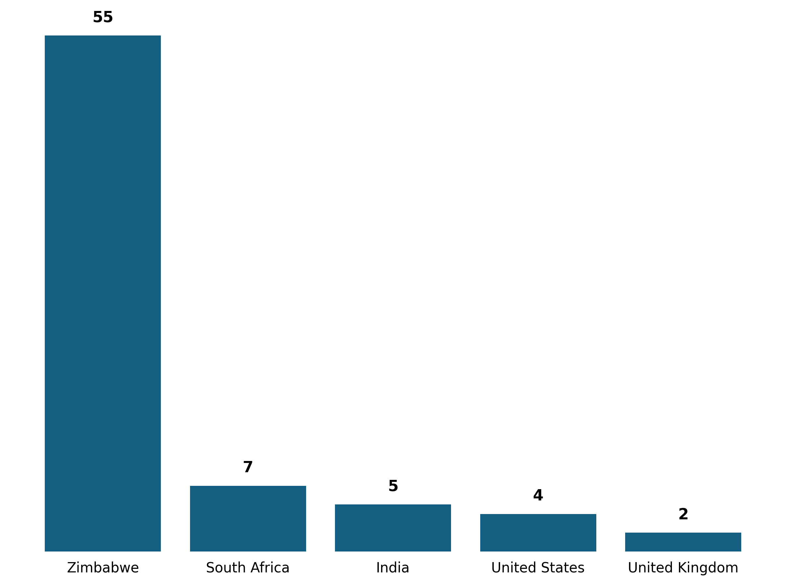
Demographic Overview
Zimbabwe is the primary source of traffic, accounting for (55 users), with South Africa (7 users), India (5 users), United States (4 users), and United Kingdom (2 users) contributing thereafter.

Slide 6
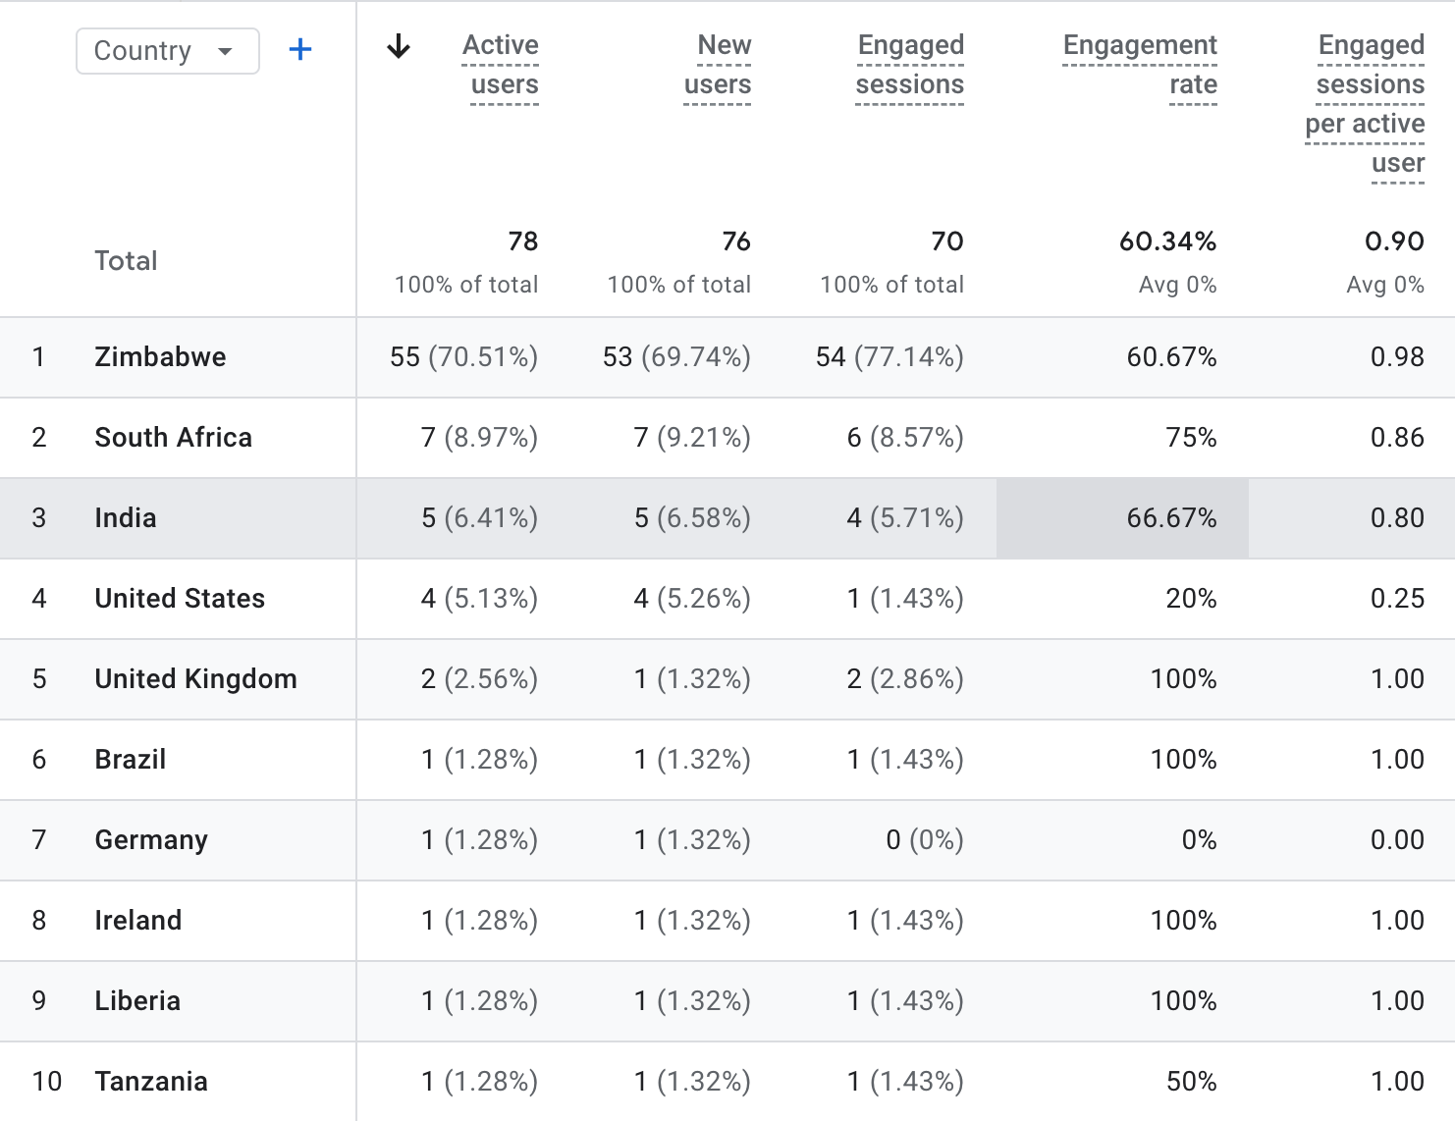
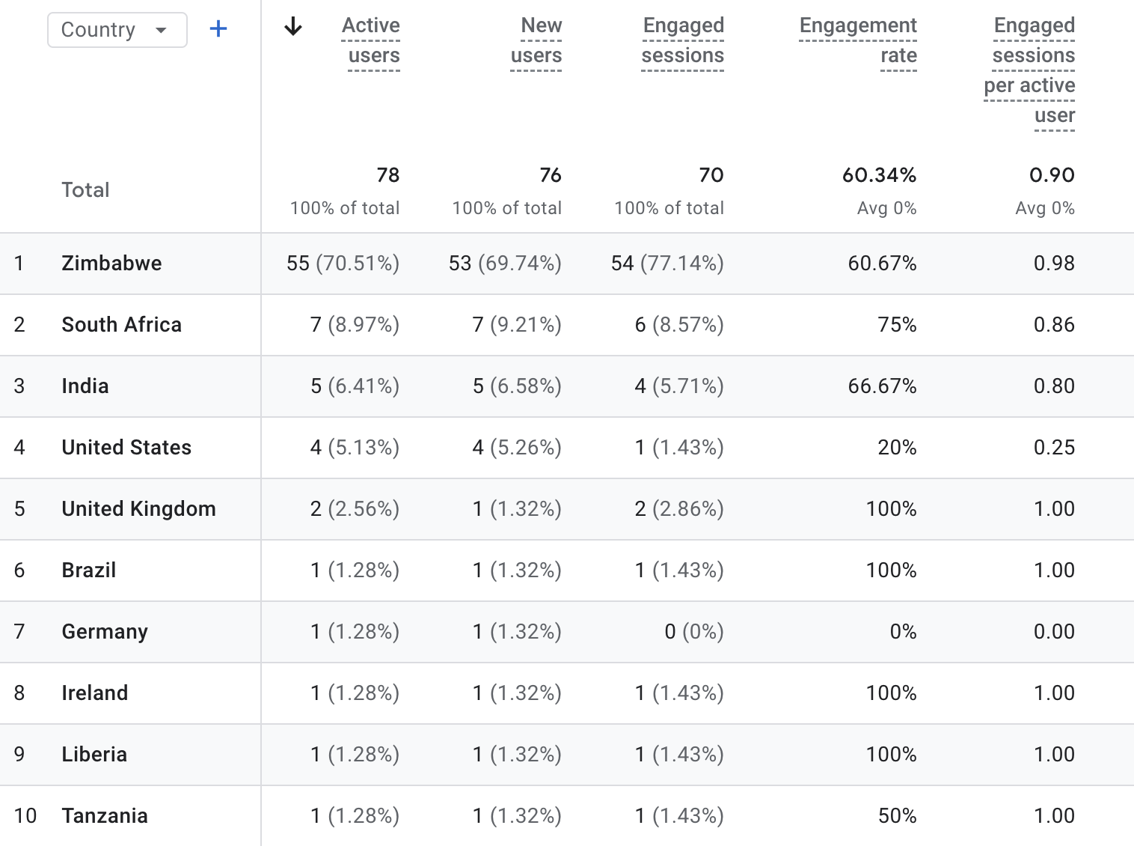
Demographic Overview

Slide 7
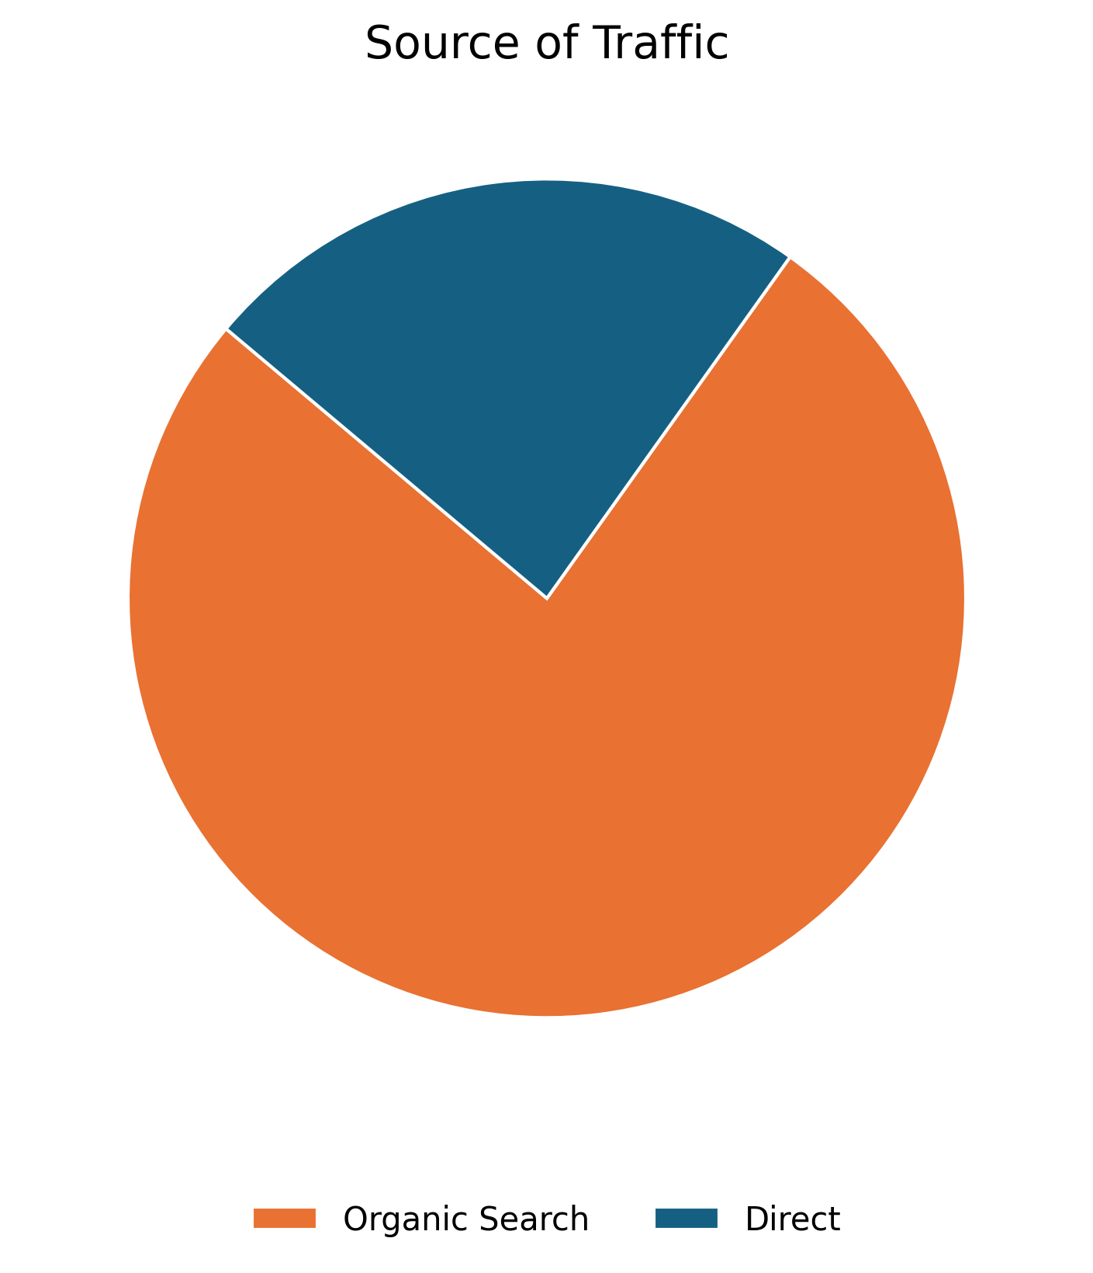
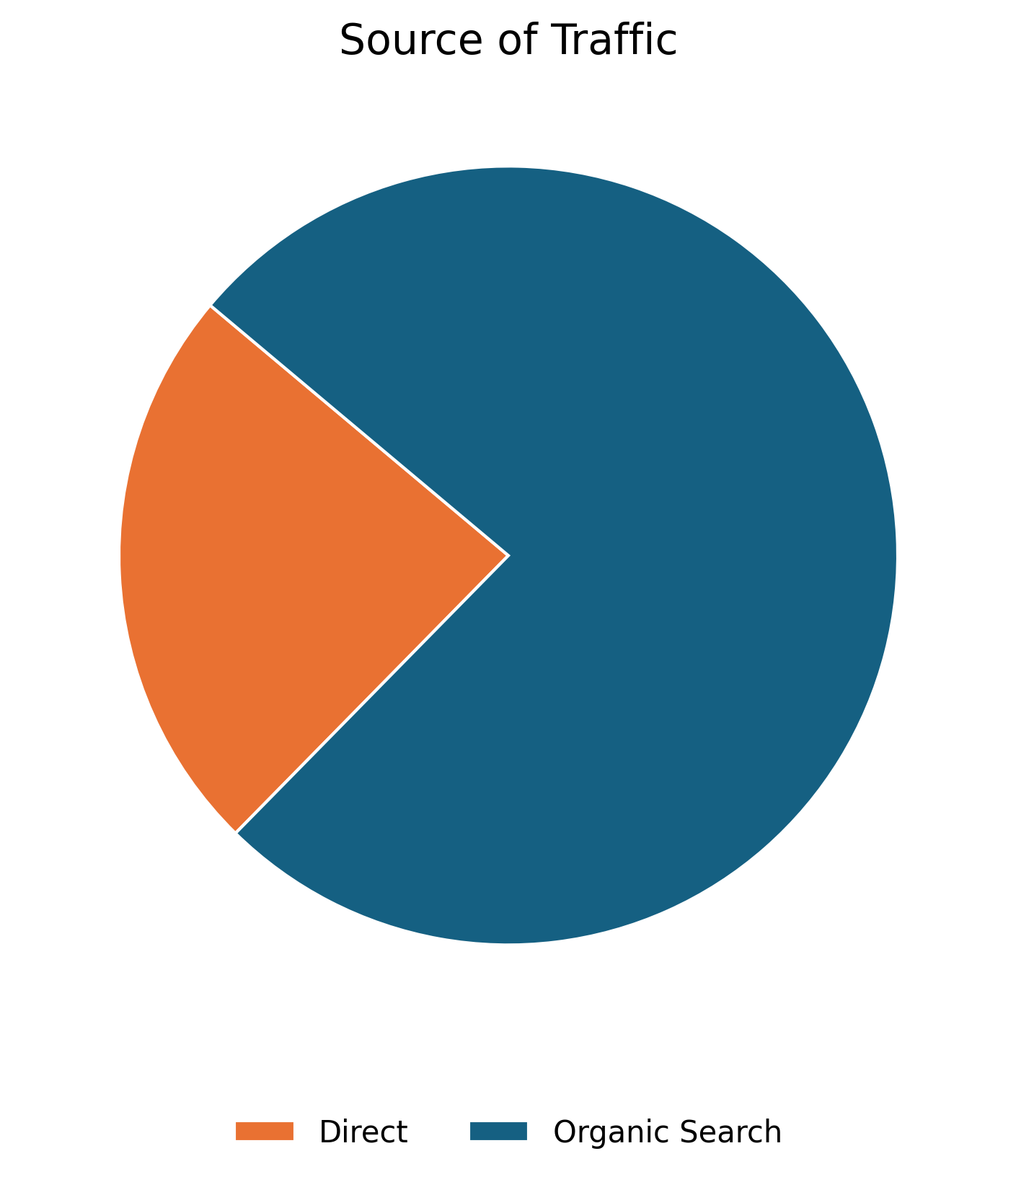
04 February 2026
User Acquisition
This slide presents an overview of the traffic channels directing users to the Econet AI website. Organic Search is the dominant channel, accounting for 61 users, followed by Direct with 19 users. Organic Search specifically refers to traffic originating from unpaid search engine results, generated based on their relevance to the user's query.
Source | Users
Organic Search | 61
Direct | 19

Slide 8
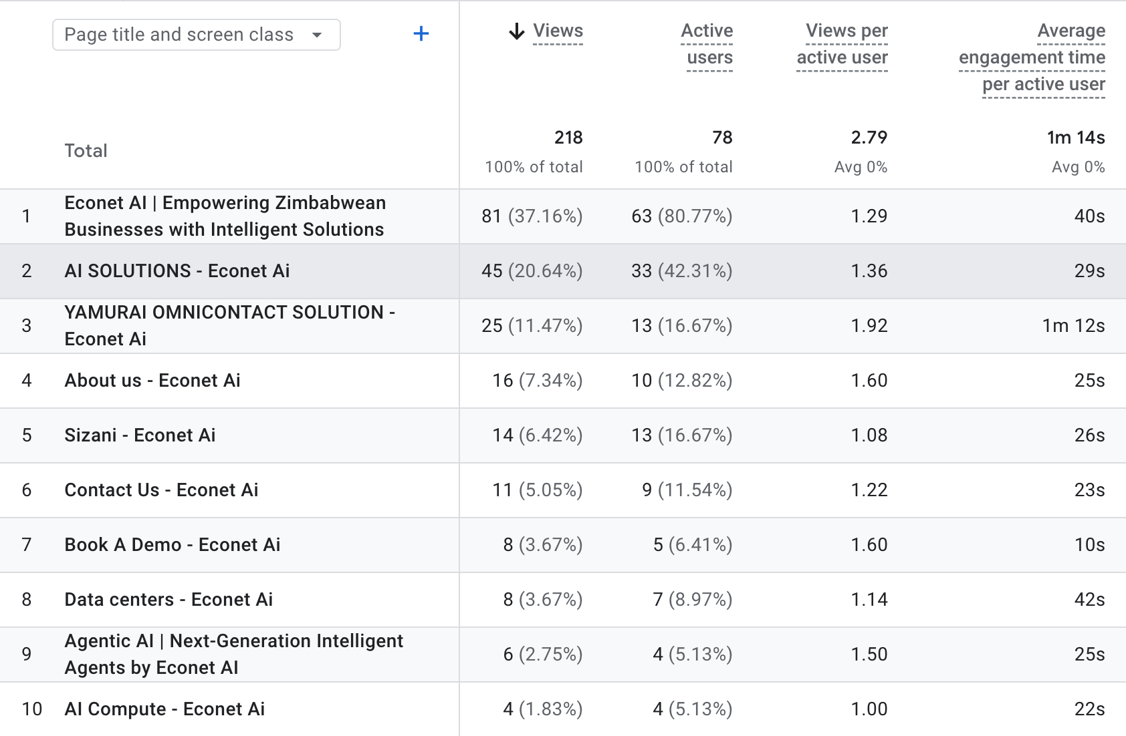

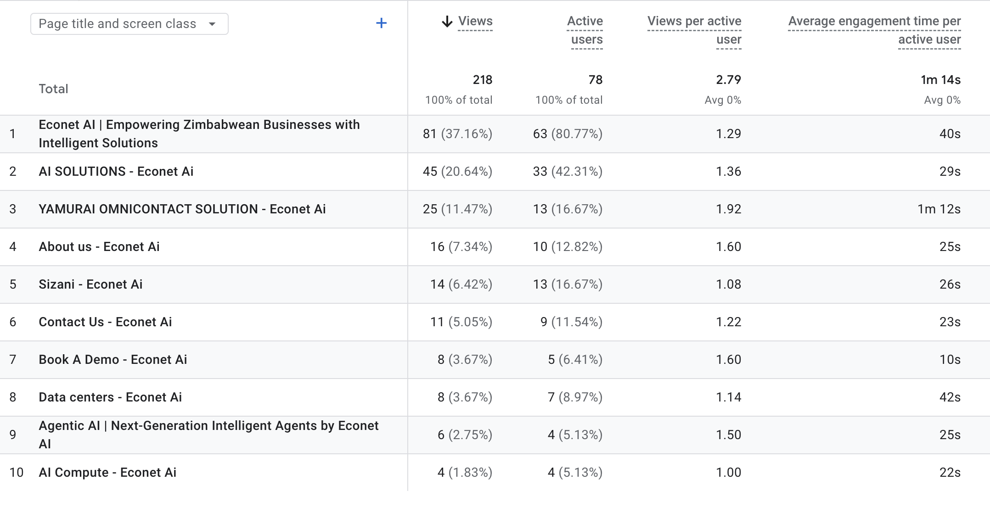
Pages Sessions
The table shows the top pages visited by users in the previous month

Slide 9
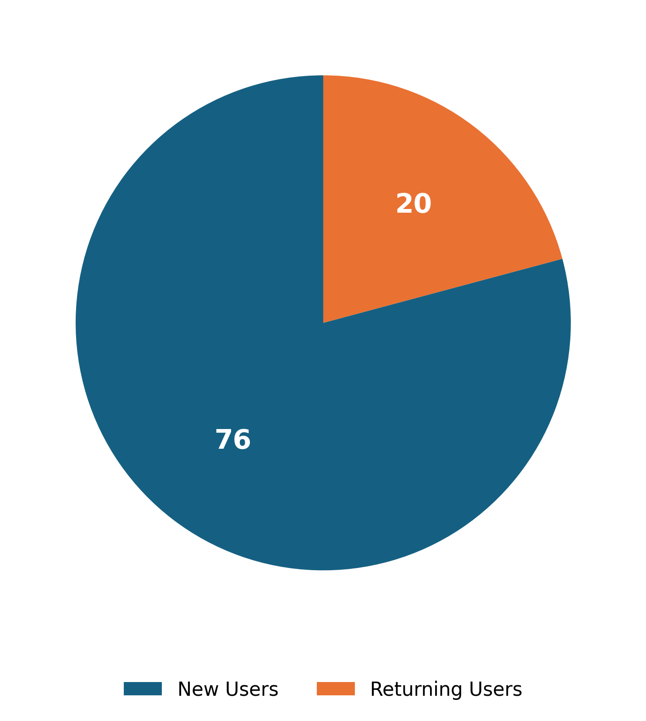
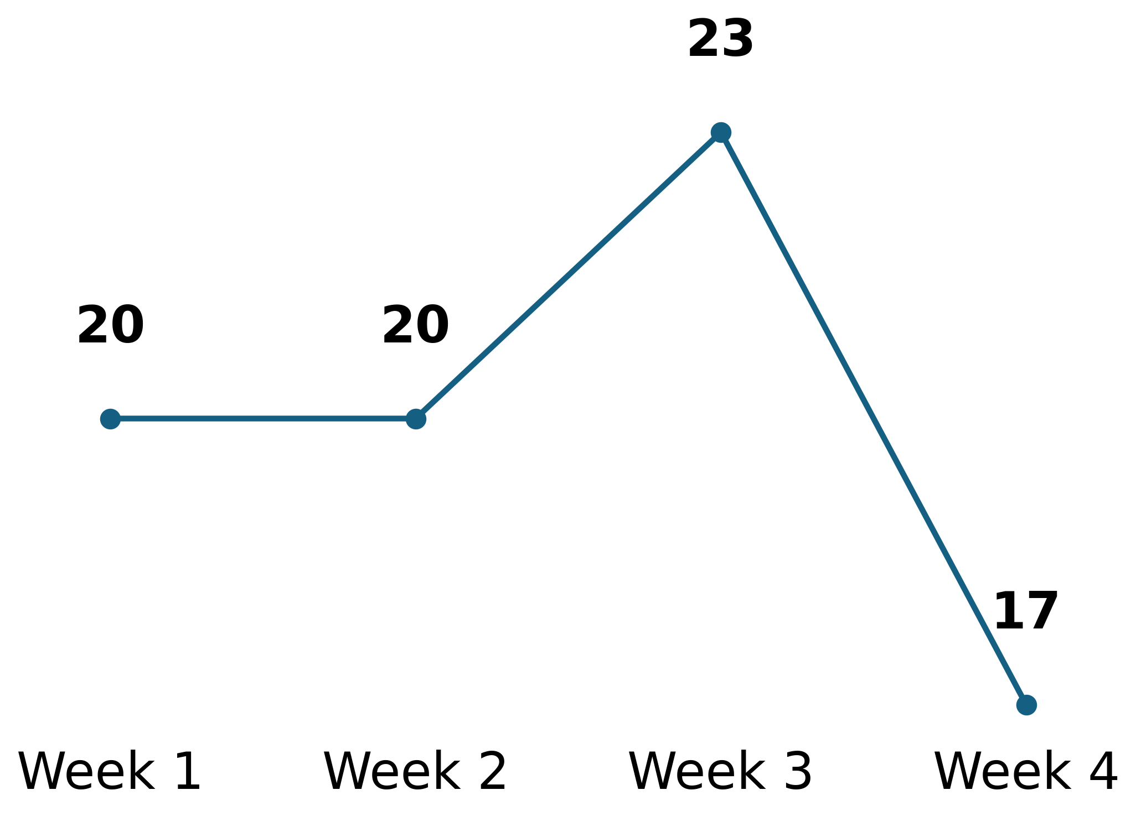
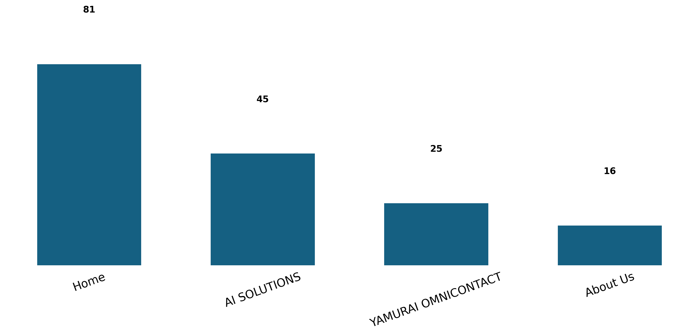

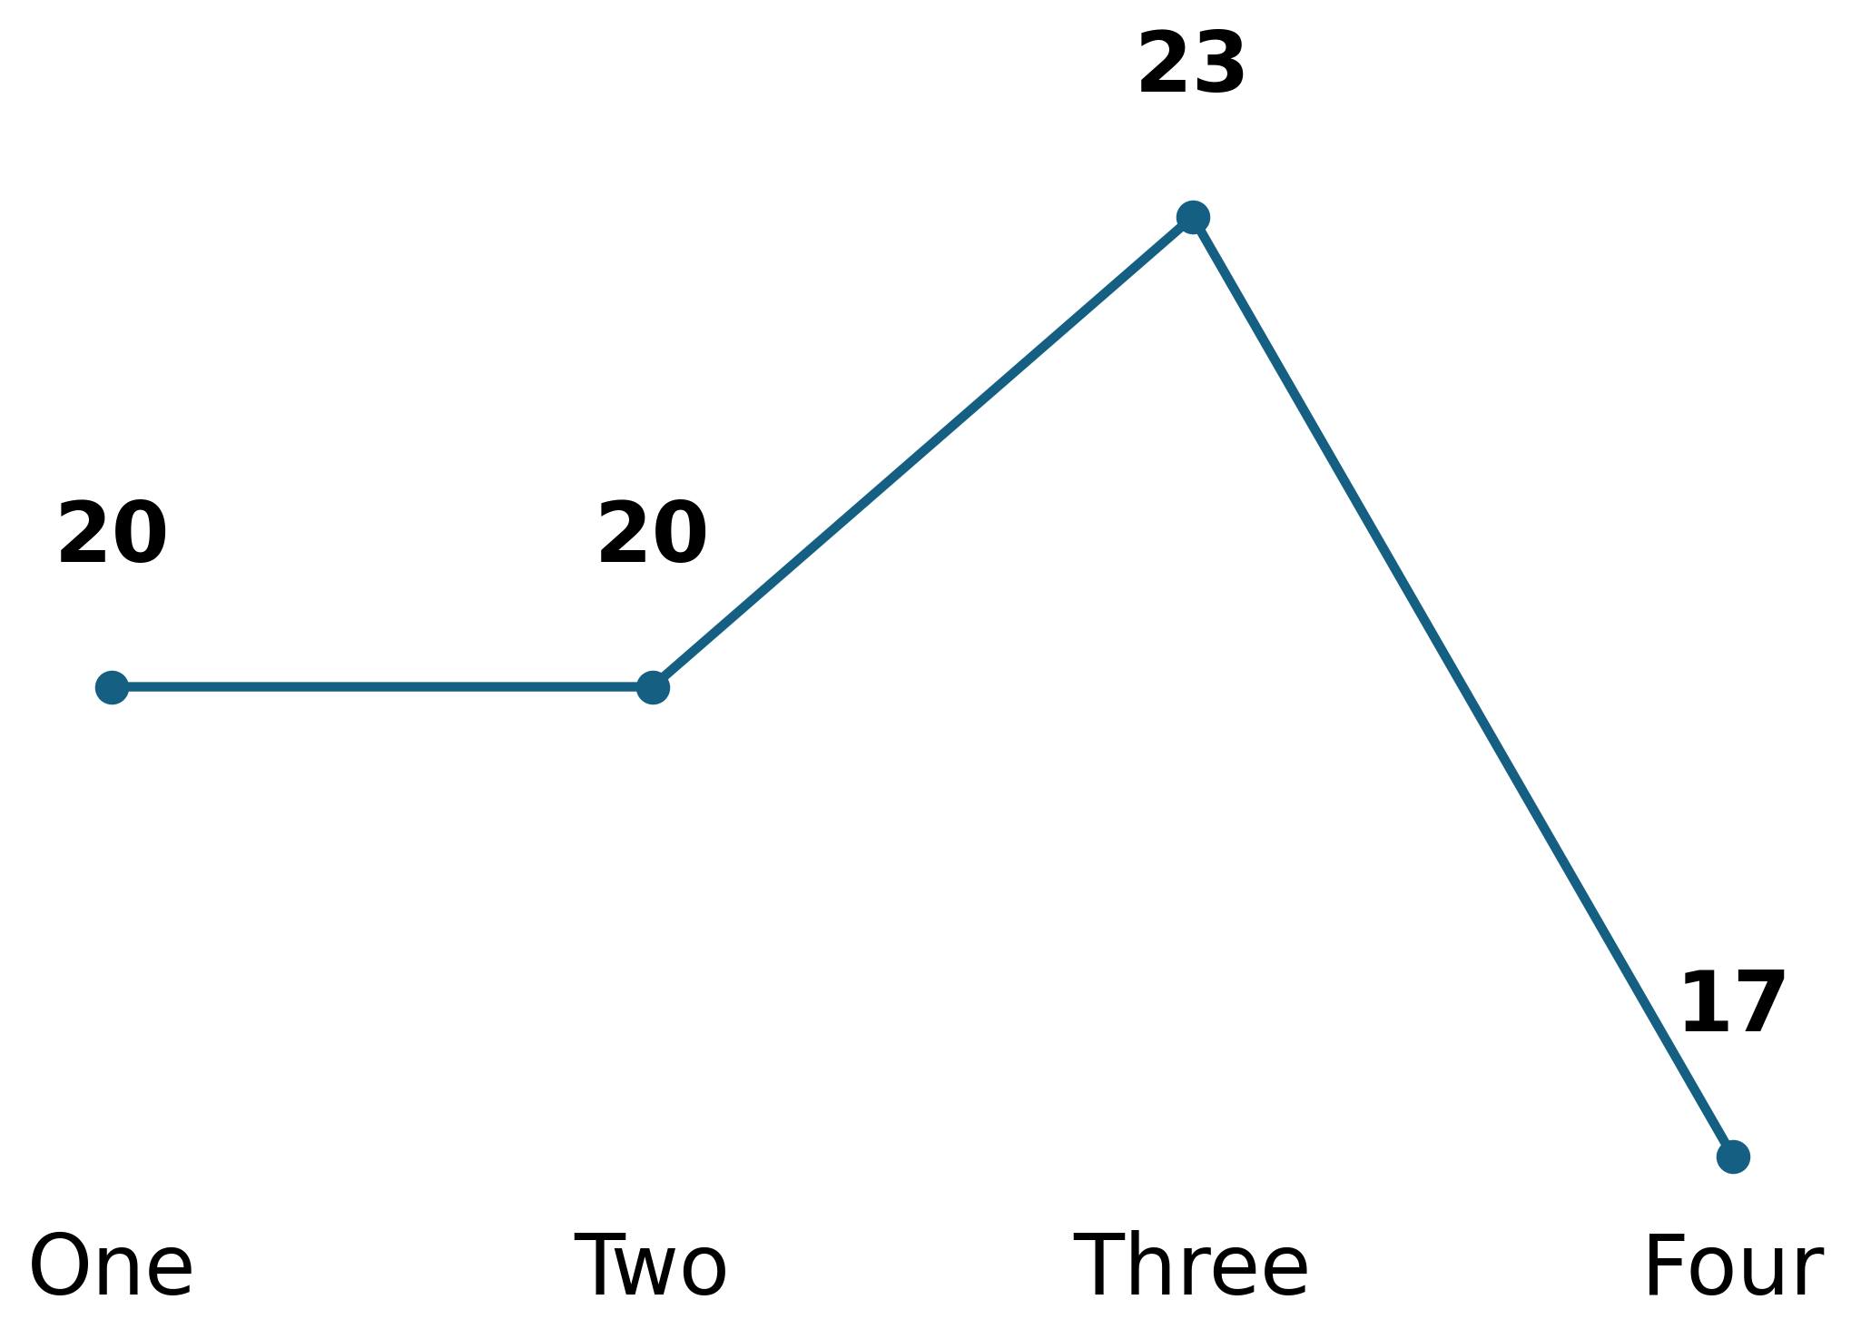
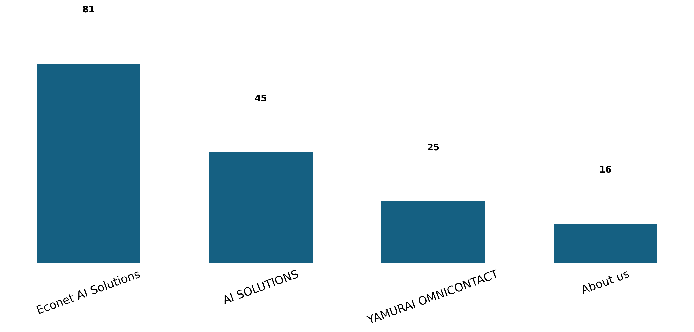
Behavior Analysis
Users
Engagement Rate Per Week
Page Views
Based on user interactions.
Measure user interaction.
Track page visits.

Slide 10
Recommendations
Based on data insights
1. Intensify organic and direct traffic generation efforts through refined SEO strategies and targeted digital marketing campaigns, acknowledging the updated lower visitor counts from these key channels.
2. Enhance user engagement by integrating interactive content, such as real-world demo videos and updated use-case stories for products like Yamurai OmniContact, directly onto the Home and AI SOLUTIONS landing pages.
3. Increase overall active user acquisition by implementing high-visibility promotional banners on the main Econet website that link to specific AI SOLUTIONS, complemented by a dedicated section on recent AI advancements to encourage revisits.

