Slide 1

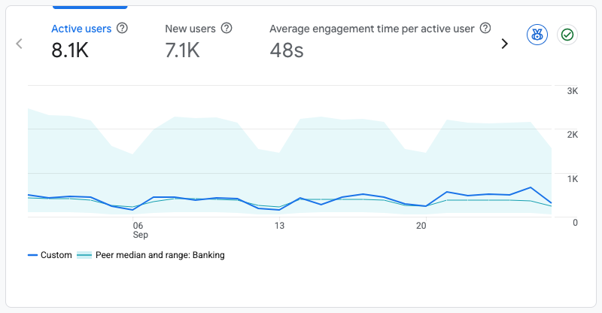

Website Performance Report
Analysis & Strategic Insights
September,2026

Slide 2
Overview
This report aims to analyse the website’s performance for September 2026, focusing on traffic, user flow, demographics, behaviours and security. The wider scope covers the ongoing management, maintenance and optimisation of the BancABC website to ensure it remains secure, functional, updated and accessible. This includes CMS maintenance, plugin and theme updates, application-level security monitoring, backup oversight, performance and site health optimisation, technical SEO support, limited content and page updates, third-party integration monitoring, incident response, access governance, change management and monthly reporting. The service is focused on keeping the website stable and professionally managed, while ensuring key updates, risks, fixes and recommended actions are clearly documented.

Slide 3
Executive Summary
8.1K
Active Users
During the reporting period, the BancABC website attracted 8.1K active users, including 7.1K (87.7%) new visitors. This audience mix reflects the website's continued ability to reach and attract new users across digital channels.
87.7%
N ew Visitors
7.4%
CTR

Slide 4
Site Overview
Engagement metrics confirm a 7.1K strong active user baseline.
8.1K
Total Active Users
7.1K
New Users (87.7%)
48s
Avg Engagement Time
The BancABC website exhibited solid and encouraging performance during the reporting period, with 8.1K active users recorded. New visitors represented 7.1K users (87.7%) of this total, underscoring strong brand discovery and the effectiveness of current reach and awareness initiatives.

Slide 5
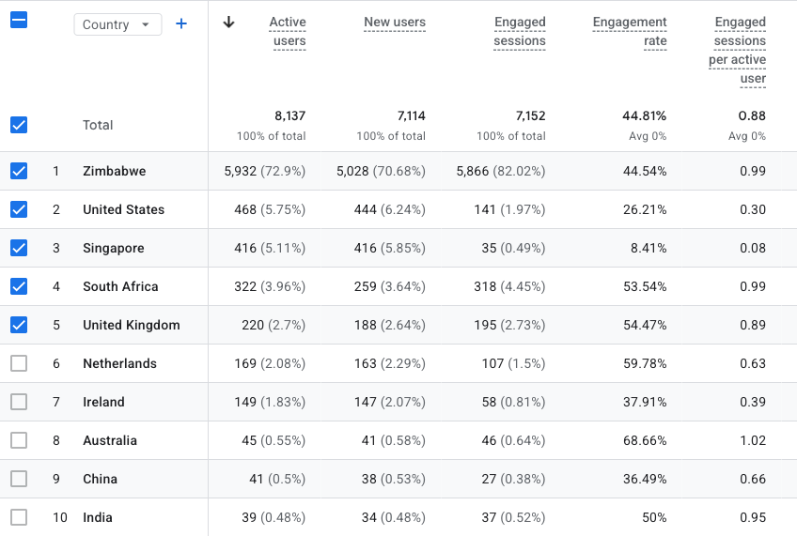
Geographic Performance
Zimbabwe's dominance, international opportunities emerging.
Zimbabwe exhibits dominant geographic performance, accounting for 5,932 users (76.04% of total traffic). A 44.54% engagement rate and 0.99 engaged sessions per user indicate strong volume paired with consistent interaction.
United States (468 users) recorded a 26.21% engagement rate, versus Singapore's (416 users) 8.41%, signifying superior visit quality despite lower traffic.
Notably, smaller markets South Africa (53.54%), United Kingdom (54.47%), Netherlands (59.78%), Australia (68.66%) demonstrate strongest engagement efficiency, suggesting high-intent audiences.
In summary, Zimbabwe drives scale, while select international markets present strong engagement depth and potential conversion value.

Slide 6
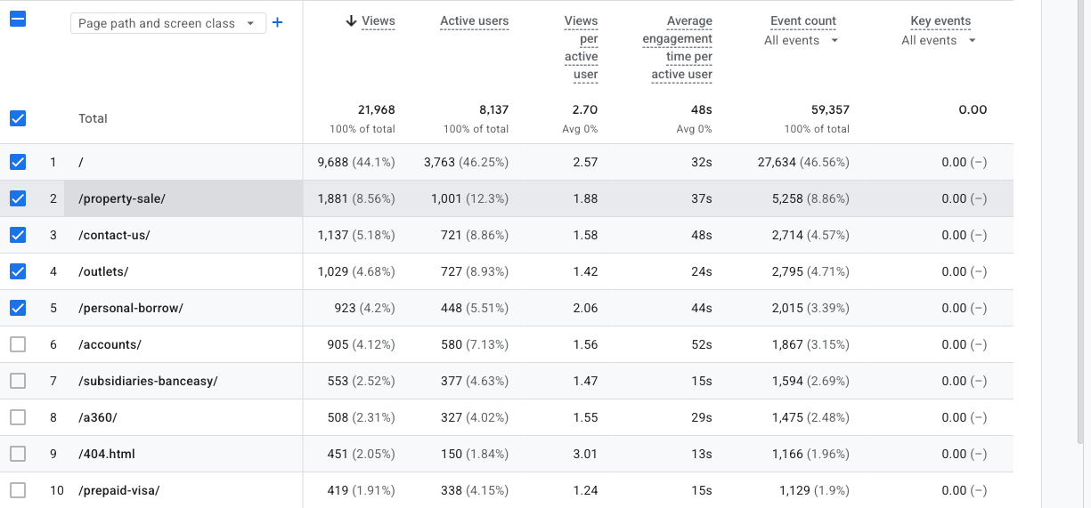
Page Performance
The Homepage and Property Sale pages drive the most meaningful engagement.
The Homepage drives the highest traffic, accounting for 51.87% of total views (9,439 views), with 2.68 views per active user and an average engagement duration of 34s. This substantial volume indicates strong content discoverability and user interest.
The Homepage drives the highest traffic, accounting for 44.1% of total views (9,688 views), with 2.57 views per active user and an average engagement duration of 32s. This substantial volume indicates strong content discoverability and user interest.
Secondary pages such as Property Sale and Contact Us contribute meaningful traffic, but with more limited evidence of deep exploratory browsing.

Slide 7
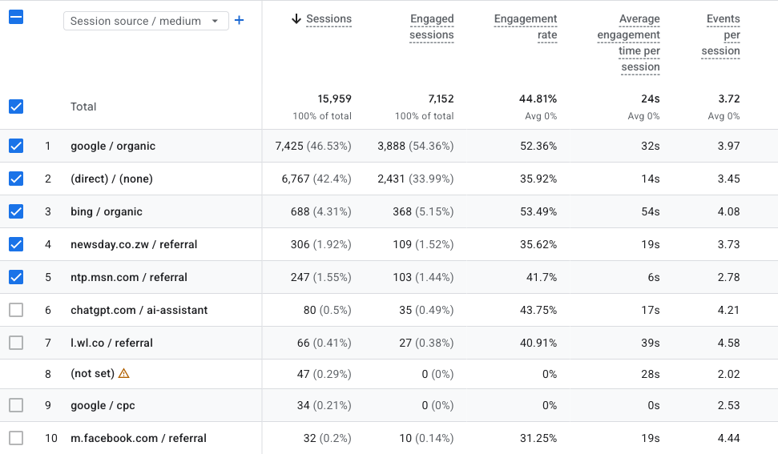
Traffic Acquisition
google / organic and (direct) / (none) were the primary drivers of website sessions, accounting for 46.53% and 42.4% respectively.
Overall Insight:
google / organic spearheaded website acquisition with 7,425 sessions, comprising 46.53% of all sessions. It registered a 52.36% engagement rate and 32s average engagement time.
(direct) / (none) was second with 6,767 sessions (42.4%). Its 35.92% engagement rate and 14s average engagement time indicated more limited interaction than the leading source.
Organic search demonstrated strong traffic quality. google / organic achieved a 52.36% engagement rate, an average engagement time of 32s, and 3.97 events per session.
In total, the website registered 0 sessions and 0 engaged sessions, yielding an overall engagement rate of N/A. The channel mix underscores where acquisition volume and engagement quality were most prominent during the reporting period.

Slide 8
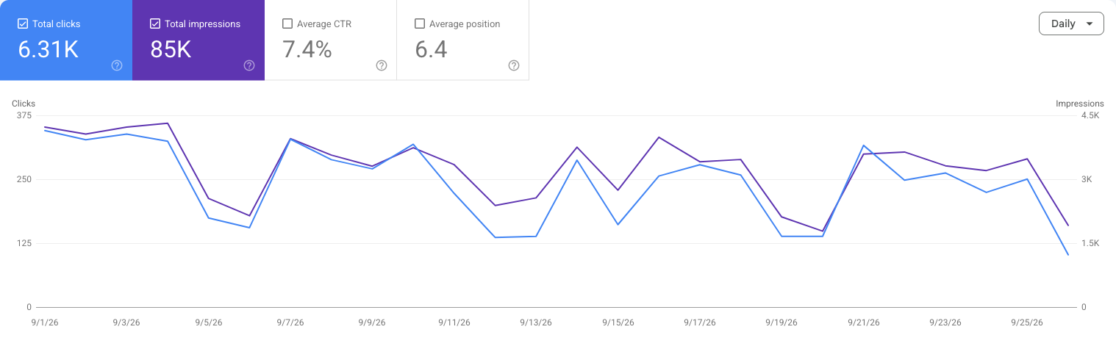
Search Performance
Strong search visibility resulted in a 7.4% Click-Through Rate.
The brand maintained substantial search result presence with 85K impressions, signaling strong keyword coverage and consistent discoverability. This visibility subsequently generated 6.31K clicks, reflecting meaningful traffic acquisition directly from search engines.
The 7.4% click-through rate signifies robust conversion of impressions into clicks, demonstrating compelling meta titles and descriptions that effectively align with searcher intent.

Slide 9
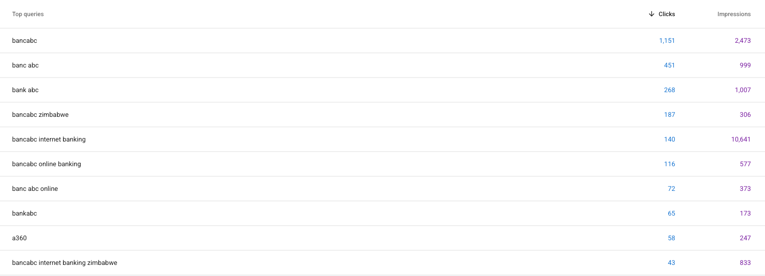
Top Queries
The leading search queries were “bancabc” (1,151 clicks) and “banc abc” (451 clicks). These terms represent the strongest sources of organic search traffic during the reporting period.

Slide 10
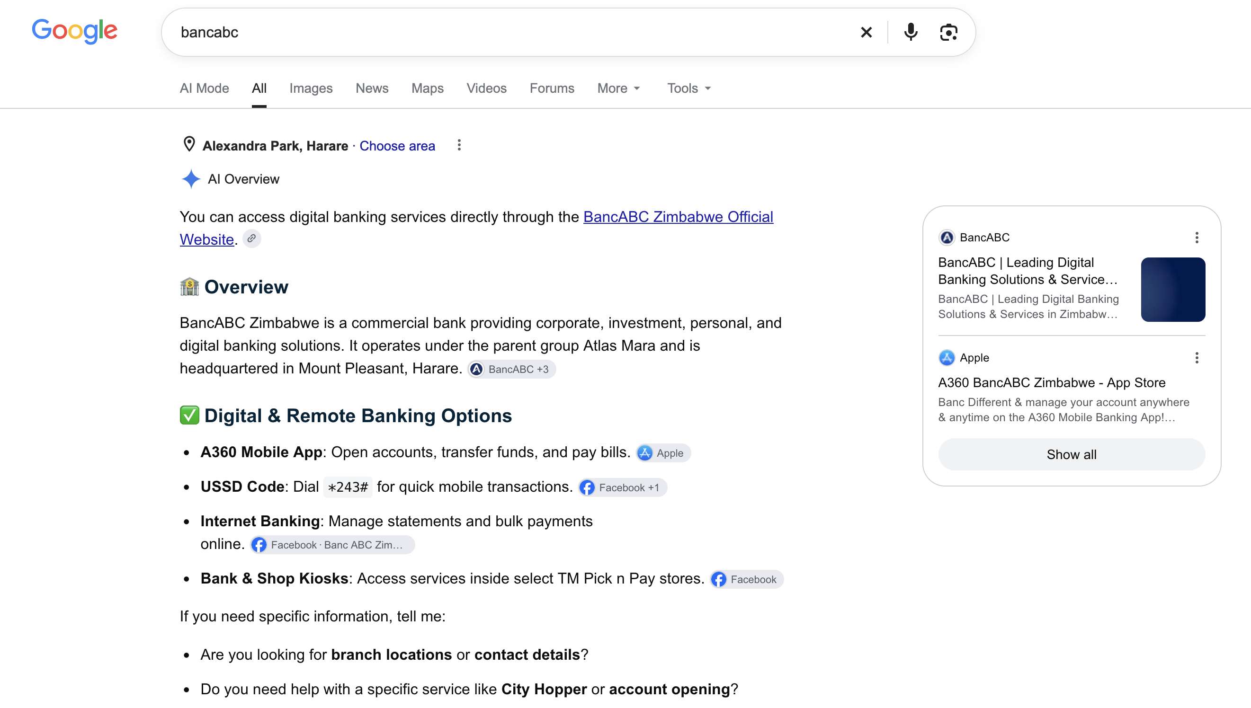
SEO
BancABC
Search results for BancABC demonstrate strong branded search visibility, with the official BancABC Zimbabwe website prominently featured alongside relevant associated digital platforms, including the A360 Mobile Banking application. The presence of BancABC within Google’s AI-generated overview further strengthens brand exposure, indicating that users searching directly for BancABC can easily access authoritative and relevant brand-owned information and services.

Slide 11
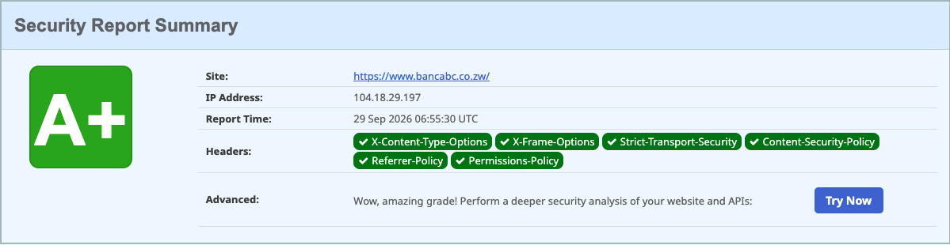
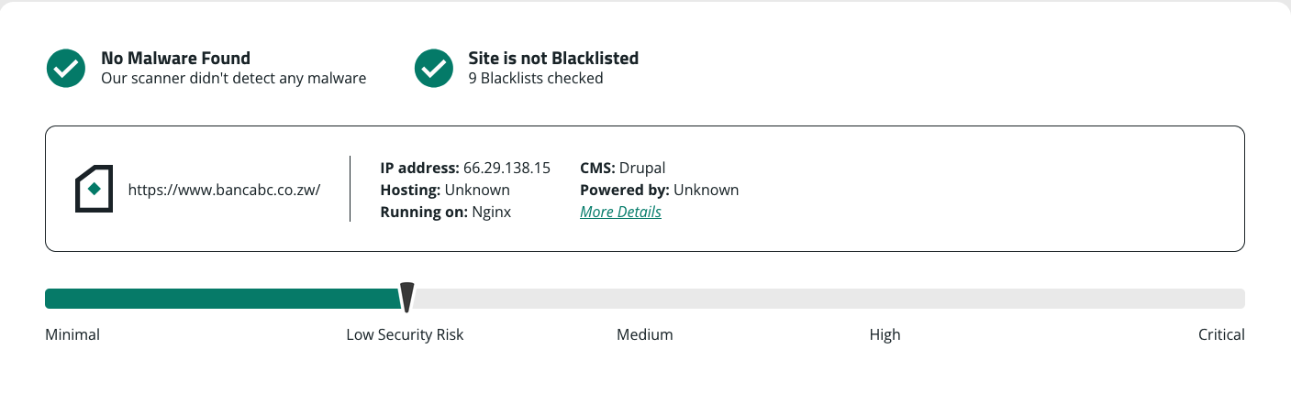
Security
Security Overview​
No malware was detected on the website​
The site is not listed on any known blacklists​
A total of 9 blacklist databases were checked​
The website has achieved an A+ security rating,
indicating a very strong security posture​
The scan confirms that key security configurations are
properly implemented​
Risk Assessment​
The website is currently classified as Low Security Risk​
No immediate threats or critical vulnerabilities were
identified​
The overall security posture is stable and well-
protected​

Slide 12
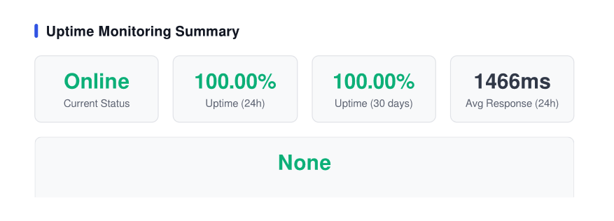
Uptime and System Reliability Insight
​
The website demonstrates strong operational stability,
maintaining a 100% uptime over the past 24 hours and
100% uptime over the last 30 days, indicating highly
reliable service availability.​
The average response time of 1466ms reflects
acceptable performance, though there is an opportunity
to further optimize speed for an improved user
experience.​ ​
Overall, the system is stable, reliable, and performing
well, with minimal downtime and no active incidents.
Continued monitoring and performance optimization
will help maintain and further enhance service quality.​

Slide 13
Recommendations

Slide 14
THANK YOU

