Slide 1

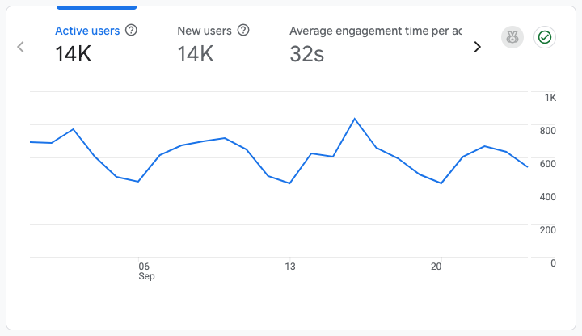

Website Performance Report
Analysis & Strategic Insights
September,2026

Slide 2
Overview
This report aims to analyse the website’s performance for September 2026, focusing on traffic, user flow, demographics, behaviours and security. The wider scope covers the ongoing management, maintenance and optimisation of the Delta website to ensure it remains secure, functional, updated and accessible. This includes CMS maintenance, plugin and theme updates, application-level security monitoring, backup oversight, performance and site health optimisation, technical SEO support, limited content and page updates, third-party integration monitoring, incident response, access governance, change management and monthly reporting. The service is focused on keeping the website stable and professionally managed, while ensuring key updates, risks, fixes and recommended actions are clearly documented.

Slide 3
Executive Summary
During the reporting period, the Delta website attracted 14K active users, including 14K (100.0%) new visitors. This audience mix reflects the website's continued ability to reach and attract new users across digital channels.
Average engagement time was 32s, showing that visitors spent meaningful time interacting with the website content rather than leaving immediately.
14K
Active Users
100.0%
N ew Visitors
2.9%
CTR

Slide 4
Site Overview
Active User Baseline of 14K Demonstrates Robust Engagement.
14K
Total Active Users
14K
New Users (100.0%)
32s
Avg Engagement Time
The Delta website exhibited solid and encouraging performance this period, recording 14K active users. Notably, 14K users (100.0%) were new visitors, underscoring robust brand discovery and the success of current reach and awareness initiatives.

Slide 5
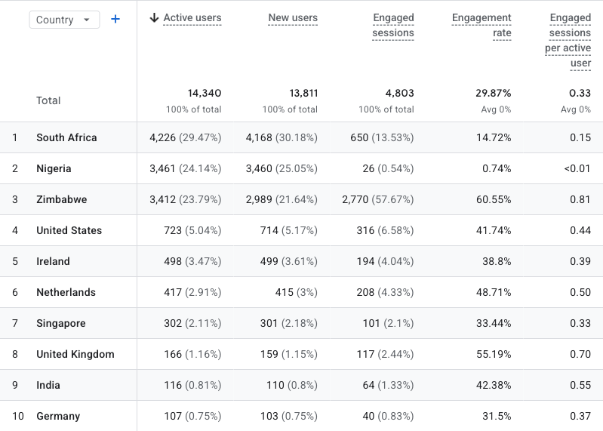
Geographic Performance
South Africa's market dominance presents international opportunities.
Geographic analysis confirms South Africa as the primary market, generating 4,226 users (42.4% of total traffic) with a 14.72% engagement rate and 0.15 engaged sessions per user, indicating substantial volume and consistent user interaction.
Zimbabwe (3,412 users) registers a 60.55% engagement rate, while United States (723 users) registers a 41.74% engagement rate, indicating superior visit quality despite reduced traffic volumes.
Notably, smaller markets such as Zimbabwe (60.55%) and United Kingdom (55.19%) display the strongest engagement efficiency, suggesting high-intent audiences.
Overall, South Africa delivers scale, while select international markets exhibit strong engagement depth and potential conversion value.

Slide 6
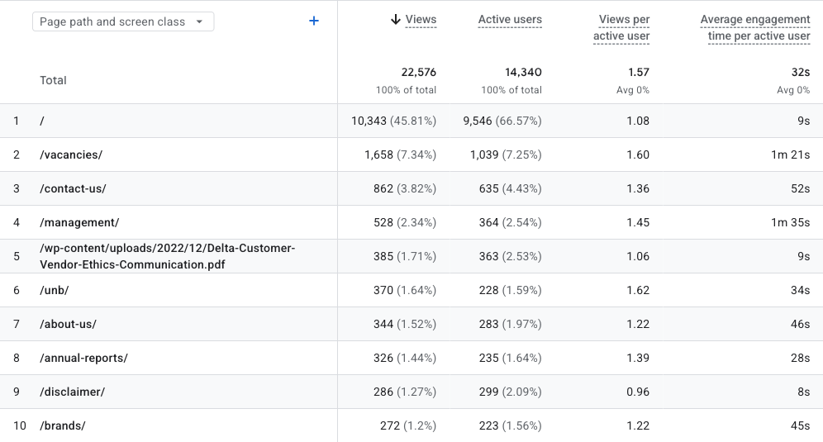
Page Performance
The Homepage and Vacancies pages drive the most meaningful engagement.
Overall Insight:
The Homepage drives the highest traffic, accounting for 45.81% of total views (10,343 views), with 1.08 views per active user and an average engagement duration of 9s. This substantial volume indicates strong content discoverability and user interest.
Compliance pages, including Disclaimer (1.27% of views), yield considerable traffic, predominantly influenced by campaign landing directives over organic browsing.
Support-focused pages including Contact Us attract consistent traffic but exhibit lower engagement depth, indicating they are mainly used for quick access to assistance rather than extended browsing.

Slide 7
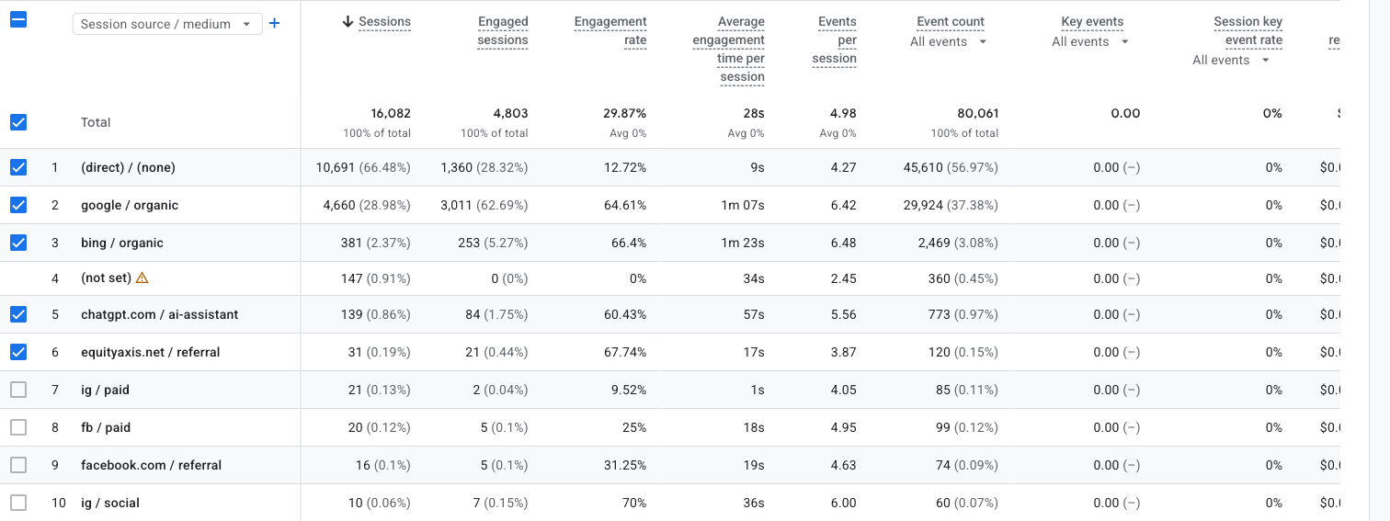
Traffic Acquisition
(direct) / (none) and google / organic accounted for the largest proportions of website sessions, contributing 66.48% and 28.98% respectively.
Overall Insight:
(direct) / (none) led website acquisition with 10,691 sessions, comprising 66.48% of the total. It demonstrated a 12.72% engagement rate and a 9s average engagement time.
google / organic ranked second, providing 4,660 sessions (28.98%). Its 64.61% engagement rate and 1m 07s average engagement time showed stronger interaction than the leading source.
Organic search yielded high-quality traffic. google / organic achieved a 64.61% engagement rate, an average engagement time of 1m 07s, and 6.42 events per session.
The website generated 0 sessions and 0 engaged sessions overall, with an engagement rate of N/A. The channel mix illustrates where acquisition volume and engagement quality were strongest during the reporting period.

Slide 8
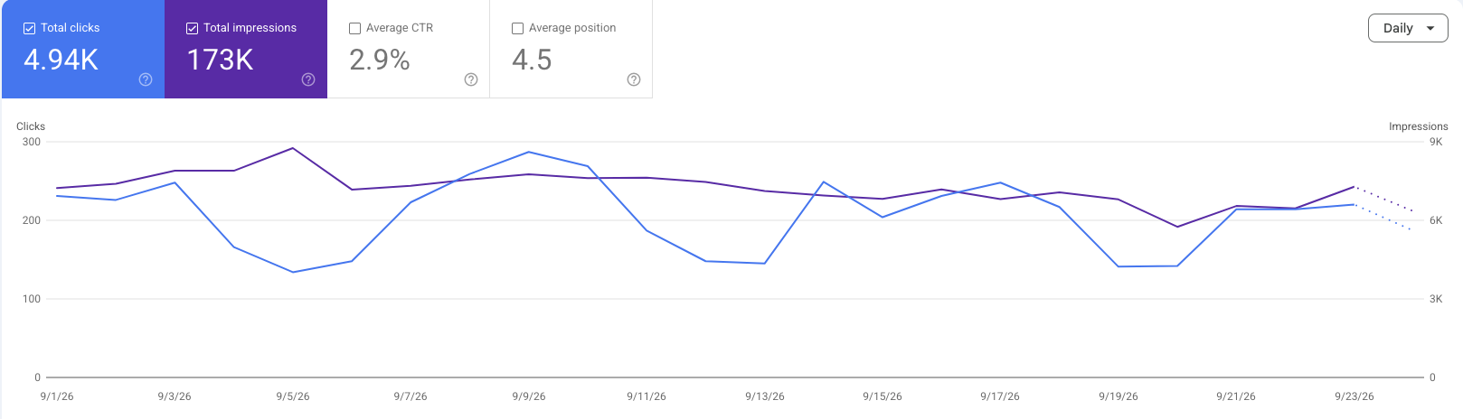
Search Performance
Search Presence Established, with CTR Optimization Potential.
The brand achieved 173K impressions, signifying substantial search result presence, strong keyword coverage, and consistent discoverability. This visibility led to 4.9K clicks, demonstrating significant traffic acquisition directly from search engines.
The average position of 4.5 is encouraging, consistently placing the website on the first page of search results for many queries. This reinforces strong SEO foundations and competitive ranking strength.

Slide 9
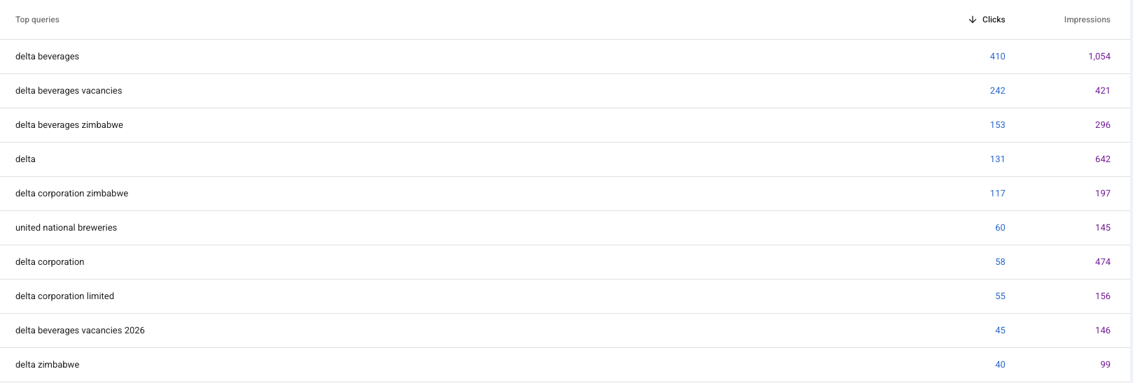
Top Queries
The leading search queries were “delta beverages” (410 clicks) and “delta beverages vacancies” (242 clicks). These terms represent the strongest sources of organic search traffic during the reporting period.

Slide 10
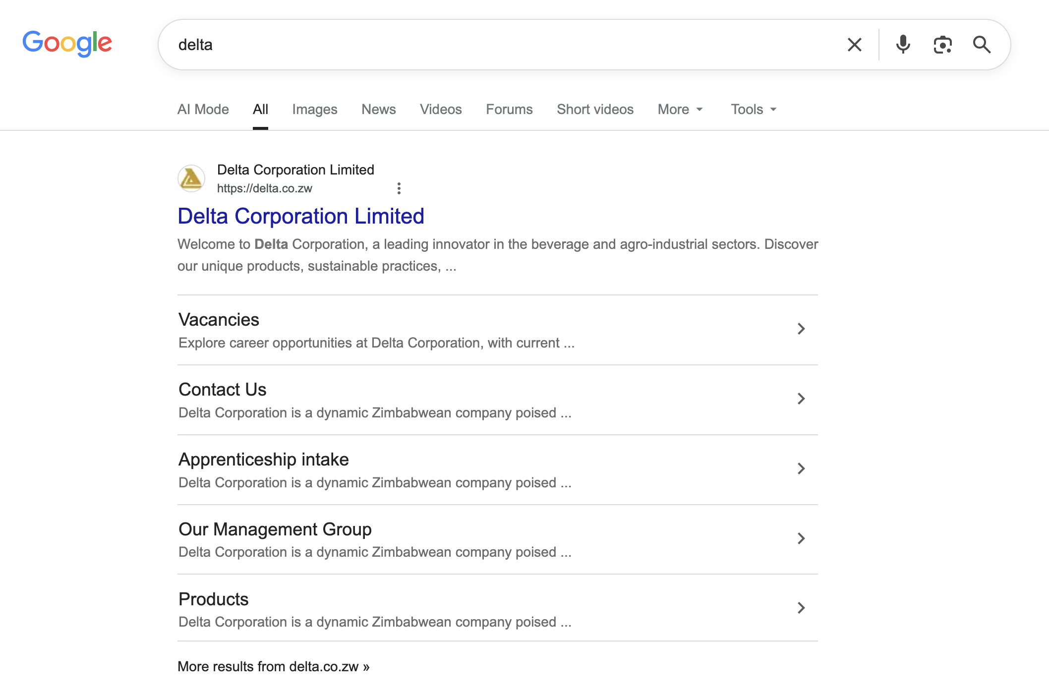
SEO
Delta Beverages
The search results for Delta Beverages are correctly pulling through relevant brand-owned and associated pages, with the official Delta website appearing prominently as the top result. This indicates that the brand has strong search visibility and is discoverable when users search for Delta directly. ​

Slide 11
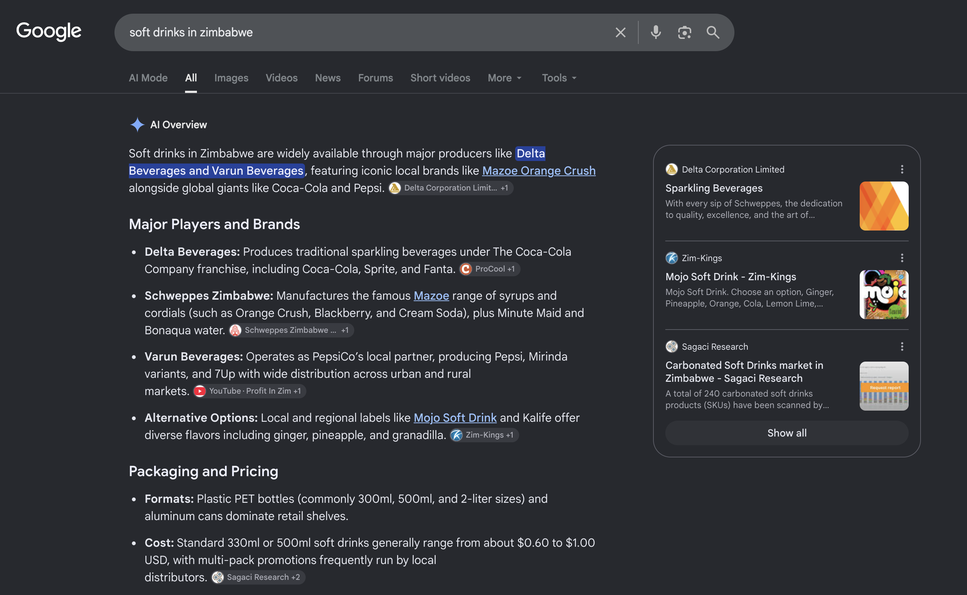
SEO
Delta Beverages
Mazoe Orange Crush, bottled locally by Delta Beverages, ranks prominently in Google’s AI Overview for “soft drinks in Zimbabwe.” This indicates that Delta has strong category-level visibility, with one of its major bottled brands being recognised as a leading soft drink option in the local market.

Slide 12
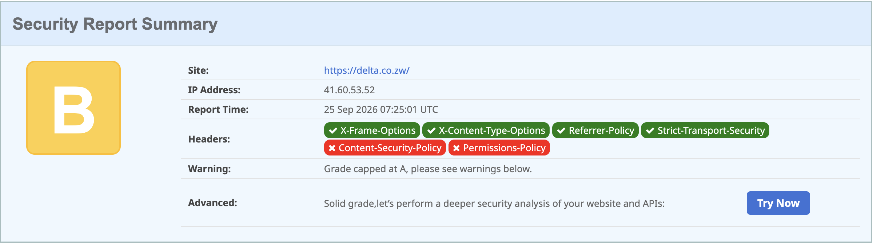
Security
Security Overview
No malware was detected on the website.
The website received a B security rating, indicating a generally good security posture with some areas requiring improvement.
The overall security posture is stable, though implementing the missing security headers would further strengthen the website's protection and improve its security rating.

Slide 13
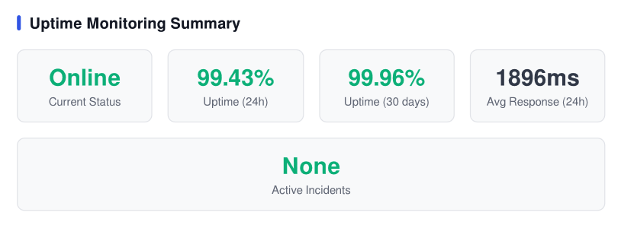
Uptime and System Reliability Insight
​
The website demonstrates strong operational stability,
maintaining a 100% uptime over the past 24 hours and
99.43% uptime over the last 30 days, indicating highly
reliable service availability.​
The average response time of 1896ms reflects
acceptable performance, though there is an opportunity
to further optimize speed for an improved user
experience.​ ​
Overall, the system is stable, reliable, and performing
well, with minimal downtime and no active incidents.
Continued monitoring and performance optimization
will help maintain and further enhance service quality.​

Slide 14
Recommendations

