Slide 1

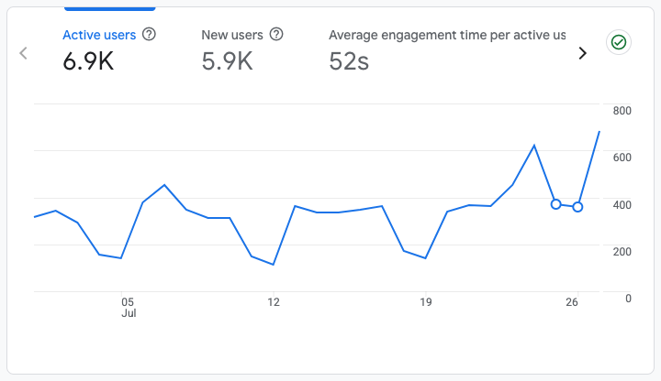

Website Performance Report
Analysis & Strategic Insights
July,2026

Slide 2
Overview
This report aims to analyse the website’s performance for July 2026, focusing on traffic, user flow, demographics, behaviours and security. The wider scope covers the ongoing management, maintenance and optimisation of the BancABC website to ensure it remains secure, functional, updated and accessible. This includes CMS maintenance, plugin and theme updates, application-level security monitoring, backup oversight, performance and site health optimisation, technical SEO support, limited content and page updates, third-party integration monitoring, incident response, access governance, change management and monthly reporting. The service is focused on keeping the website stable and professionally managed, while ensuring key updates, risks, fixes and recommended actions are clearly documented.

Slide 3
Executive Summary
Performance overview shows 85.5% of users were first-time visitors.
6.9K
Active Users
During the reporting period, the BancABC website attracted 6.9K active users, including 5.9K (85.5%) new visitors. This audience mix reflects the website's continued ability to reach and attract new users across digital channels.
85.5%
N ew Visitors
7.6%
CTR

Slide 4
Site Overview
Engagement metrics confirm a 6.9K strong active user baseline.
6.9K
Total Active Users
5.9K
New Users (85.5%)
52s
Avg Engagement Time
The BancABC website demonstrated robust performance this period, recording 6.9K active users. Notably, 5.9K users (85.5%) were new visitors, underscoring sustained brand visibility and the effectiveness of ongoing reach and awareness initiatives.

Slide 5
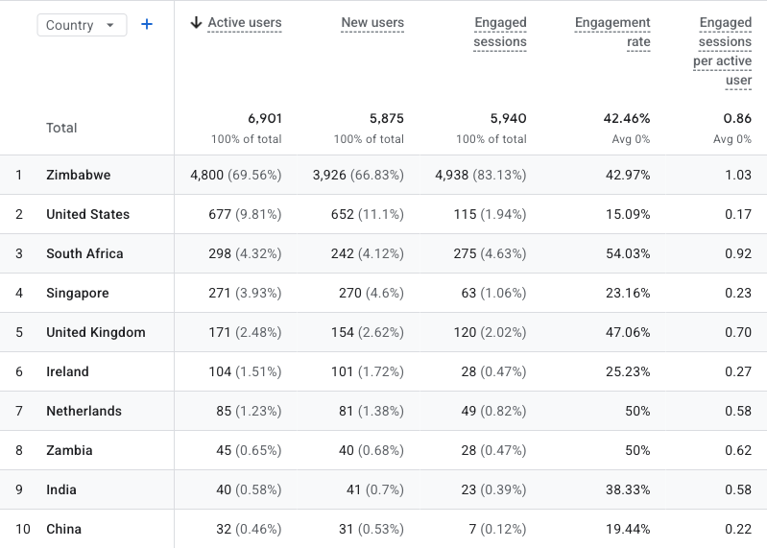
Geographic Performance
Zimbabwe Dominates; International Opportunities Emerge.
Geographic performance confirms Zimbabwe as the primary market, contributing 4,800 users (73.59% of total traffic) with a 42.97% engagement rate and 1.03 engaged sessions per user, delivering substantial volume and consistent interaction.
United States (677 users) registers a 15.09% engagement rate, whereas South Africa (298 users) achieves a 54.03% engagement rate, reflecting stronger visit quality despite lower traffic volumes.
Specifically, smaller markets such as South Africa (54.03%) exhibit robust engagement efficiency, suggesting high-intent audiences.
In summary, Zimbabwe achieves scale, while specific international markets display robust engagement depth and potential conversion value.

Slide 6
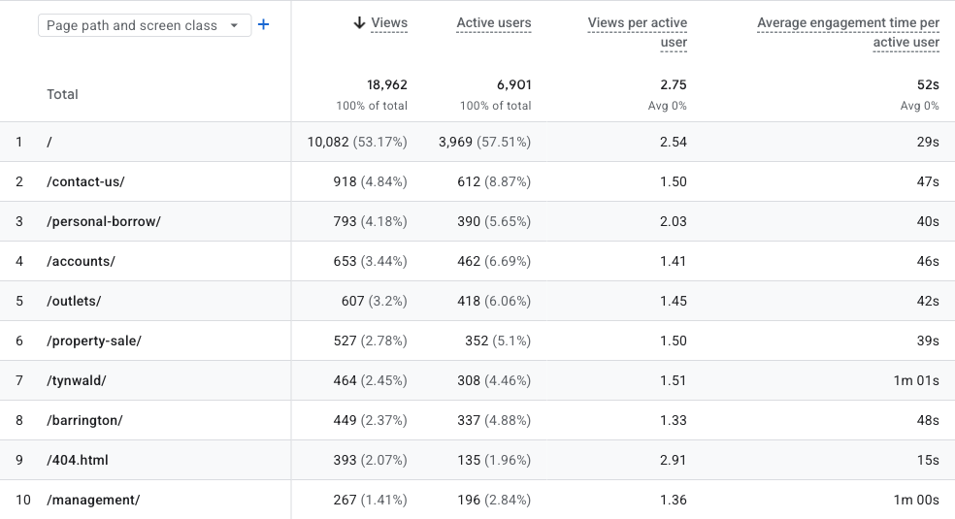
Page Performance
The Homepage and Contact Us pages drive the most meaningful engagement.
The Homepage drives the highest traffic, accounting for 51.87% of total views (9,439 views), with 2.68 views per active user and an average engagement duration of 34s. This substantial volume indicates strong content discoverability and user interest.
The Homepage drives the highest traffic, accounting for 53.17% of total views (10,082 views), with 2.54 views per active user and an average engagement duration of 29s. This substantial volume indicates strong content discoverability and user interest.
Secondary pages such as Contact Us and Personal Borrow contribute meaningful traffic, but with more limited evidence of deep exploratory browsing.

Slide 7
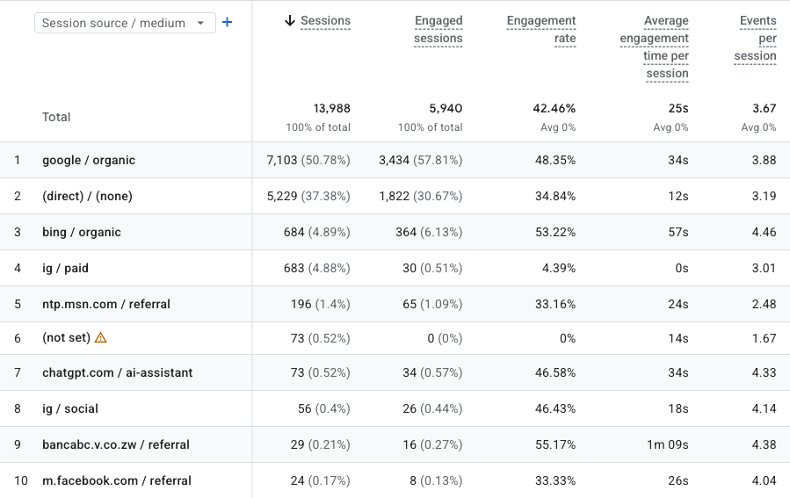
Traffic Acquisition
Traffic Acquisition engagement was predominantly driven by google / organic at 50.78% and (direct) / (none) at 37.38%.
Overall Insight:
google / organic led website acquisition with 7,103 sessions, representing 50.78% of total. This source achieved a 48.35% engagement rate and 34s average engagement time.
(direct) / (none) is the second-largest source at 5,229 sessions, but its 34.84% engagement rate and 12s average engagement time signal limited engagement considering its traffic.
Organic search yielded high-quality traffic. google / organic registered a 48.35% engagement rate, a 34s average engagement time, and 3.88 events per session.
Overall, the website generated 13,988 sessions and 5,940 engaged sessions, with an overall engagement rate of 42.46%. The channel mix outlines the key strengths in acquisition volume and engagement quality for the reporting period.

Slide 8
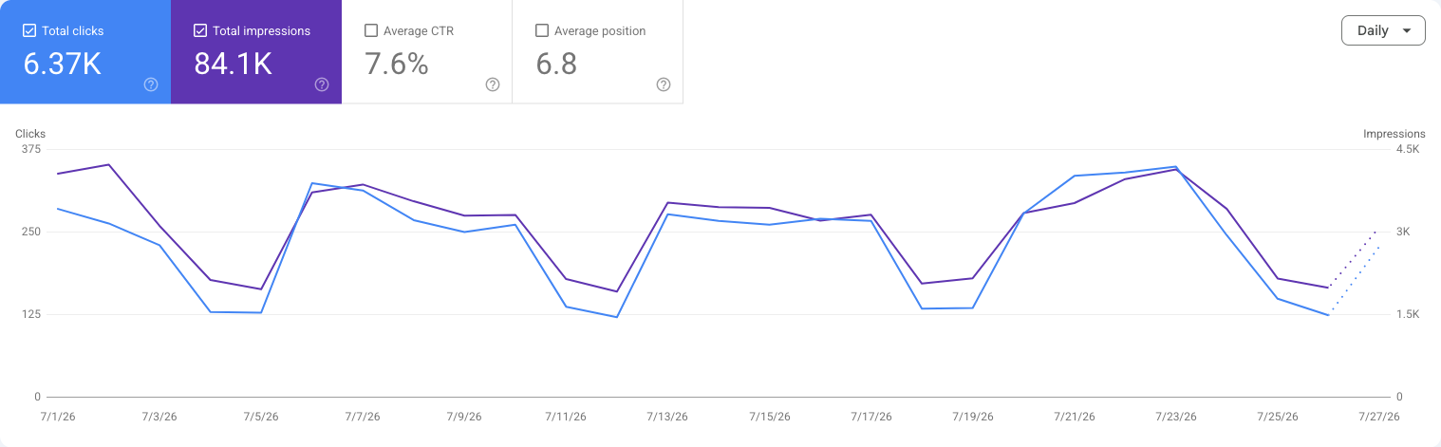
Search Performance
Achieved substantial search visibility with a 7.6% Click-Through Rate.
Attaining 84.1K impressions, the brand demonstrates significant presence within search results, underscoring robust keyword coverage and sustained discoverability. This visibility yielded 6.37K clicks, signifying valuable traffic acquisition originating directly from search engines.
The 7.6% click-through rate indicates strong impression-to-click conversion. This suggests compelling meta titles and descriptions that effectively resonate with searcher intent.

Slide 9
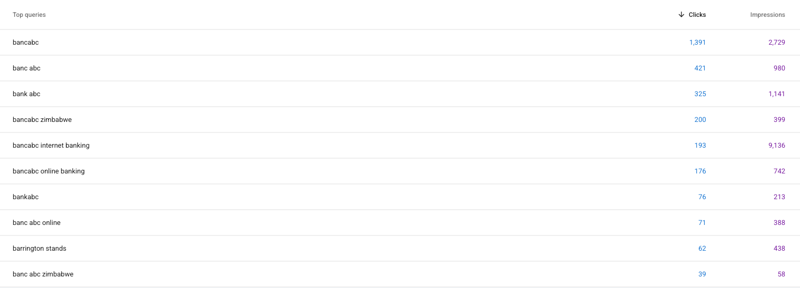
Top Queries
The leading search queries were “bancabc” (1,391 clicks) and “banc abc” (421 clicks). These terms represent the strongest sources of organic search traffic during the reporting period.

Slide 10
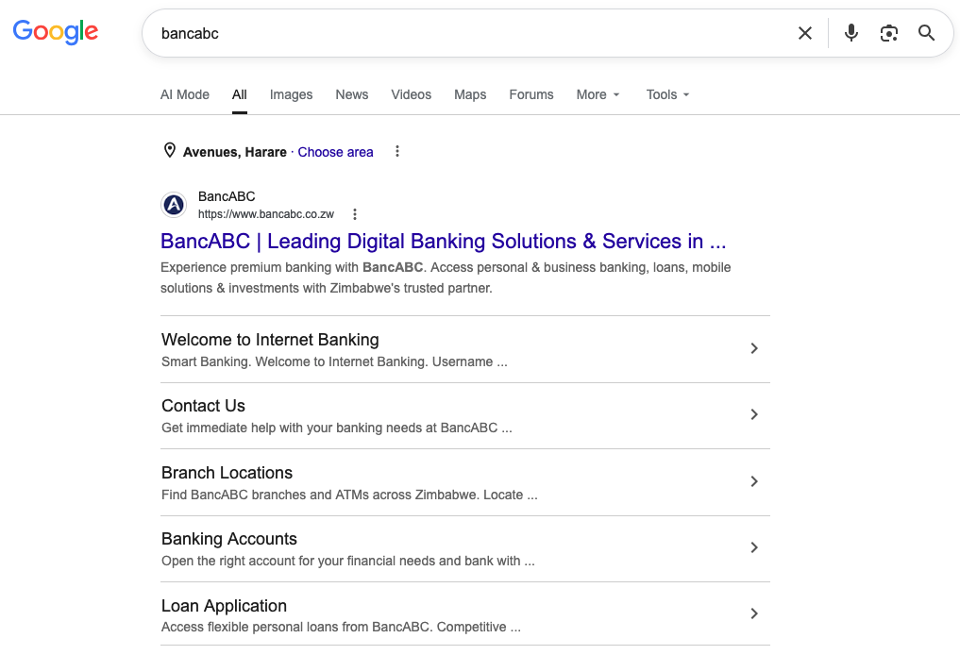
SEO
BancABC
The search results for BancABC are correctly pulling through relevant brand-owned and associated pages, with the official BancABC website appearing prominently as the top result. This indicates that the brand has strong search visibility and is discoverable when users search for BancABC directly. ​

Slide 11
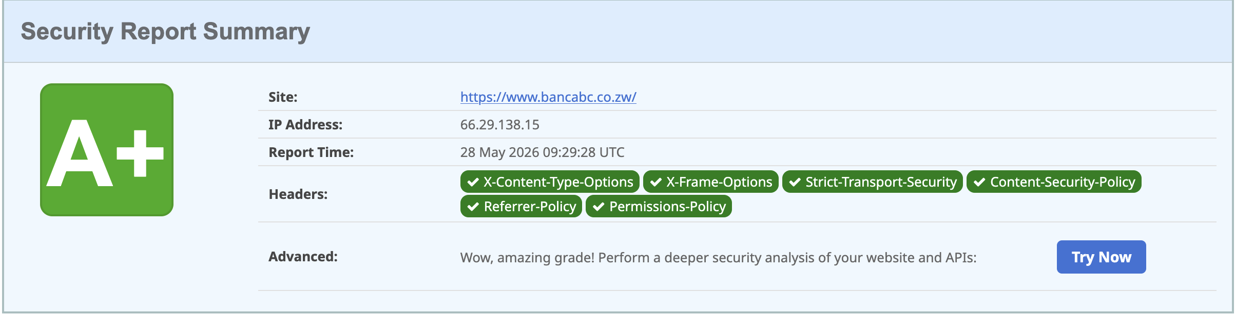
Security
Security Overview​
No malware was detected on the website​
The site is not listed on any known blacklists​
A total of 9 blacklist databases were checked​
The website has achieved an A+ security rating,
indicating a very strong security posture​
The scan confirms that key security configurations are
properly implemented​
Risk Assessment​
The website is currently classified as Low Security Risk​
No immediate threats or critical vulnerabilities were
identified​
The overall security posture is stable and well-
protected​

Slide 12
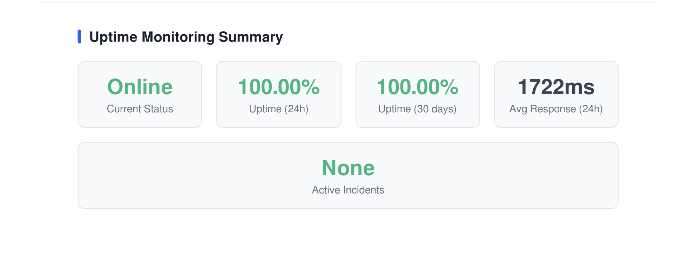
Uptime and System Reliability Insight
​
The website demonstrates strong operational stability,
maintaining a 100% uptime over the past 24 hours and
100% uptime over the last 30 days, indicating highly
reliable service availability.​
The average response time of 1722ms reflects
acceptable performance, though there is an opportunity
to further optimize speed for an improved user
experience.​ ​
Overall, the system is stable, reliable, and performing
well, with minimal downtime and no active incidents.
Continued monitoring and performance optimization
will help maintain and further enhance service quality.​

Slide 13
Recommendations

Slide 14
THANK YOU

