Slide 1

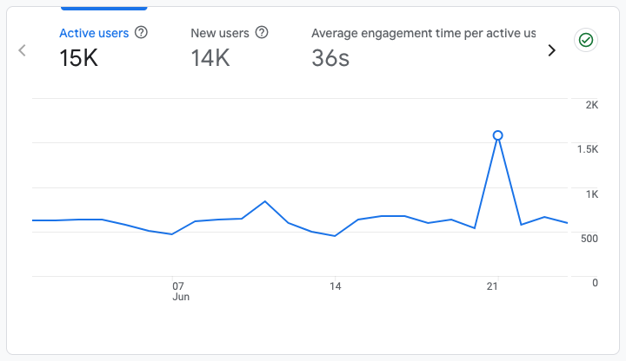

Website Performance Report
Analysis & Strategic Insights
June,2026

Slide 2
Overview

Slide 3
Executive Summary
Performance overview shows 93.3% of users are first-time visitors.
The Delta website achieved strong overall performance during the review period, drawing 15K active users, with 14K (93.3%) identified as new visitors. This substantial ratio of first-time users demonstrates successful audience acquisition and consistent brand presence across digital channels.
From a search visibility standpoint, the website registered 1.39K impressions, a 0.9% click-through rate, and an average search position of 5.9. This reflects strong organic discoverability and continued relevance in search results.
An average engagement time of 36s signifies substantial user interaction with the content. Visitors are dedicating time to engagement rather than prompt exits, reflecting relevant and compelling content irrespective of audience size.
15K
Active Users
93.3%
N ew Visitors
0.9%
CTR

Slide 4
Site Overview
Active User Baseline of 15K Demonstrates Robust Engagement.
15K
Total Active Users
14K
New Users (93.3%)
36s
Avg Engagement Time
The Delta website exhibited solid performance, recording 15K active users this period. Of these, 14K users (93.3%) were new visitors, underscoring strong brand discovery and the efficacy of current reach and awareness initiatives.
An average engagement time of 36s demonstrates moderate yet meaningful interaction. While slightly below longer-form corporate benchmarks, this duration suggests users review key information sufficiently rather than exiting immediately.

Slide 5
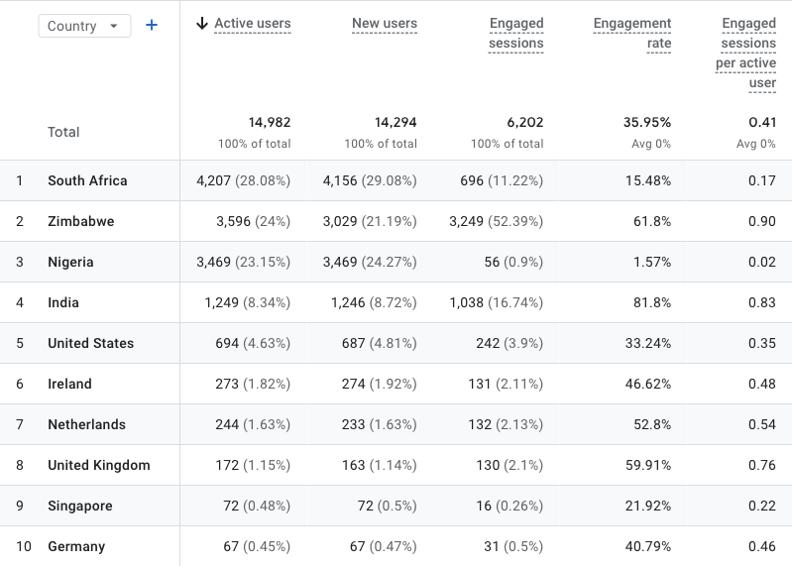
Geographic Performance
South Africa leads, presenting international growth opportunities.
South Africa stands as the dominant market in geographic performance, providing 4,207 users (29.96% of total traffic). Its 15.48% engagement rate and 0.17 engaged sessions per user deliver strong volume with steady interaction.
Zimbabwe (3,596 users) achieves a 61.8% engagement rate, while Nigeria (3,469 users) records a 1.57% engagement rate, indicating stronger visit quality despite lower traffic volumes.
Significantly, smaller markets Zimbabwe (61.8%), India (81.8%), Netherlands (52.8%), United Kingdom (59.91%) demonstrate strongest engagement efficiency, suggesting high-intent audiences.
Overall, South Africa drives scale; select international markets show strong engagement depth and potential conversion value.

Slide 6
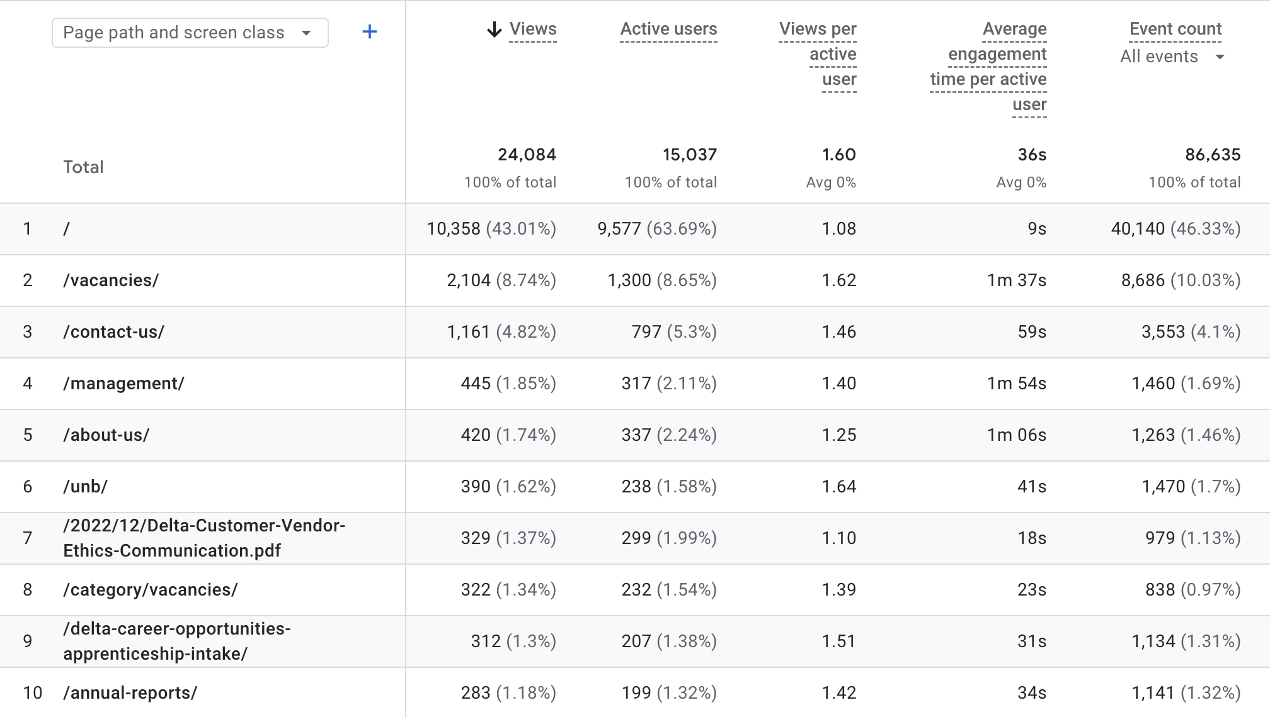
Page Performance
The Homepage and Vacancies pages drive the most meaningful engagement.
Overall Insight:
The Homepage drives the highest traffic, accounting for 43% of total views (10,330 views), with 1.08 views per active user and an average engagement duration of 9s. This substantial volume indicates strong content discoverability and user interest.
Secondary pages such as Vacancies and Contact Us contribute meaningful traffic, but with more limited evidence of deep exploratory browsing.
Pages with the deepest browsing engagement include Unb (1.64 views per user), Vacancies (1.62 views per user), Delta Career Opportunities Apprenticeship Intake (1.51 views per user), indicating stronger exploration intent and higher content value for those visitors.

Slide 7
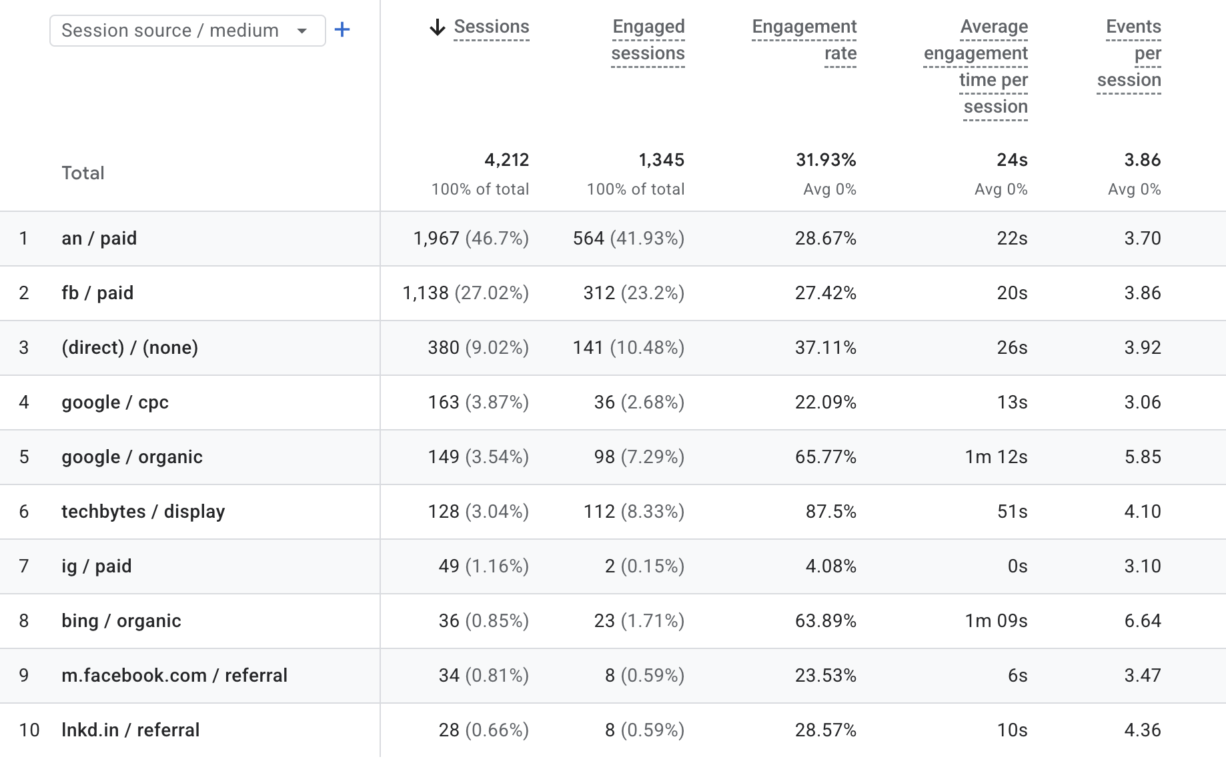
Traffic Acquisition
Overall Insight:

Slide 8
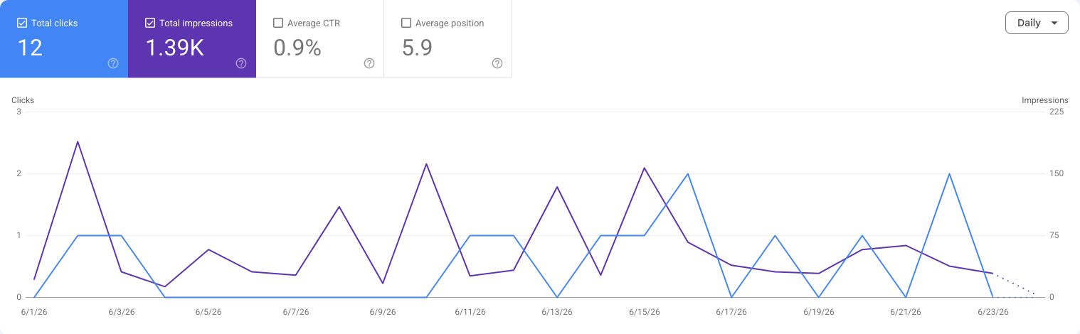
Search Performance
Established search presence presents a CTR optimization opportunity.
The brand secured 1.39K impressions, demonstrating substantial search result presence, strong keyword coverage, and consistent discoverability. This visibility yielded 12 clicks, signifying effective traffic acquisition directly from search engines.
An encouraging average position of 5.9 places the website on the first page for numerous search queries. This metric validates robust SEO foundations and confirms competitive ranking strength within the market.
Performance trends show relative stability across the period, featuring normal fluctuations without significant declines, which indicates consistent search demand and sustained visibility.

Slide 9
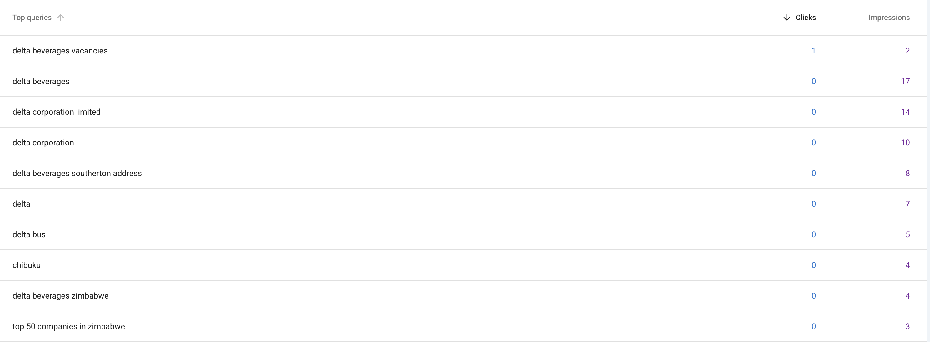
Top Queries
Brand-driven searches dominate, with terms like “delta beverages” (17 impressions) and “delta beverages vacancies” (2 impressions) leading performance, indicating strong brand recognition and direct user intent​​

Slide 10
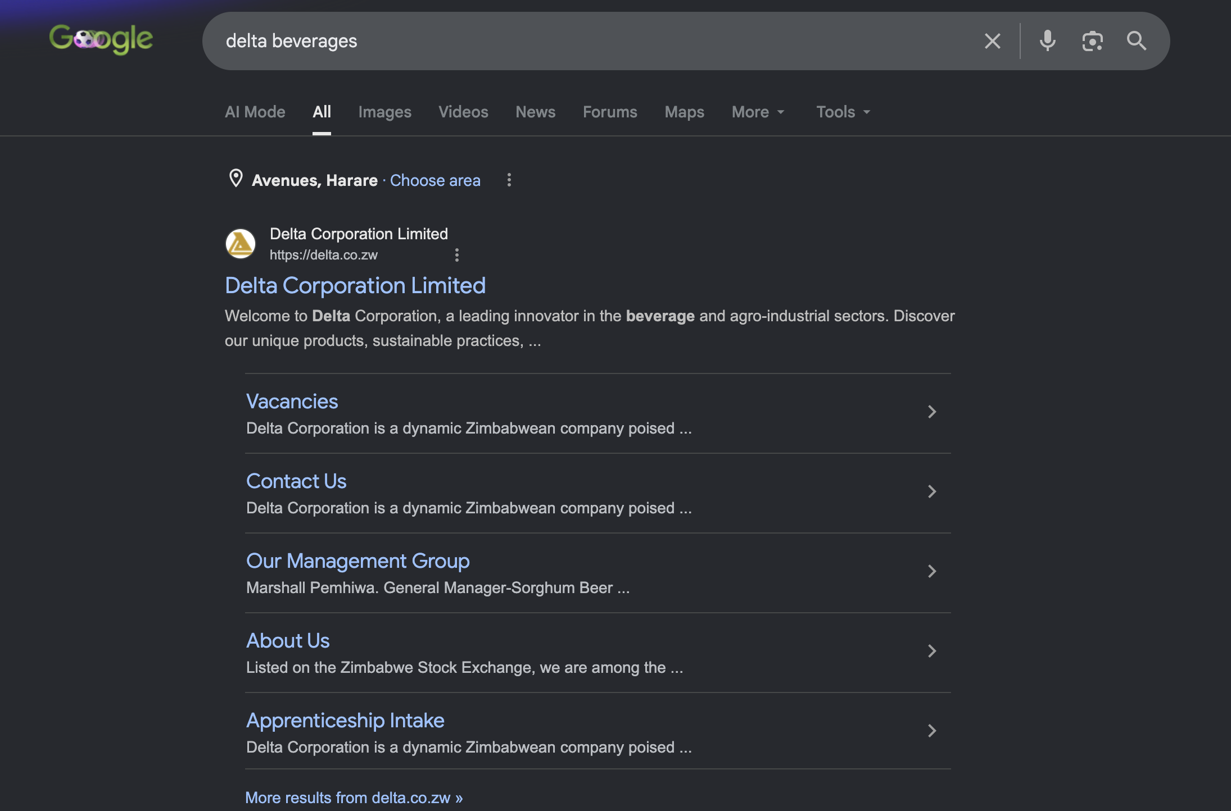
SEO
Delta Beverages
The search results for Delta Beverages are correctly pulling through relevant brand-owned and associated pages, with the official Delta website appearing prominently as the top result. This indicates that the brand has strong search visibility and is discoverable when users search for Delta directly. ​

Slide 11
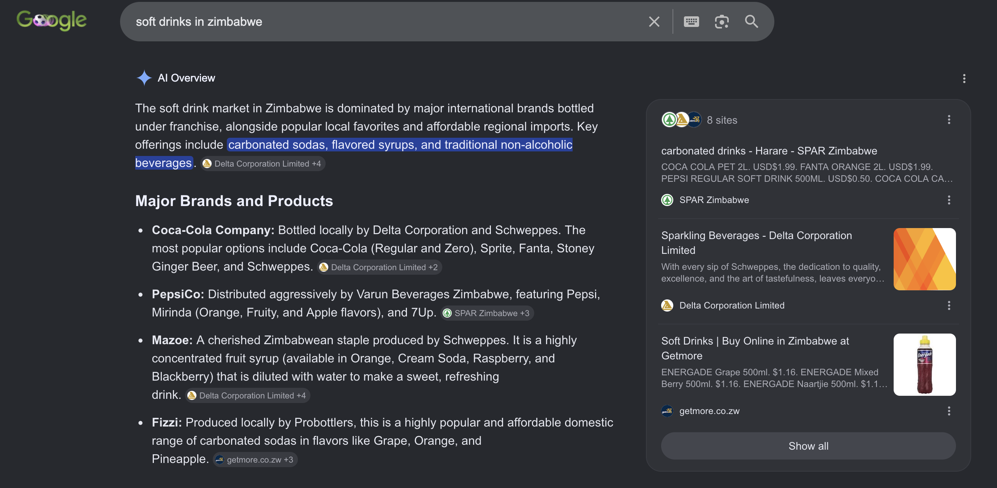
SEO
Delta Beverages
Coca-Cola, bottled locally by Delta Beverages, ranks prominently in Google’s AI Overview for “soft drinks in Zimbabwe.” This indicates that Delta has strong category-level visibility, with one of its major bottled brands being recognised as a leading soft drink option in the local market.

Slide 12
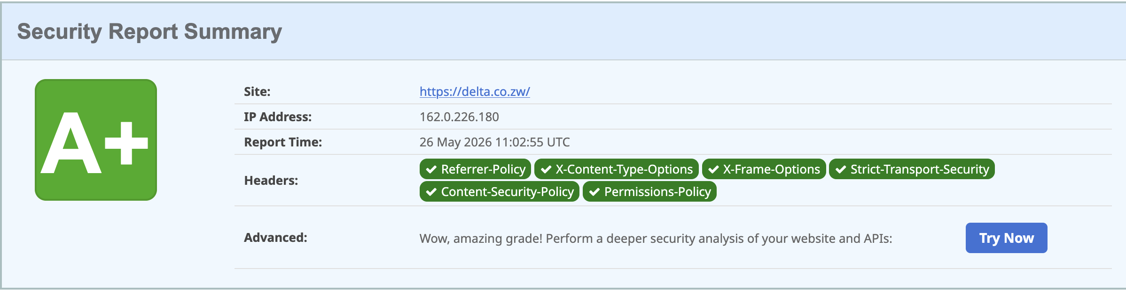
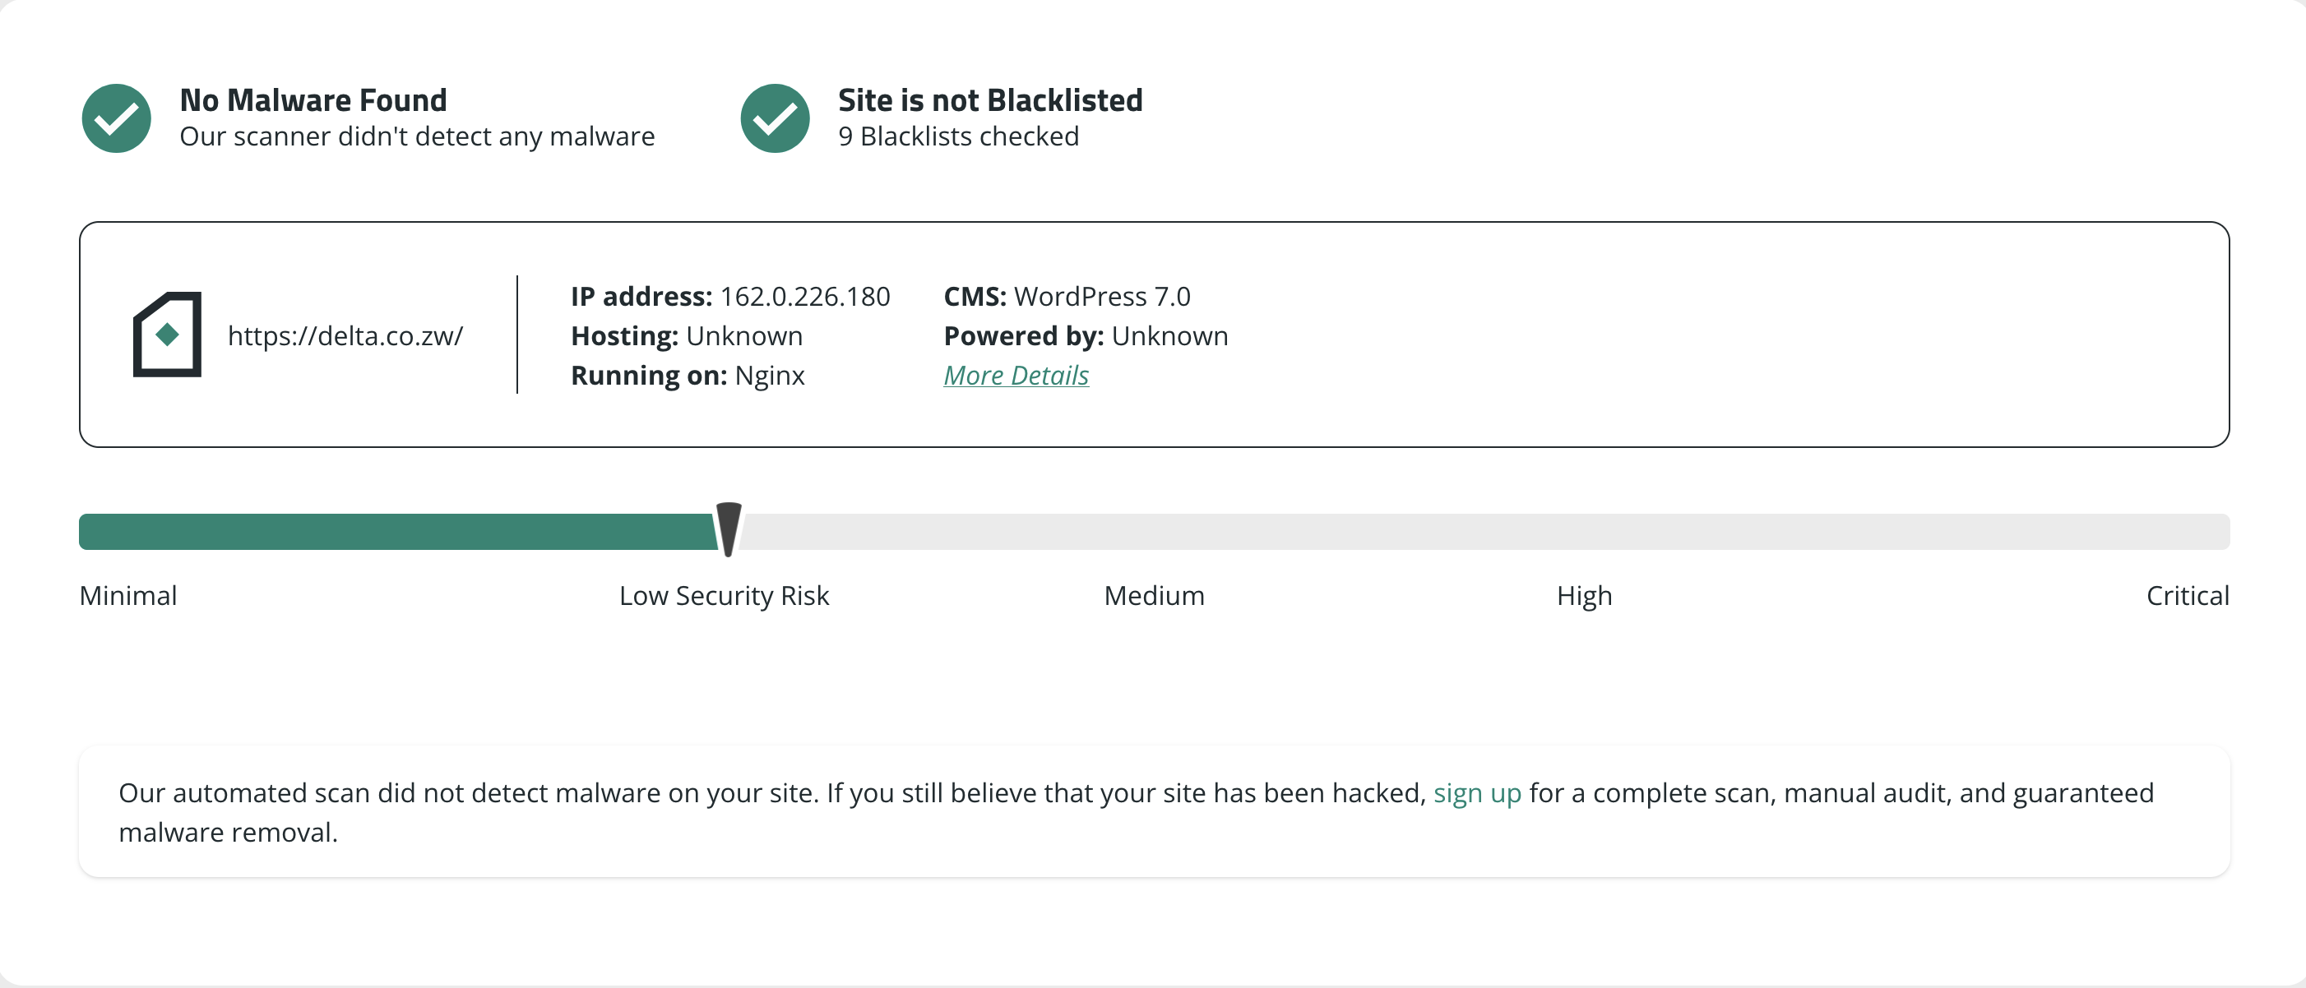
Security
Security Overview​
No malware was detected on the website​
The site is not listed on any known blacklists​
A total of 9 blacklist databases were checked​
The website has achieved an A+ security rating,
indicating a very strong security posture​
The scan confirms that key security configurations are
properly implemented​
Risk Assessment​
The website is currently classified as Low Security Risk​
No immediate threats or critical vulnerabilities were
identified​
The overall security posture is stable and well-
protected​

Slide 13
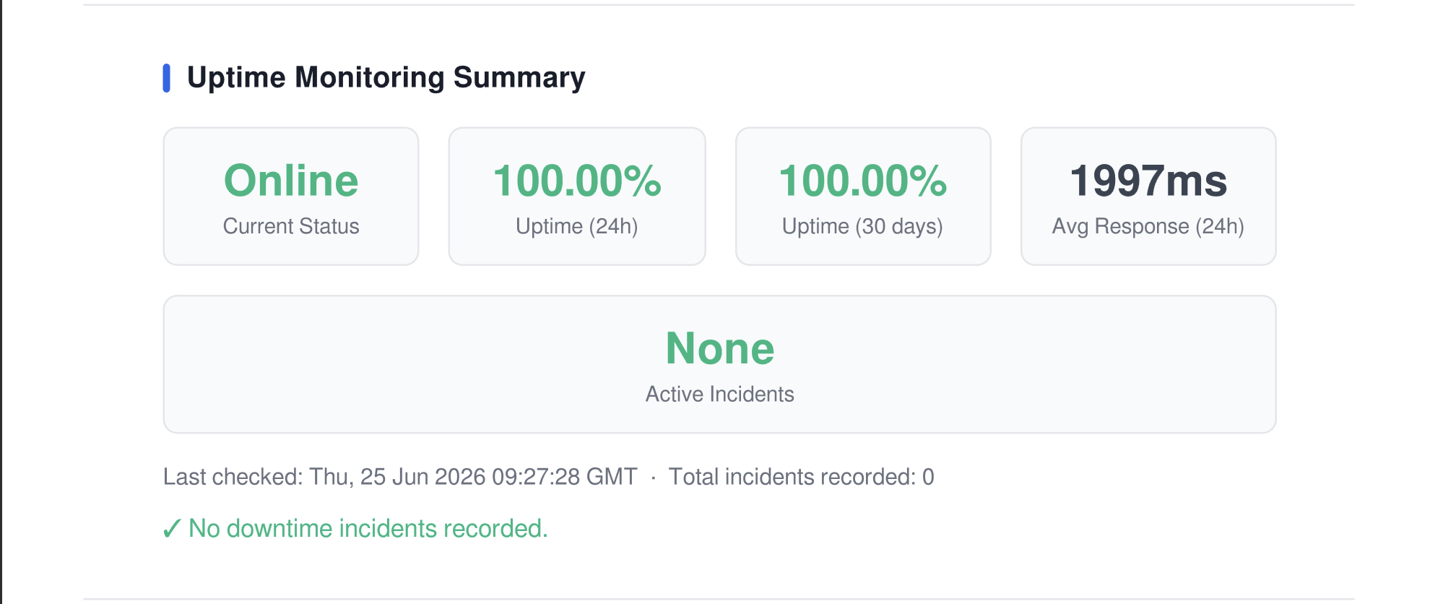
Uptime and System Reliability Insight
​
The website demonstrates strong operational stability,
maintaining a 100% uptime over the past 24 hours and
100% uptime over the last 30 days, indicating highly
reliable service availability.​
The average response time of 1997ms reflects
acceptable performance, though there is an opportunity
to further optimize speed for an improved user
experience.​ ​
Overall, the system is stable, reliable, and performing
well, with minimal downtime and no active incidents.
Continued monitoring and performance optimization
will help maintain and further enhance service quality.​

Slide 14
Recommendations

