Slide 1
History of development and prospects of NFC
Moiseenko Pavel
2 year, CSCE, Iitito, Herzen University

Slide 2
What is NFC?
Near-field communication (NFC) is a set of communication protocols for communication between two electronic devices over a distance of 4 cm (1​¹/₂ in) or less. In other words, NFC allows an ordinary user to quickly transfer a contact or video from one smartphone to another with a simple touch of these devices, as well as make contactless payments by replacing bank cards.

Slide 3
The history of development
In 1983, the history of NFC begins. On May 17 of that year, Charles Walton, an electrical engineer by training, received a patent for a “portable RF emitter-identifier.” This is how the very concept of RFID (Radio Frequency IDentification) appears — a way of automatically identifying objects in wich data stored in the so-called transponders or RFID tags are read or written using radio signals.
On December 8, 2003, NFC was aproved as an ISO/IEC standard, and then as an ECMA standard.

Slide 4
On March 18, 2004, Nokia, Royal Philips Electronics and Sony Corporation organized the NFC Forum, a nonprofit association to promote and standardize NFC technology for use in consumer electronics, computers and mobile devices. In 2006, the initial specification of NFC tags appeared, and in 2007 the first commercial phone with an NFC chip, Nokia 6131, was released. In May 2009, the NFC Forum introduced the peer-to-peer mode for transferring various information between devices with NFC chips: links, contacts, data for establishing communication via Bluetooth. In March 2011, Google joined the NFC Forum.

Slide 5
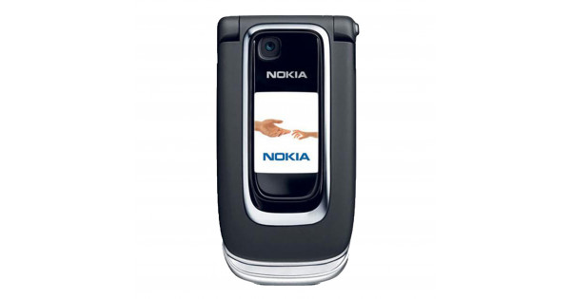

Slide 6
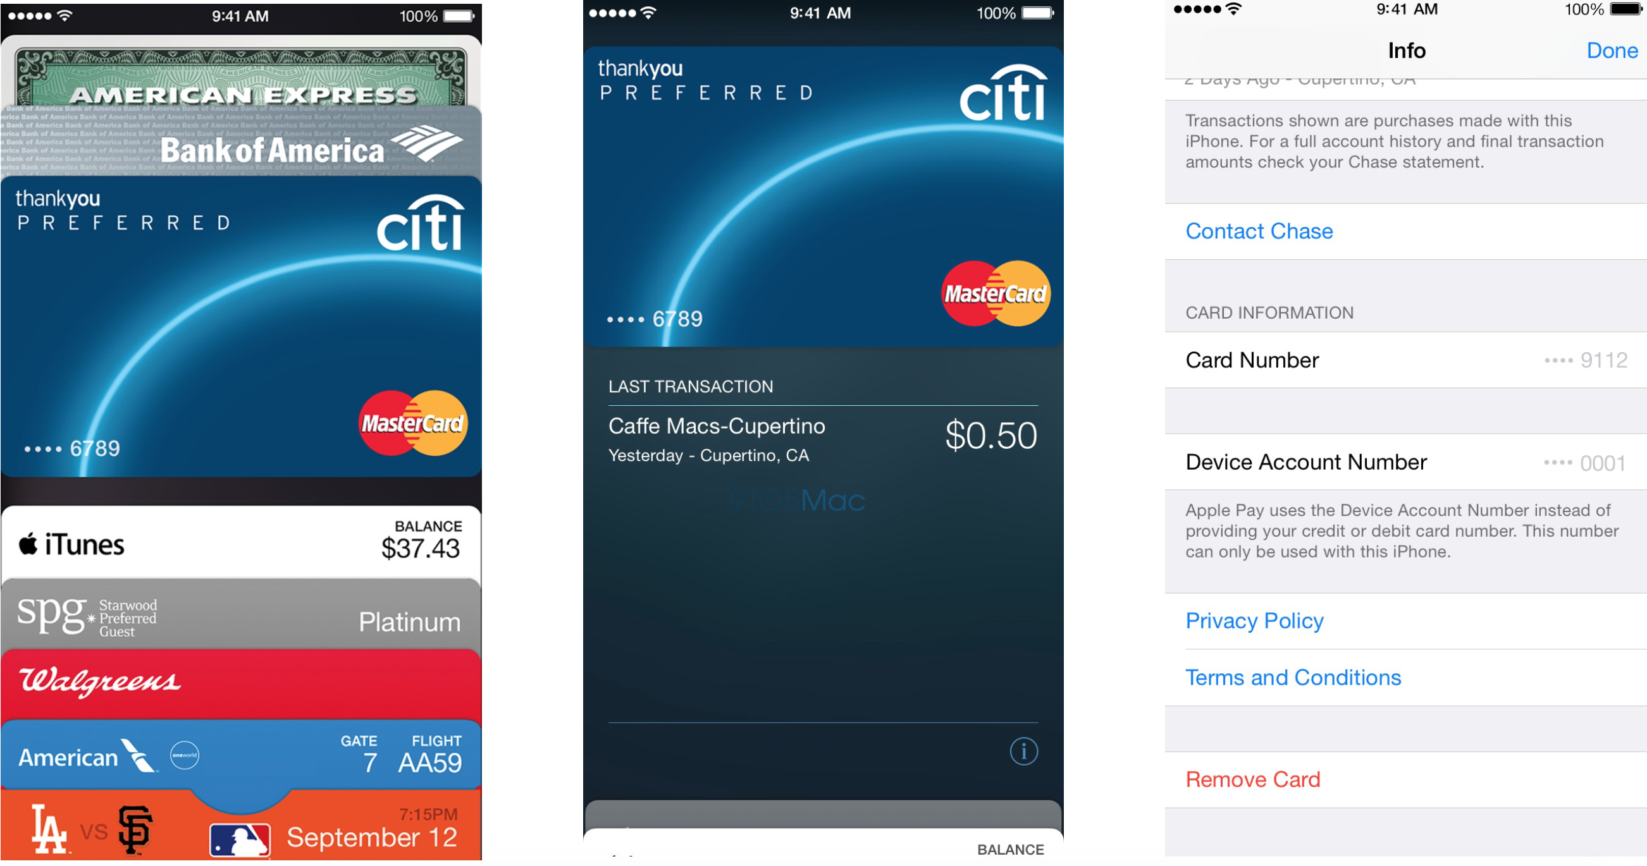
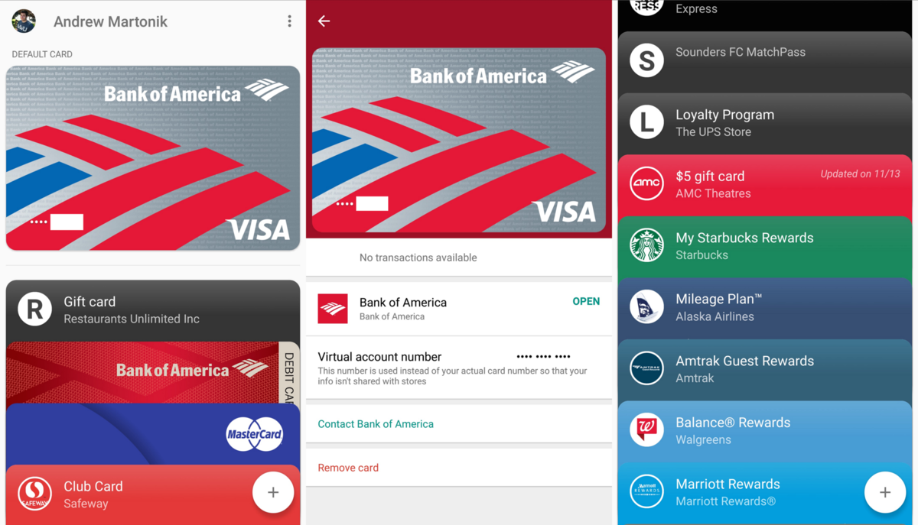
In May 2011, Google announced Google Wallet, a mobile application for linking bank cards to smartphones with NFC chips.
In August 2011, Nokia announced that all upcoming Symbian smartphones will be equipped with NFC chips.
In 2012, Sony introduced NFC smart tags for changing modes and profiles on a Sony smartphone at close range, which appeared in the Sony Xperia P smartphone released in the same year.
In 2014, Apple introduced Apple Pay with support for mobile payments using NFC on the iPhone 6 and 6 Plus and Apple Watch, which were released on April 24, 2015.
In November 2015, Google's Android Pay feature (now called Google Pay) was launched, which directly competes with Apple Pay. It was first available in the United States.

Slide 7
NFC technology is a logical continuation of RFID technology, and its main difference from the latter is its limited range. While the reading distanse of active RFID tags can reach several hundred meters, NFC tags are only available within 4-10 cantimeters. The operating frequency of NFC-chips is in the unlicenced radio frequency range of the ISM band, used for industrial, medical and scientific purposes, and is 13.56 MHz, and the information transfer rate can be 106, 212 or 424 Kbps.

Slide 8
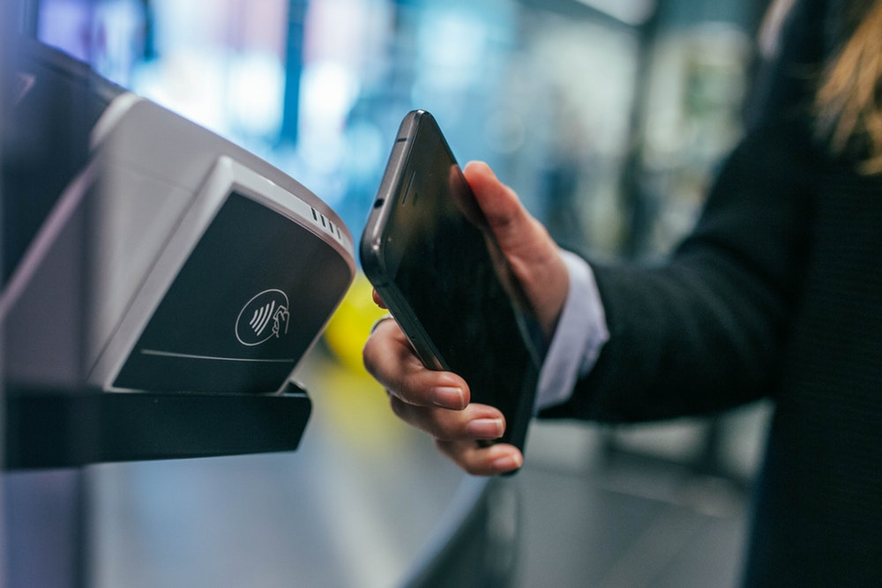

Slide 9
NFC and Bluetooth are short-range comunication technologies that have recently been integrated into mobile phones. A significant advantage of NFC over Bluetooth is a shorter connection setup time. Instead of following the matching instructions to identify the Bluetooth device, the connection between the two NFC devices is established immediately (in less than one tenth of a second). To avoid a complicated pairing process, NFC can be used to establish connections in wireless technologies such as Bluetooth. The maxinum NFC data rate (424 Kbps) is less than Bluetooth (24 Mbps). NFC has a shorter range (less than 20 cm), which provides a greater degree of security and makes NFC suitable for crowded spaces where mapping between the signal and the physical device that transmitted it (and as a result, its user) might otherwise be impossible. Unlike Bluetooth, NFC is compatible with existing RFID structures. NFC can also work when one of the devices is not equipped with a power source (for example, a phone that can be turned off, a contactless credit smart card, smart poster, etc.).

Slide 10
Development prospects
According to Retail Banking Research, the number of mobile payments in Europe will increase by 9 times by 2020 and reach 12.2 billion. According to Juniper Research, the number of NFC-enabled devices in world will also increase significantly by 2020 by 3.9 billion. The results of such studies suggest that contactless payment technologies have enormous development potential, and the possibilities for their application will only expand.
/
Another factor of popularity is the emergence of wearable devices with support for NFC technology, the demand for which continues to grow among the younger generation. The speed of payment and it simplicity inevitably attract the attention of younger generation.

Slide 11
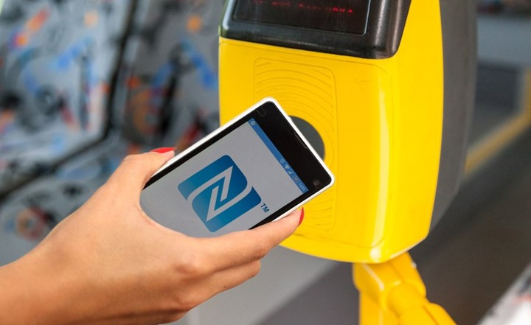
The rapid development of contactless payments is also taking place in the field of transport: now in many cities of the world you can pay for travel by subway or bus, or even purchase plane tickets using only smartphone with the possibility of contactless payment. According to J’son & Partners Consulting, the volume of the Russian smartphone market in 2016 exceeded 26.4 million devices. This indicates the presence in Russia of the infrastructure necessary for the large-scale deployment of contactless payment technologies in all their diversity. According to Christoph Zekhnaker from Mastercard: «Selling transport tickets is one of the strongest drivers in the field of contactless payments, and the realization of its advantages by service providers has become the main driving force in this area. For example, more and more authorities are following the example of organizing the London transport system. In addition the growing number of contactless cards has great potential and transport organizations want to use this opportunity, especially in regions such as France and Russia.»

Slide 12
Спасибо за внимание!!!

