Slide 1
ПРИВЕТ!
Я Моисеенко Павел
Я учусь на 1-ом курсе по направлению ИВТ в РГПУ им. А. И. Герцена.

Slide 2
HELLO!
I am Moiseenko Pavel
I study at the 1st course in the direction of ICT at the Herzen University.

Slide 3
Edmund Gunter

Slide 4
1581—1626
Hertfordshire, England—London, England

Slide 5
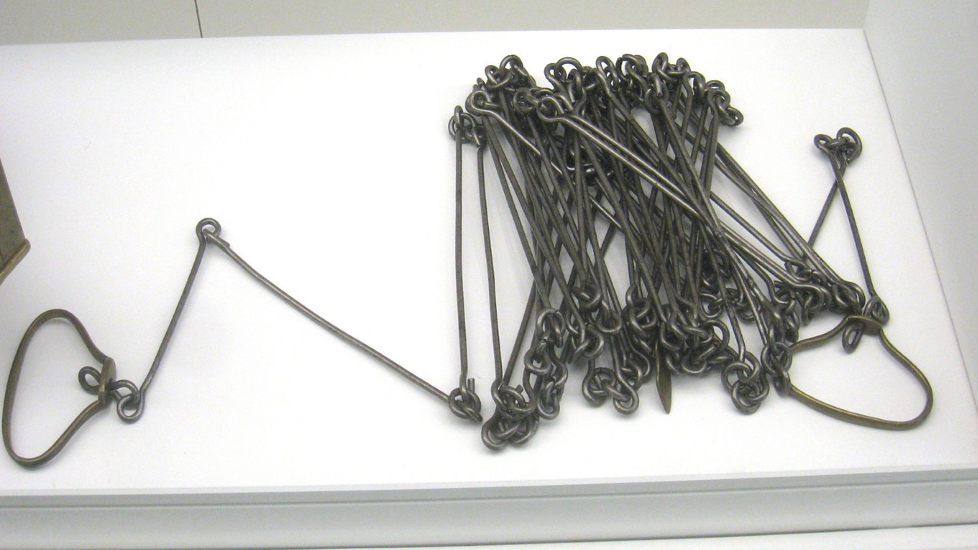

Slide 6
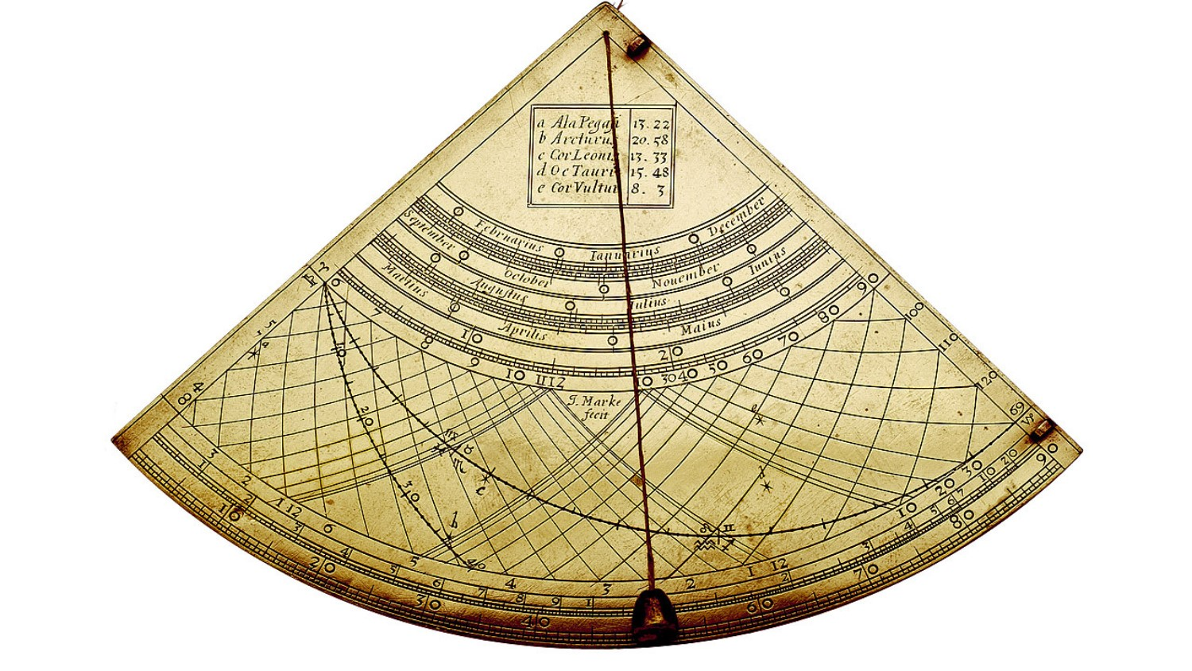

Slide 7
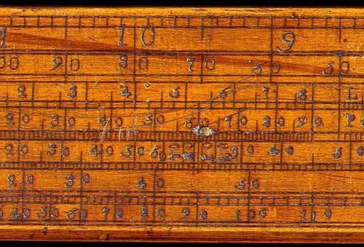

Slide 8
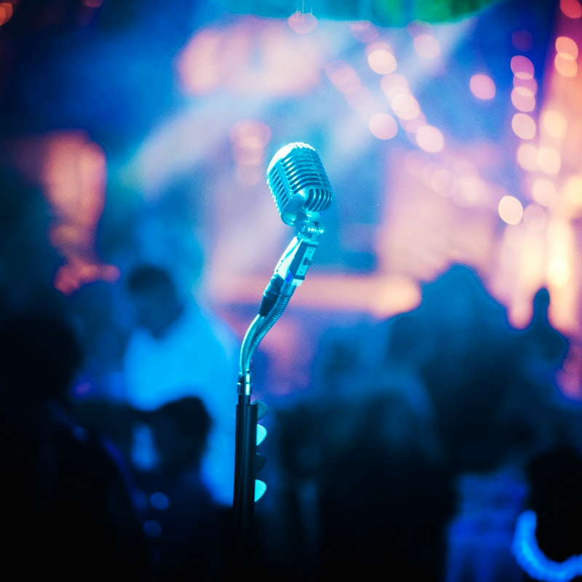
THANKS!

Slide 9
CREDITS
https://www.slidescarnival.com/iago-free-presentation-template/3283
https://en.wikipedia.org/wiki/Edmund_Gunter
https://www.encyclopedia.com/people/science-and-technology/mathematics-biographies/edmund-gunter
https://www.computerhope.com/people/edmund_gunter.htm

