Slide 1

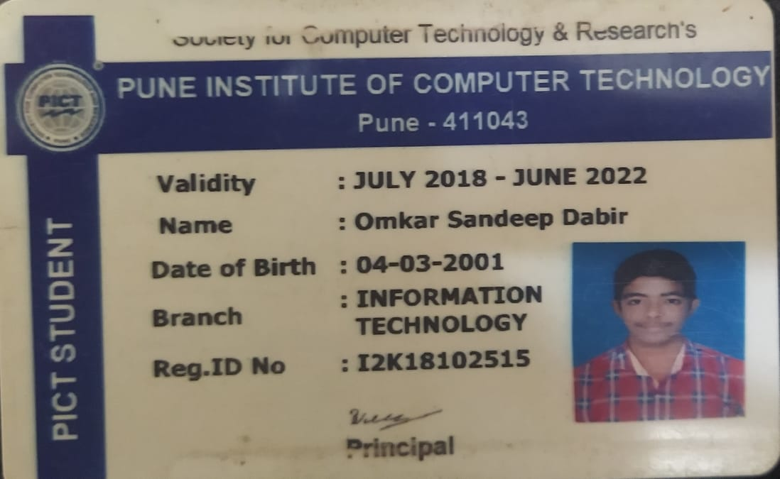
SL-III Assignment 1.1 Document structure
Name : Omkar Dabir
Roll No. : 33115
Class : TE-09
Subject : SL-3

Slide 2
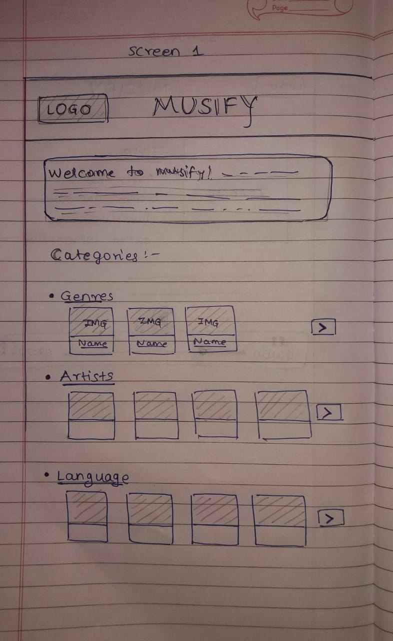
Screen 1
This is the homepage of the website.
It will be mainly consisting of different categories like Genre, Artist, Language and respective albums (collections) as a list.
The links to categories will redirect the user to screen 2.
Tags used :
<header>, <section>, <img>, <div>, <a>, <button>, <h1>, <p>

Slide 3
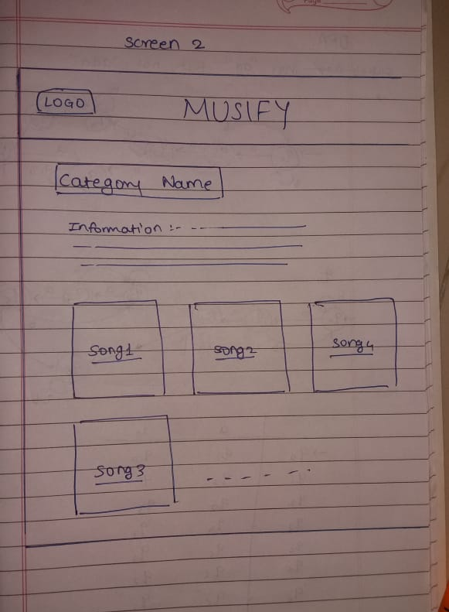
Screen 2
This is a page related to a specific category.
It will contain some information about the category and along with it, will have a list of songs related to the specific category.
When clicked on a song thumbnail, user will be redirected to screen 3.
Tags used :
<img>, <div>, <a>, <button>, <ul>, <li>, <h1>, <p>

Slide 4
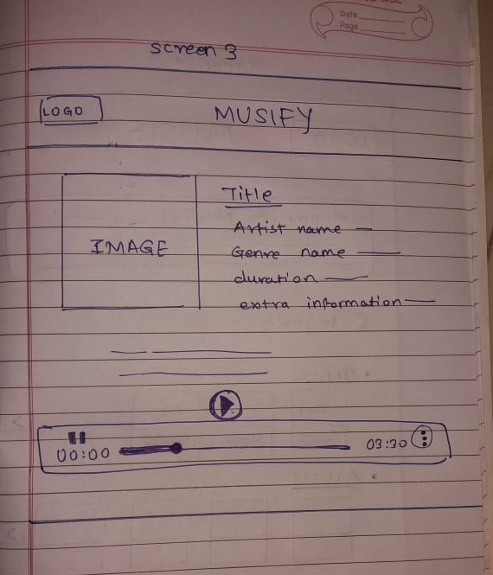
Screen 3
This page will contain all the information of a song.
The song will start playing automatically when the page loads.
The page will also have controls such as play/pause, change volume, mute/unmute, seek, download, etc.
Tags used :
<img>, <audio>, <a>, <button>, <ul>, <li>

Slide 5

Thank you
References used :
https://open.spotify.com/
https://gaana.com/
https://www.youtube.com/

