Slide 1
Capstone Project
The battle of Neighborhoods

Slide 2
Problem Statement
To recommend a fine place to start a restaurant
To recommend the type of restaurant

Slide 3
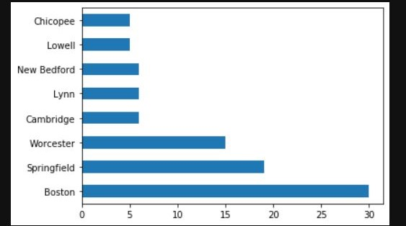
City selected
State: Massachusetts
City: Boston
It’s one the largest city in MA, and that it houses people from various countries because of the prestigious universities located there

Slide 4
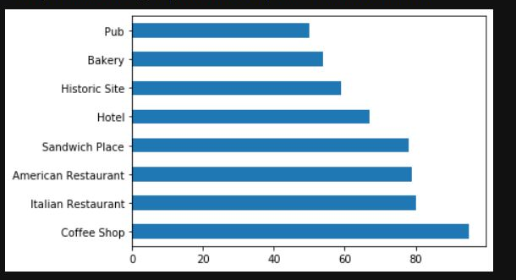
Venue recommended
Based on the venue details obtained from Foursquare API two categories of venues can be recommended
A Café
An Italian Restaurant

Slide 5
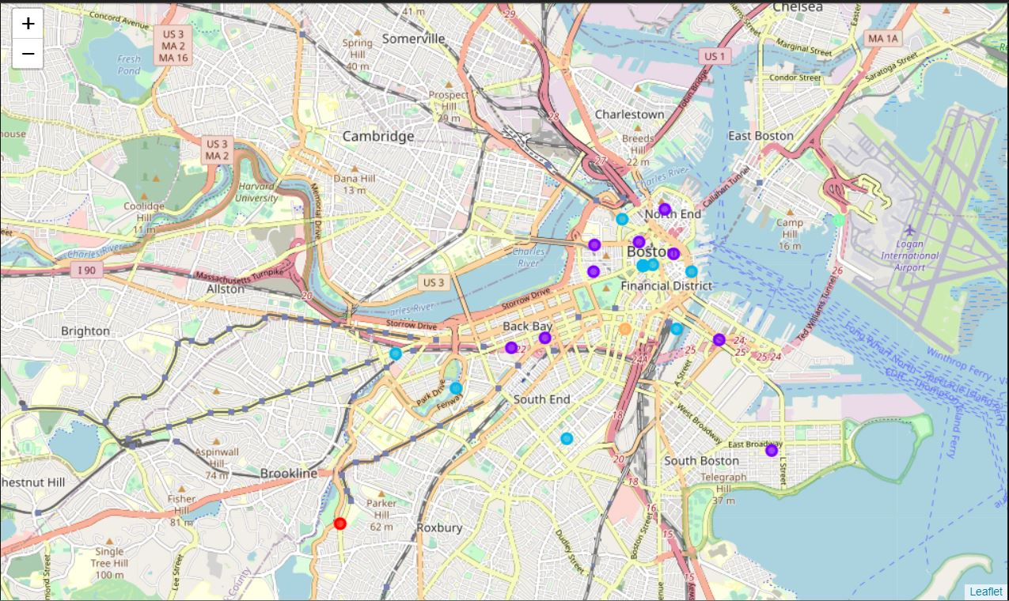
Clustering the neighborhoods
Later we cluster the neighborhoods based on the similarity of categories of venues in each neighborhood and plot them

Slide 6
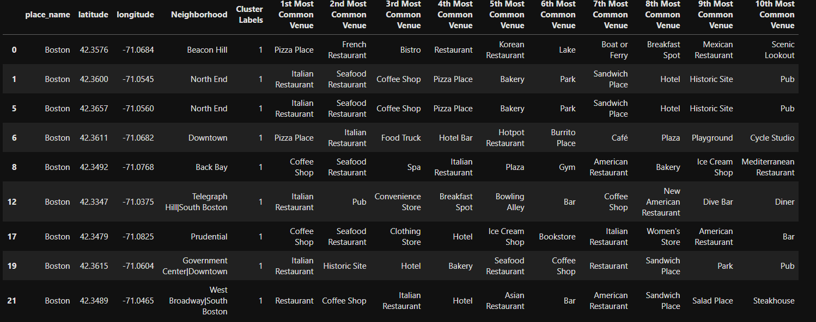
Cluster Analysis
On observing the cluster=1, both the recommended venues have good chances to perform well in those neighborhoods

Slide 7
Recommended Neighborhoods
Prudential
Back bay
North End
West Broadway| South Boston

