Slide 1
Telecom Network Decision-Support Assistant
Technical project review
AI-Powered Historical Incident Retrieval, Network Analytics and Troubleshooting Recommendations

Slide 2

Problem Statement
Recurring network issues
Congestion
High latency
Packet loss
Dropped calls
Project objective
Handover failures
Service degradation
Develop an AI-powered decision-support assistant that converts natural-language network queries into relevant historical evidence, network analysis, risk predictions and troubleshooting recommendations.
Historical records hold metrics, alarms, configuration changes, traffic and past faults, but searching them manually for similar incidents is slow.
Engineers need relevant cases, likely causes, risk assessment and recommended actions.

Slide 3





Proposed Solution
Intelligent Incident Retrieval
Network Analysis
Predictive Analytics
Troubleshooting Recommendations
Interactive Interface
Hybrid keyword and semantic search with metadata filters. Synapt (via MCP) adds domain knowledge and schema context
Root-cause hypotheses, incident classification and potential impact
ML models for performance prediction and fault-risk estimation
Domain-informed suggestions supported by relevant procedures
Natural-language queries, telemetry predictions and scenario comparison
Combines historical evidence, machine learning and domain knowledge to support informed network-engineer decisions. MCP connects the assistant to the Synapt Context Substrate.

Slide 4
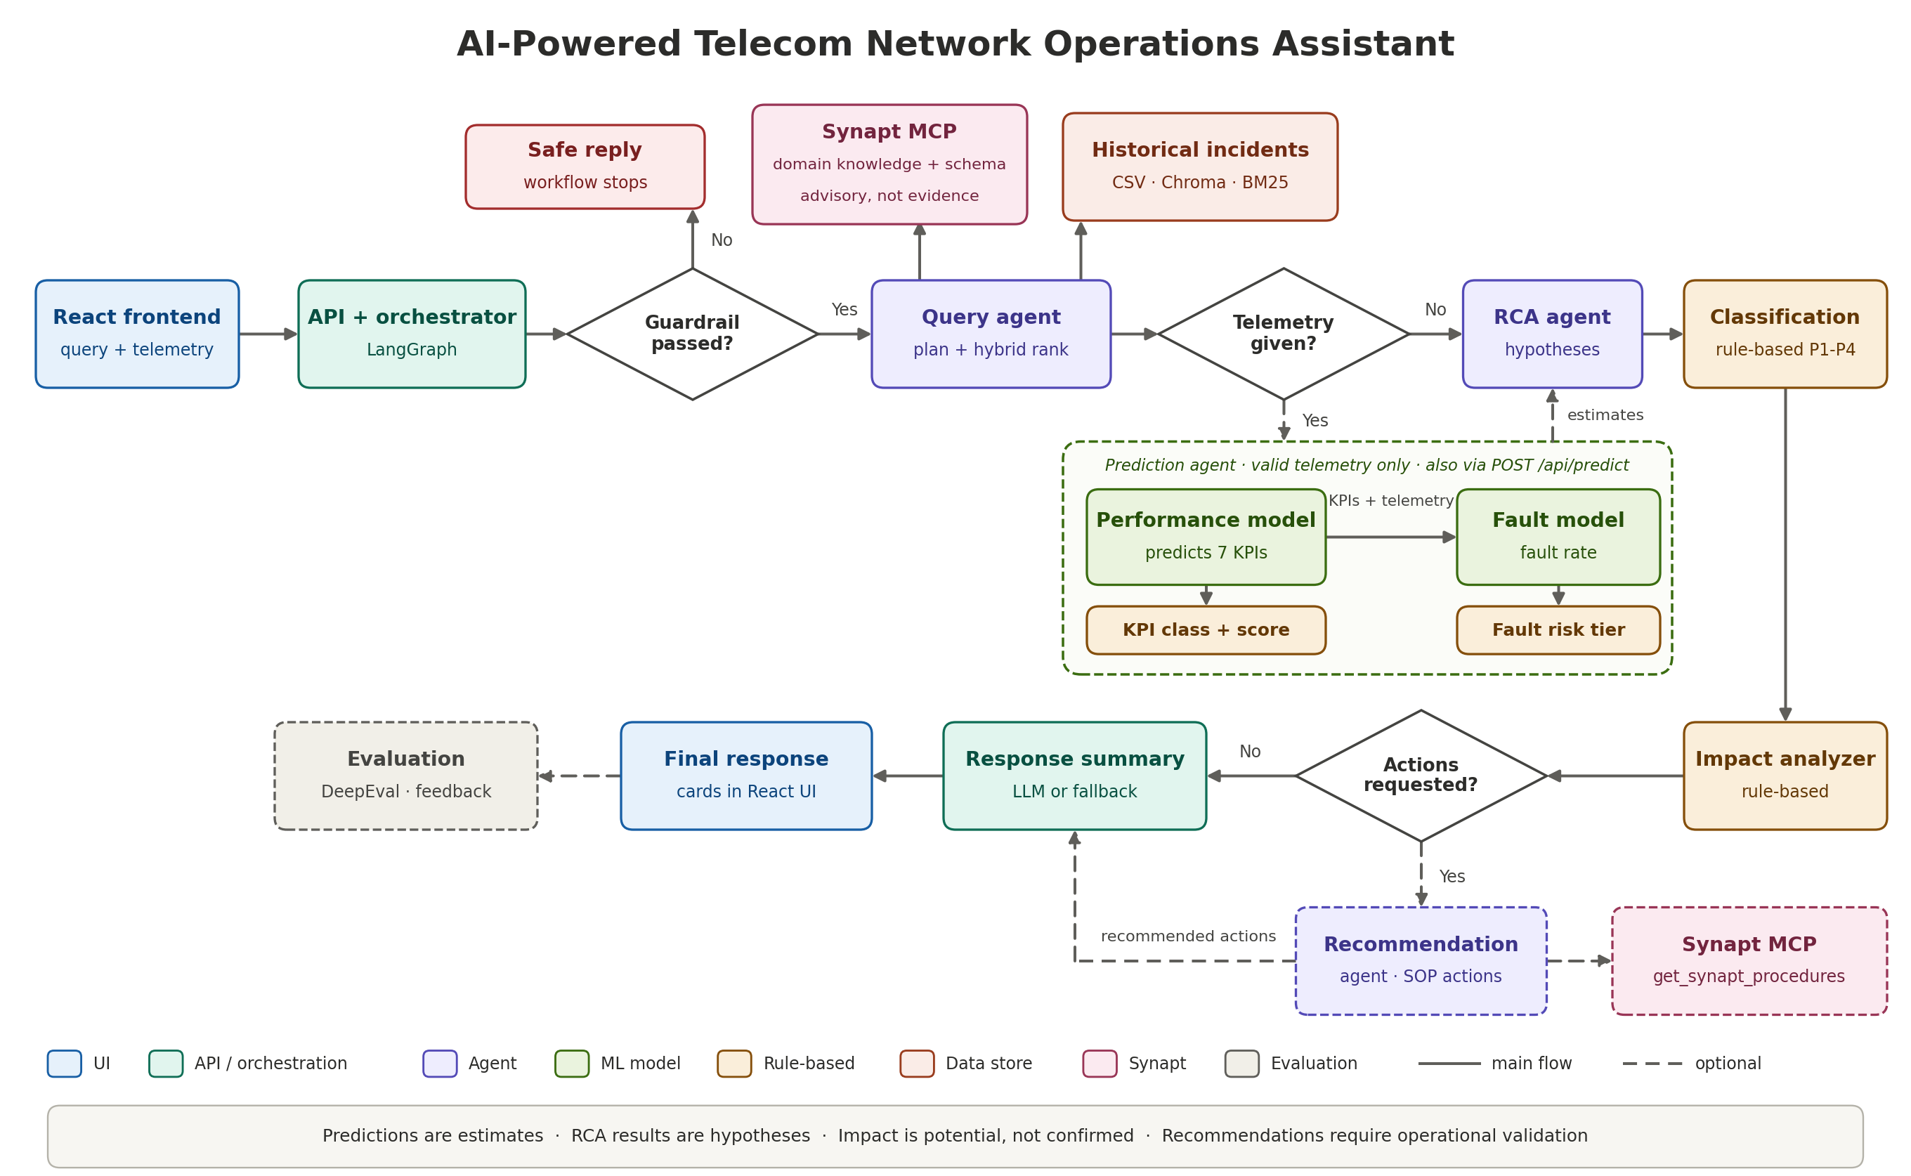

Slide 5
Multi-Agent Application Components
Major AI/ML agents
Decision and rule-based
Control and support services
Query/RAG Agent
QuerySynaptAgent
Synapt context, planning, hybrid retrieval
Rule-Based Incident Classification Agent
IncidentClassificationAgent
P1 to P4 priority and current-scenario classes
Input Guardrail
InputGuardrail
Validates and blocks unsafe input; not an AI agent
Prediction Agent
NetworkPredictionAgent
Performance and fault-risk models
Orchestrator
TelecomAnalysisOrchestrator
LangGraph workflow and shared state
RCA Agent
RCAAgent
Evidence-based root-cause hypotheses
Network Impact Analyzer
NetworkImpactAnalyzer
Rule-based estimate of possible network and service impact
Response summary and assembly
LLM summarizer or fallback
Builds the structured response
SOP Recommendation Agent
RecommendationAgent
Synapt procedures to recommended actions
Evaluation and feedback
DeepEval, contract tests
Feedback stored for later evaluation
Two separate classifications
Prediction Agent
KPI classification
Good · Moderate · Poor · Critical
RCA Agent
Rule-Based Incident Classification Agent
P1 · P2 · P3 · P4

Slide 6
Query Understanding and Hybrid Retrieval
Natural-language query
e.g. latency above 130 ms
Query planning
LLM planner, deterministic fallback
Normalization and filters
metrics, schema, metadata, explicit numeric
Synapt: telecom domain knowledge and schema context
Hybrid retrieval over the historical incident dataset
Ranked historical incidents
evidence for RCA
Hybrid ranking
plus metric relevance scoring
Chroma semantic search
~60% of hybrid score
Historical incident dataset
CSV with applied filters
BM25 keyword search
~40% of hybrid score
Historical incidents are the evidence source. Synapt context is advisory and does not prove root cause.

Slide 7


Network Analysis and Troubleshooting
Root-cause hypotheses
Rule-based incident classification
Ranked, evidence-linked hypotheses
Supporting incidents and metrics
Missing or contradictory evidence noted
Rule-based P1 to P4 priority
Historical and current scenario
Prototype thresholds, not SLAs
Potential impact assessment
Procedure-supported recommendations
Possible network and service effects
Rule-based, uses telemetry and predictions
Not confirmed customer impact
Procedures retrieved through Synapt
Converted into recommended actions
Runs only when requested
Evidence
Hypotheses link to historical incidents
Uncertainty
RCA is a hypothesis, impact is potential
Validation
Engineers confirm against approved procedures

Slide 8
Machine Learning and Prediction
The telemetry also goes to the fault model as input
Current telemetry
valid inputs only
Network performance model
predicts 7 KPIs
7 predicted KPIs
Fault tolerance model
predicts fault occurrence rate (%)
Risk tier
LOW to CRITICAL
Rule-based KPI classification
Good to Critical, status, score
How the prediction runs
1
Telemetry enters the prediction agent
2
The network performance model predicts the 7 KPIs
3
The predicted KPIs are added to the telemetry as input
4
The fault tolerance model predicts the fault rate and risk tier
Requires valid telemetry. Predictions are estimates, not live observations.

Slide 9
Application Demo
Screenshot
Screenshot
Screenshot
1 AI Assistant
Ask a network question: evidence, RCA, impact, recommendations
2 ML Prediction
Enter telemetry: KPI predictions and fault risk
3 Scenario Comparison
Current vs what-if telemetry: score and status change

Slide 10
Evaluation Results
ML model evaluation
0.96
RAG retrieval quality
DeepEval judge metrics, test case latency_above_130
80,000 training samples, 20,000 held-out test samples
Network Performance Model
good
R² score
0.9782
Retrieval
RCA
Final answer
MAE
29.44 Mbps
Contextual Precision
1.00
RCA Quality [GEval]
1.00
Answer Relevancy
1.00
RMSE
35.42 Mbps
Contextual Recall
1.00
Faithfulness
1.00
Faithfulness
0.86
Fault Risk Model
good
Contextual Relevancy
1.00
Evidence and Caution
1.00
Hallucination
1.00
R² score
0.9907
Filter Compliance
1.00
MAE
1.07%
Final-answer faithfulness 0.86
The output stated 165 historical incidents, but the retrieval context listed only 5.
RMSE
1.35%

Slide 11
Conclusion
One decision-support workflow, from input guardrail to response
1
Input guardrail validates and blocks unsafe or irrelevant queries
Synapt Context Substrate, via MCP
Connected through the Model Context Protocol. Two key uses:
1 Telecom domain knowledge and schema context
ask_synapt in the Query agent. Advisory, not evidence.
2 SOP procedures for recommendations
get_synapt_procedures in the Recommendation agent.
2
Query agent Synapt domain context, planning, hybrid incident retrieval
3
Prediction agent performance model, then fault model, with valid telemetry
4
RCA agent evidence-based root-cause hypotheses
5
Classification agent rule-based P1 to P4 priority
6
Impact analyzer possible network and service impact
RCA results are hypotheses
Predictions are estimates
Impacts are potential, not confirmed
Recommendations need operational validation
7
Recommendation agent Synapt SOP procedures turned into actions
8
Response summary structured answer with evidence and metadata
Thank You · Questions & Answers

