Slide 1



PREDICTING FRAUD
IN AUTO INSURANCE CLAIM
B S Raksha
5096
Batch 122

Slide 2
01.
ABOUT THE DATA
Understanding and creating the required data
02.
DATA VISUALIZATION, EDA AND PRE-PROCESSING
Visualizing the data and performing pre-processing steps
03.
MODEL BUILDING AND EVALUATION
Building models and evaluating their performance
04.
PATTERN EXTRACTION AND PREDICTION
Extracting top 20 features and predicting on unseen data
TABLE OF
CONTENT

Slide 3
01.
ABOUT THE DATA

Slide 4
PROBLEM STATEMENT
A major general insurance company has a business problem with significant number of claims being reported are fraudulent in nature and it is leading to loss. The task is to predict the fraudulent ones before even processing the claims to allocate costs appropriately, to keep the thorough investigation process in place and to design proper action plan for the claims to be approved. The goal of the project is prediction of fraud plays in auto insurance claims.

Slide 5
DATA GIVEN
Data of Claim
These files consist of the details about the insurance claim, that the customer applied for
Demographic Data
Consist of the demographic data of each customer.
Policy Information
Consist of the customer auto insurance policy information, connected to the claim with the insurance company
Data of Vehicle
Consist of the details about the Vehicle, connected to the policy.
Fraud Data
Fraud information details

Slide 6

PRE-PROCESS BEFORE MERGING
Demographic Data
The file consists of 10 columns and 28836 rows
InsuredZipCode, although numbers, represent regions in the country and hence are categorical variables.
Policy Information
The file consists of 10 columns and 28836 rows
Policy_CombinedSingleLimit has two values split limit and combined single limit separated by '/'
DateOfPolicyCoverage is a datetime attribute
Claim Information
The file consists of 19 columns and 28836 rows
DateOfIncident is a datetime attribute

Slide 7
PRE-PROCESS BEFORE MERGING
Data of Vehicle
The file consists of 3 columns and 115344 rows
VehicleAttribute has 4 values, namely, VehicleMake, VehicleID, VehicleModel and VehicleYOM
Creating 4 new columns to obtain a file consisting of 5 columns and 28836 rows
Claim Information
The file consists of 2 columns and 28836 rows
DateOfIncident is a datetime attribute

Slide 8

MERGING
All the five data sets have one column in common, CustomerID
We merge the datasets on column CustomerID to obtain our train data set
The train data consists of 2 columns and 28836 rows

Slide 9
02.
DATA VISUALIZATION, EDA AND PRE-PROCESSING

Slide 10
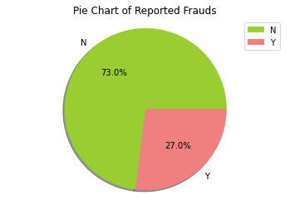
Target: Reported Frauds
458K
73% of the reported data is not a fraud.
26% of the reported data is fraud.

Slide 11
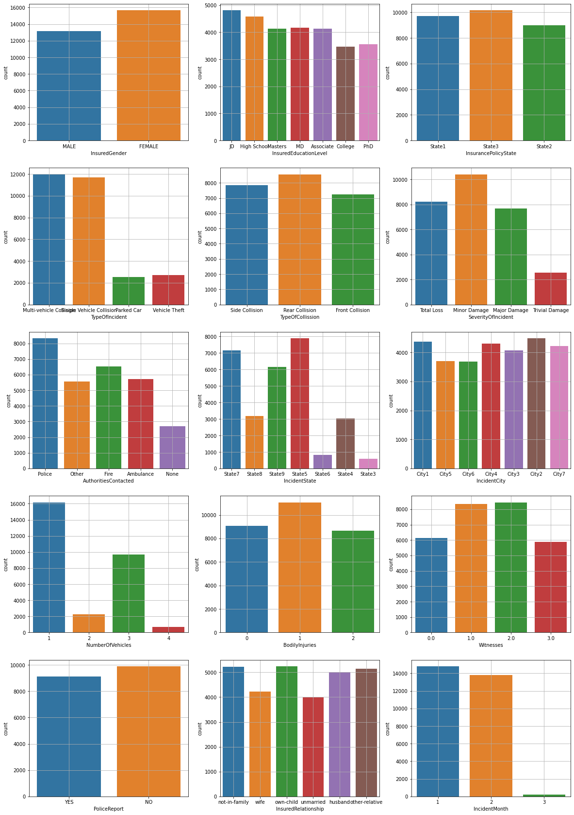
COUNT PLOTS

Slide 14
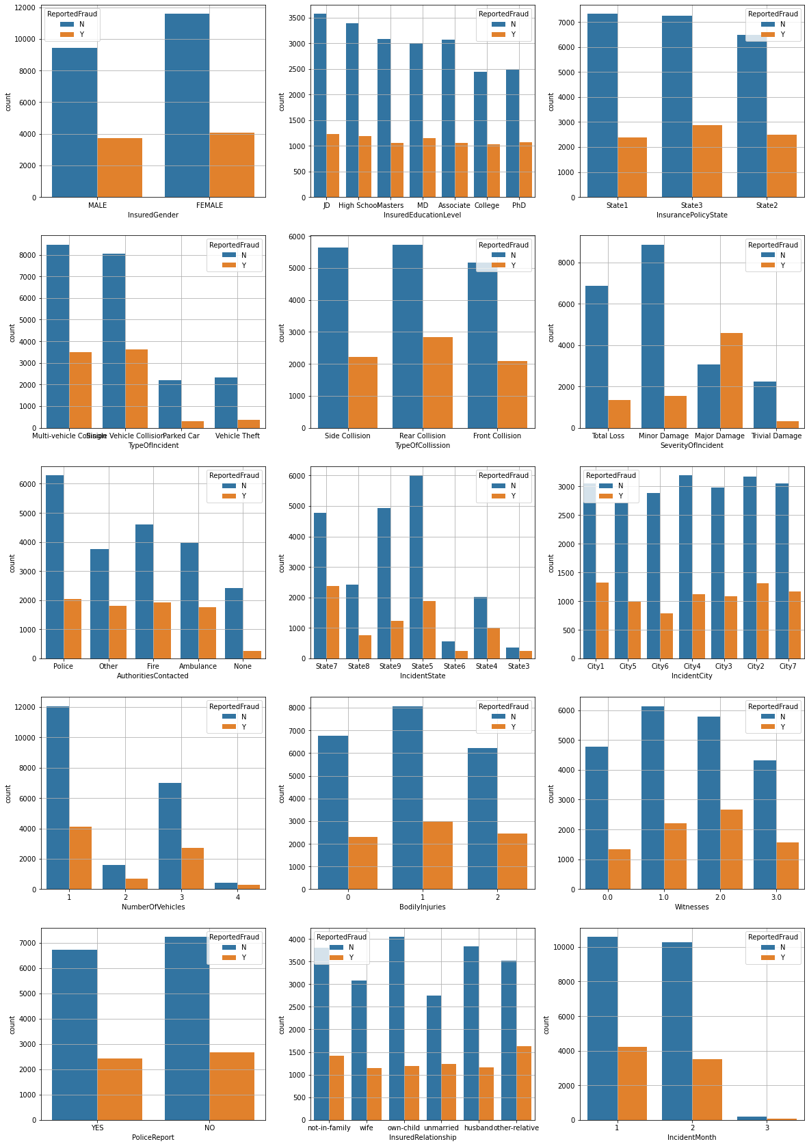
COUNT PLOTS WITH REPORTED FRAUDS

Slide 17
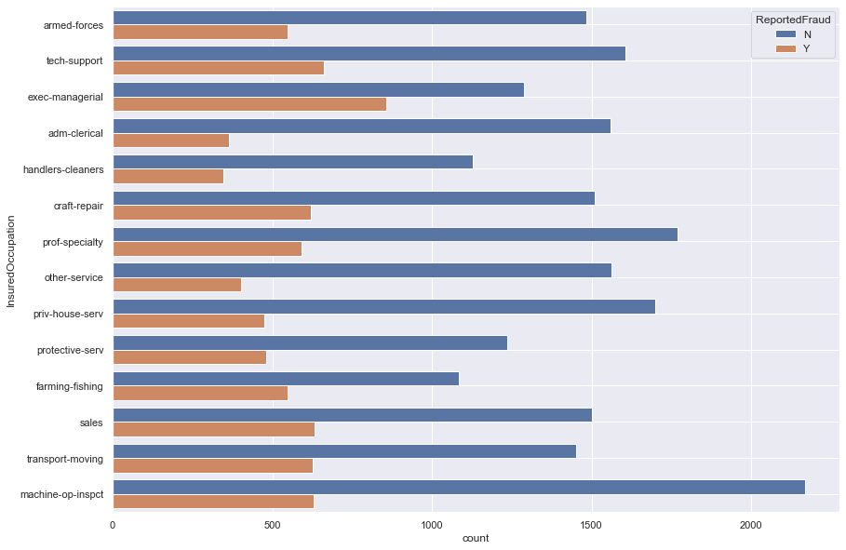

Slide 18
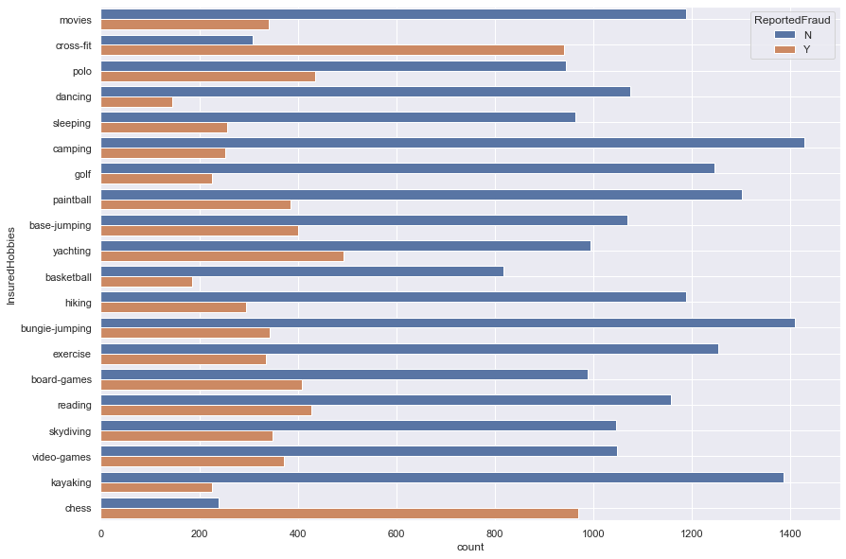

Slide 19
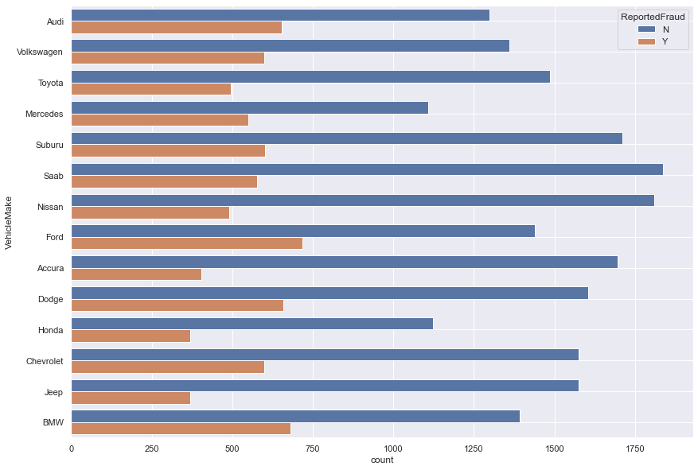

Slide 20
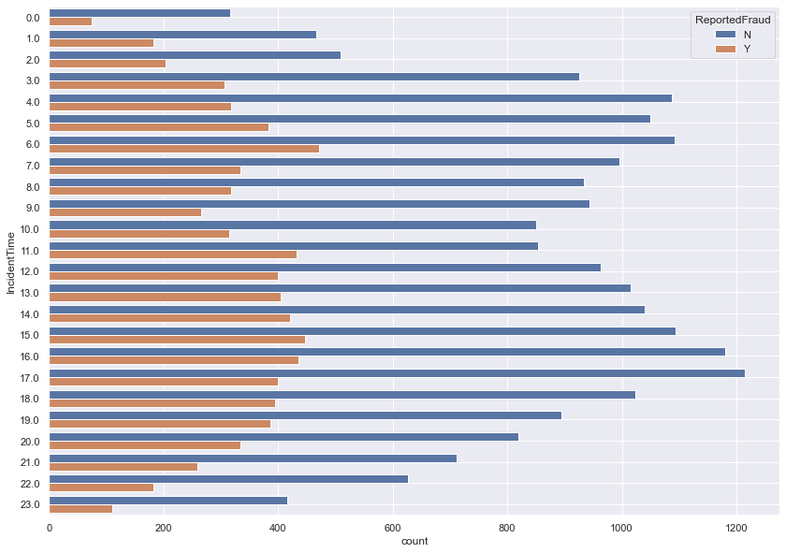

Slide 21
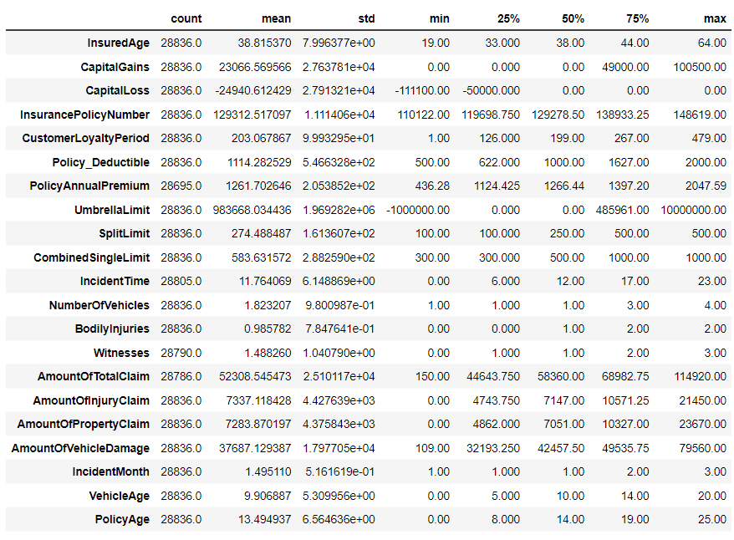
STATISTICAL
SUMMARY

Slide 22
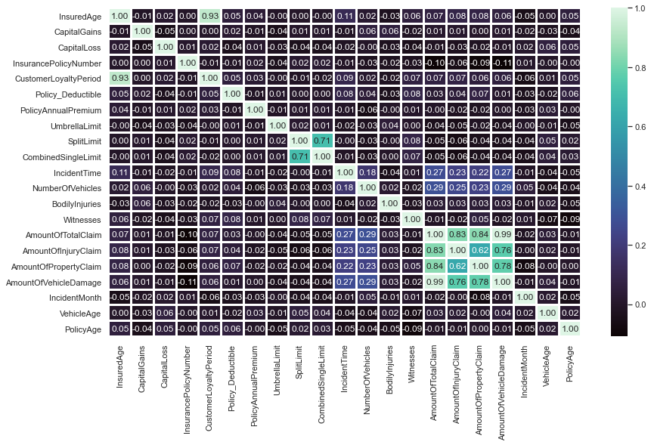
CORRELATION
HEATMAP

Slide 23
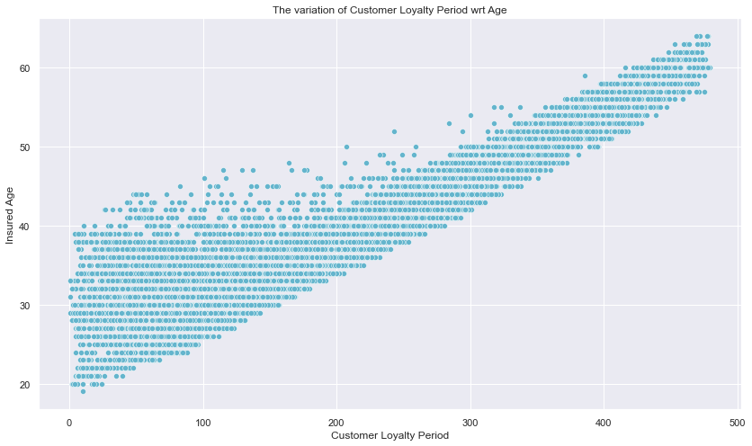
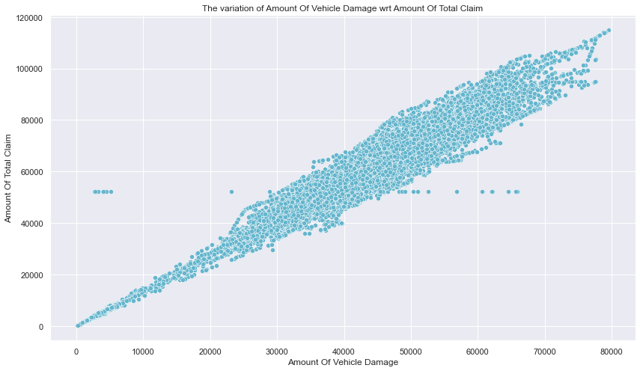
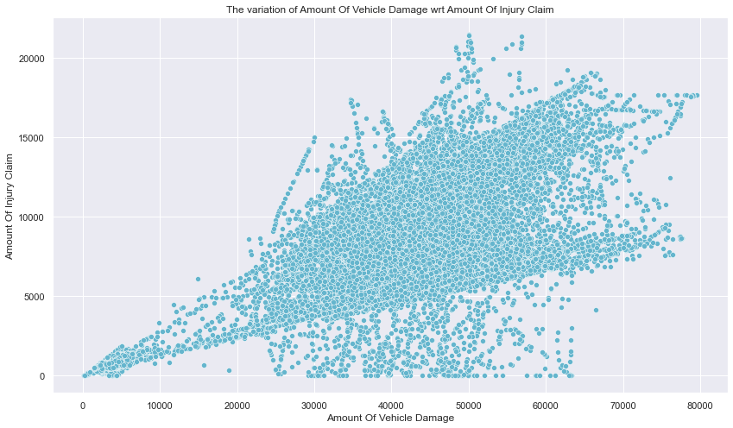
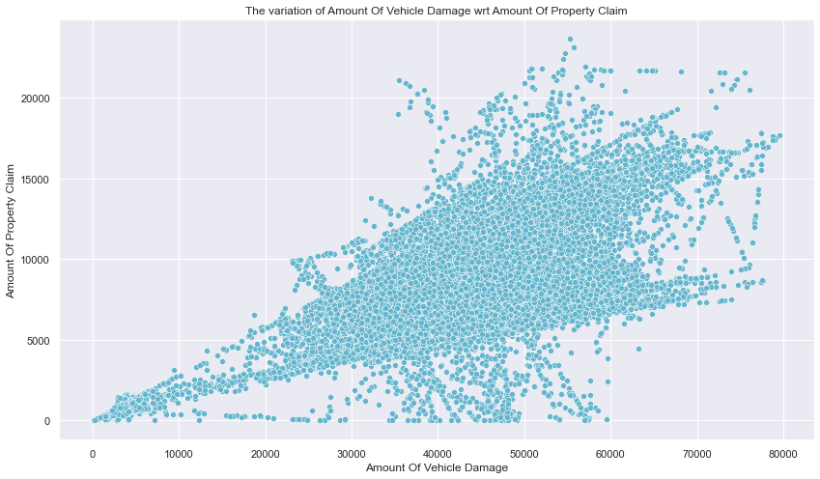

Slide 24
MISSING VALUE TREATMENT
Column Name | Amount of missing data | % of missing data | Imputation
Categorical | Categorical | Categorical | Categorical
InsuredGender | 30 | 0.1.04 % | Mode
VehicleMake | 50 | 0.173 % | Mode
Country | 2 | 0.007 % | India
PropertyDamage | 10459 | 36.271 % | Unknown
PoliceReport | 9805 | 34.003 % | Unknown
TypeOfCollission | 5162 | 17.901 % | Unknown
Numerical | Numerical | Numerical | Numerical
IncidentTime | 31 | 0.107 % | Median
Witnesses | 46 | 0.159 % | Mean
AmountOfTotalClaim | 50 | 0.173 % | Mean
PolicyAnnualPremium | 141 | 0.489 % | Mean

Slide 25
CREATING AND DROPPING COLUMNS
We create a column 'VehicleAge' to represent the age of the vehicle at the time of incident.
We create a column 'PolicyAge' to represent the number of years since the policy was taken.
Due to the above changes we do not require the following columns: 'YearOfPolicyCoverage', 'DayOfPolicyCoverage', 'MonthOfPolicyCoverage', 'IncidentDay'
The number of unique values in the columns CustomerID', VehicleID and InsurancePolicyNumber of the test dataset are 28836 which is the same as the number of datapoints in the column, hence we do not require the column and drop it.
IncidentYear has only one value of 2015 and Country also has only one value 'India', hence we drop them
The rest of the columns in the data set need not be dropped

Slide 26
Ordinal Encoding
Both Education level and Severity of incident, although categorical, have an order to the data. Hence we use ordinal encoder to depict this order.

Slide 27
03.
MODEL BUILDING AND EVALUATION

Slide 28
PREPARING THE DATA FOR MODEL BUILDING
Initial steps
Splitting the data
Separating the categorical and numerical columns for pipeline
Over sampling the data
Encoding and Standardizing
.Creating a pipeline with standard scalar for numeric data
Creating a pipeline with one hot encoding for categorical data
Column Transformer to parallelize the process

Slide 29
MODEL BUILDING
We use the following algorithms to build the model, fit the train data and predict for the test data.
RANDOM FOREST CLASSIFIER
DESCISION TREE CLASSIFIER
LOGISTIC REGRESSION
SUPPORT VECTOR CLASSIFIER
ADABOOSTCLASSIFIER

Slide 30
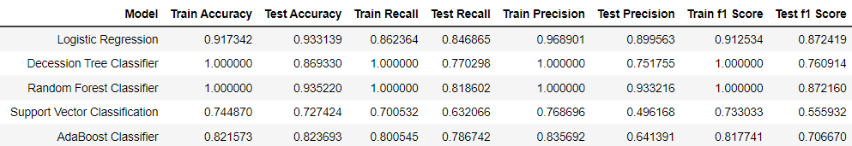
EVALUATION RESULTS
458K
People use this product

Slide 31
04.
PATTERN EXTRACTION AND PREDICTION

Slide 32
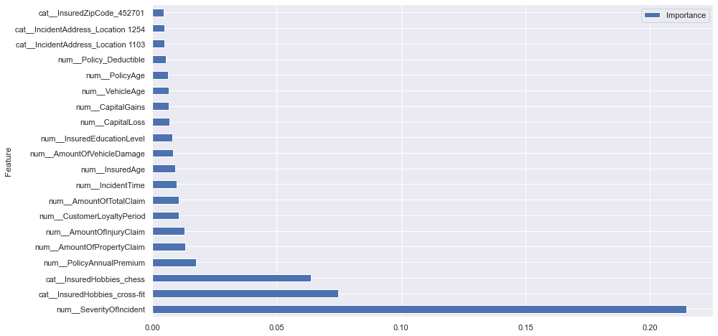
TOP 20 FEATURES ACCORDING TO DESCISION TREE CLASSIFIER

Slide 33
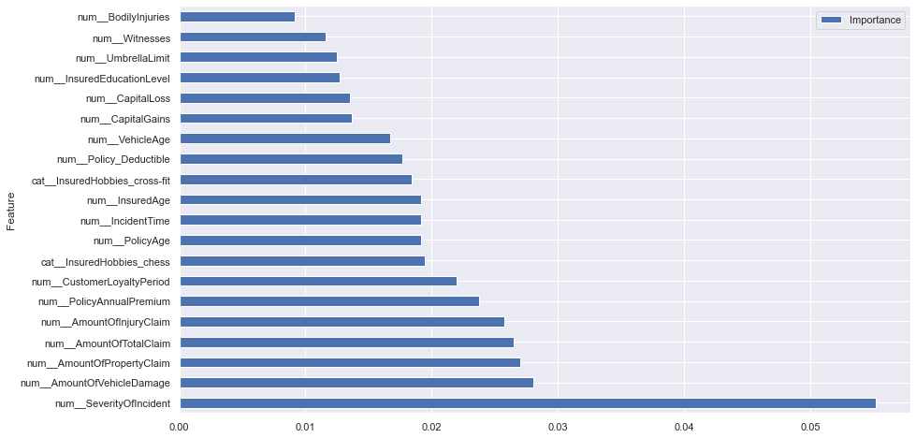
TOP 20 FEATURES ACCORDING TO RANDOM FORREST CLASSIFIER

Slide 34
PREDICTION
The final model we use for prediction is RandomForestClassifier as is has the highest f1 score for the test data.
We predict the ReportedFraud column for the unseen data provided using RandomForestClassifier

Slide 35
THANK YOU

