Slide 1
C++
C++ basics
Introduction to C++
2) Structure of C++
3) Download
4)First Program in C++
5)Compilation and Execution Process of C++ Program
6)DataType
7)Variables
8)Keyword
9)Constants
10)Decision making statement
11)Operators
Turbo C++
Dev C++
Code:: blocks
compiler

Slide 2
Introduction to C++
Q. What is C++ ?
Ans. C++ is a high level semi object oriented programming language developed by “Bjarne Stroustrup” in the year 1979,
At “Bell Laboratory”
Note :
C++ is a case-sensitive language
In earlier the name of C++ was “C with classes”
C++ is a Portable Programming Language
Syntax of C++ Program :

Slide 3
Structure to C++
Iostream
Cout = print output
Cin = for input
Q. What is Syntax of C++?
header file
Ans. #include<iostream>
#include<conio.h>
returntype main()
{
//code
}
Optional header file
Preprocessor
Int
Float
Char
Void
DataTypes

Slide 4
First Program in C++
Q. Program for printing output
Ans. #include<iostream>
void main()
{
cout<<“learning code”;
}
To save code in c++ ,
We use name.cpp extension
Insertion Operator

Slide 5
Compilation and Execution in C++
First.cpp
Save file
Preprocessor
Link header file
compiler
First.obj
Add more than one object files and liberaries
Linker
First.exe
Loader
Loader loads .exe file into main memory
Run Program

Slide 6
DataType in C++
Q. What is Datatype ?
Ans. DataType defines the type of value means what kind of value the variable will store
There are Three types of DataType
Primitive
Derived
User Defined

Slide 7
DataType in C++
Primitive
Primitive Data Types: These data types are built-in or predefined data types and can be used directly by the user to declare variables.
Integer
Character
Boolean
Floating Point
Double Floating Point
Valueless or Void

Slide 8
DataType in C++
Derived
The data-types that are derived from the primitive or built-in datatypes are referred to as Derived Data Types. These can be of four types namely:
Function
Array
Pointer
Reference

Slide 9
DataType in C++
Abstract or User Defined
These data types are defined by user itself. Like, defining a class in C++ or a structure.
Class
Structure
Union
Enumeration

Slide 10
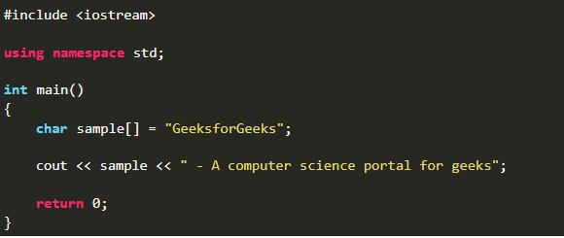
DataType in C++
Program for char

Slide 11
DataType in C++
Program for input and output
standard output stream (cout)
standard input stream (cin)
The extraction operator(>>) is used along with the object cin for reading inputs. The extraction operator extracts the data from the object cin which is entered using the keyboard.
insertion operator(<<) is used along with the object cout for printing output

Slide 12
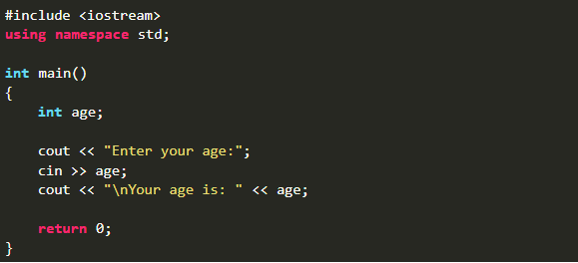
Program for input and output

Slide 13
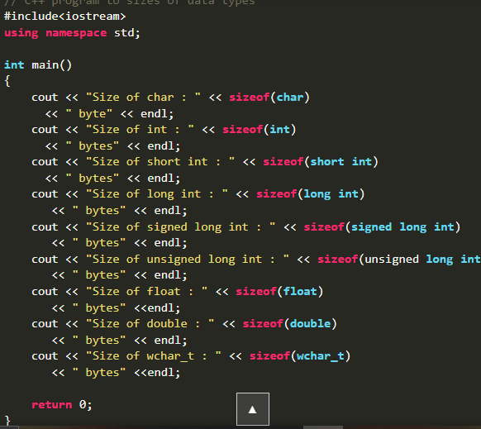
DataType in C++
Program to find size od dataTypes

Slide 14
Keyword in C++
What is Keyword ?
Keyword is nothing but reserved word, whose meaning is already define on the compiler
Note :
We can’t use keyword as an variable
Keyword must be in lowercase
For eg :
Int, char, float, template, class etc.

Slide 15
Variable in C++
What is Variable ?
A variable is a name of memory location where we store values.
Note :
Variable are case-sensitive in c++
In c++ , variable must start from capital letter(A - Z), small letter(a-z) and underscore(_)
We can’t give extra space between the variable
For eg :
Int cod ing; //this is wrong

Slide 16
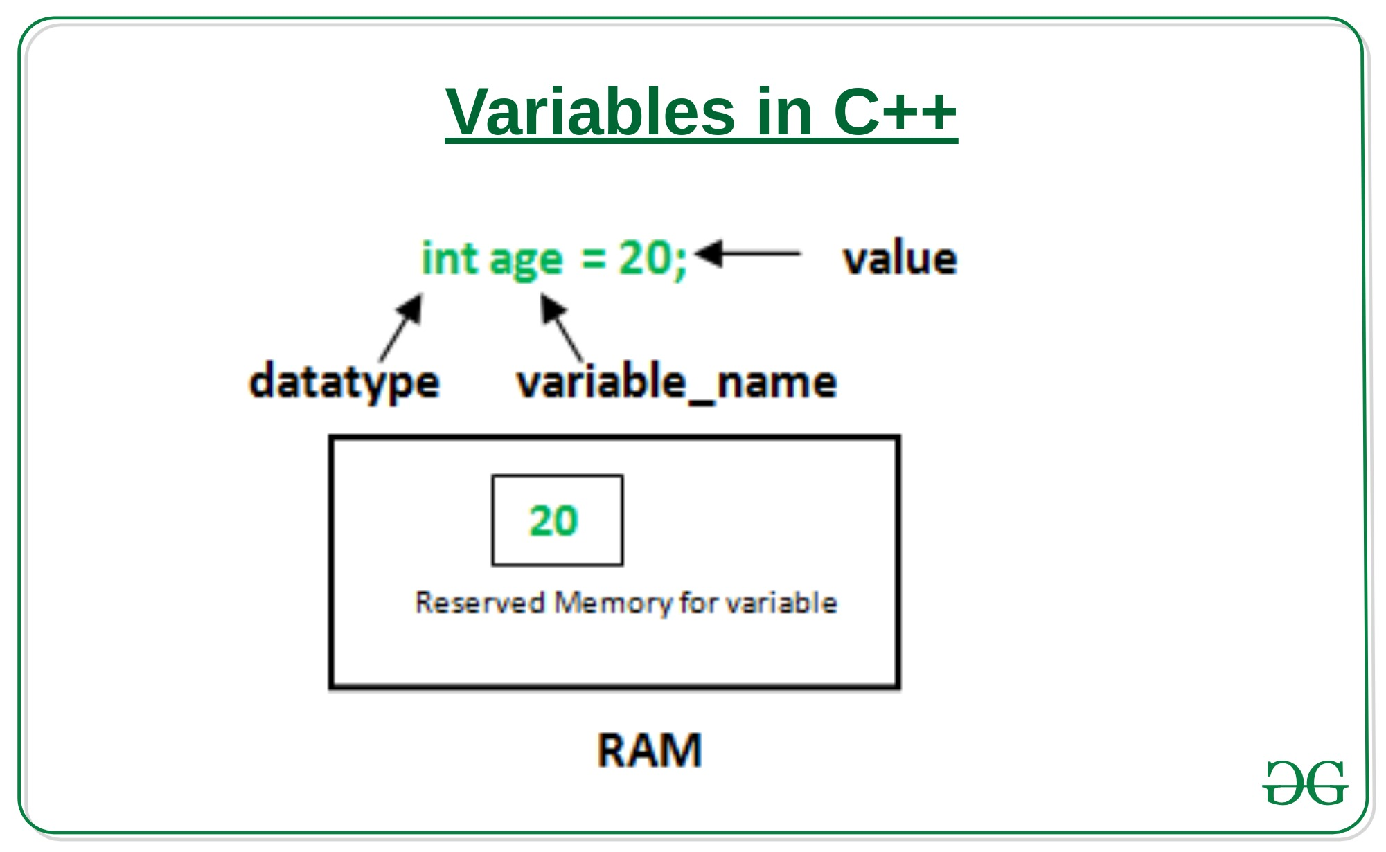
Variable in C++
Q. What is Syntax of variable?

Slide 17
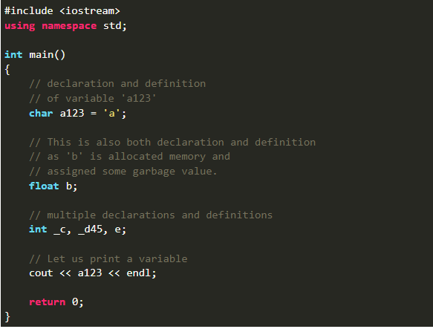
Variable in C++
Program to understand variable

Slide 18
Constant in C++
What is constant ?
the name constants are given to such variables or values in C++ programming language which cannot be modified once they are defined. They are fixed values in a program. There can be any types of constants like integer, float, octal, hexadecimal, character constants, etc.
Note :
Const keyword is used to declare a constant
Constant are also called literals

Slide 19
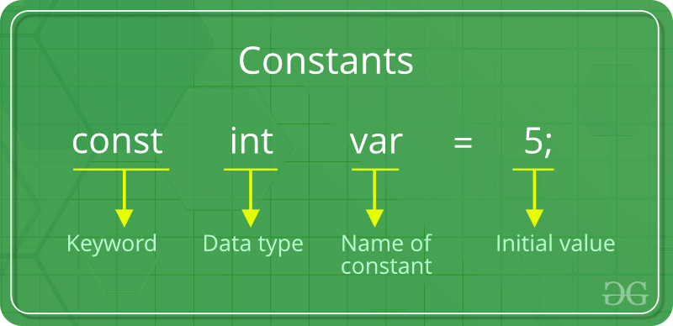
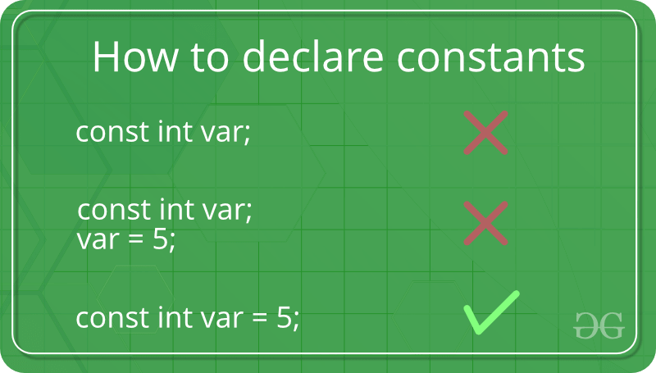
Constant in C++
Q. What is Syntax of constant?

Slide 20
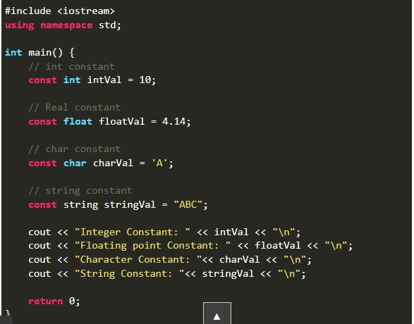
Constant in C++
Program to understand constant

Slide 21
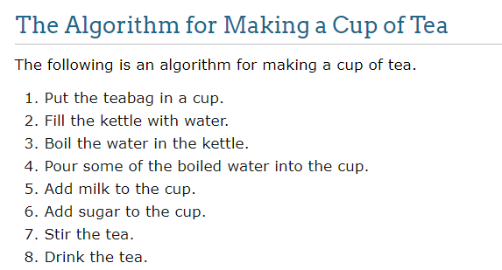
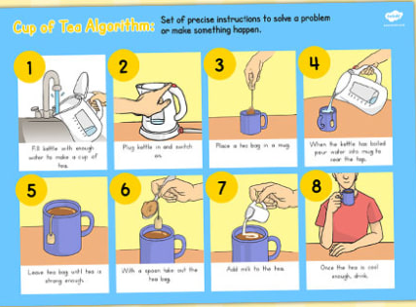
an algorithm is a set of steps used by a program to accomplish a task.

Slide 22

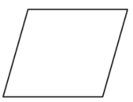
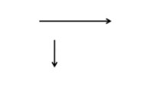
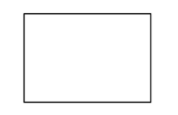

Flowchart in C++
A flowchart is a type of diagram that represents an algorithm, workflow or process
Terminal start and end
Flow line
Input/output
ellipse
Parallelogram
process
Decision making
rectangle
diamond

Slide 23
Operator in C++
Operator is a symbol that tells the compiler to perform mathematical and logical work
Types of Operator
Arithmetic Operator
Relational Operator
Logical Operator
Increment and Decrement Operator
Ternary Operator
Assignment Operator

Slide 24
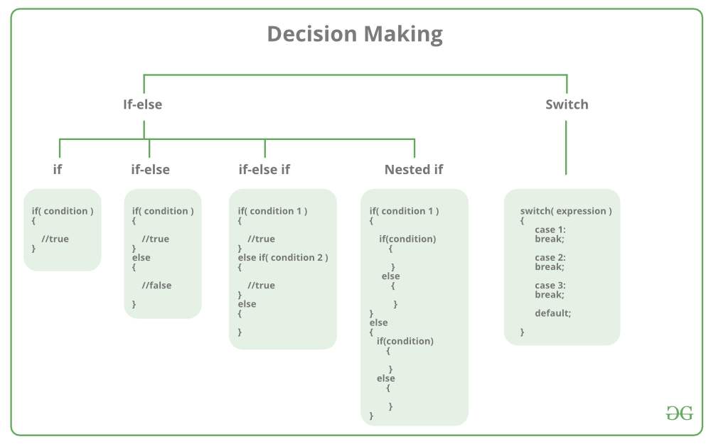
Decision Making in C++
Q.Type of decision making and their syntax?

Slide 25
Decision Making in C++
What is if statement ?
If statement test conditions, if condition is true(1) ,then if block code will be executed otherwise no action taken.
Syntax :
if(condition) {
// Statements to execute if // condition is true
}

Slide 26
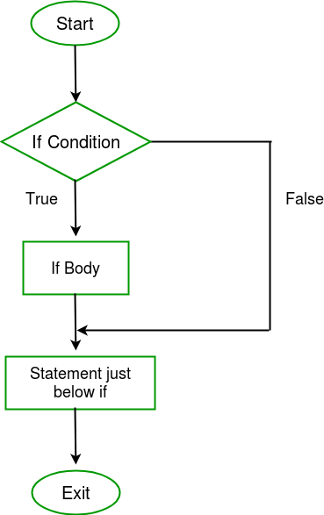
Decision Making in C++
Flowchart of if statement?

Slide 27
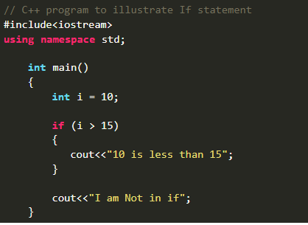
Decision making in C++
Program for if

Slide 28
Decision Making in C++
What is if-else statement ?
It is used to execute two statements for a single condition, if given condition is true,
If block executed otherwise else block will be executed
Syntax :
if (condition)
{
// Executes this block if
// condition is true
}
else {
// Executes this block if
//condition is false
}

Slide 29
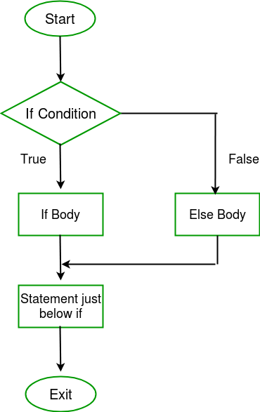
Decision Making in C++
Flowchart of if-else statement?

Slide 30
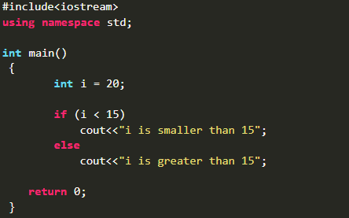
Decision making in C++
Program for if -else

Slide 31
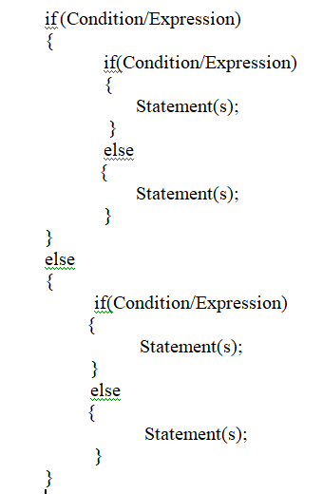
Decision Making in C++
What is nested if-else statement ?
Whenever we defined if else block inside another if else block is called nested if-else statement
Syntax :

Slide 32
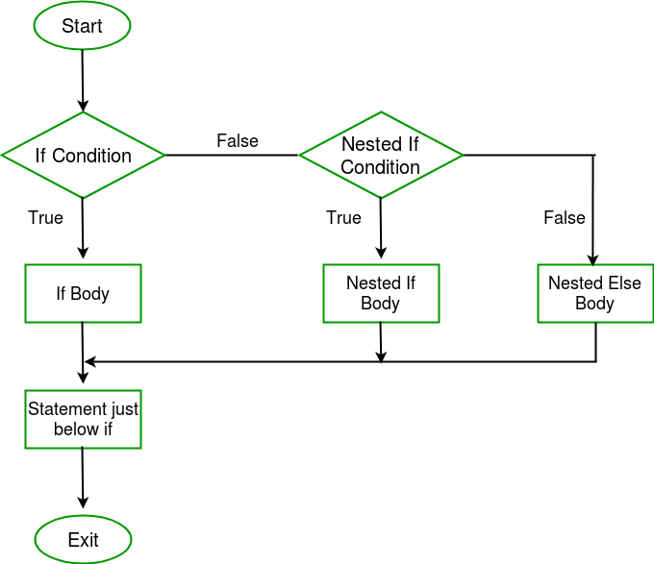
Decision Making in C++
Flowchart of nested if-else statement?

Slide 33
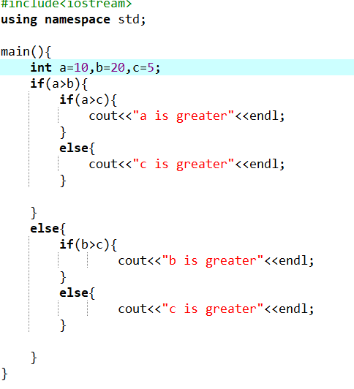
Decision making in C++
Program for nested if -else
Which number is greater among a, b, c;

Slide 34
Decision Making in C++
What is if-else-if ladder statement ?
It is used when we have multiple condition to test
Syntax :
if (condition)
statement;
else if (condition)
statement;
.
.
else statement;

Slide 35
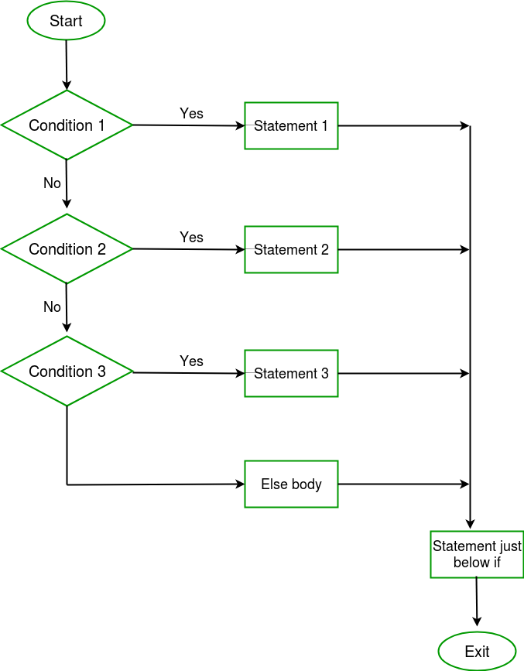
Decision Making in C++
Flowchart of if-else-if ladder

Slide 36
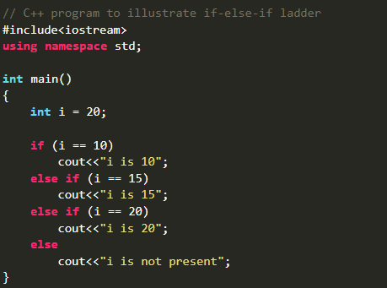
Decision making in C++
Program for if-else-if ladder

Slide 37
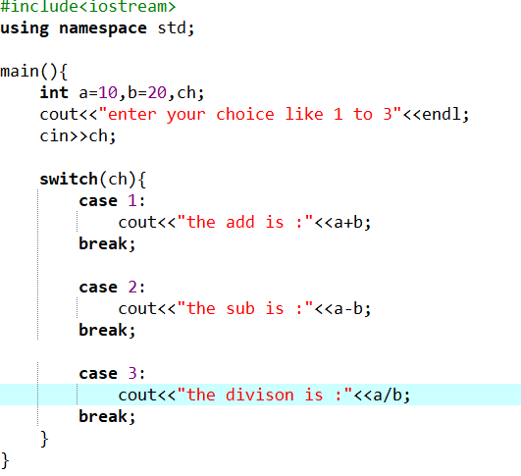
Decision Making in C++
What is Switch statement ?
Switch is the shortcut of if-else-if ladder
program :

Slide 38
Loops in C++
What is loops?
Loop is nothing but iterative statement which allow a block of code to be executed
repeatedly
Types of loops?
While loop
Do while loop
For loop

Slide 39
Loops in C++
What is while loop?
While loop is also known as entry controlled loop. The statement will be executed continuously until the given condition is no longer satisfied
Syntax :
While(condition)
{
//statement;
//increment /decrement;
}

Slide 40
Loops in C++
What is do_while loop?
It is also known as exit control loop, because it tests condition at the end of the loop body
Syntax :
do
{
//statement;
//increment /decrement;
}
While(condition);

Slide 41
Loops in C++
What is for loop?
Unlike while loop, for loop performs all operation in single line
Syntax :
for(initialization;condition;iteration);
{
//statement;
}

Slide 42
function in C++
What is function?
A function is a block of code which only runs when it is called. You can pass data, known as parameters, into a function. Functions are used to perform certain actions, and they are important for reusing code: Define the code once, and use it many times.

Slide 43
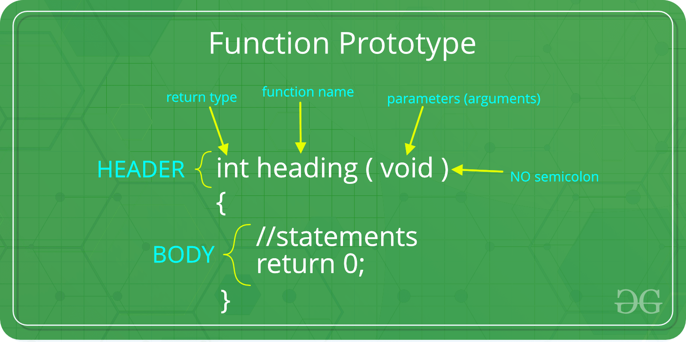
Syntax of function

Slide 44
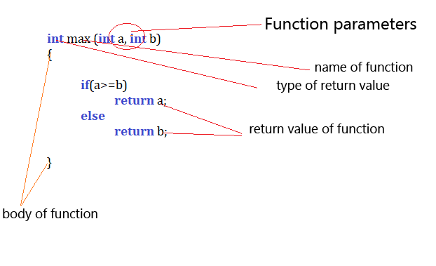
Sample Code?

Slide 45
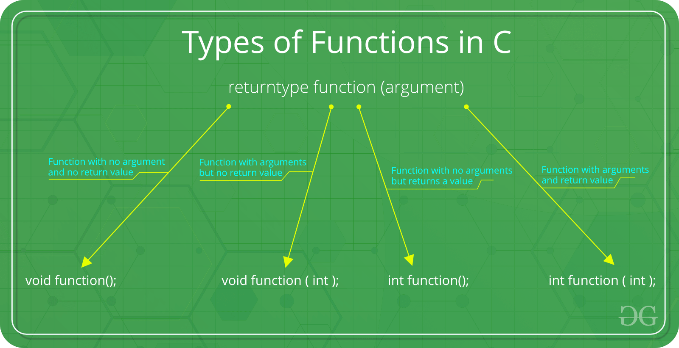

Slide 46
Function in C++
Type1: Function with no argument and no return value

Slide 47
Function in C++
Type2: Function with argument and no return value

Slide 48
Function in C++
Type3: Function with no argument but return a value

Slide 49
Function in C++
Type4: Function with argument and with return type

Slide 50
Topics in OOPs
Class
Object
Access Specifiers
Encapsulation
Inheritance
Polymorphism
Abstraction
Template
Exception Handling

Slide 51
OOPS ?
-OOPS stands for object oriented Progamming language.
-The aim of oops to perform real world entities like inheritance,hiding,polymorphism etc.
-it also provide reusability
- It is used to organize our code
It is used to achieve modular programming
Eg.student module,teacher module etc in a school as well as in college.

Slide 52
Classes in C++
A class in C++ is the building block that leads to Object-Oriented programming. It is a user-defined data type, which holds its own data members and member functions, which can be accessed and used by creating an instance of that class
Data members are the data variables and member functions are the functions
Real World example of class and object
Class : Human
Object : man ,father ,son
Class : Fruit
Object : Apple, mango,banana etc

Slide 53
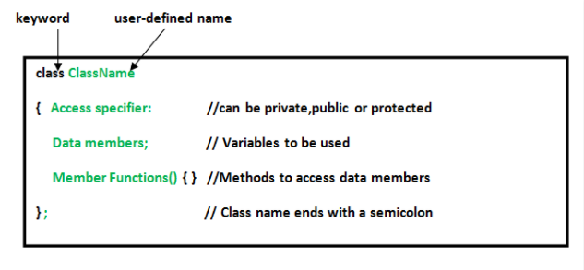
Object in C++
An Object is an instance of a Class. When a class is defined, no memory is allocated but when it is created memory is allocated.

Slide 54
Program :

Slide 55
Method Function in C++
It is function which is used to show function of class with the help of object
Types of function
Inside the class
Outside the class
Program :

Slide 56
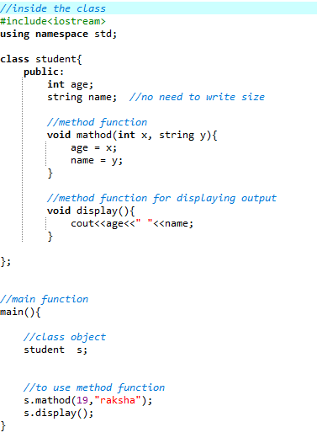
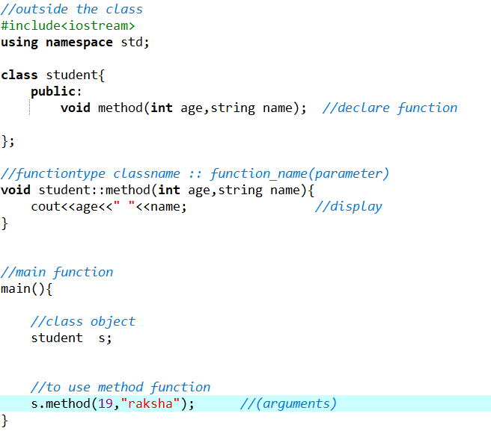
Method Function in C++
Inside the class
2. Outside the class
Program :

Slide 57
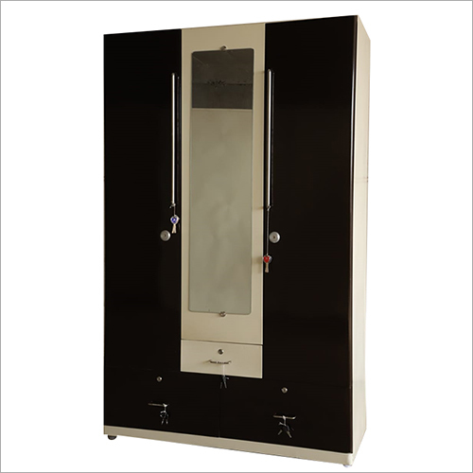
Access Specifiers in C++
It is used to show access of given class members inside and outside the class
There are three access modifiers/specifiers :
public, private and protected.
Public - It give access inside and outside both
Private – It give access only inside the class
Protected – it is similar as private access modifier but we can give access outside the class using inheritance(scope resolution operator)

Slide 58
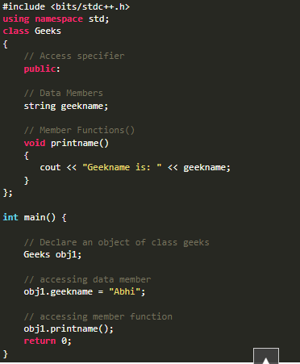
Access Specifiers in C++

Slide 59
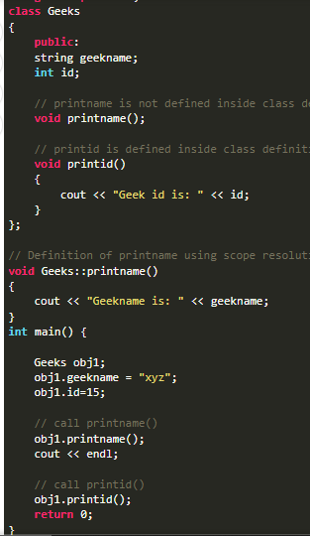
Inside class definition
Outside class definition
scope resolution :: operator

Slide 60
Type Conversion to C++
C-style (data_type)expression;
Function Notation data_type(expression);
Operator
There are 4 operators
static_cast
dynamic_cast
const_cast
reinterpret_cast

