Slide 1
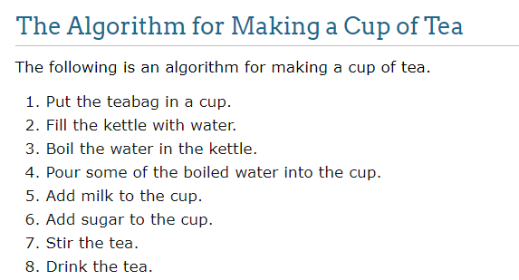
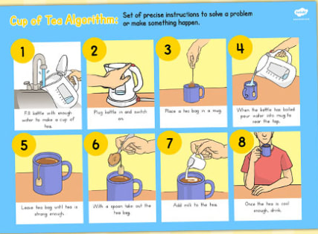
an algorithm is a set of steps used by a program to accomplish a task.

Slide 2
Type Casting in C
Implicit
Explicit

Slide 3
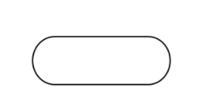
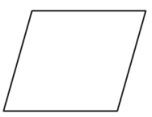
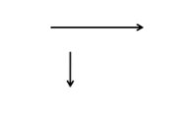
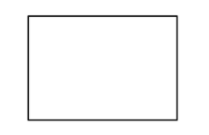
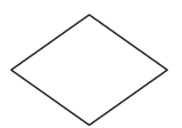
Flowchart in C
A flowchart is a type of diagram that represents an algorithm, workflow or process
Terminal start and end
Flow line
Input/output
ellipse
Parallelogram
process
Decision making
rectangle
diamond

Slide 4
C language
Q. What is C language?
Ans. C is a middle level procedural oriented programming language developed by “Dennis Ritchi” at AT’s and T bell laboratory in the year 1974 in USA

Slide 5
Structure to C
stdio
printf = print output
scanf = for input
Q. What is Syntax of C?
header file
Ans. #include<stdio.h>
#include<conio.h>
returntype main()
{
//code
}
Optional header file
Preprocessor
Int
Float
Char
Void
DataTypes

Slide 6
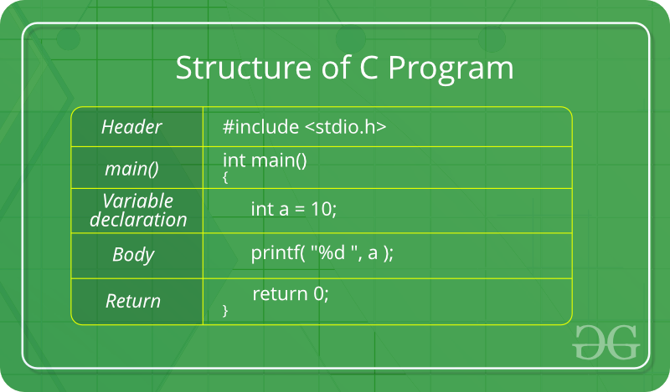

Slide 7
First Program in C
Q. Program for printing output
Ans. #include<stdio.h>
void main()
{
printf(“learning code\n”);
}
To save code in c ,
We use name.c extension

Slide 8
Keyword in C
What is keyword ?
Keyword is a reserved word whose meaning is already defined in the compiler.
We cannot use keyword as variables name and function name

Slide 9
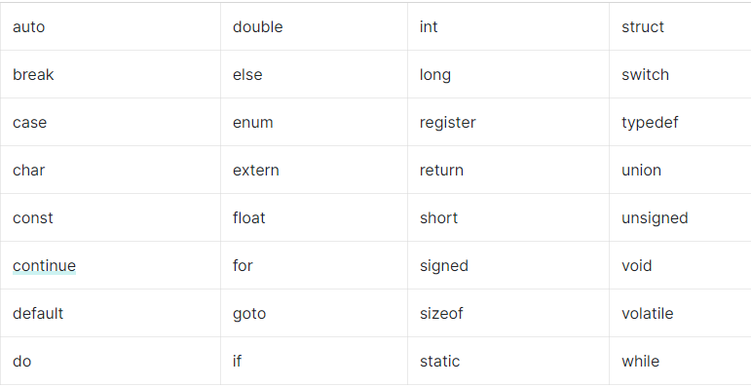
There are total 32 keyword in c

Slide 10
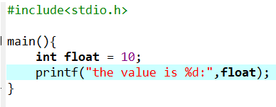
Program :

Slide 11
Comment in C
\n
\t

Slide 12
Formate Specifier in C
To denote datatype in c we use format specifier
%d , %i - int
%f - float, double
%c - Char
%s - string

Slide 13
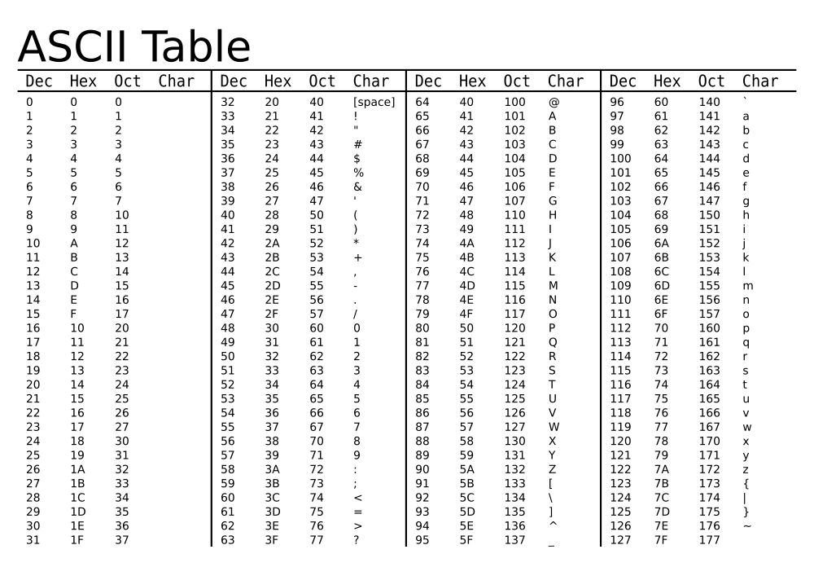

Slide 14

Variable and identifiers in C
Variables are memory locations(storage area) in the C programming language.
To indicate the storage area, each variable should be given a unique name (identifiers).
Here, PlayerScore is a variable of int type. Here, the variable is assigned an integer value 95.

Slide 15
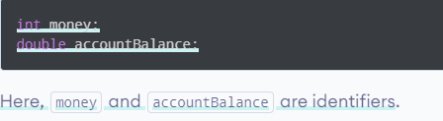

Slide 16
Q. Rules for writing variable?
1.A variable name can only have letters (both uppercase and lowercase letters), digits and underscore.
2.The first letter of a variable should be either a letter or an underscore.
3.There is no rule on how long a variable name (identifier) can be

Slide 17
Q. Types of variable?
1.Local Variable -- only access to scope{}
2.Global Variable -- access to whole code
3.Static Variable -- work as constant, we can update value into memory

Slide 18
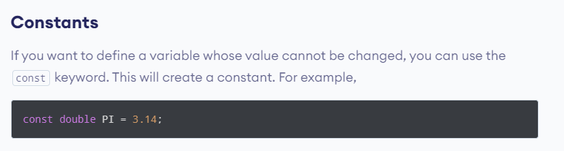
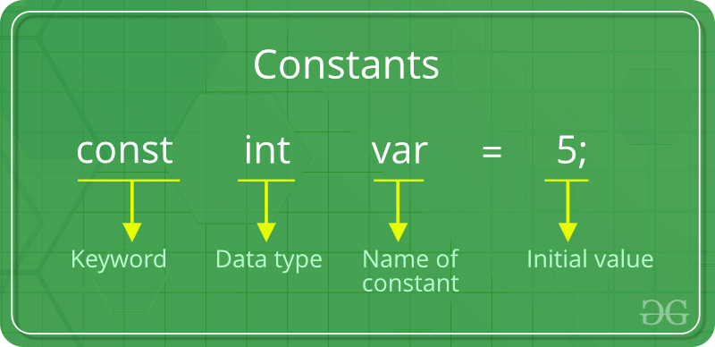

Slide 19
DataType in C
Q. What is Datatype ?
Ans. DataType defines the type and size of values that can be stored in an variable
There are 2 types Datatype ?
Primitive
Derived

Slide 20
Primitive
Primitive Data Types: These data types are built-in or predefined data types and can be used directly by the user to declare variables.
Integer 4byte
Character 1byte
Boolean 1byte
Floating Point 4byte
Double Floating Point 8byte
Valueless or Void 0byte

Slide 21
Derived
The data-types that are derived from the primitive or built-in datatypes are referred to as Derived Data Types. These can be of four types namely:
Function
Array
structure
union

Slide 22
Sizeof() in C
To find the size of datatype like 1byte, 2byte etc..

Slide 23
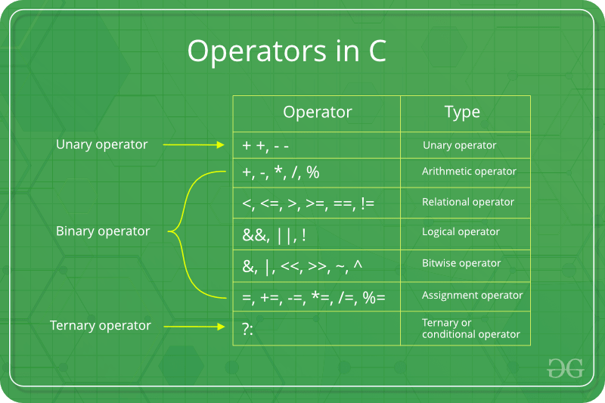

Slide 24
Area of triangle
Area of rectangle

Slide 25
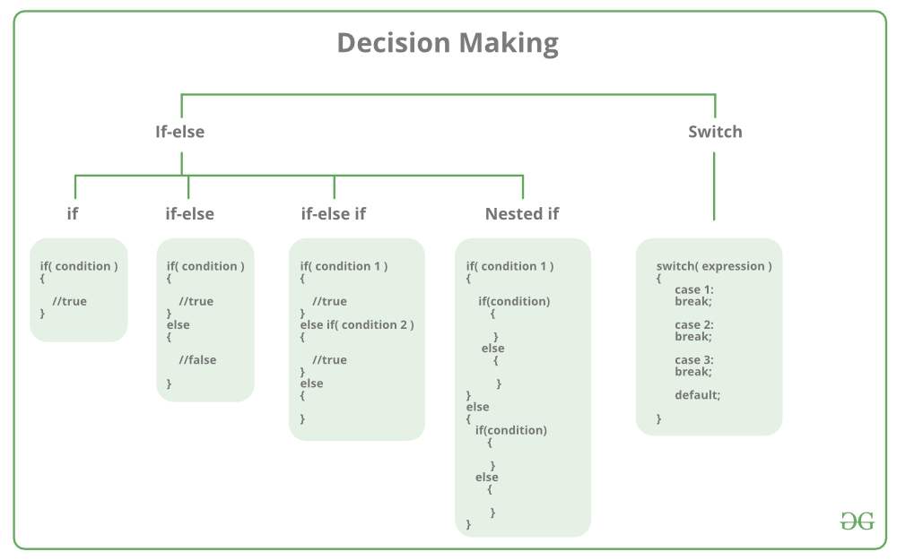
Decision Making in C
Q.Type of decision making and their syntax?

Slide 26
Decision Making in C
What is if statement ?
If statement test conditions, if condition is true(1) ,then if block code will be executed otherwise no action taken.
Syntax :
if(condition) {
// Statements to execute if // condition is true
}

Slide 27
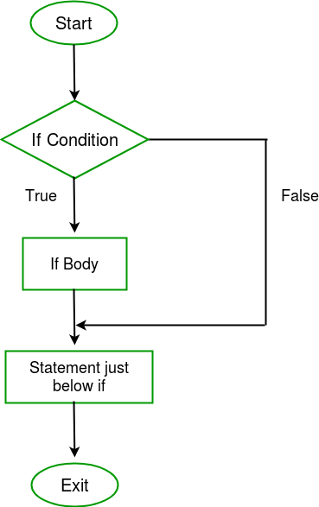
Decision Making in C
Flowchart of if statement?

Slide 28
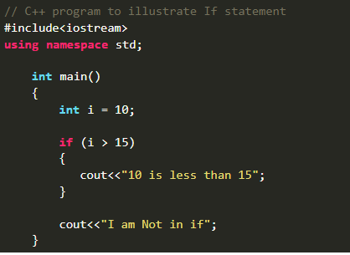
Decision making in C
Program for if

Slide 29
Decision Making in C
What is if-else statement ?
It is used to execute two statements for a single condition, if given condition is true,
If block executed otherwise else block will be executed
Syntax :
if (condition)
{
// Executes this block if
// condition is true
}
else {
// Executes this block if
//condition is false
}

Slide 30
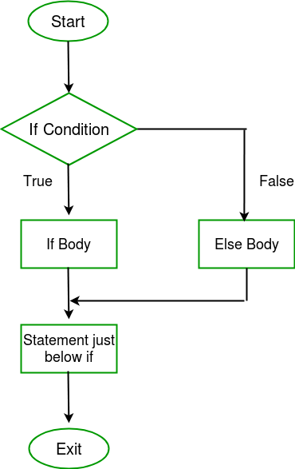
Decision Making in C
Flowchart of if-else statement?

Slide 31
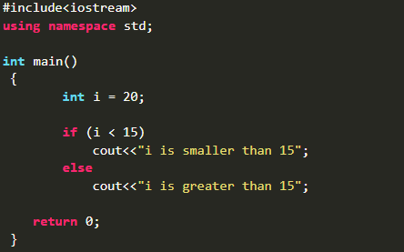
Decision making in C
Program for if -else
Voting program

Slide 32
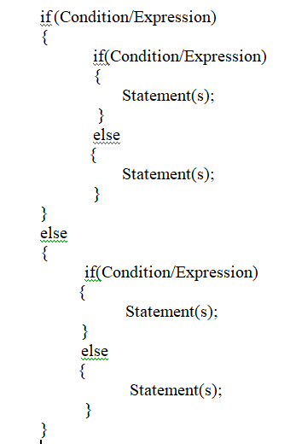
Decision Making in C
What is nested if-else statement ?
Whenever we defined if else block inside another if else block is called nested if-else statement
Syntax :

Slide 33
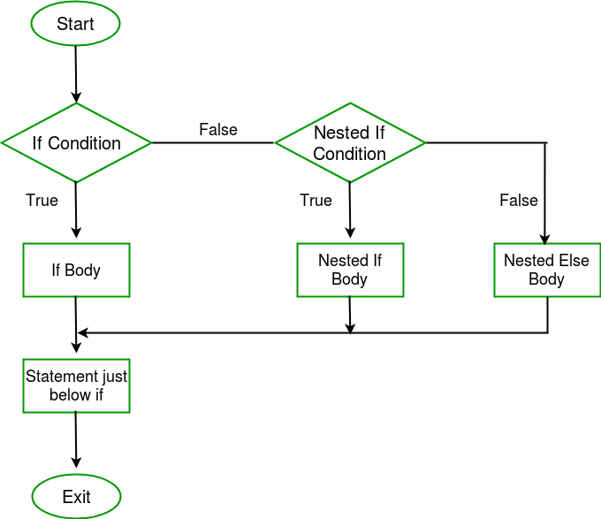
Decision Making in C
Flowchart of nested if-else statement?

Slide 34
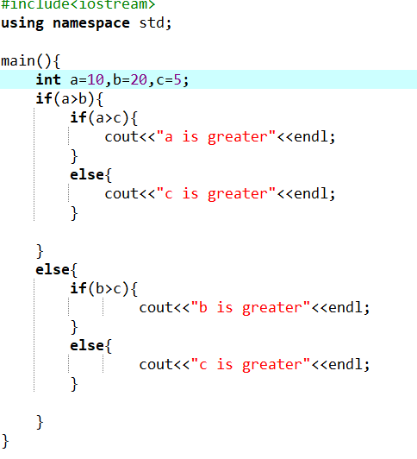
Decision making in C
Program for nested if -else
Which number is greater among a, b, c;

Slide 35
Decision Making in C
What is if-else-if ladder statement ?
It is used when we have multiple condition to test
Syntax :
if (condition)
statement;
else if (condition)
statement;
.
.
else statement;

Slide 36
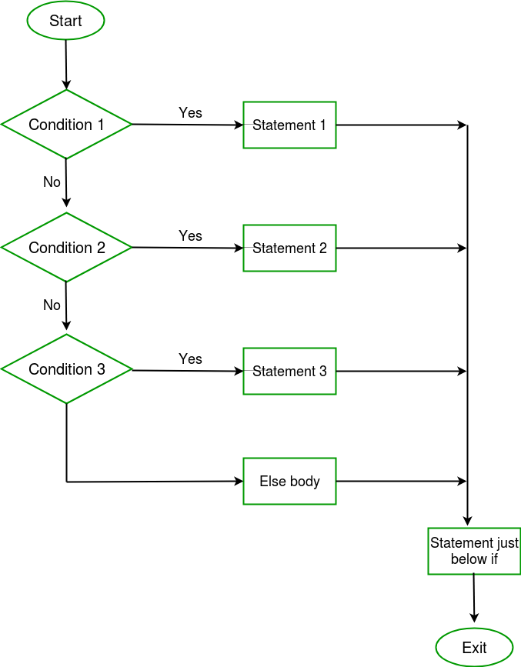
Decision Making in C
Flowchart of if-else-if ladder

Slide 37
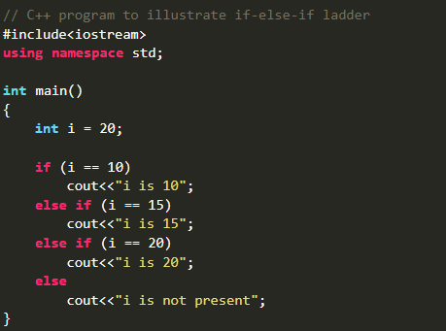
Decision making in C++
Program for if-else-if ladder

Slide 38
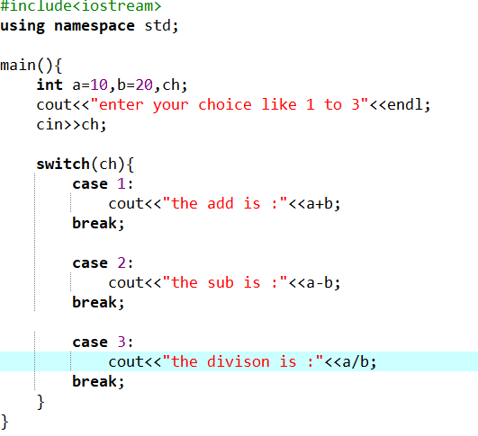
Decision Making in C
What is Switch statement ?
Switch is the shortcut of if-else-if ladder
program :

Slide 39
Jumping statement in C
Break - terminate the code after finding it’s true value
Continue - skip the value
Exit - Exit the whole code
Goto Label - Work as the loop
Return – after calling it return value in main function

Slide 40
Loops in C
What is loops?
Loop is nothing but iterative statement which allow a block of code to be executed
repeatedly
Types of loops?
While loop
Do while loop
For loop

Slide 41
Loops in C
What is while loop?
While loop is also known as entry controlled loop. The statement will be executed continuously until the given condition is no longer satisfied
Syntax :
While(condition)
{
//statement;
//increment /decrement;
}

Slide 42
Loops in C
What is do_while loop?
It is also known as exit control loop, because it tests condition at the end of the loop body
Syntax :
do
{
//statement;
//increment /decrement;
}
While(condition);

Slide 43
Loops in C
What is for loop?
Unlike while loop, for loop performs all operation in single line
Syntax :
for(initialization;condition;iteration);
{
//statement;
}

Slide 44
Real Life Example of function
Declaration -- guest in house / friend
Calling -- calling guest / calling friend
Defintion --process n talking to guest / talk to friend

Slide 45
function in C
What is function?
A function is a block of code which only runs when it is called. You can pass data, known as parameters, into a function. Functions are used to perform certain actions, and they are important for reusing code: Define the code once, and use it many times.

Slide 46
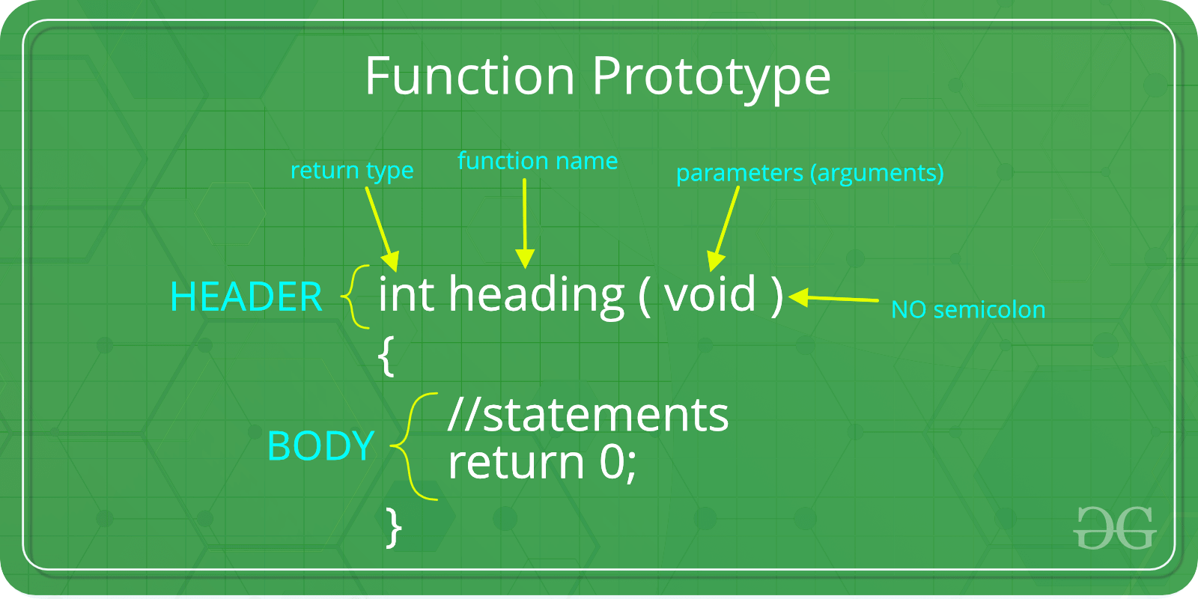
Syntax of function

Slide 47
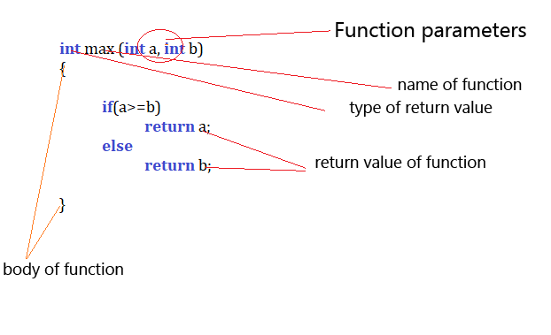
Sample Code?

Slide 48
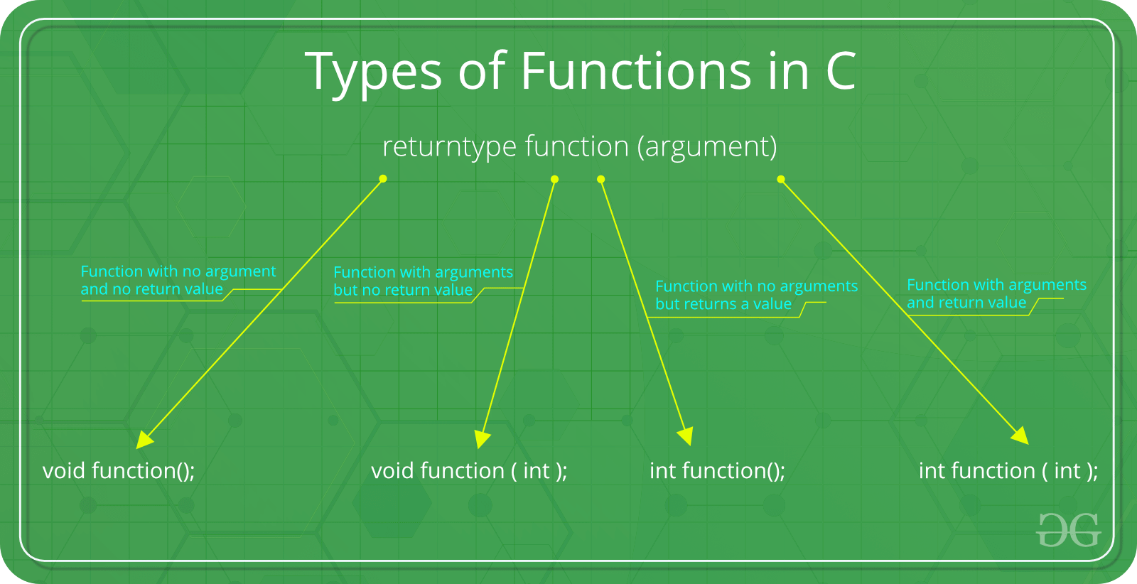

Slide 49
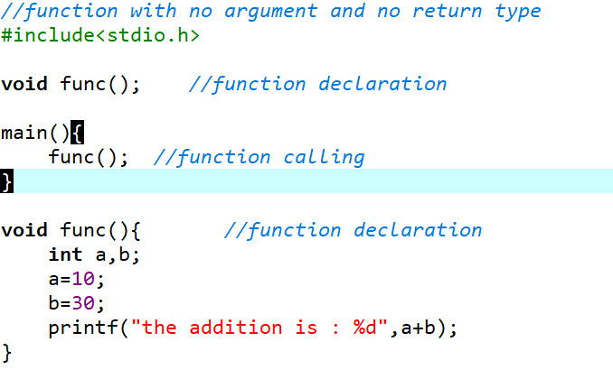
Type1: Function with no argument and no return value

Slide 50
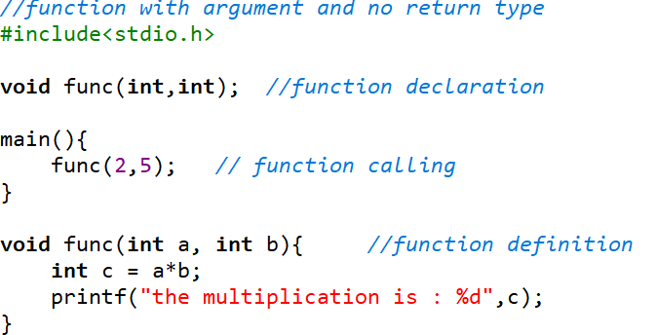
Type2: Function with argument and no return value

Slide 51
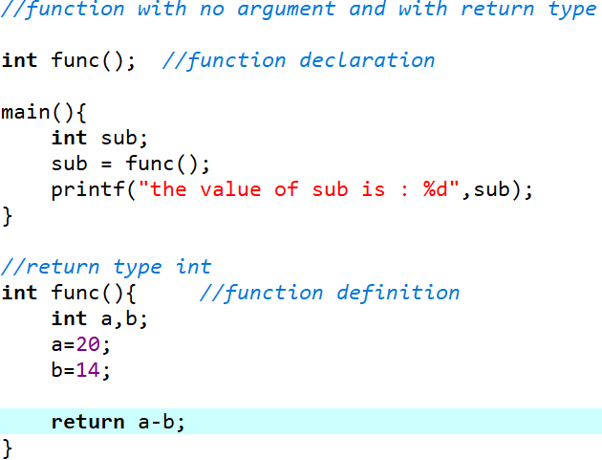
Type3: Function with no argument but return a value

Slide 52
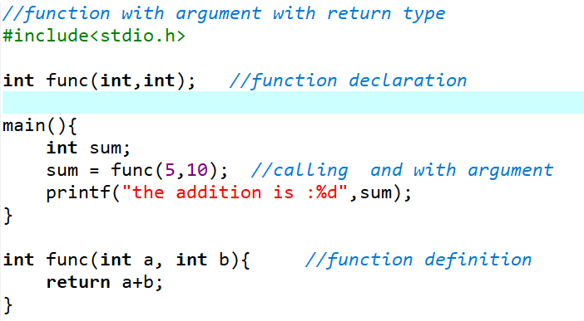
Type4: Function with argument and with return type

Slide 53
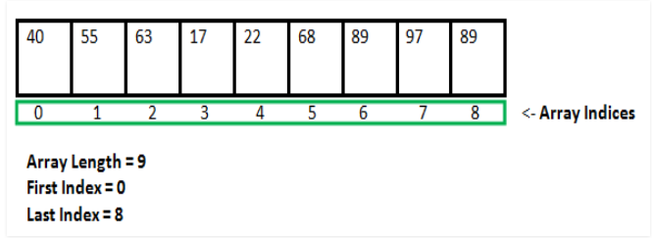
Array in C
An array is defined as the collection of similar type of data items stored at contiguous memory locations.

Slide 54


Array in C
Syntax
Datatype array_name[size];
Example
{1,2,3,4}
{‘c’, ‘f’, ‘h’ , ‘I’}
{‘d’ , 3 , ‘f’ , 4.3}
int num[4] = { 10 , 20, 30, 40}; 4byte each
Index 0 1 2 3

Slide 55
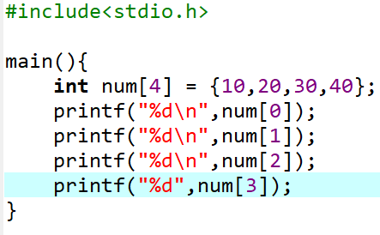
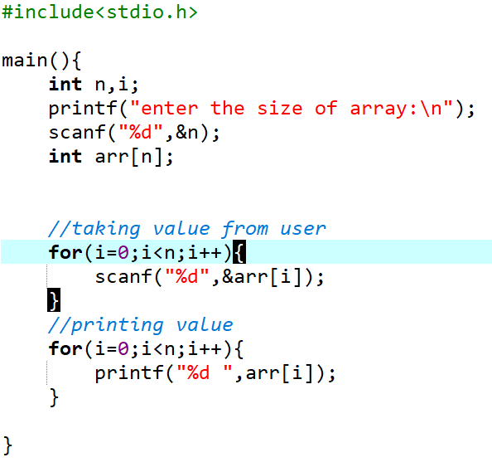
Array in C

Slide 56
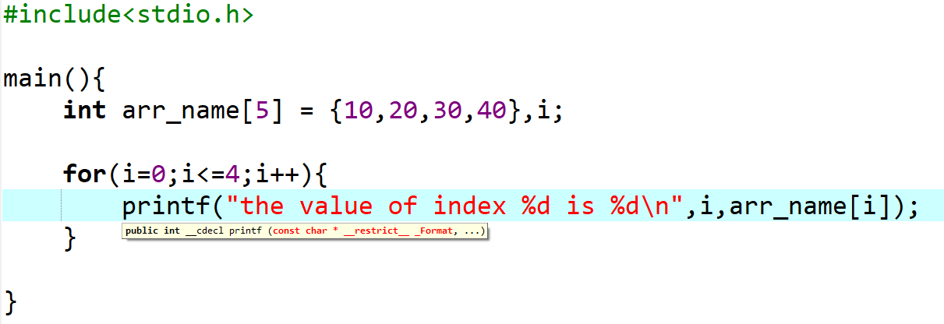
Array in C
One dimensional array

Slide 57
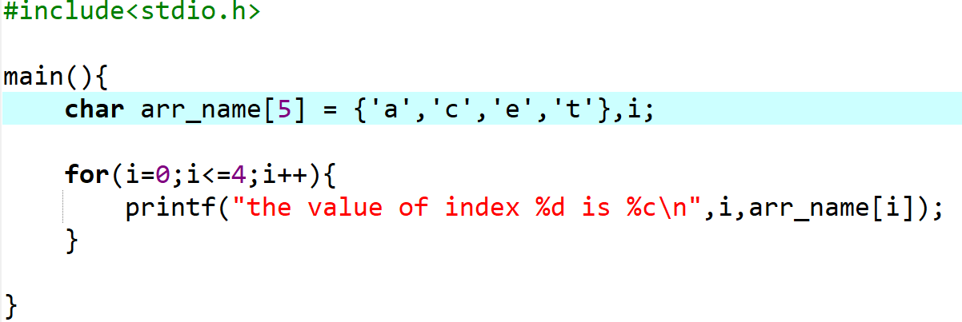
Array in C
One dimensional array

Slide 58
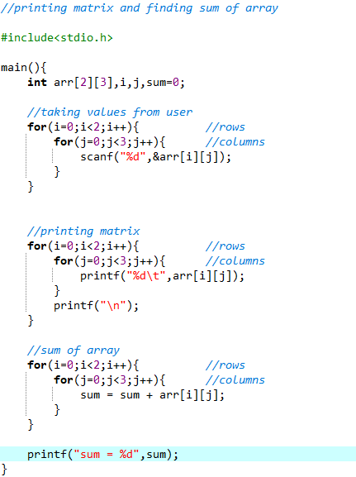
Array in C
two dimensional array

Slide 59
String in C
String is a combination or collection of words. the %s is used as format specifier in string. String is a character array which is terminates by \0.
Note :
We need string.h header file to access string function

Slide 60

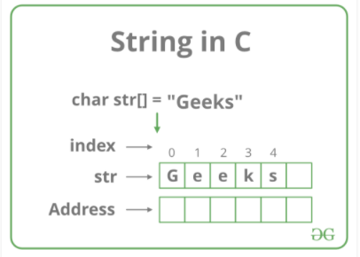
String in C
Syntax

Slide 61
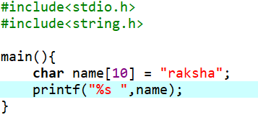
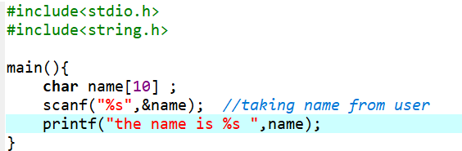
String in C
Program :

Slide 62
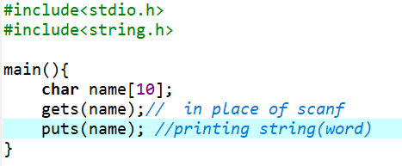
String in C
Puts() and Gets() function
Puts() – for Printing characters
Gets()– for Taking Input
Program :

Slide 63
String in C
Types of string
Strlen(); - for finding the length of the string
Strcmp(); - to compare two string
Strcpy(); - to copy one string into another
Strcat(); - to concate or add two strings
Strlwr(); - for lowercase
Strupr(); - for uppercase

Slide 64
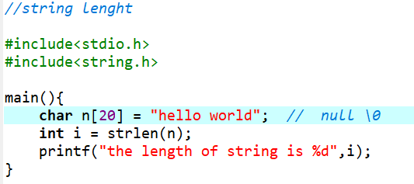
String in C
String length function
Program :

Slide 65
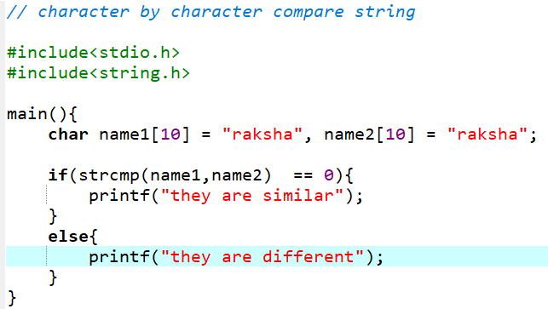
String in C
String compare function
Program :

Slide 66
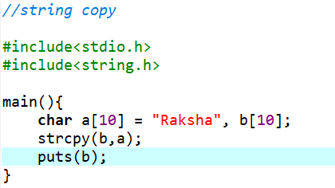
String in C
String copy function
Program :

Slide 67
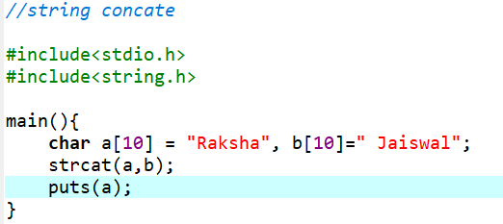
String in C
String concate function
Program :

Slide 68
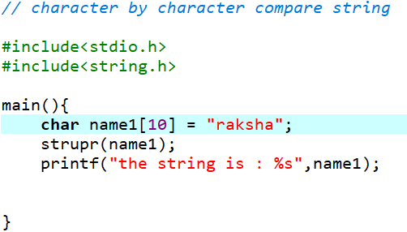
String in C
String uppercase function
Program :

Slide 69
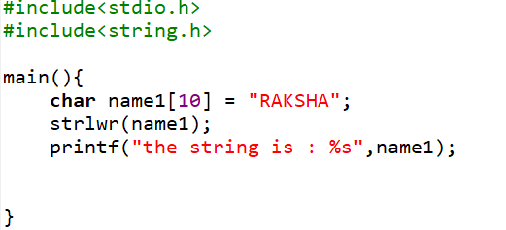
String in C
String lowercase function
Program :

Slide 70
Pointer in C
What is pointers ?
A pointer is a variable that contains the address of another variable.
We can say that the pointer ”points to” another variable
Size of pointer variable in 2 byte
It is derived data type
Pointer provide such low level memory handling.
syntax :
Value at address operator
Datatype *var_name ;

Slide 71
Pointer in C
unary & (Address of) operator
* (Dereference) operator
a
10
1024
*
Value at address operator
p
&1024
1028

Slide 72
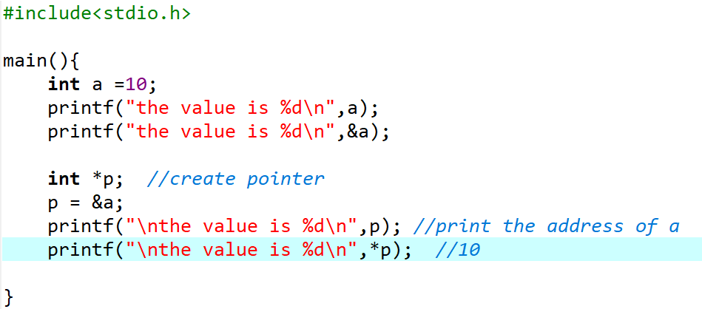
Program :

Slide 73
Pointer in C
Types of pointers
Void pointer
Null pointer
Wild pointer
Pointer to pointer

Slide 74

Pointer in C
Void pointers
A pointer which is declared by the help of “void” keyword is called void pointer
It can hold any type of address
The size of void pointer is 2 byte
It is also known as Generic pointer
syntax :
Void *var_name ;

Slide 75

Pointer in C
Null pointers
A pointer variable that is initialize with the NULL values at the time of pointer declaration is called Null pointer
A Null pointer that doesn’t point to any memory location
syntax :
Datatype *var_name = ‘\0’ ;

Slide 76

Pointer in C
wild pointers
A pointer variable that is not initialize with any address is called wild pointer
It is also known as bad pointer because it holds the address of random memory location
syntax :
Datatype *var_name ;

Slide 77

Pointer in C
Pointers to pointer
A pointer variable which holds the address of another pointer variable is called pointer to pointer
a
10
1000
p
1000
2000
q
2000

Slide 78
Recursion Function in C
A function which calls itself is called recursion function and it’s technique is known as recursion
Stack
Syntax :
Void main{
m1(); //function
}
Void m1(){
m1(); //function call again inside function
}
m2();
m1();
Main()

Slide 79

Recursion Function in C
To find the factorial

Slide 80
Structure in C
Structure is a user defined datatype which is constructed by the help of primitive and derived datatype
2. It can store more than one value of different datatypes in different – different memory location
3. The size of structure is sum of it’s all data members
4. The minimum size of structure is 1byte like character
5. The structure is declared by the help of struct keyword
6. Every structure should end with semi-colon(;)

Slide 81

Structure in C
To check the size of structure

Slide 82

Structure in C
structure Program

Slide 83

Union in C
Union is used to store different types of data in same location. It is declared by using union keyword but it print only the data which is bigger in size and show in last

Slide 84
Types of file
Files Handling in C
Text file
Binary file
Easier to read
Eg. .txt, .c , .pyp
Each data taken as character by character
Eg.23456 will taken 1 byte each which is 5 byte of memory
In the end of file, EOF(special character, ascii = 26) is written.
Unable to read in memory
.mp4,.gif, .exe, .jpg
Each data will not taken as character by character
Eg. 23456 will taken 4 byte of memory
No such thing happen here.

Slide 85
Files Handling in C
It is used to modify the given data of file using program
Read, write , open , close
fopen() - it is used to open the file
Syntax :
fclose() - it is used to close the given file
Syntax :

Slide 86
Files Handling in C
INPUT / OUTPUT in File
Hard Drive
RAM
Buffer
abc.txt
Content : This is a my first file
The address of this file will store in pointer fp
fp will be able to perform all the operation on files
If somehow file will not open it will print the NULL value
Copy of
abc.txt
abc.txt
*fp
Store address of abc.txt

Slide 87
Files Handling in C
fprintf() - it is used to print file w
fscanf() - it is used to read file r
fputc() - it is used to print characters of file w/a = append or write
fgetc() - it is used to read characters of file r
w/a : if file does not exist they will create a file.

Slide 88


Slide 89

Writing in a File

Slide 90

reading a File/fgetc

Slide 91

Files Handling in C
writing in a File/fputc

Slide 92

Files Handling in C
fprintf()

Slide 93
Dynamic Memory Allocation in C
Store fix no. of size of array in memory
Stack
To store dynamic size of array using calloc,malloc,realloc,free
heap
Static var n global var

Slide 94
Dynamic Memory Allocation in C
We use <stdlib.h> header file
Malloc() – memory allocation
Calloc() – contiguous allocation
Realloc() – reallocation
Free() – to free the given space by malloc and calloc

Slide 95
Dynamic Memory Allocation in C
malloc in C
Malloc is a short name for”memory allocation” and is used to dynamically allocate a single large block of contiguous memory according to the size specified
If allocation fails return a NULL pointer

Slide 96
Dynamic Memory Allocation in C
malloc in C
Syntax :
Int *ptr = (int *) malloc(n * sizeof(int));
Contiguous memory allocation
Datatype of array
size of array
4
0
1
2
n
To free this malloc space we use free() method in c

Slide 97


Slide 98
Dynamic Memory Allocation in C
calloc in C
calloc is a short name for”contiguous allocation” and is used to dynamically allocate no. of block of memory according to the size specified
If allocation fails return a NULL pointer

Slide 99
Dynamic Memory Allocation in C
calloc in C
Syntax :
Int *ptr = (int *) calloc( n , sizeof(int));
Contiguous memory allocation
Datatype of array
size of array
4
0
1
2
n
To free this calloc space we use free() method in c

Slide 100


Slide 101
Dynamic Memory Allocation in C
realloc in C
To change the size of memory(re allocate memory).
We can either increase the size or decrease it.
Syntax :
ptr = (int *)realloc(ptr , x);
Old pointer
New size in bytes

Slide 102
Dynamic Memory Allocation in C
Free() in C
Malloc is used for releasing the space allocated by malloc and calloc
Syntax :
free(ptr);

Slide 103


Pascal Triangle in C

Slide 104



Slide 105


Slide 106


