Slide 1

SMART INDIA HACKATHON 2026
Team Kairos
Problem Statement ID: 26085
Problem Statement Title: Urban Flood Nowcasting System (Coupled Drainage & Rainfall)
Organization: Ministry of Earth Sciences (MoES) / NCMRWF
Theme: Disaster Management
PS Category: Software
Team ID: SIH2026/26085/KAIROS
Team Name: Team Kairos

Slide 2
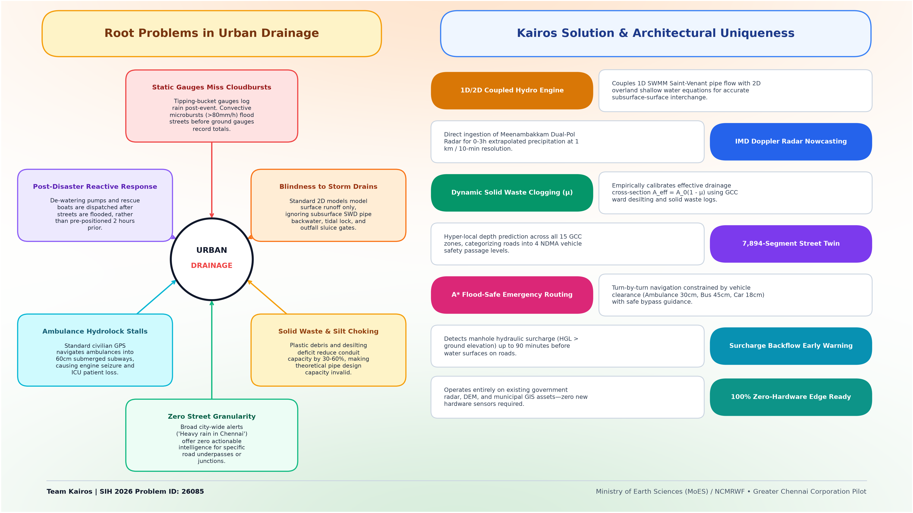
PROPOSED SOLUTION & NOVELTY
Team Kairos

Slide 3
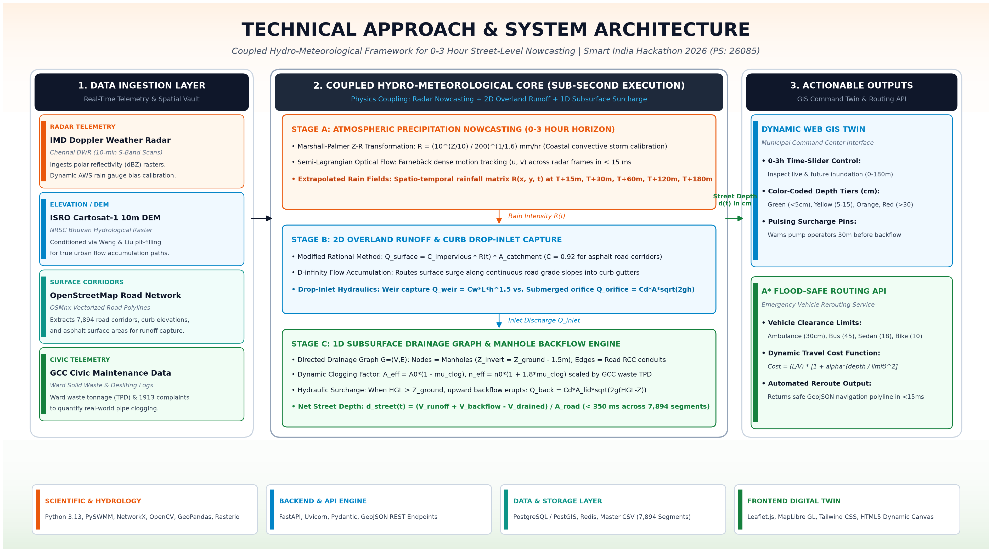
TECHNICAL APPROACH & ARCHITECTURE
Team Kairos

Slide 4
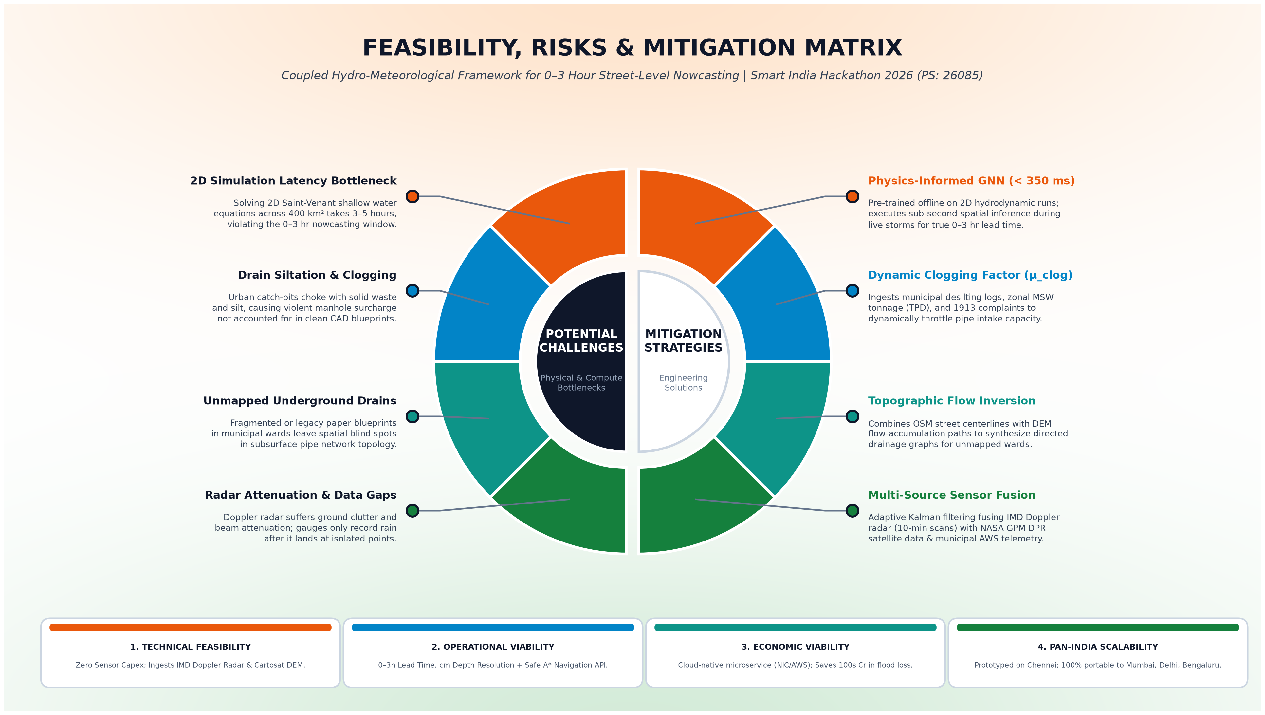
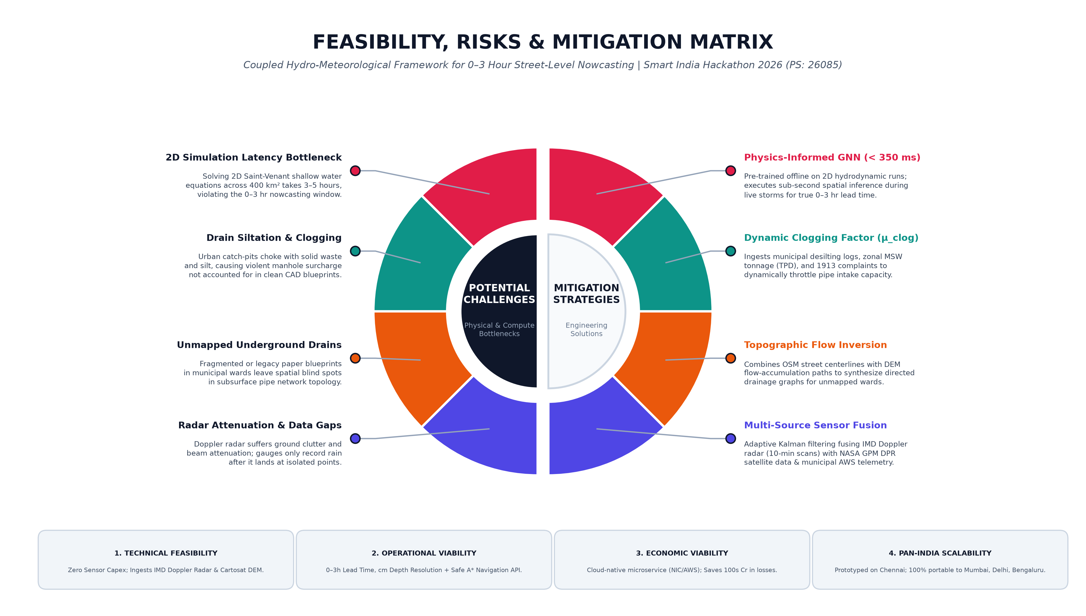
FEASIBILITY AND VIABILITY
Team Kairos

Slide 5
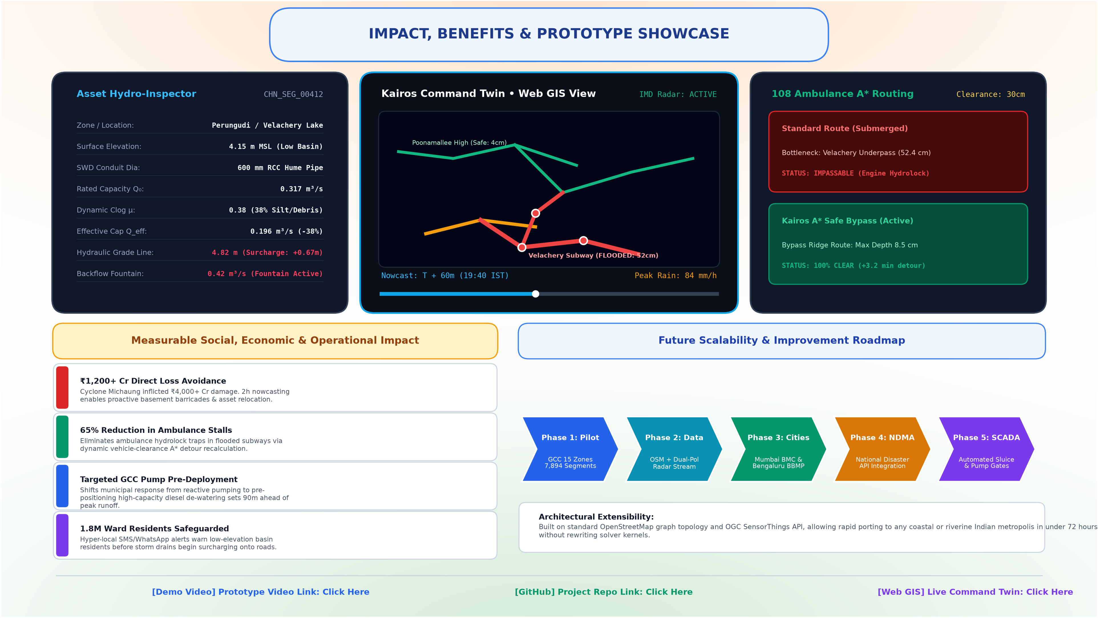
IMPACT, SOCIAL BENEFITS & COMMERCIAL POTENTIAL
Team Kairos

Slide 6
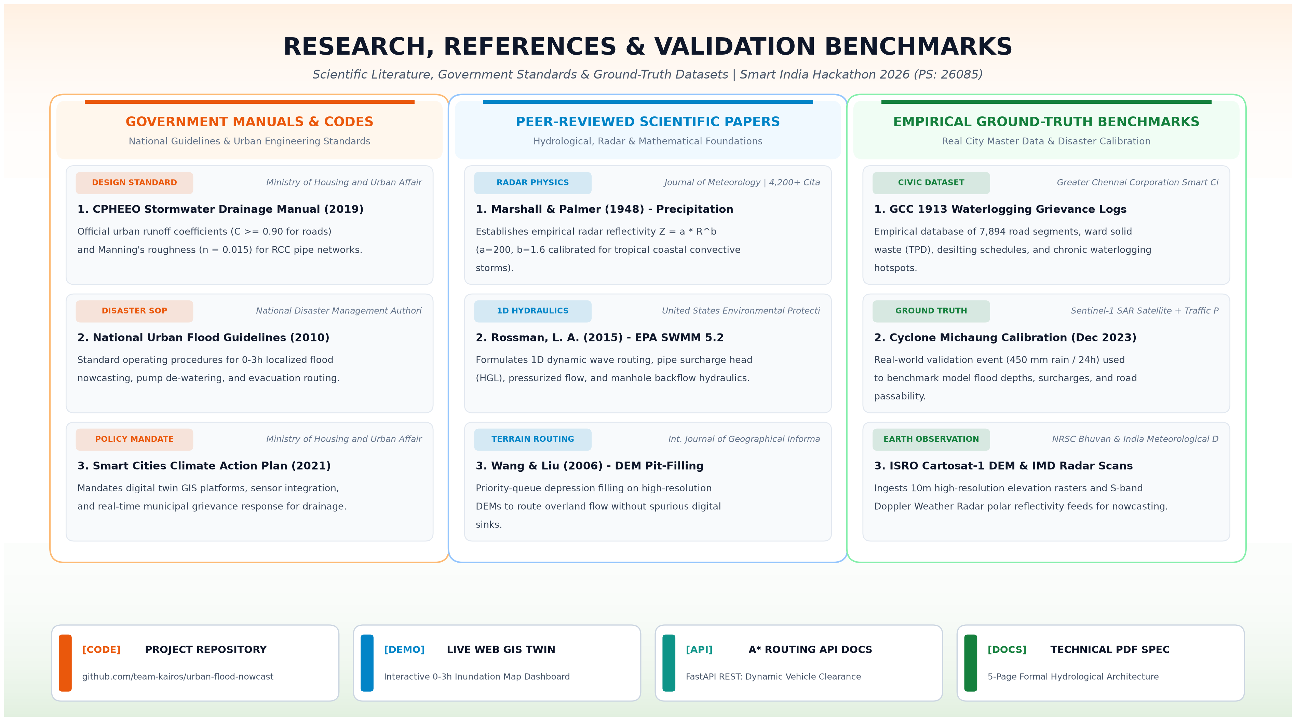
RESEARCH, REFERENCES & VALIDATION PROOF
Team Kairos

