Slide 1
Campus Complaint & Grievance Tracker
Objectives
Users
Normalized schema
Multi-department campus database
State-machine lifecycle
Invalid status jumps blocked by the DB
Student
Files complaints, tracks only their own
1
2
Staff
Resolves assigned complaints, updates status
3
Auto-escalation
Overdue complaints escalate after SLA
4
Role-based views
Each user sees only relevant data
Warden
Oversees hostel complaints, assigns staff
5
Automatic audit trail
Every status change logged
6
Faster queries
Indexing with measurable gains
Admin
All departments, reports, manages records
Notes:
Good morning everyone. Our project is the Campus Complaint & Grievance Tracker, a database-driven system for recording, tracking and resolving student complaints across hostel, mess, academics, infrastructure, labs and library.
Today, complaints on most campuses travel through WhatsApp groups, verbal requests to wardens or ad-hoc emails. Nothing is recorded, nobody is clearly accountable, and there is no escalation if the issue is ignored. Our system replaces that with one centralized database that enforces the rules itself.
We set six objectives. First, a normalized relational schema for a multi-department campus. Second, a complaint lifecycle enforced as a state machine inside the database, so a complaint cannot jump from Open straight to Resolved. Third, automatic escalation when a complaint stays unresolved beyond its category's SLA. Fourth, role-based views so each user sees only what is relevant. Fifth, an automatically generated audit trail of every status change. And sixth, indexing to make frequent queries measurably faster.
On the right are the four types of users. Students file complaints and track their own. Staff resolve the complaints assigned to them and update status. Wardens oversee complaints from their own hostel and assign or reassign staff. Admins see everything across departments, generate reports and manage department, category and staff records.
Now let me walk you through what the system actually does.

Slide 2
Core Functionalities
14 functional requirements grouped by purpose
File & Track FR1 – FR3
Resolve FR4 – FR6
Assign & Oversee FR7 – FR9
Register and log in
File a complaint under a category
View status and history of own complaints
Staff view assigned complaints
Update status via valid transitions
Add resolution notes on closing
Warden views hostel complaints
Assign or reassign staff
Admin views all departments
Automate FR10 – FR12
Admin & Reports FR13 – FR14
Core rule: the lifecycle
Auto-escalate after category SLA
Auto-log every status change
Reject invalid transitions
Volume, category trends, average resolution time
Manage department, category and staff records
Open → Assigned → In-Progress → Resolved / Escalated
No step can be skipped. Enforced by the database, not the app.
Notes:
Our fourteen functional requirements fall into five groups.
First, File and Track. Students register and log in, file a complaint under a specific category, and view the status and full history of only their own complaints.
Second, Resolve. Staff see the complaints assigned to them, update the status, and add resolution notes when they close a complaint. Every update must follow a valid transition.
Third, Assign and Oversee. Wardens view all complaints in their hostel and assign or reassign staff. Admins have a view across every department.
Fourth, Automate. This is where the database does the work. A complaint is escalated automatically once it passes its category's SLA. Every status change is logged into the audit trail with no manual step. And any invalid transition is rejected.
Fifth, Admin and Reports. Admins generate reports on complaint volume, category trends and average resolution time, and manage department, category and staff records.
The dark card shows the core rule: Open, then Assigned, then In-Progress, then Resolved or Escalated. No step can be skipped, and this is enforced by the database, not by the application.
To make all of this possible, we need the right data structure, which is our ER diagram on the next slide.

Slide 3
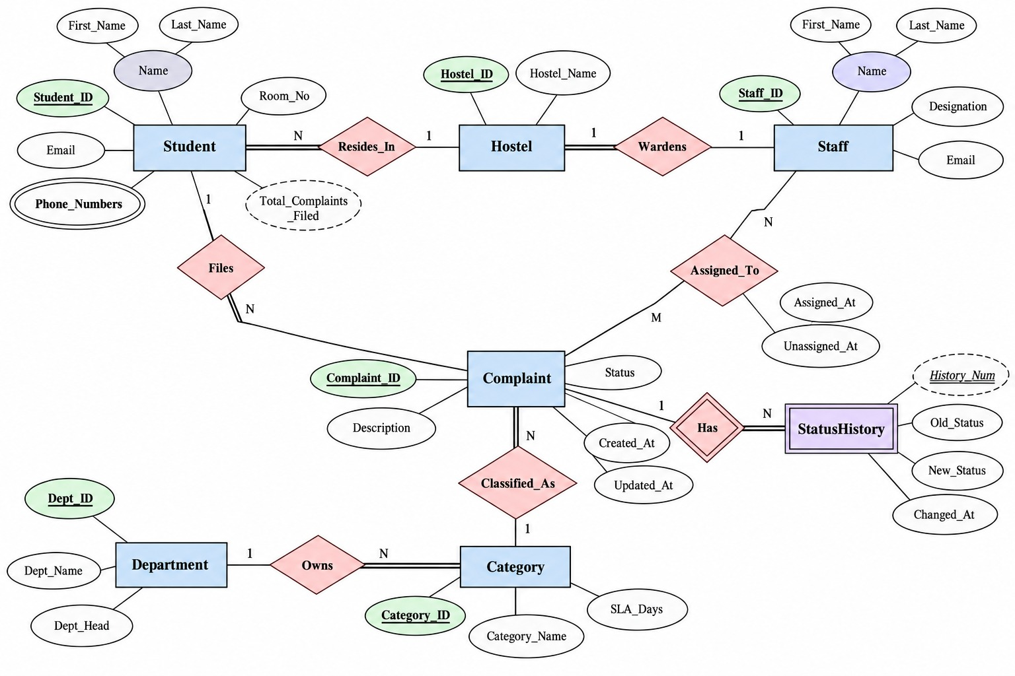
Entity-Relationship Diagram
Reading the diagram
7 entities; Complaint is the hub
1 student files N complaints
Each complaint: 1 category, owned by 1 department
Assigned_To is M:N with its own attributes
StatusHistory is a weak entity (via Has)
Multivalued: Phone_Numbers. Derived: Total_Complaints_Filed
Notes:
This is our ER diagram in Chen notation. Rectangles are entities, ellipses are attributes, diamonds are relationships. A double line means total participation and a single line means partial participation.
There are seven entities: Student, Staff, Hostel, Department, Category, Complaint and StatusHistory. Complaint is the hub of the design.
Starting from the Student: one student Files many complaints, and every complaint must be filed by a student. A student Resides_In one hostel, and many students can live in the same hostel. Each Hostel has exactly one warden from the Staff entity through the Wardens relationship, a one-to-one link.
Each complaint is Classified_As exactly one category, and each Category is Owned by one Department. That chain lets us report complaints by department without storing the department on the complaint itself.
Assigned_To is the many-to-many relationship between Staff and Complaint. It carries its own attributes, Assigned_At and Unassigned_At, so we keep a full assignment history.
StatusHistory is a weak entity, shown with a double border. A history row has no meaning without its complaint, so it is identified by the complaint plus its partial key, History_Num, through the identifying relationship Has.
Finally, two special attributes. Phone_Numbers is multivalued, shown with a double ellipse, because a student can have several numbers. Total_Complaints_Filed is derived, shown dashed, because we calculate it by counting complaints rather than storing it.
When converted to tables, this design is in third normal form. Thank you. I'm happy to take any questions.

