Slide 1

CAPSTONE PROJECT AI-Based Emotion Detection from Text and Voice
Presented By
Student Name: B. Rakshan
College Name: Adhiparasakthi Engineering college
Department: Computer science and engineering
Email ID: rakshanbaskaran147@gmail.com
AICTE Student ID:STU67970a214350c1737951777

Slide 2
OUTLINE
Problem Statement
Proposed System/Solution
System Development Approach
Algorithm & Deployment
Result
Conclusion
Future Scope
References

Slide 3
Problem Statement
Today, many applications require understanding human emotions — such as mental health apps, virtual assistants, or customer feedback analyzers. However, most existing systems process only text or only voice. This leads to inaccurate or limited emotion detection. A solution that supports both text and voice inputs with intelligent emotion classification is needed for better human-computer interaction.

Slide 4
Proposed Solution
The proposed system accepts text or voice input, processes it through NLP and speech recognition, and uses a machine learning model to classify the emotion as happy, sad, angry, or neutral.
Uses SpeechRecognition to convert voice to text
Applies TF-IDF + Logistic Regression for emotion classification
A Gradio interface is provided for easy user interaction

Slide 5
System Approach
System Requirements:
Python 3.9+
Libraries: scikit-learn, gradio, speechrecognition
Technology Stack:
NLP & ML: Scikit-learn
Audio Processing: SpeechRecognition
UI: Gradio
Data: Sample emotion-labeled text

Slide 6
Algorithm & Deployment
Algorithm Used: Logistic Regression
Input: Text from user or transcribed from audio
Preprocessing: TF-IDF Vectorizer
Model Training: Trained on labeled emotional text samples
Deployment:
gr.Interface() from Gradio
Handles both audio and text
Local web app for demo

Slide 7
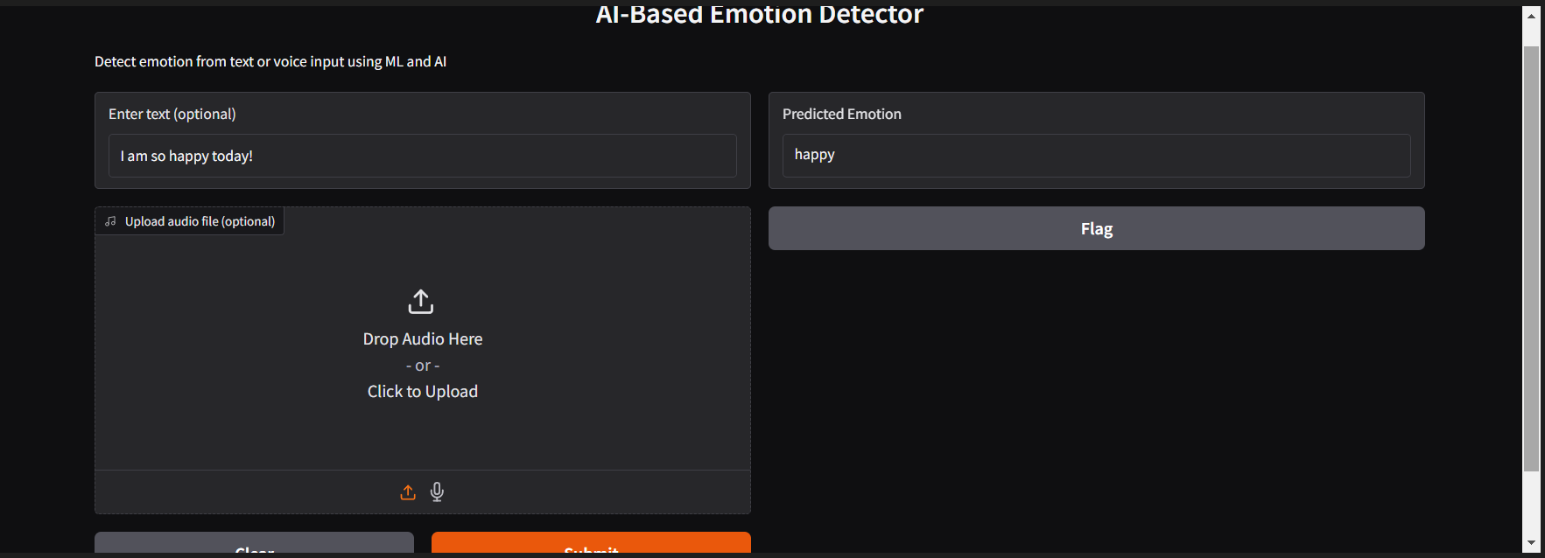
Result
Result:
Detects emotions from:
✅ Text input (e.g., "I am so happy") → happy
✅ Audio input (e.g., .wav file with voice saying "I'm sad") → sad
UI built with Gradio

Slide 8
Conclusion
This project successfully demonstrates an AI-powered solution for detecting emotions from both text and voice. It combines ML, NLP, and speech recognition in a single user-friendly tool. The model performs well on basic emotion classification and opens doors for integration into mental health support systems, smart assistants, and more.

Slide 9
Future scope
Use advanced models (e.g., Transformers or LSTM) for better accuracy
Add support for multiple languages
Train with larger real-world datasets
Deploy to web using Streamlit, Hugging Face, or Flask
Integrate real-time microphone input & camera-based emotion detection

Slide 10
References
https://scikit-learn.org
https://pypi.org/project/SpeechRecognition
https://gradio.app
“Emotion detection using ML” – Research articles on arXiv
GitHub link: https://github.com/Rakshan1407/Edunet_Project.git

Slide 11
Thank you

