Slide 1


NEXT GEN EMPLOYABILITY PROGRAM
CREATING A FUTURE-READY WORKFORCE
Student Name :
B Rakshan
Student ID :
College Name :
STU67970a214350c1737951777
Adhiparasakthi Engineering College

Slide 2
CAPSTONE PROJECT SHOWCASE
Project Title
Personal Finance Manager with MERN Technology
Abstract | Problem Statement | Project Overview | Proposed Solution | Technology Used | Modelling & Results | Conclusion

Slide 3
Abstract
1
Problem Statement
2
Project Overview
3
Proposed Solution & Technology Used
4
Conclusion

Slide 4


Problem Statement
Personal Finance Manager with MERN Technology :
"The Expense management project is designed to create a platform where users can create, view, edit, and delete expense with real-time updates. The platform ensures that any changes made to any expense are instantly reflected across all reports. This project will provide you with hands-on experience in implementing user authentication, managing documents, and ensuring real-time collaboration using the MERN stack (MongoDB, Express.js, React.js, Node.js).

Slide 5

Project Overview
The Personal Finance Manager is a web-based platform developed using the MERN stack (MongoDB, Express.js, React.js, Node.js) to help users manage their expenses efficiently. The platform allows users to create, view, edit, and delete expenses while ensuring real-time updates across all reports.
This project focuses on improving financial tracking by providing a user-friendly and interactive interface for managing expenses. It incorporates user authentication, enabling secure access and data privacy. The system also includes dynamic dashboards that visualize spending trends, offering users insights into their financial habits.
By leveraging modern web technologies, the platform ensures seamless performance, real-time collaboration, and an intuitive user experience, making personal finance management easier and more effective.

Slide 6
Proposed Solution
The Personal Finance Manager, built with the MERN stack (MongoDB, Express.js, React.js, Node.js), offers a secure, real-time, and user-friendly expense tracking solution.
Key Features:
Secure Authentication: Ensures data privacy with JWT-based login.
Real-Time Expense Tracking: Users can add, edit, and delete expenses with instant updates.
Data Insights & Reports: Interactive dashboards provide spending analytics.
Cloud-Based Storage: Scalable MongoDB database for seamless data management.
Cross-Platform Accessibility: Responsive React.js interface for desktop and mobile.
This solution simplifies financial management, providing users with a fast, efficient, and intuitive way to track and control their expenses.

Slide 7
Technology used
The Personal Finance Manager is built using the MERN stack, ensuring a scalable, real-time, and efficient expense management system.
MongoDB: NoSQL database for secure and scalable data storage.
Express.js: Backend framework for handling API requests efficiently.
React.js: Frontend library for a dynamic and responsive user interface.
Node.js: Backend runtime for server-side processing and real-time updates.
JWT Authentication: Secure user login and session management.
Chart.js / Recharts: Data visualization for expense insights.
MongoDB Atlas: Cloud-based database storage for scalability.
This technology stack ensures a fast, secure, and user-friendly personal finance management solution.

Slide 8
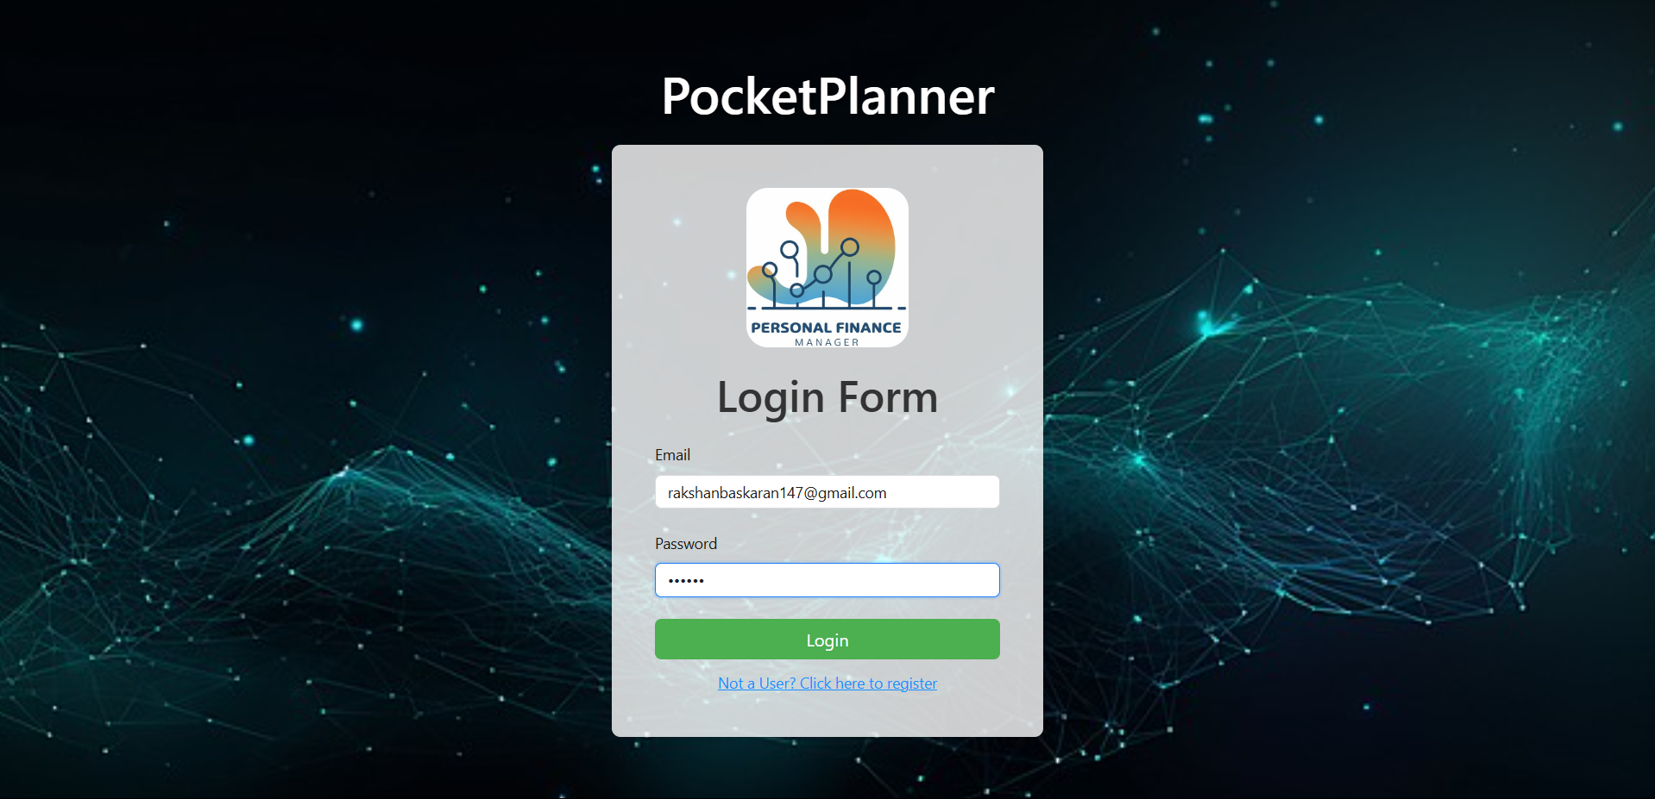
Modelling & Result : Login Page

Slide 9
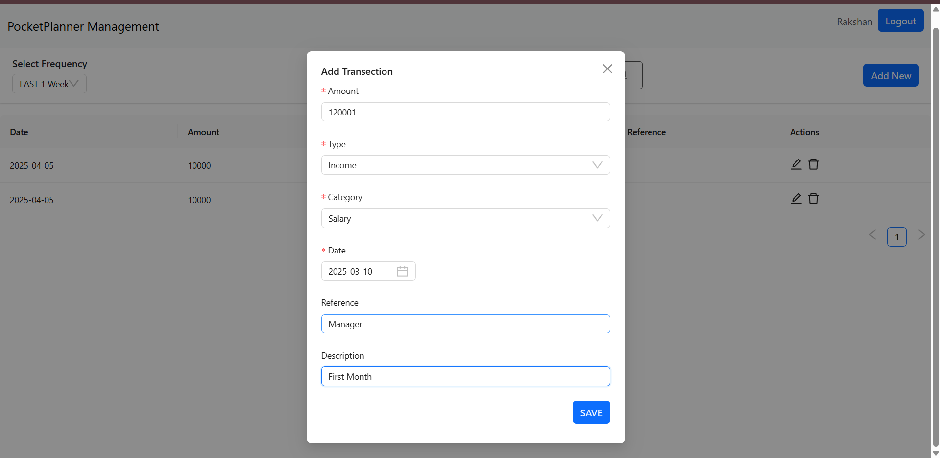
Modelling & Result : New Transection

Slide 10
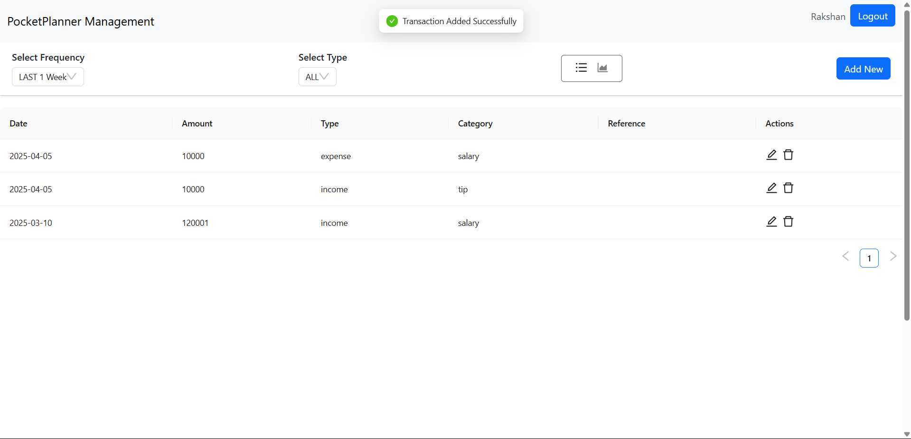
Modelling & Result : Dashboard

Slide 11

Conclusion
The Personal Finance Manager provides a secure, real-time, and user-friendly solution for managing expenses efficiently. By leveraging the MERN stack, it ensures seamless data synchronization, insightful financial tracking, and a responsive user experience.
With features like real-time expense updates, interactive dashboards, and cloud-based storage, this platform simplifies personal finance management, helping users gain better control over their spending.
This project demonstrates the power of modern web technologies in building efficient financial tools, offering a scalable and practical solution for everyday expense tracking.

Slide 12


Notes:
Thank You !!

