Slide 1


Nutrition Analytics
Rakshanda Hedawoo
Yash Khanna
Team 24061

Slide 2



Meet the team
Rakshanda Hedawoo
M.S. Information Systems in Robert H. Smith School of Business @UMD
Yash Khanna
B.S. Information Sciences in College of Information Studies; ACES Student in Honors College @UMD

Slide 3
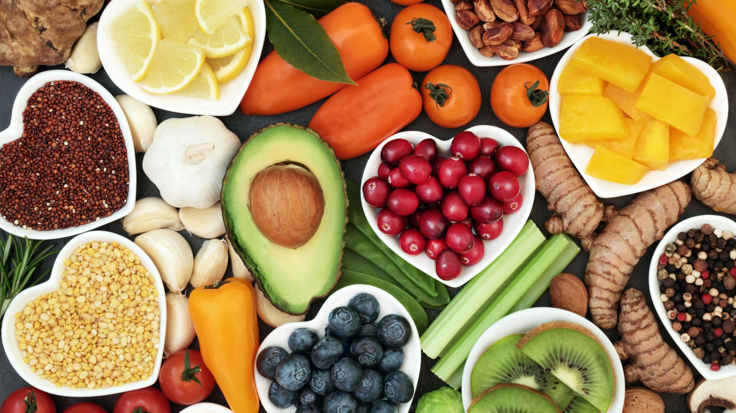
How many of you consume at least one food product?
Dairy and egg Products
Fruit and Fruit juices
Vegetables
Beans
Baked products
Grains and Pasta

Slide 4

Questions
Which food categories have gone through the significant change overtime?
When comparing nutrients from the two datasets, does the mean value for SR Legacy fall between the minimum and maximum values of the Foundation Foods?
Which nutrients fall out of range the most and which fall in range more frequently?

Slide 5
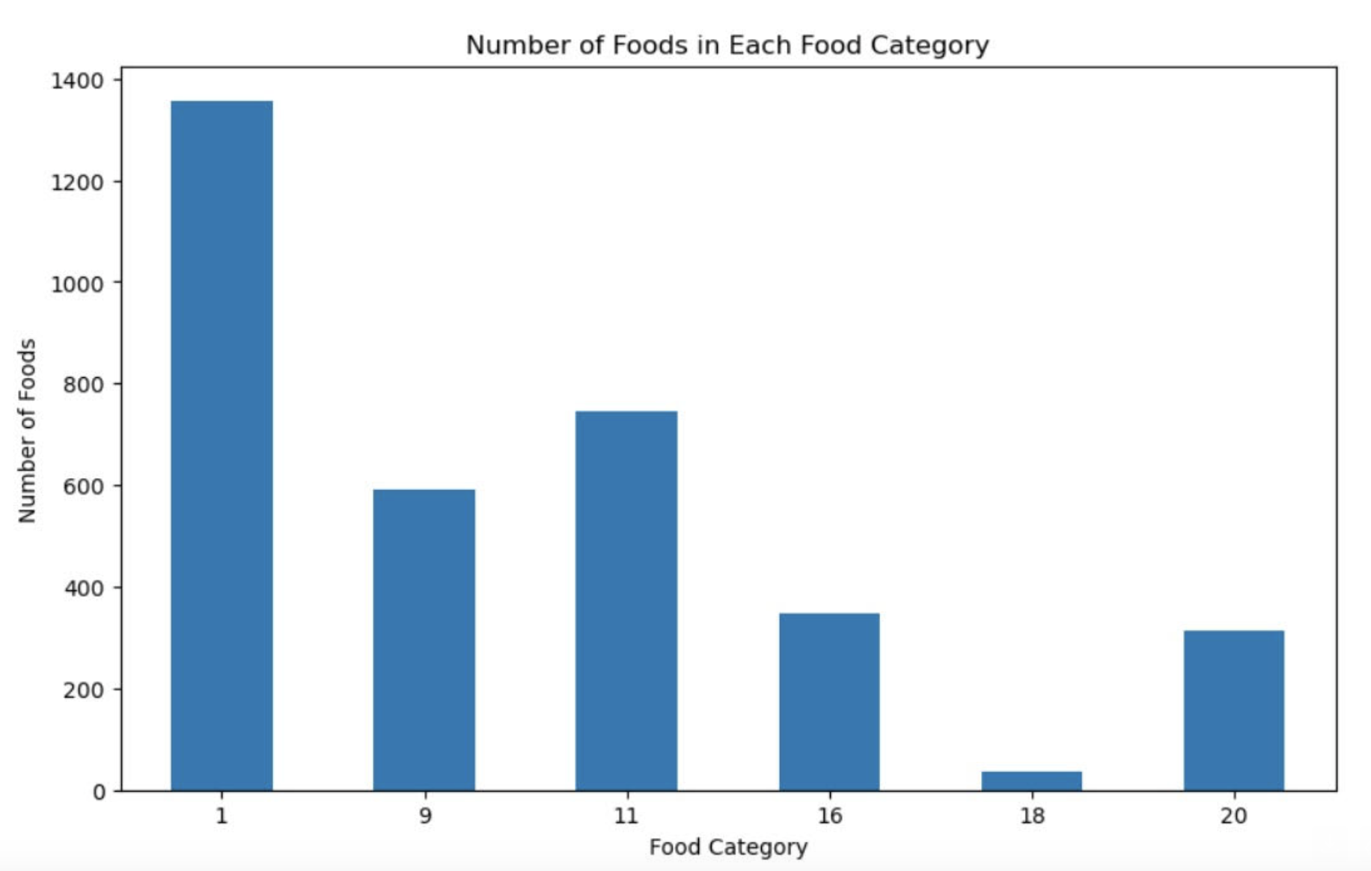
1: Dairy and egg products
9: Fruit and fruit juices
11: Vegetable and vegetable products
16: Legumes
18: Baked products
20: Cereal grains and pasta

Slide 6
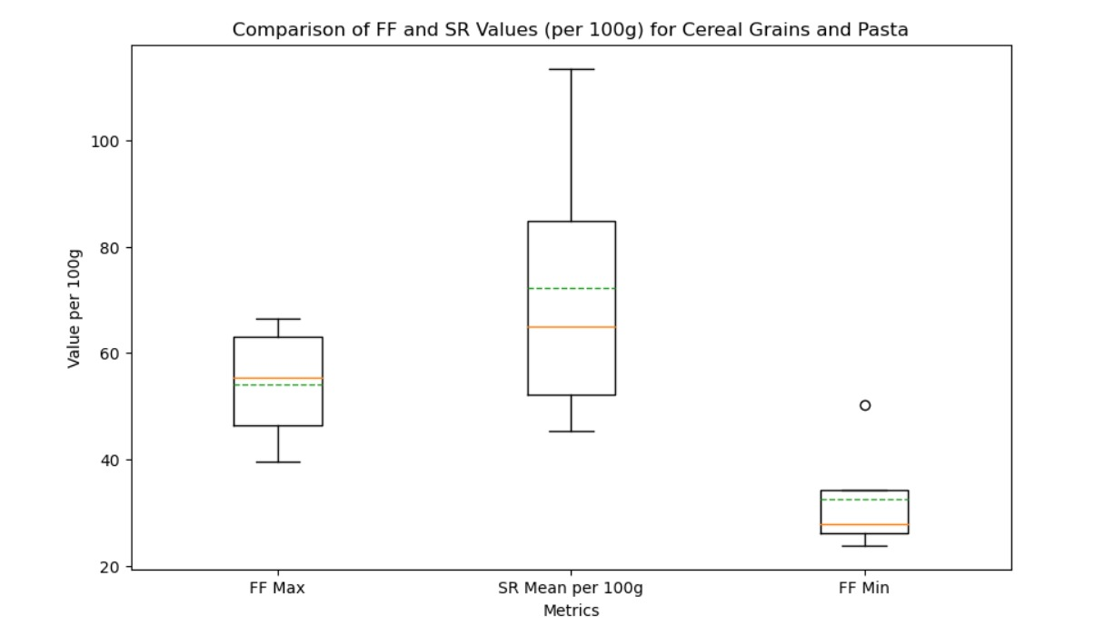

Slide 7
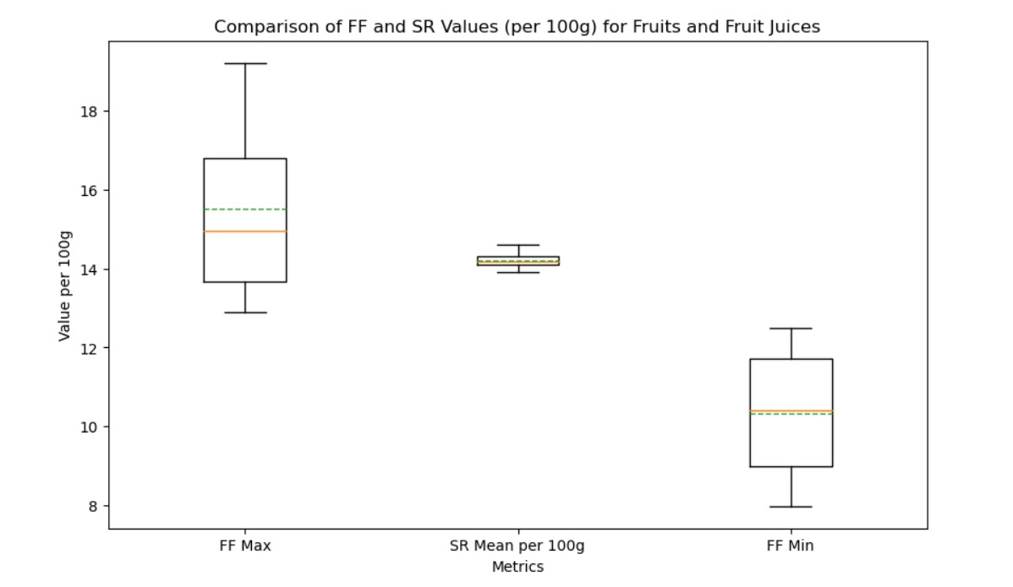

Slide 8
Food categories to analyze change in nutrient value
Dairy and egg products
Vegetable and vegetable products
Baked products
Cereal grains and pasta

Slide 9
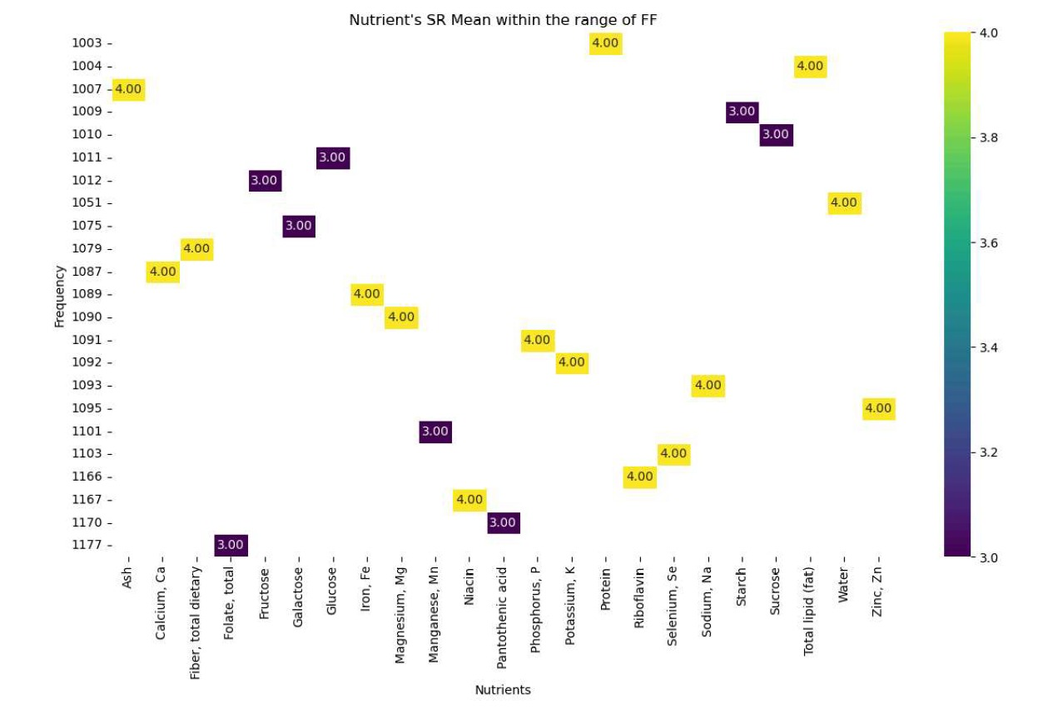

Slide 10
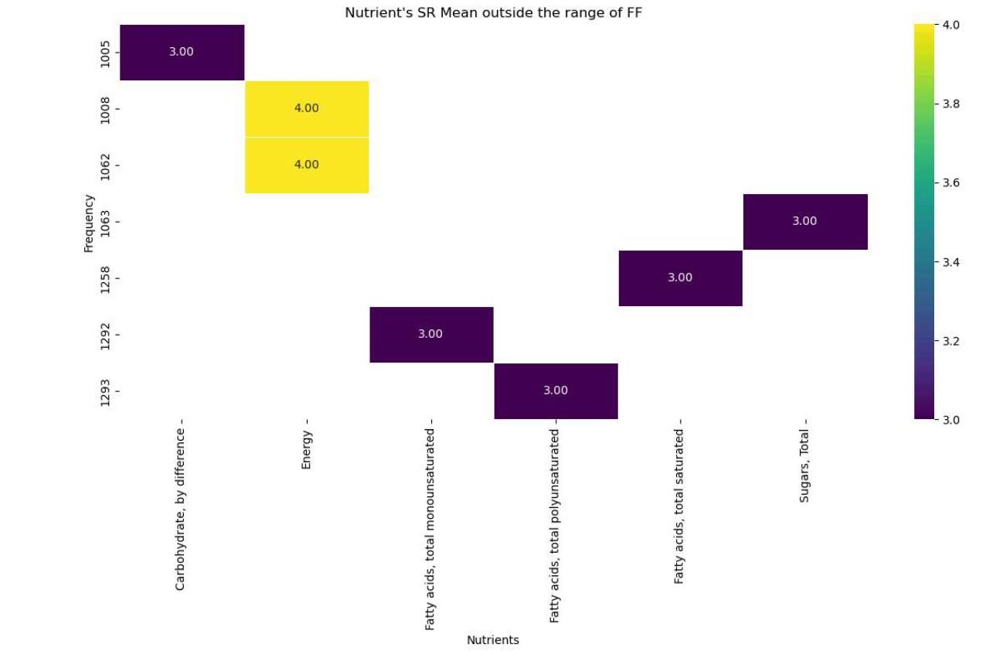

Slide 11
Recommendations
We must analyze carbohydrates, energy content, and fatty acids because of the following reasons:
Environmental factors
Agriculture practices
Food processing
Breeding and genetics
Regulatory changes
Nutrients like: Proteins, Irons, Potassium, Glucose, Starch, Water, Sucrose, Magnesium, etc. are less likely to change significantly due to the following reasons:
Basics Biological composition
Conservation in food processing
Nutrient Enrichment

