Slide 1


Understanding and Predicting Customer Churn at
Team 15
Rakshanda Hedawoo Srinivas Varma Chintalapati Srinidhi Reddy Elkicherla

Slide 2

OBJECTIVE
Identify main drivers of customer churn.
Analyze demographic factors' influence on churn.
Evaluate financial metrics' impact on attrition.
Examine patterns in customer behavior linked to churn.
Develop predictive models for future churn risk.
Derive actionable insights for targeted retention.

Slide 3

About the Data
Source: Kaggle
Sample Size (n): 10,000 records
Variables: 17
Key Variables:
Geography Gender Age Tenure Balance
NumOfProducts HasCrCard IsActiveMember Exited Satisfaction Score

Slide 4

Implementation
Utilized PySpark SQL for initial exploratory data analysis (EDA).
Applied k-means clustering for customer segmentation.
Trained and evaluated logistic regression, decision trees, and random forest classifiers on historical data for predictive modeling.

Slide 5

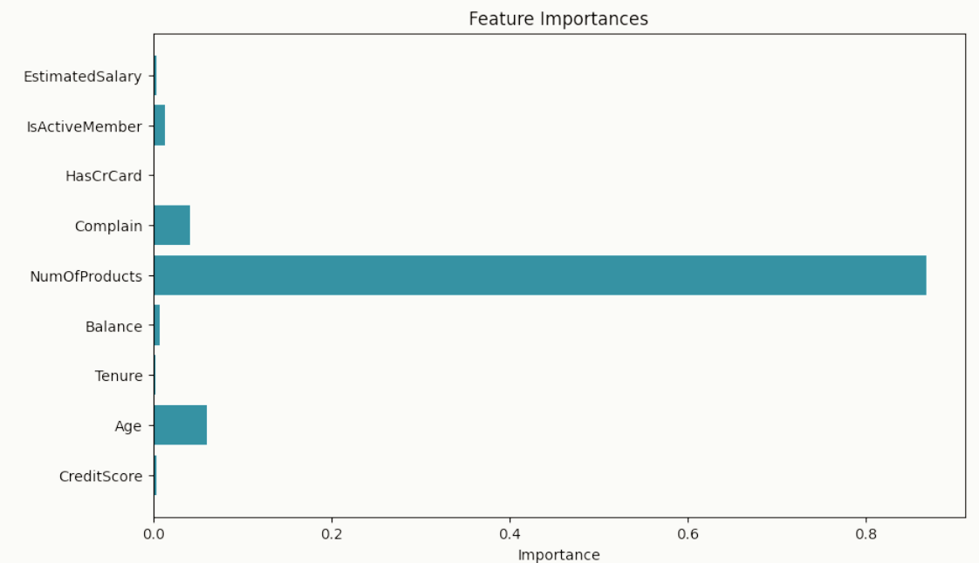
Results & Findings
Demographic analysis- Geography,Gender
Financial Health Analysis -Geography,Credit Score and Balance Risk and Churn Analysis-NumOf Product and Card Type Cluster Analysis - Tenure, EstimatedSalary, Age, and Complain Decision Tree (highest accuracy)

Slide 6

Recommendations
Dynamic Product Alignment
Cross-Functional Customer Success Teams
Proactive Complaint Resolution Mechanism
Customized Engagement Programs
Geo-Specific Retention Campaigns

Slide 7

Conclusion
Our analysis has provided valuable insights into customer churn for Oasis Bank. By identifying key factors influencing churn and recommending targeted strategies, we aim to support the bank in enhancing customer retention and driving sustainable growth.
Thank you.

