Slide 1
DATABASE MANAGEMENT SYSTEMS
Team 7
Rakshanda Hedawoo
Srinivas Varma Chintalapati
Krupa Shah
Srinidhi Reddy Elkicherla

Slide 2


A leading consulting firm specializing in university rankings.
Core Service:
Assisting universities in enhancing their rankings by analyzing real-time data and trends in the educational landscape.

Slide 3
PROJECT MISSION
Aims to empower UMD Smith School stakeholders with detailed, accurate ranking data.
Develops a state-of-the-art database integrating diverse data over multiple years.
Utilizes comprehensive ranking data to provide valuable insights for UMD stakeholders.
Examining how data sources weigh and evaluate programs, focusing on specific criteria.
Analyzing top competitors to strategize Smith School's improved market standing.

Slide 4



BACKGROUND ANALYSIS
Users
Ranking Sources
Ranking Criteria
Current Students
Prospective Student
Parents
Academic Advisor
Professors
QS World University
The Financial Times
U.S. News
Poets & Quants
Fortune
Edvoy
Reputation and Quality
Student and Faculty Metrics
Career and Alumni Outcomes
Educational & Financial Factors
Institutional Recognition
Notes:
Reputation and Quality:
Academic Reputation
Employer Reputation
Student and Faculty Metrics:
Faculty-to-Student Ratio
International Faculty
Student Satisfaction
Career and Alumni Outcomes:
Alumni Salary
Career Progress
Employment Rate
Alumni Outcomes
Educational and Financial Factors:
Debt After Graduation
Admissions Standards
Academic Experience
Graduation Rate
Financial Resources
Return of Investment
Institutional Recognition:
Outcomes Score
Brand Score
Fortune 1000 Score

Slide 5
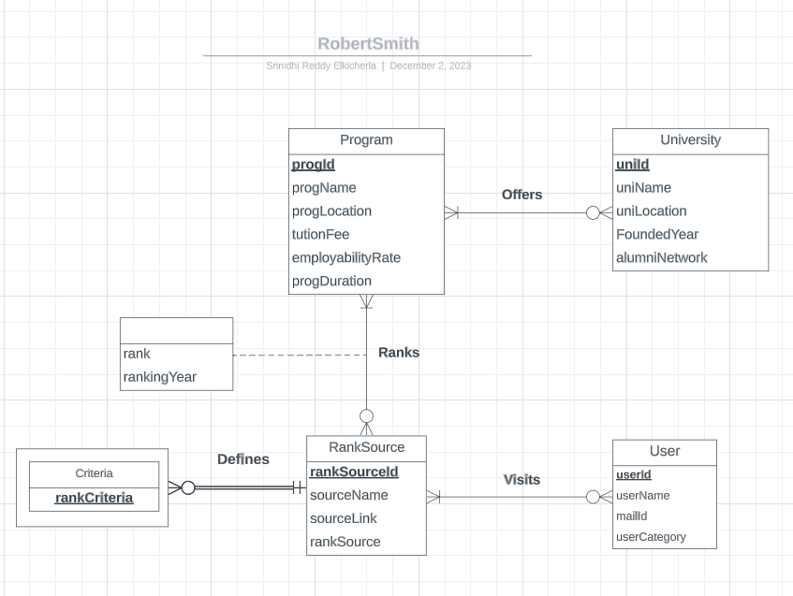
CONCEPTUAL DATABASE DESIGN
Entity Relationship Diagram

Slide 6
LOGICAL DATABASE DESIGN
Relational Schema
University(uniId, uniName, uniLocation, foundedYear, alumniNetwork)
Program(progId, progName, progLocation, tuitionFee, progDuration,
employabilityRate)
RankSource(rankSrcId, rankSrcName, rankSrcLink, rankingCriteria)
Criteria(rankCriteria, rankSrcId)
User(userId, userName, userEmailId, userCategory)
Ranks(progId, rankSrcId, rankYear, rank)
Offers(progId, uniId)
Visits(rankSrcId, userId)

Slide 7

PHYSICAL DATABASE DESIGN
CREATE TABLE [UniRank.Program](
progId CHAR (4) NOT NULL,
uniId CHAR(4) NOT NULL,
progName VARCHAR (60),
progLocation VARCHAR (60),
progTuitionFee DECIMAL,
progDuration DECIMAL,
progEmployabilityRate DECIMAL,
CONSTRAINT pk_Program_progId PRIMARY KEY (progId),
CONSTRAINT fk_Program_uniId FOREIGN KEY (uniId)
REFERENCES [UniRank.University] (uniId)
ON DELETE CASCADE ON UPDATE NO ACTION);

Slide 8
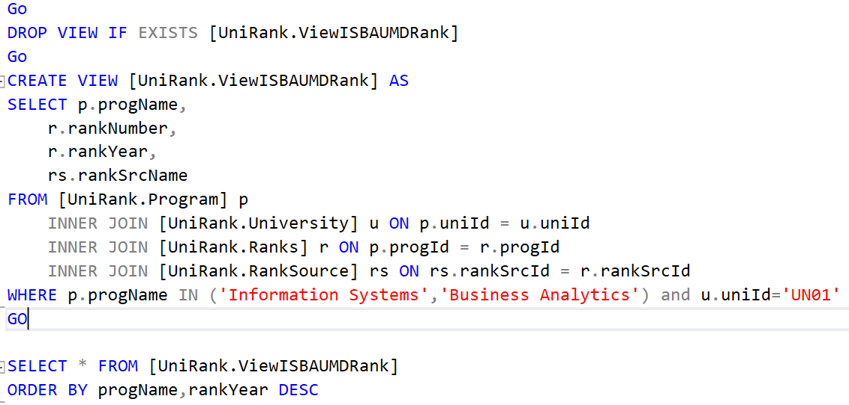
What is the ranking trend for Information Systems and Business Analytics for UMD over past 3 years? Are they improving or declining?

Slide 9
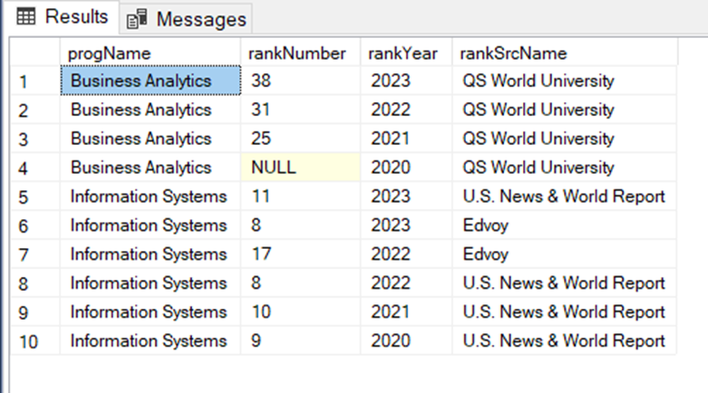
OUTPUT

Slide 10
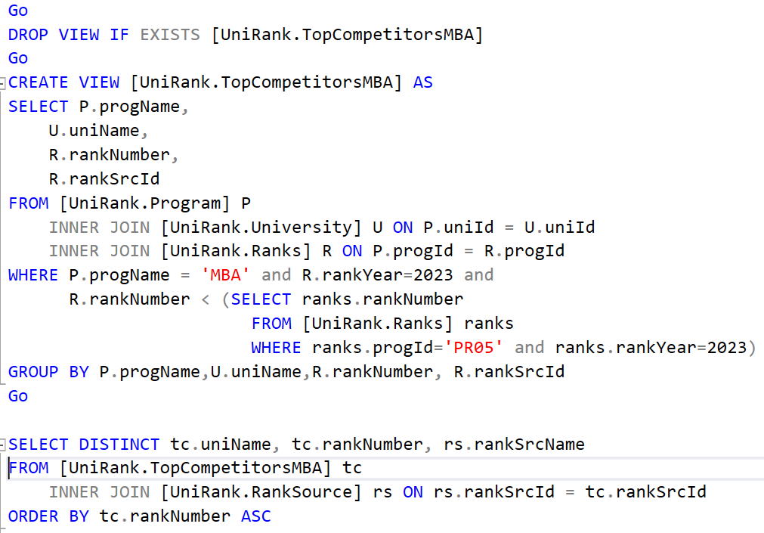
Who are the top-ranking competitors for UMD Smith School in MBA?

Slide 11
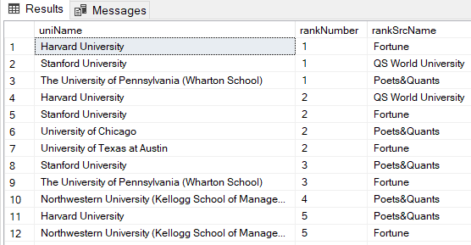
OUTPUT

Slide 12
Thank you

