Slide 1

SMART INDIA HACKATHON 2026
Angaar (अंगार)
Coal mine compliance
Problem Statement ID – SIH26024
Problem Statement Title- AI-Based Smart Governance and Compliance Monitoring System for Coal Mines
Theme- Smart Automation
PS Category- Software
Team ID- 178955
Team Name - Computer Smashers

Slide 2
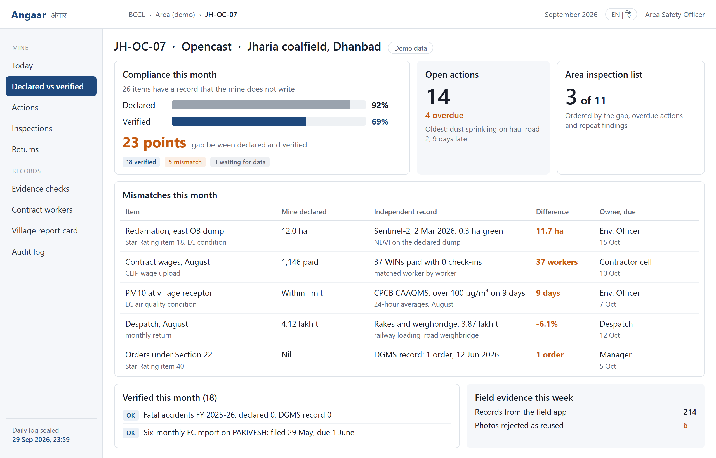
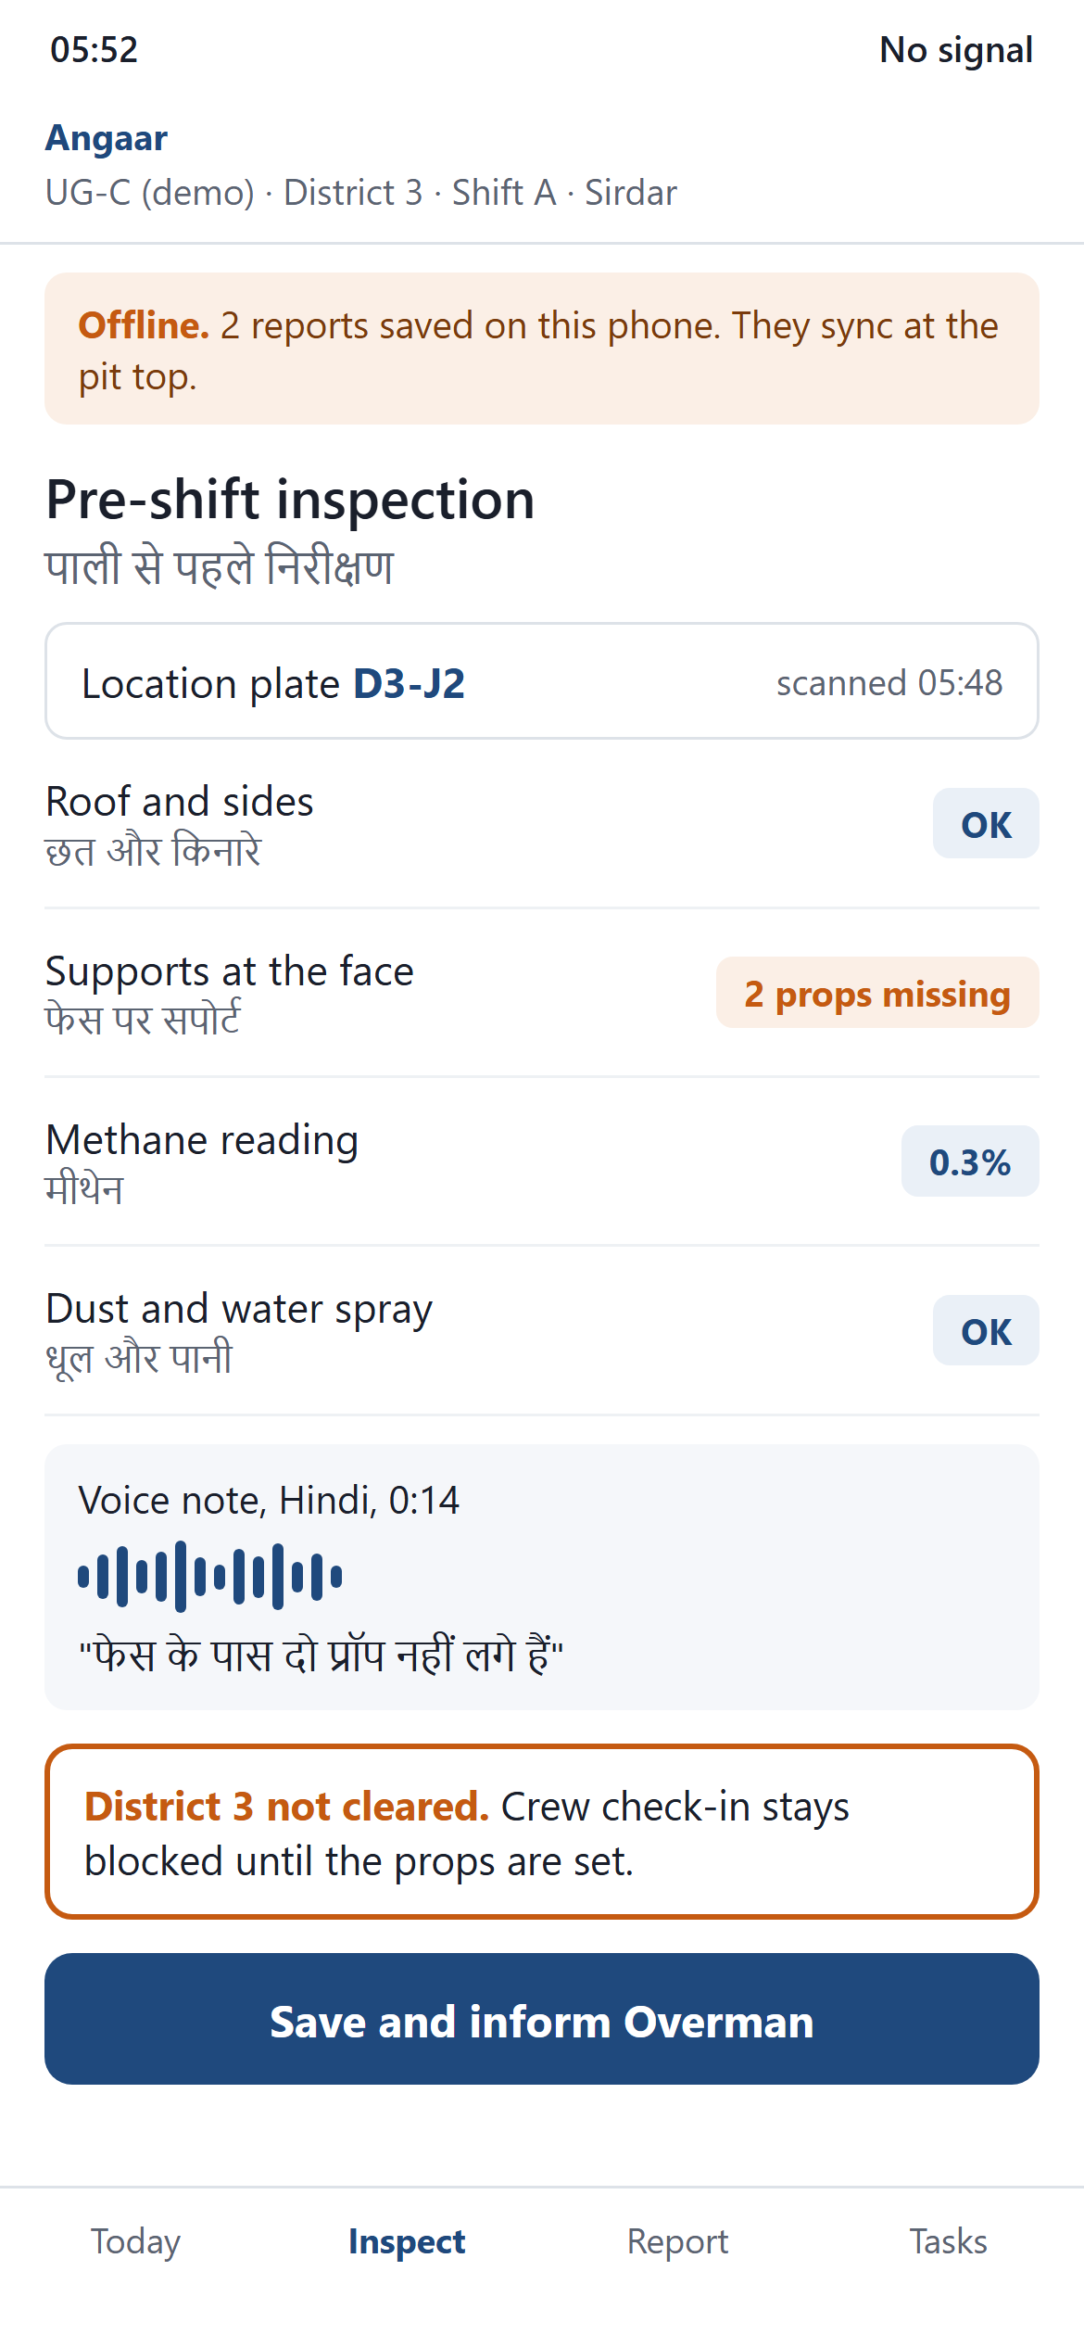
Angaar (अंगार)
Coal mine compliance, checked against records the mine does not write
Computer
Smashers
Proposed Solution:
Why it is needed: in the Ministry of Coal Star Rating for 2022-23, 380 mines rated themselves. Only the top 10% got a site visit; the rest were reviewed online.
Detailed explanation of the proposed solution
One web app for office and phone; works offline underground
Staff log inspections and fixes at QR plates with photo proof
How it addresses the problem
Declared figures are checked against Sentinel-2, CPCB, CLIP
A mismatch becomes an action with an owner and a due date
Innovation and uniqueness of the solution
Angaar web and field app. Grey bar: what the mine declared. Blue bar: what outside records confirm. Phone: a Sirdar's pre-shift check with no signal.
Every mine gets two scores: Declared and Verified
DGMS and CCO inspection lists are ordered by the gap

Slide 3
TECHNICAL APPROACH
Computer
Smashers
Technologies used:
Part | What we use | Who built it
Web and phone app | Next.js 15 PWA, Workbox offline cache, IndexedDB queue, QR scanner | Our code
Server | FastAPI (Python 3.12), Celery and Redis for nightly checks and deadlines | Our code
Database | PostgreSQL 16 with PostGIS and TimescaleDB, MinIO for photos | Open source, self-hosted
Checks and models | NDVI with rasterio, Isolation Forest, LightGBM with SHAP, TF-IDF classifier | Our code, our trained models
Outside models | Sentinel-2 images, Bhashini speech-to-text, Tesseract OCR, Llama 3.1 8B | External (Llama on our server)
Security and audit | Role-based login, SHA-256 hash-chained audit log, encrypted storage | Our code
Methodology and process for implementation:
1. Capture
Field app, offline: QR plate, photo, Hindi voice note
2. Collect
CLIP wages, despatch, Sentinel-2, CPCB air data, DGMS orders
3. Cross-check
Declared figure vs outside record: Verified, Mismatch or Waiting
4. Act
Owner, due date, escalation to Area GM; closes only with proof
5. Report
Dashboards from mine to Ministry; Star Rating and PARIVESH drafts
Human control: the software only flags a mismatch and Llama only drafts reports; an officer closes every case.

Slide 4
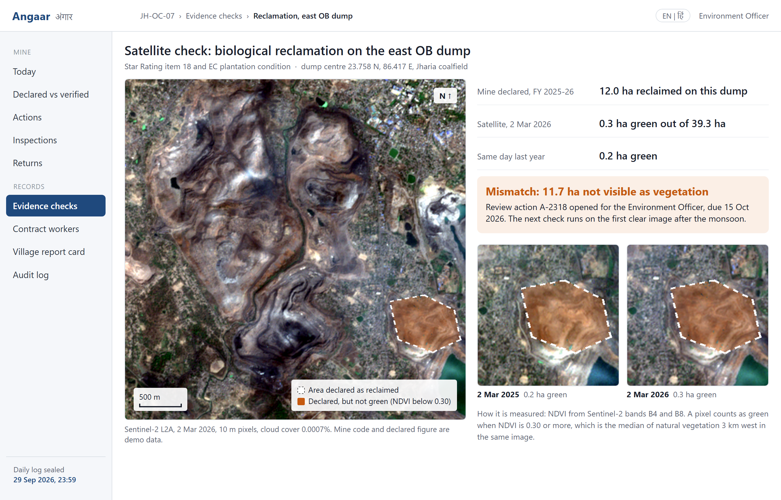
FEASIBILITY AND VIABILITY
Computer
Smashers
Analysis of the feasibility of the idea
Technical: the satellite check already runs on free data
Economic: open source, no licence fees, NIC MeghRaj hosting
Operational: pilot at 5 mines of one BCCL area in 3 months
Potential challenges and risks | Strategies for overcoming these challenges
Data access: CLIP, attendance and despatch data need CIL approval | Start on public data (Sentinel-2, CPCB, DGMS, Coal Directory) and CSV files from the pilot area
Wrong results or downtime: clouds, monsoon, sensor gaps, no network | Cloud mask and dry-season images; a mismatch opens a review, never a penalty; app works offline
Adoption: Sirdars and Overmen are short of time and fear blame | Hindi voice, 3-tap forms, QR plates; results go to managers, not to the person who reported
Real satellite data: Sentinel-2, 2 Mar 2026, Jharia: only 0.3 ha of a 39.3 ha dump is green.
Months 0-3
5 pilot mines
Month 6
1 subsidiary
Month 18
322 CIL mines
Year 3
all 380 mines

Slide 5
IMPACT AND BENEFITS
Computer
Smashers
Potential impact on the target audience
Estimate: mine-checks per year
Our calculation from public figures, not official
Sirdar and Overman: Hindi forms that work without network
Contract workers: paid days matched with days at work
DGMS, CCO and CIL: visit first where the gap is widest
Benefits of the solution (social, economic, environmental, etc.)
Social: a hazard closes only with photo proof at the spot
Economic: data entered once and reused for every return
Environmental: reclamation and dust checked every month
380
Star Rating mines
in 2022-23
322
Coal India mines
on 1 April 2023
1,047.5 Mt
India's coal output
in FY 2024-25
How we got the number
380 mines rated in 2022-23; top 10%, about 38, got a visit
9 of the 50 opencast items have an outside record (slide 6)
380 mines × 12 months = 4,560 mine-checks a year
Site visits still check all 50 items, starting at the widest gap
Beyond India: Sentinel-2 images are free for every country and our rules are stored as data. A coal mine in Indonesia, South Africa or Australia needs a new rule pack, not new code.

Slide 6
RESEARCH AND REFERENCES
Computer
Smashers
Details / Links of the reference and research work
1. Star Rating of Coal Mines and OC template, Ministry of Coal: starrating.coal.gov.in
2. Star Rating review, The Reporters' Collective, Nov 2024: reporters-collective.in
3. DGMS SANKET: coal mine accidents 2016-22: dgms.net
4. DGMS at a Glance 2023: risk-based inspection: dgms.net
5. Coal Directory of India 2024-25, Coal Controller: coalcontroller.gov.in
6. Sentinel-2 L2A images, ESA Copernicus: earth-search.aws.element84.com
7. CPCB CAAQMS air quality data: airquality.cpcb.gov.in/ccr
8. UTTAM: third-party coal quality results, CIL: uttam.coalindia.in
9. PARIVESH: six-monthly EC compliance: parivesh.nic.in
10. OSH Code 2020 in force 21 Nov 2025, PIB: pib.gov.in
11. CLIP contract labour portal, CIL: clip.cmpdi.co.in
Our research: Star Rating opencast template
50 items, all typed in by the mine
9 of 50
checkable
■ 9 items: air quality, EC report date, reclamation, despatch, coal grade, and 4 DGMS items
■ 41 items: typed in only by the mine
Data links: sources 3 to 9 are public. CLIP wages, attendance and despatch (CIL) and inspection records (DGMS) connect through approved data sharing.
Live check: Sentinel-2 separates bare dumps from vegetation in Jharia (slide 4).

