Slide 1

Maisammaguda, Kompally, Medchal- MalkajgiriDistrict Hyderabad - 500100, Telangana State. www.mallareddyuniversity.
(Telangana State Private Universities Act No. 13 of 2020 & G.O.Ms. No. 14, Higher Education (UE)Department)
Department of Computer Science & Engineering
SnapRoll: Instantly Recognize, Effortlessly Track
Batch Details: PDT-91
2111CS010370-BANDARI PRATHIK
2111CS010373-NIMMALA PRAVEEN
2111CS010389-SWAMI RAKSHIT RAVI
2111CS010391-KURELLA RAKSHITHA
2111CS010423-VELDURTHI RUSHIKESH
Guide Name: Dr. M. Sirisha

Slide 2
Abstract
This project focuses on developing a real-time multi-person face recognition system integrated into a web application.
It leverages deep learning-based models for high-accuracy face detection and recognition.
The system captures video streams using an IP webcam, which broadcasts over a local network via a unique IP address.
A Docker container hosts the application, ensuring portability, isolated runtime, and ease of deployment.
It can recognize multiple faces simultaneously from a live feed and mark attendance or identify individuals.
The solution is designed to be scalable, efficient, and suitable for automation in institutions, workplaces, and surveillance.

Slide 3
Introduction
Face recognition is a biometric technology that identifies or verifies individuals using facial features.
The increasing demand for contactless, real-time identification systems has made face recognition widely adopted in various domains.
Traditional systems often fail to handle multiple faces or require complex hardware setups.
This project introduces a lightweight and scalable multi-person face recognition solution using a simple IP webcam and Python-based web app.
The use of Docker ensures platform independence and streamlined deployment, even for non-technical users.
The project merges the fields of artificial intelligence, computer vision, and web development to create a seamless user experience.

Slide 4
Problem Statement
Traditional face recognition systems are often built for single-user detection or static images.
Most systems require expensive hardware setups or on-premises infrastructure.
Real-time recognition with multiple people in the frame remains a challenge in lightweight environments.
Deploying such systems manually can be complex for users without a technical background.
There's a gap in providing an easily deployable, containerized solution for multi-person detection and recognition.
This project addresses the need for a portable, real-time, and scalable face recognition system with minimal resource requirements.

Slide 5
Existing System
Existing face recognition systems often rely on static datasets and are not optimized for real-time video input.
Many available solutions focus on single-person recognition rather than detecting and recognizing multiple faces simultaneously.
They typically require heavy computational resources and GPU-based processing.
Some cloud-based solutions exist but raise concerns about data privacy and latency.
Most implementations lack portability and are not easily deployable across different environments.
There is limited use of containerization (like Docker) to simplify deployment and scaling.

Slide 6
Proposed System
A web-based multi-person face recognition application built using real-time camera input from an IP Webcam.
The system uses machine learning (with OpenCV and face recognition libraries) to identify multiple individuals simultaneously.
Docker containers are used to package and deploy the application efficiently, ensuring platform independence.
A simple user interface allows users to input the camera’s IP address to start real-time detection.
The system processes frames, detects faces, matches them against a known dataset, and displays results instantly.
The modular design supports future upgrades and potential cloud integration for scalability.

Slide 7
Objectives
To develop a real-time, multi-person face recognition system that functions efficiently through a web interface.
To ensure accurate detection and identification of individuals using live video feeds from IP cameras.
To utilize containerization (Docker) for seamless deployment and platform independence.
To maintain a modular codebase that allows for easy updates and enhancements.
To build a user-friendly interface that allows quick IP input and system interaction.
To prepare the system for potential future scalability to cloud platforms for handling large datasets and multiple streams.

Slide 8
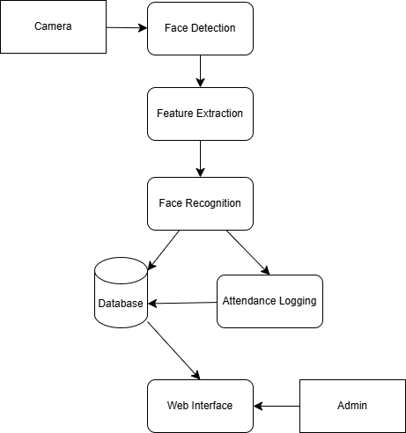
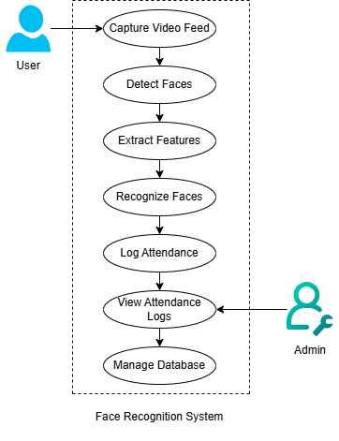
Architecture

Slide 9
Code
# Dataset Preparation
for file_name in os.listdir('dataset'):
img = face_recognition.load_image_file(f"dataset/{file_name}")
encoding = face_recognition.face_encodings(img)[0]
known_encodings.append(encoding)
known_names.append(file_name.split('.')[0])
# Live Video & Recognition
cap = cv2.VideoCapture('http://<ip>:8080/video')
small_frame = cv2.resize(frame, (0, 0), fx=0.25, fy=0.25)
rgb_frame = small_frame[:, :, ::-1]
face_locations = face_recognition.face_locations(rgb_frame)
face_encodings = face_recognition.face_encodings(rgb_frame, face_locations)
# Matching & Display
for encoding in face_encodings:
matches = face_recognition.compare_faces(known_encodings, encoding)
for (top, right, bottom, left), name in zip(face_locations, face_names):
cv2.rectangle(frame, (left, top), (right, bottom), (0, 255, 0), 2)
cv2.putText(frame, name, (left, top - 10), cv2.FONT_HERSHEY_SIMPLEX, 0.75, (255, 255, 255), 2)

Slide 10


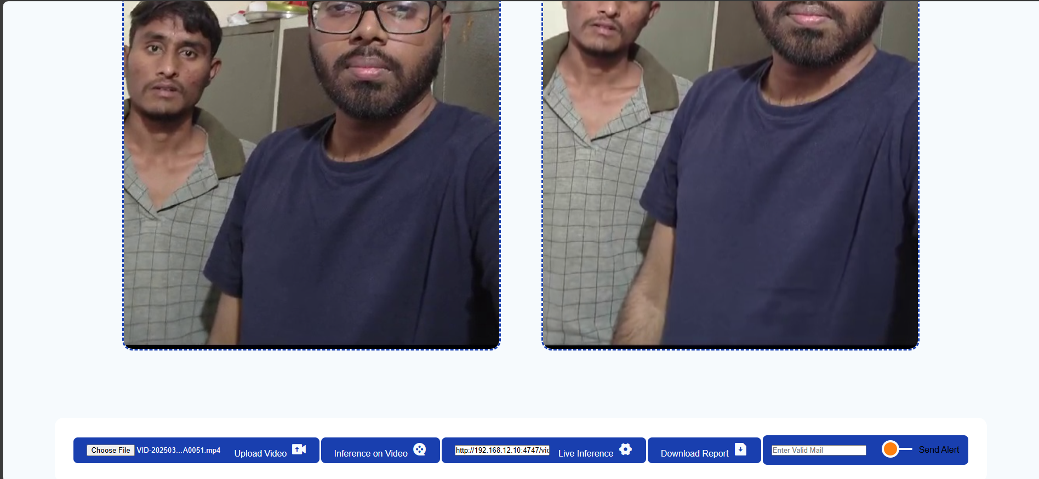
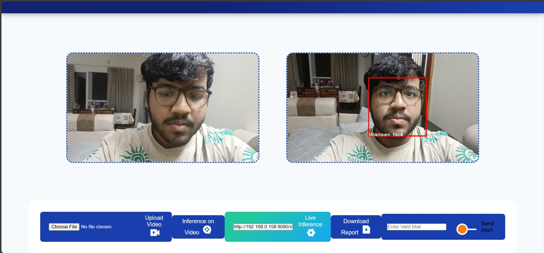
Outcome of Project

Slide 11
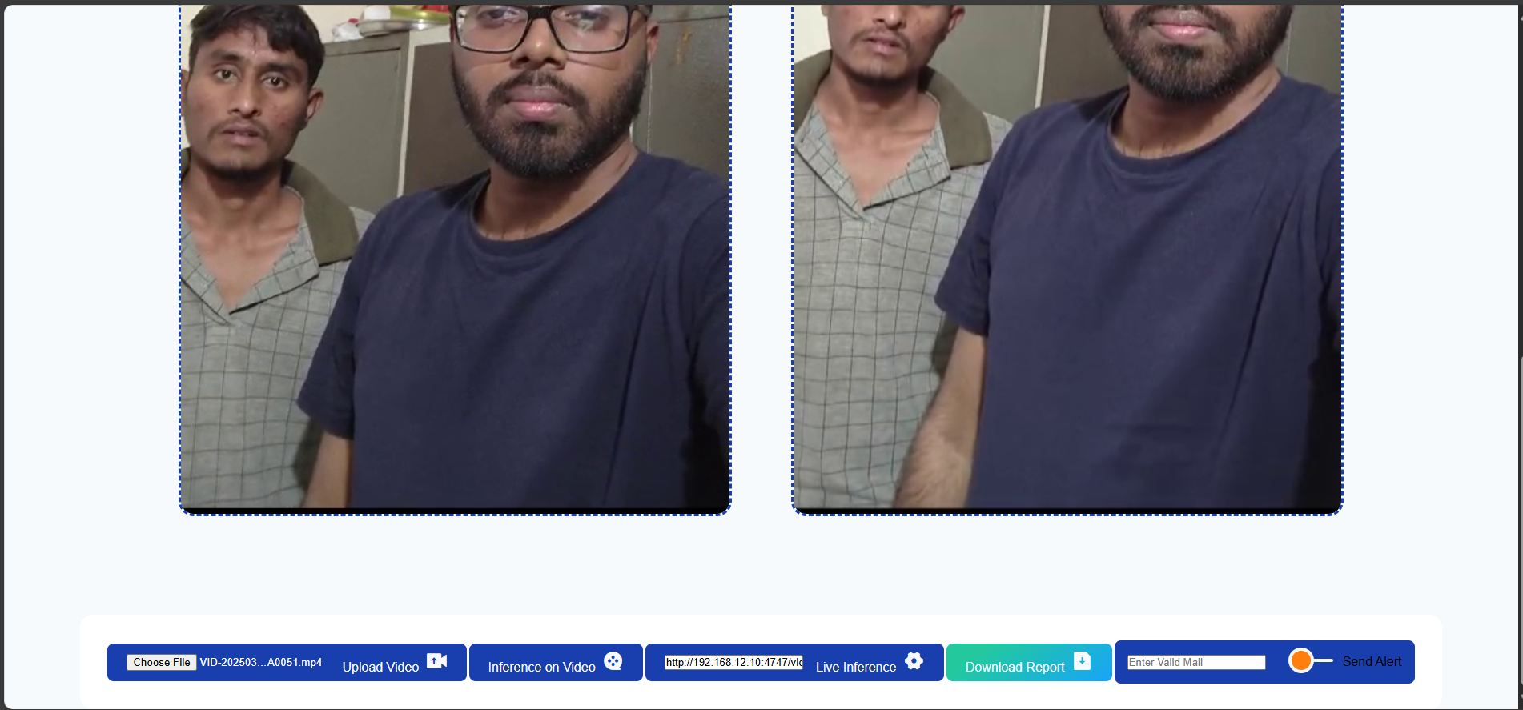
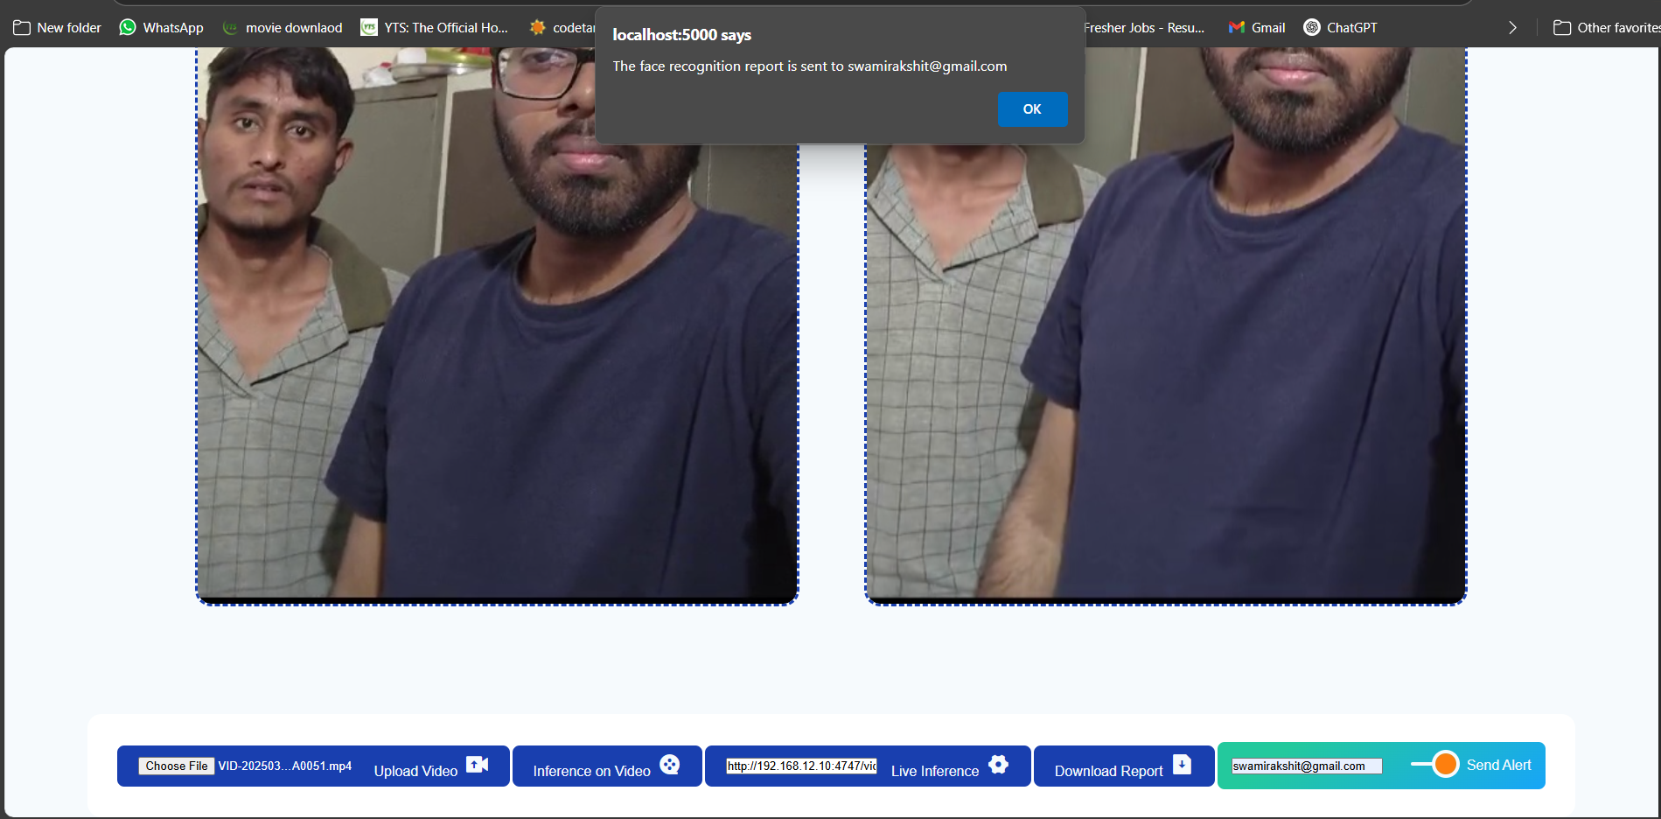

Slide 12
Conclusion
The project successfully demonstrates real-time multi-person face recognition via IP webcam integration.
It leverages modern deployment tools like Docker for platform independence and ease of setup.
The system achieves accurate detection and identification with a simple, user-friendly web interface.
Modular design and containerized deployment enhance maintainability and scalability.
The project lays the groundwork for integrating advanced features like cloud-based storage or model training.
Future improvements can further enhance performance, user access control, and real-world applications.

Slide 13
References
Paul Viola and Michael Jones, “Rapid Object Detection using a Boosted Cascade of Simple Features,” Proceedings of the 2001 IEEE Computer Society Conference on CVPR.
Omkar M. Parkhi, Andrea Vedaldi, Andrew Zisserman, “Deep Face Recognition,” British Machine Vision Conference (BMVC), 2015.
Florian Schroff, Dmitry Kalenichenko, James Philbin, “FaceNet: A Unified Embedding for Face Recognition and Clustering,” IEEE CVPR 2015.
Gary B. Huang et al., “Labeled Faces in the Wild: A Database for Studying Face Recognition in Unconstrained Environments,” University of Massachusetts, Amherst, 2008.
Satya Mallick, “Face Detection and Recognition using OpenCV,” LearnOpenCV (learnopencv.com)

Slide 14


