Slide 1


Programming in for Business Analytics (BMAN73701)
Lecture 5 – CSV files, shallow vs deep copy, variable number of arguments in functions

Slide 2
Last Lecture
Object-oriented programming (OOP)
Introduction to OOP
The __init__ method and self keyword
Different attribute and method types
Important principles in OOP: Encapsulation, inheritance, polymorphism

Slide 3
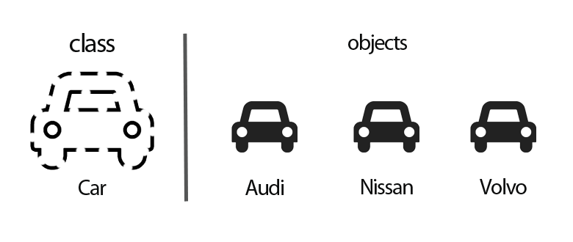
Object-oriented programming (OOP)
Conventional vs OOP
Conventional program based on functions
An object-oriented program is based on classes and a collection of interacting objects, which can receive messages, process data, and send messages to other objects

Slide 4
Object-oriented programming (OOP)
Some OOP terminology
Objects: Python’s abstraction for data. Everything in Python (e.g. an integer, list, module, function, etc) is an object and can be assigned to a variable.
Class: A structure for defining a type of object.
Method: A function that is associated/part of a class
Instance method vs Class method vs Static method
Instance: An object that is of a particular class.
Attribute: Variables or properties of a class or an instance
Class attributes vs Instance attributes
self: Refers to the instance calling the method
cls: Refers to the class calling the method

Slide 5
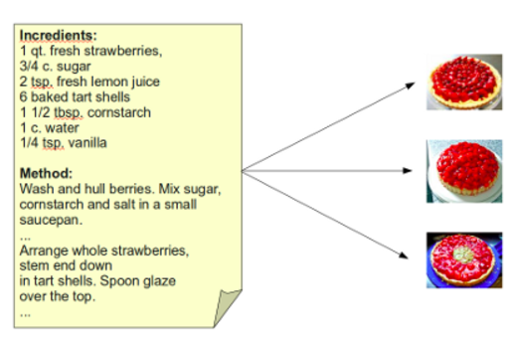
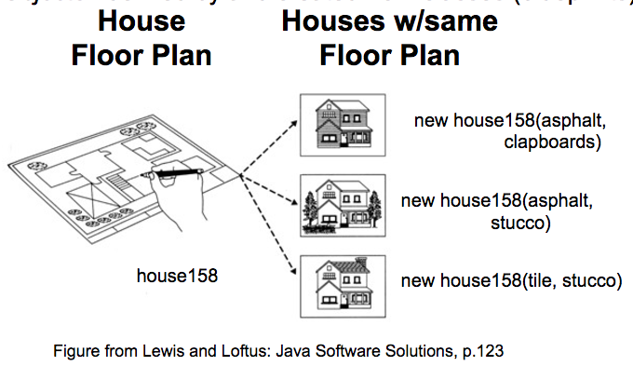
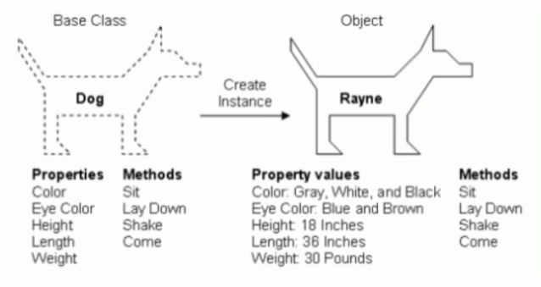
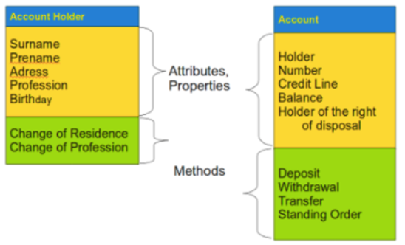
Object-oriented programming (OOP)

Slide 6

Quizz time
1. Create a class called BankAccount to represent a bank account. Instances of this class are initialized by a customer name, account number, and the balance on the account. Each bank account should also have a fixed interest rate of 0.1 (it should be able to access this value from instances of the class or the class itself).
Add the method withdraw() which decreases the balance of the account. Make sure this method does not allow the account to go to a balance of less than £100.
Add a second method add_interest() which adds interest to the balance (the interest should be the interest rate multiplied by the current balance).
Past exam question: To do at home

Slide 7
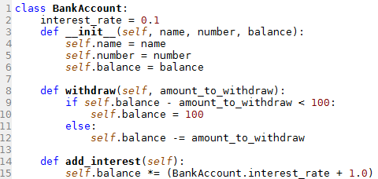
Quizz time
1. Create a class called BankAccount to represent a bank account. Instances of this class are initialized by a customer name, account number, and the balance on the account. Each bank account should also have a fixed interest rate of 0.1 (it should be able to access this value from instances of the class or the class itself).
Add the method withdraw() which decreases the balance of the account. Make sure this method does not allow the account to go to a balance of less than £100.
Add a second method add_interest() which adds interest to the balance (the interest should be the interest rate multiplied by the current balance).
Which variables are class variables and which ones instance variables?

Slide 8
Important principles in OOP
Encapsulation (Information hiding)
Restriction of access to variables and methods
Purpose is to prevent data from being modified by accident + improve control of data flow in a program
Achieved via imposing restrictions on variables (public vs private vs protected variables) + setter and getter methods
Inheritance
Polymorphism

Slide 9
Encapsulation
Three levels of restrictions are available for methods and variables:
Public
Private
Protected
All variables used so far (with exception of constructors) were private
Can be freely modified and run from anywhere, either inside or outside of the class
Public variables and methods don't use underscores, e.g. a variable speed
Private variables and methods can be accessed from within its own class or object
The value of a private variable cannot be modified from outside of a class
Private variables / methods begin with two underscores, e.g. __speed
Not often used
Should only be accessed by its own class and any classes derived from it (like private)
But can be accessed outside of the class (like public)
Protected variables / methods begin with one underscore, e.g. _speed

Slide 10
Important principles in OOP
Encapsulation (Information hiding)
Restriction of access to variables and methods
Purpose is to prevent data from being modified by accident + improve control of data flow in a program
Achieved via imposing restrictions on variables (public vs private vs protected variables) + setter and getter methods
Inheritance
The transfer of the characteristics of a class to other classes that are derived from it
Subclass vs superclass
Inherited methods/attributes with the same name are overwritten
Can be indirect but not circular
Polymorphism

Slide 11
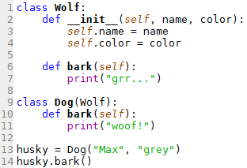
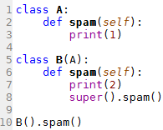
Inheritance

Slide 12
Important principles in OOP
Encapsulation (Information hiding)
Restriction of access to variables and methods
Purpose is to prevent data from being modified by accident + improve control of data flow in a program
Achieved via imposing restrictions on variables (public vs private vs protected variables) + setter and getter methods
Inheritance
The transfer of the characteristics of a class to other classes that are derived from it
Subclass vs superclass
Inherited methods/attributes with the same name are overwritten
Can be indirect but not circular
Polymorphism
Define “abstract method” which needs to be implemented by subclasses

Slide 13
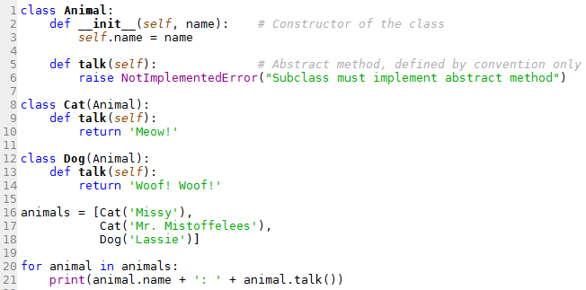

Polymorphism

Slide 14
Agenda
Nested lists
Deep vs shallow copy
Read data from file / print data to a file
Variable number of arguments in a function

Slide 15
Agenda
Nested lists
Deep vs shallow copy
Read data from file / print data to a file
Variable number of arguments in a function

Slide 16


Nested lists
So far, lists (and tuples) were mainly 1-dimensional…
But they can also be multi-dimensional (also called compound objects in Python)

Slide 17
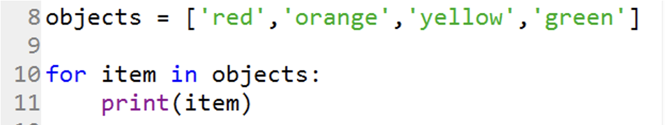
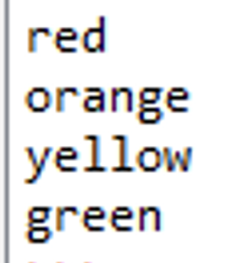
Nested lists
How to iterate over a nested list such that every item is printed out?

Slide 18

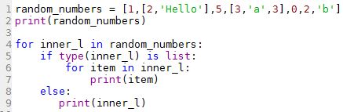
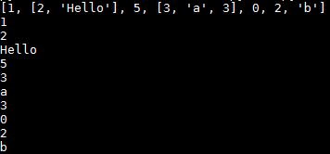
Nested lists
How to iterate over a nested list such that every item is printed out?
This could be a 3x3 matrix → Matrices (data frames) will be focus of next week

Slide 19
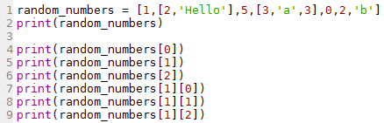
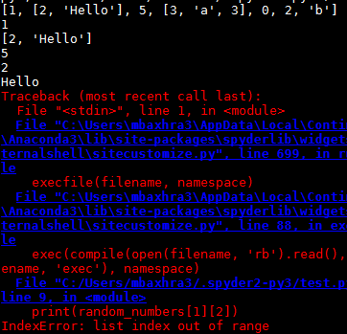
Nested lists
How to print out a specific item in a nested list, e.g. ‘Hello’?

Slide 20


Nested lists
So far we have used append(i) to add a single item i to the end of a list
What if we want to add a new list to a list, e.g. add the list [1,2,3] to the list below?
Do not get confused with the extend() method.

Slide 21

Quizz time
2. Please perform the following actions for the list below:
Print out the item with value 3
Print out the value 6 from the list
Create and print out a new list called new_list representing the item [5,5,6,5,5]
Replace the item ['c','d','c'] with an item of value 10
Replace the item with value 0 with the list [4,5,6]
Insert the word 'hello' just after the item with the value 3
Insert the list [-1,-1] at the 4th position in the list
Hint: The command li.insert(loc,item) inserts item at location loc in the list li
Check Results

Slide 22
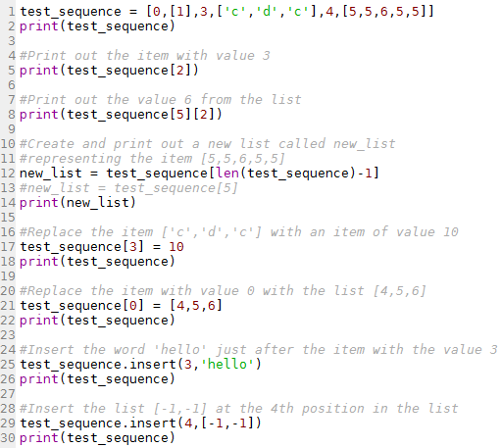
Quizz time

Slide 23

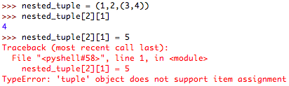
Other Nested Compounds
Dictionaries
Tuples
?
?
What is the output?

Slide 24
Agenda
Nested lists
Deep vs shallow copy
Read data from file / print data to a file
Variable number of arguments in a function

Slide 25
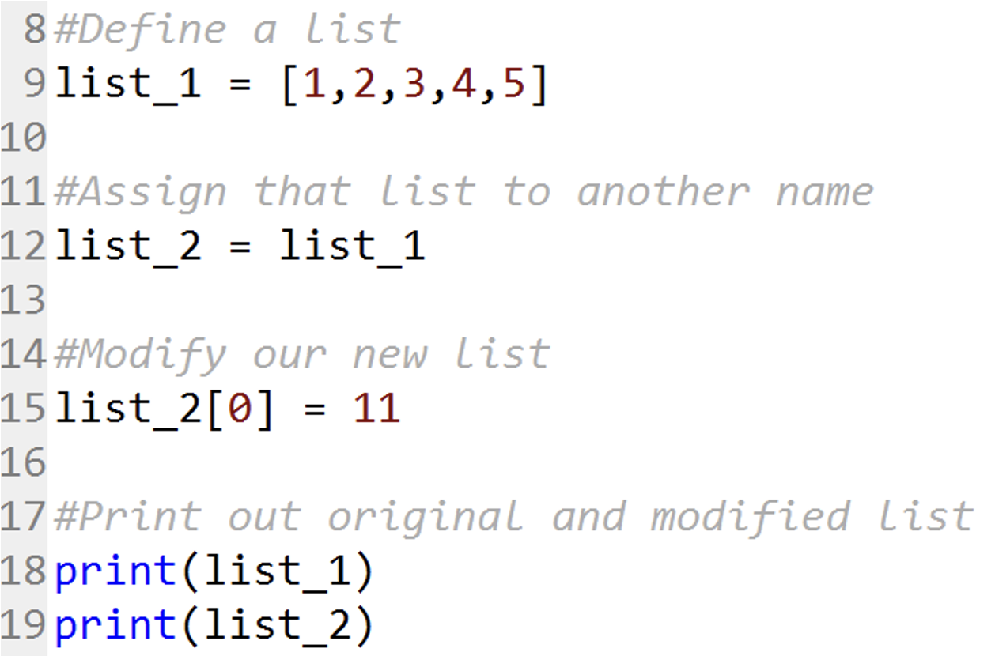
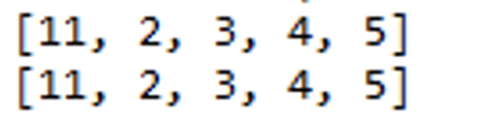
Deep copy vs shallow copy
What is the output?

Slide 26
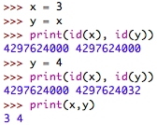
Deep copy vs shallow copy
What is a normal assignment doing when copying a simple data type, such as an integer?
x
3
?
y
?
4
Identity: Object’s address in memory (check with id()and compare with is)

Slide 27
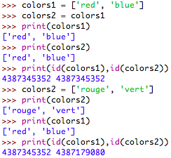
Deep copy vs shallow copy
What is a normal assignment doing when copying a mutable object, such as a list or a dictionary?
String object
List object
colors1
‘red’
colors2
‘blue’
‘rouge’
‘vert’
The simple list object above is a so-called shallow list because it doesn't have a nested structure, i.e. no sublists are contained in the list.

Slide 28
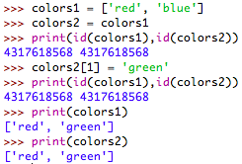
Deep copy vs shallow copy
What is a normal assignment doing when copying a mutable object, such as a list or a dictionary, and changing part of the object?
The list colours1 has been changed automatically as well because we don't have two lists: We have only two names (references) for the same list!
colors1
‘red’
‘green’
colors2
‘blue’

Slide 29
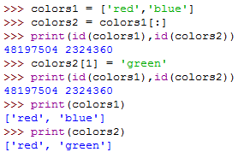
Deep copy vs shallow copy
Are there ways of copying objects completely?
The slice operation allows us to completely copy shallow list structures
colors1
‘red’
colors2
‘blue’
‘green’

Slide 30
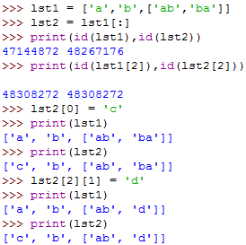
Deep copy vs shallow copy
What happens if we apply the slice operator to a nested list?
The slice operation copies the shallow list but not the sublists, only the references to the sublists are copied.
‘c’
lst1
‘a’
lst2
‘b’
‘ab’
‘ba’
‘d’

Slide 31
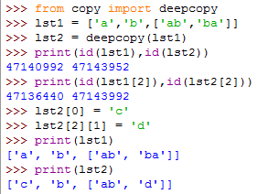
Deep copy vs shallow copy
Is there a way to copy a (nested) list completely?
Yes there is! → deepcopy()function from module copy
The module copy has also a method copy(), which is doing a shallow copy, i.e. identical to the slice operator [:]
‘c’
lst1
‘a’
lst2
‘b’
‘ab’
‘d’
‘ba’

Slide 32
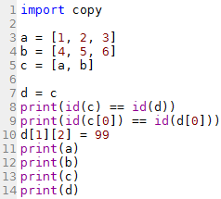
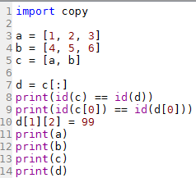

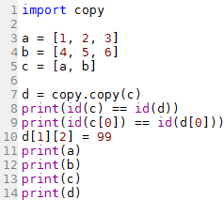
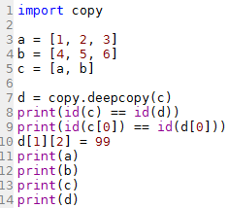
Quizz time
3. Determine the output of these 4 programs.
a)
b)
c)
d)
Check Results

Slide 33
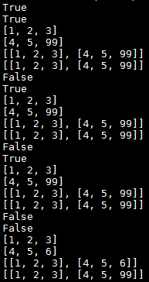
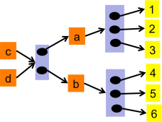
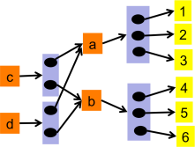
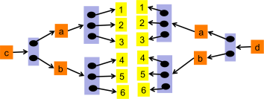
Quizz time
3. Determine the output of these 4 programs.
a)
b)
c)
d)

Slide 34
Deep vs shallow copy
The difference between shallow and deep copying is only relevant for compound objects (objects that contain other objects, like lists or class instances):
A shallow copy constructs a new compound object and then (to the extent possible) inserts references into it to the objects found in the original.
A deep copy constructs a new compound object and then, recursively, inserts copies into it of the objects found in the original.
Note, a shallow copy constructs a new object, while an assignment will simply point the new variable at the existing object.

Slide 35
How to copy an instance of a user-defined class?
Define your own copy function that returns a new class instance instantiated with the attribute values of the instance being copied
Use the deepcopy()function, which tries to copy a user-defined class object x using the function x.__deepcopy__
Change the __deepcopy__ function if you want to change they way a deep copy is done (e.g. if your copy operation is a combination of copying contents and replacing something at the same time). More information on this here https://pymotw.com/3/copy/index.html

Slide 36
Agenda
Nested lists
Deep vs shallow copy
Read data from file / print data to a file
Variable number of arguments in a function

Slide 37
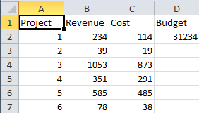
Reading and writing data
Example csv file: Projects-year1_Partial.csv
How to read in such files, modify them and print data into a file?

Slide 38
Reading and writing data
Using Python’s inbuilt module csv
If you want to import or export spreadsheets and databases for use in the Python interpreter, use the csv module (Comma Separated Values).
The csv module includes various built in functions but we will focus on two only:
csv.reader
csv.writer
The two functions allow you to edit, modify, and manipulate the data stored in a csv file
Alternative approaches:
Read CSV files Using NumPy loadtxt() method
Read CSV files Using Pandas read_csv() function

Slide 39

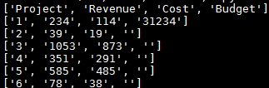
Reading and writing data
Reading data from a csv file
open(…)
File object
csv.reader(…)
Reader object
List with string objects
The open(name_of_csvfile, newline=‘’) function returns a file object (https://docs.python.org/3/library/functions.html#open)
To pull data from a file object, use the reader function csv.reader(file_object). This will generate a reader object (https://docs.python.org/3/library/csv.html#module-csv)
Each row read from the reader object is returned as a list of strings. No automatic data type conversion is performed!

Slide 40
Reading and writing data
Example: Let’s read in the data from Projects-year1_Partial.csv and increase the revenue of each project by £100. Then, for each project, print out “project ID, increased revenue”.
Each row read from the reader object is returned as a list of strings.

Slide 41
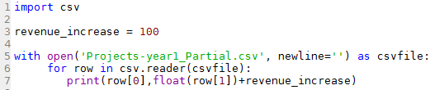
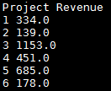
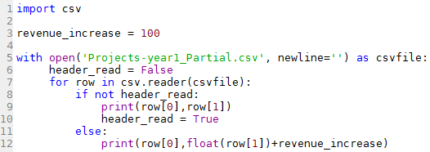
Reading and writing data
Example: Let’s read in the data from Projects-year1_Partial.csv and increase the revenue of each project by £100. Then, for each project, print out “project ID, increased revenue”.
Each row from the reader object is returned as a list of strings.
Header cannot be converted to float

Slide 42
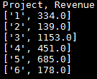
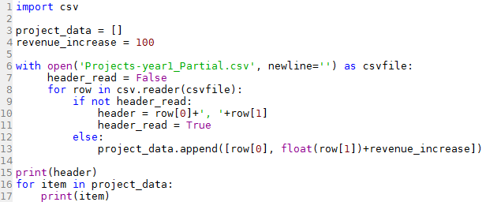
Reading and writing data
Example: Let’s read in the data from Projects-year1_Partial.csv and increase the revenue of each project by £100. Then, for each project, print out “project ID, increased revenue”. Let’s also store the project IDs and revenues in a list.

Slide 43


Reading and writing data
Writing data to a csv file
open(…,’w’,…)
File object
csv.writer(…)
Writer object
csvwriter_object.writerow(…) OR csv.writer(…).writerow(…)
Write list as a row of comma separated items
The open(name_of_csvfile, ‘w’, newline=‘’) function returns a file object. ‘w’ indicates the write mode which is used to edit and write new information to the file (any existing files with the same name will be erased when this mode is activated)
To write data to a file, use the function csv.writer(file_object). This will return a writer object responsible for converting the user’s data into delimited strings on the given file-like object.
csvwriter.writerow(row) writes the row item to the writer’s file object

Slide 44
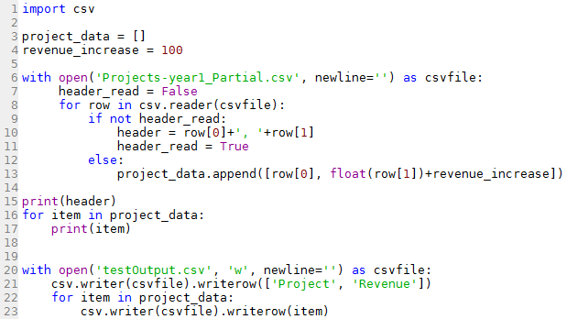
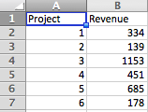
Reading and writing data
Example: Print out the header, project ID and updated revenues

Slide 45
Agenda
Nested lists
Deep vs shallow copy
Read data from file / print data to a file
Variable number of arguments in a function

Slide 46
Variable number of arguments in a function
Often it is desirable to call the same function with a variable number of arguments (not just different values)
For example, the function range can be called in several different ways:
range(m, n, s): for example, range(4,11,2) would result in the sequence 4, 6, 8, 10
range(m, n): equivalent of range(m, n, 1). We say that the default value of step is 1
range(n): equivalent of range(0, n) or range(0, n, 1). In other words, the default value of start is 0

Slide 47
Variable number of arguments in a function
Three forms to defined functions with a variable number of arguments:
Default argument values
Keyword arguments (*args, **kwargs)
Arbitrary argument lists

Slide 48
Variable number of arguments in a function
Three forms to defined functions with a variable number of arguments:
Default argument values
Keyword arguments (*args, **kwargs)
Arbitrary argument lists

Slide 49


Default argument values
Default arguments allow you to make some arguments of functions as optional and use default values if the user does not want to provide values for such arguments
Specify default argument values using argument_name = default value in the function definition
The value of a default argument should be immutable, e.g. a constant

Slide 50
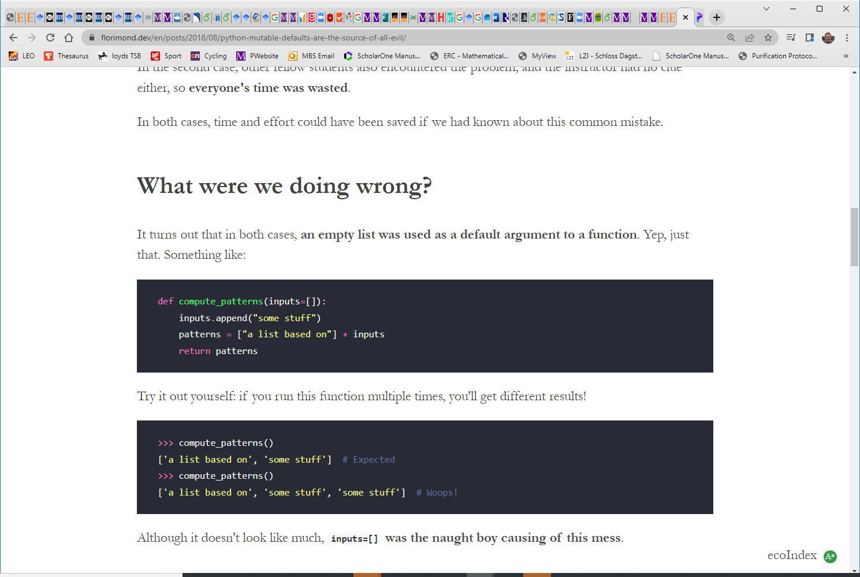
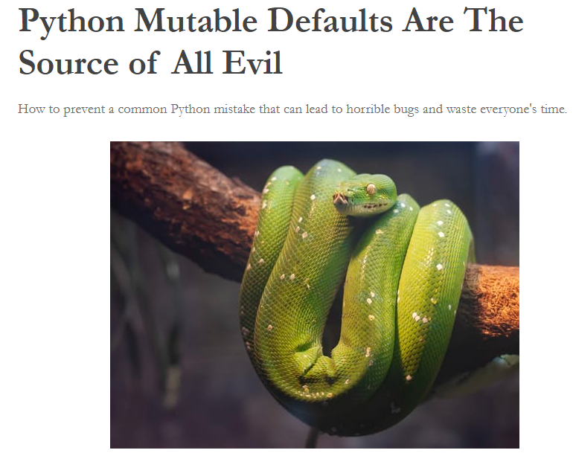
Default argument values
In Python, when passing a mutable value as a default argument in a function, the default argument is mutated anytime that value is mutated

Slide 51


Default argument values
Important: You cannot have a parameter with a default argument value before a parameter without a default argument value in the order of parameters declared in the function parameter list
This is because the values are assigned to the parameters by position.
Valid
Invalid

Slide 52


Quiz time
4. Assuming you have the method below, which alternative function definitions would be valid?
Check Results
a)
b)
c)
d)
e)

Slide 53
Quiz time
4. Assuming you have the method below, which alternative function definitions would be valid?

Slide 54
Variable number of arguments in a function
Three forms to defined functions with a variable number of arguments:
Default argument values
Keyword arguments (*args, **kwargs)
Arbitrary argument lists
Please refer to the Python documentary for this topic
https://docs.python.org/3.5/tutorial/controlflow.html#arbitrary-argument-lists

Slide 55
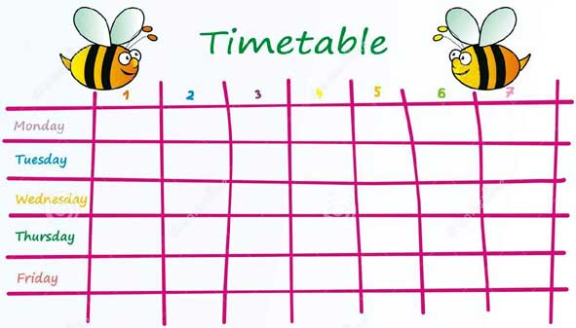
Week | Topic | Readings | Exercises | Seminar
1 | Course Intro + Setting up your integrated analysis environment | Sections 8.1 and 8.2 (pages 212-219) | 8.1 & 8.2 | No seminar
1 | Python Essentials I | Sections 8.3 and 8.4 (pages 220 – 228) | 8.3 & 8.4 | Ex. 8.1 & 8.2
Fanlin
2 | Python Essentials II | Sections 9.1 and 9.2 (pages 229 – 238) | 9.1 & 9.2 | Ex. 8.3 & 8.4
Basics of Python (and many other languages)
Write own routines from scratch
Apply to artificial or easy problems
2 | Object-oriented programming I | Sections 9.3 and 9.4 (pages 238 - 254) | 9.3 & 9.4 | Ex. 9.1 & 9.2
3 | Object-oriented programming II | Sections 9.5 and 10.1 (pages 255 – 270) | 9.5 & 10.1 | Ex. 9.3 & 9.4
Xian
3 | Accessing and preparing data | Sections 10.2 & 10.4 (pages 271 – 292) | 10.2 & 10.4 | Ex. 9.5 & 10.1
Use existing sophisticated modules
Apply modules to real data or complex problems
4 | Numerical analysis, data exploration, and data visualization I | Sections 10.5 and 10.6 (pages 292 - 304) | 10.5 & 10.6 | Ex. 10.2 & 10.4
4 | Numerical analysis, data exploration, and data visualization II | Sections 11.1 and 11.2 (pages 305 - 317) | 11.1 & 11.2 | Ex. 10.5 & 10.6
5 | Introduction to analytics and optimization algorithms I | Section 11.3 (pages 318 - 321) | 11.3 | Ex. 11.1 & 11.2
5 | Introduction to analytics and optimization algorithms II | Chapter 13 (pages 361 - 377) | 13.1 to 13.3 | Ex. 11.3
tbc | Revision lecture | Chapter 14 (pages 378 - 400) | 14.1 & 14.2 | Ex. 13.1 to 13.3

Slide 56


Lecture 6 Preparation
Prior to seminars
Revise lecture slides and do quizzes
Have a go at quizzes and questions on BB
Prior to lecture, have a look at
Pandas
Matplotlib
Good Python book for many/all things we have done so far
http://www.diveintopython3.net/table-of-contents.html

