Slide 1
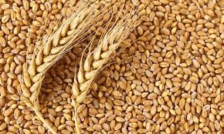

FarmEase
PRODUCT PITCH DECK
FarmEase makes farm decisions faster, local, and actionable.
5
3
Connected decisions
Visible languages
Weather, markets, diagnosis, recommendation, and community are handled inside one product.
The signed-in app exposes EN, HI, and TE toggles for wider accessibility.
An AI-assisted agriculture platform that brings weather, mandi prices, disease detection, crop recommendation, and community help into one mobile-first experience.
50 km
1
Local market scope
Unified dashboard
The live mandi screen frames coverage around the farmer's nearby market radius.
The first screen already combines alerts, market signals, and action prompts.
Rubric fit
This deck is structured directly around problem framing, research insights, solution logic, before/after impact, and reflection.
Prepared by
Polana Rakshita
Source: FarmEase live product audit + local repository review
01

Slide 2
P R O B L E M F R A M I N G
Farmers are not solving one problem. They are juggling three high-stakes decisions at once.
FarmEase exists because daily farm management is fragmented across weather checks, market calls, memory, and reactive problem-solving.
Weather uncertainty
Crop health risk
Farmers need local temperature, humidity, wind, and rain signals before irrigation or sowing decisions.
Farmer
Plant diseases escalate quickly, but diagnosis is often delayed until visible damage becomes expensive.
Needs quick, local, trustworthy action cues on a phone, not scattered information.
Price timing pressure
Selling too early or to the wrong mandi can reduce margin because local price visibility is fragmented.
Problem framing based on observed product modules and repository scope
02

Slide 3
P R O B L E M F R A M I N G
The real user is last-mile, mobile-first, and needs the product to earn trust quickly.
The strongest evidence is visible in the live app itself: location prompts, language switching, manual fallback paths, and action-first cards.
“
Where is your farm? We need your location to provide accurate weather and market data.
Key stakeholders
Farmers
Need fast local decisions, simple inputs, and visible confidence cues.
Observed in the signed-in onboarding modal
“
Market sellers
Need better timing on where and when to sell produce.
Source: AGMARKNET India
Observed in the live mandi page footer
Agri advisors / experts
Need a way to extend guidance through diagnosis, alerts, and community support.
EN / HI / TE
Stakeholder cue
Product team
Needs reliability across weather APIs, ML services, auth, and location handling.
The UI is already designed for multilingual access, which matters for real farmer adoption.
Evidence: live UI audit, modal copy, language toggles, and local component review
03

Slide 4
R E S E A R C H I N S I G H T S
The need is real: agriculture is large, crop loss is costly, and local price discovery is still messy.
41.6%
20–40%
1 local flow
What this means for FarmEase
India employment in agriculture
Crop loss risk
Market simplification need
Most recent World Bank value retrieved for India (2025), showing how large the user base remains.
FAO estimates plant pests and diseases reduce yields by roughly 20–40%, making early detection valuable.
FarmEase uses AGMARKNET-linked market signals because local mandi timing still matters in practice.
Insight 1
A farmer product cannot be desktop-heavy or abstract; it has to work on a phone in short bursts.
Insight 2
Plant health and selling decisions both need speed, which justifies the action-first dashboard and diagnosis entry points.
Insight 3
Location and language are not edge features; they are core trust features that change whether the product is usable at all.
Observed proof
The live app already exposes language toggles, a location modal, manual city selection, and market radius framing.
Sources: World Bank SL.AGR.EMPL.ZS (India, 2025), FAO plant health pages, FarmEase market and dashboard audit
04

Slide 5
S O L U T I O N
FarmEase is strongest when read as a connected decision platform, not a pile of features.
The architecture works in layers: farmer inputs and location on top, decision modules in the middle, and live data plus ML services underneath.
Farmer touchpoints
Location
Language toggle
Voice / AI entry
Mobile dashboard
Member account
Core decision modules
Dashboard
Market
Plant Doctor
Crop Recommendation
Community
Data and intelligence layer
Weather APIs
AGMARKNET market signals
TensorFlow / ML diagnosis
Location context
Auth + membership
Architecture distilled from observed routes and frontend/backend component structure
05

Slide 6
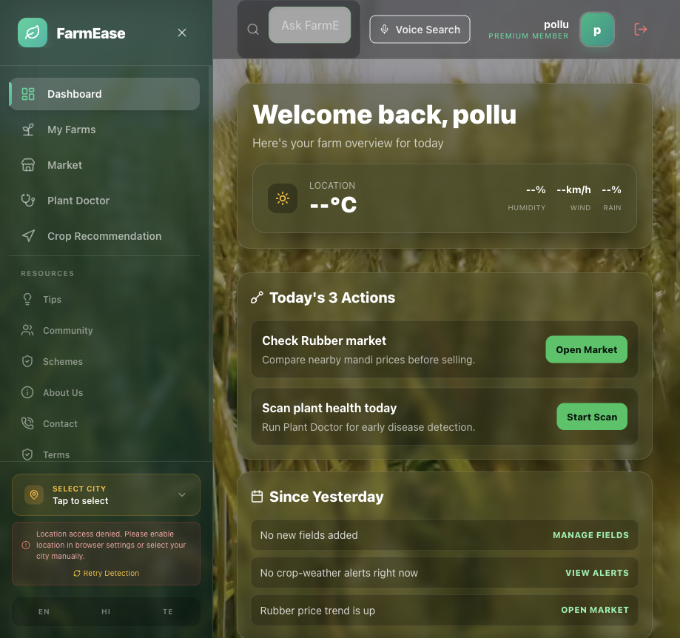
D E S I G N D E C I S I O N S
The interface choices show intent: reduce friction first, then add intelligence.
Action-first dashboard
The first screen does not hide value behind menus; it immediately shows actions, alerts, trends, and status.
Location + manual fallback
The market flow asks for location, but still provides manual city selection when detection fails.
Multilingual accessibility
Visible EN / HI / TE toggles acknowledge that adoption depends on language comfort, not just features.
Glass-on-dark visual system
The same emerald-teal glass aesthetic from the landing page carries into the signed-in product, which builds brand coherence.
Screenshot captured from the authenticated dashboard; rationale derived from live UI behavior
06

Slide 7
S Y S T E M T H I N K I N G
The real value is the loop: context in, signals in, action out, support when needed.
This is why FarmEase feels more mature than a single-feature prototype. Each module has a role inside a larger decision system.
1. Set context
2. Read signals
3. Convert to action
4. Escalate when needed
5. Loop back
Farmer location, language, and account state establish the local decision context.
Weather, mandi prices, and crop status enter the workflow from APIs and ML services.
Dashboard cards, plant diagnosis, and crop recommendation turn signals into concrete next steps.
Community / Kisan Charcha adds a human support layer when confidence or edge cases matter.
Every new farm update or market refresh improves the next recommendation and the next selling decision.
Why this matters
A feature list can impress a panel. A decision loop shows system thinking, which is what makes the product scalable and teachable.
System flow synthesized from dashboard, market, diagnosis, recommendation, and community modules
07

Slide 8
B E F O R E / A F T E R
FarmEase changes the workflow from fragmented searching to guided action.
Before FarmEase
After FarmEase
—
Weather checked in one place, market prices in another, and disease advice somewhere else.
+
One dashboard surfaces local signals, action cards, and alerts together.
—
Selling decisions depend on phone calls, memory, or delayed market data.
+
Market view frames nearby mandis, crop filters, and timing cues in one flow.
—
No single dashboard to prioritize what the farmer should do first today.
+
Plant Doctor and Crop Recommendation shorten the path from uncertainty to action.
—
Support is reactive: ask for help only after the problem becomes urgent.
+
Community becomes a built-in escalation path instead of a separate step.
Comparison framed as workflow transformation, not yet as field-validated outcome metrics
08

Slide 9
I M P A C T
The measurable impact today is product compression: more farm decisions handled in one place.
These are prototype-level impact signals, not field-study claims. They still show clear improvement in decision coverage and product readiness.
5 → 1
3
50 km
24/7
Decision surfaces compressed
Languages visible
Local market framing
Always-on interface promise
Weather, markets, diagnosis, recommendation, and community now converge in one product flow.
The app visibly supports English, Hindi, and Telugu toggles for broader reach.
The mandi page already frames decisions around nearby coverage instead of generic national data.
The landing page positions the platform as continuously available support.
What improved qualitatively
•
Fewer context switches between apps, memory, and manual checking.
•
Better trust through visible fallbacks like manual city selection when location fails.
•
Faster path from uncertainty to action because recommendations sit next to the daily dashboard.
•
Stronger retention potential because community and premium membership make the app sticky beyond one-time use.
Impact slide uses observed product scope and workflow simplification, not invented adoption outcomes
09

Slide 10
R E F L E C T I O N
The biggest learning was that a good agri product has to feel dependable before it feels advanced.
01
Trust beats novelty
02
Reliability is part of UX
The product became stronger when location fallback, market provenance, and visible action cards were prioritized over flashy extras.
Deployment notes show that ML uptime and token freshness are not backend details; they directly affect whether the user trusts the app.
03
Localization is product strategy
04
System thinking matters
Language toggles and manual city selection are not polish. They are adoption levers for the actual audience.
The project became more coherent when each screen was treated as part of a loop rather than as a standalone feature demo.
Reflection grounded in live product behavior plus deployment and reliability notes
10

Slide 11
N E X T S T E P S
Polana Rakshita
The next milestone is simple: turn a strong prototype into a reliable farmer pilot.
FarmEase already demonstrates clear product thinking. The next phase should validate it with reliability improvements and real user feedback.
Now
Next
Later
Stabilize production ML services, tighten auth refresh flows, and keep market synchronization dependable.
Run farmer testing to validate which dashboard actions, diagnoses, and recommendations are most trusted.
Measure real behavior: repeat use, recommendation accuracy, time-to-decision, and mandi price outcomes.
Closing note
FarmEase is promising because it does not just show AI features. It shows how weather, crop health, price timing, and community support can become one coherent farmer workflow.
Next steps informed by DEPLOYMENT_STATUS.md and the live authenticated product review
11

