Slide 1
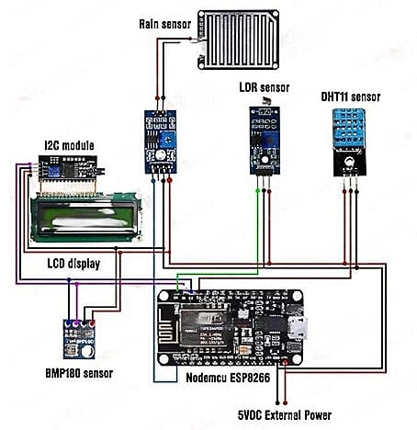
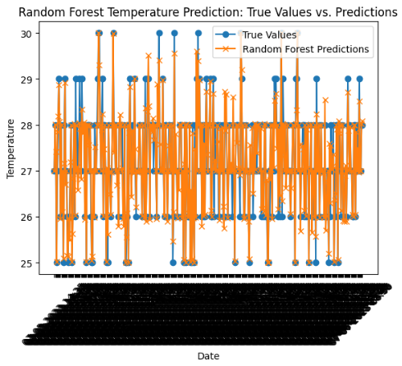
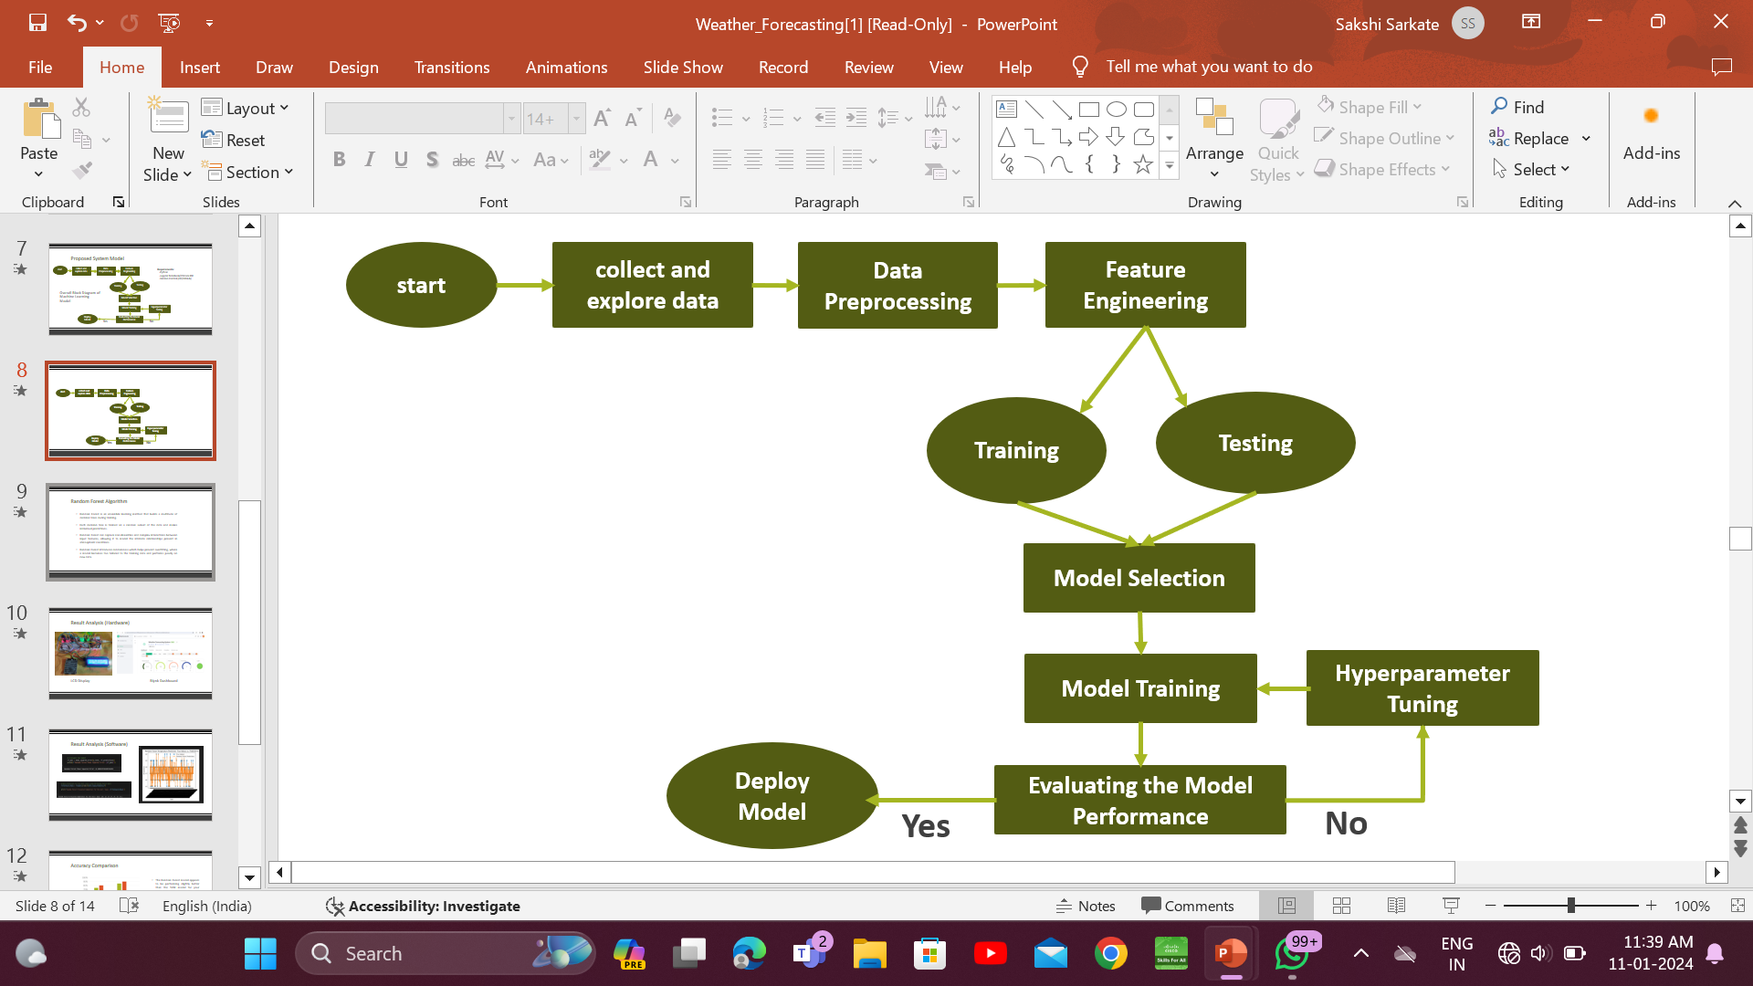
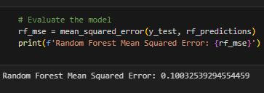
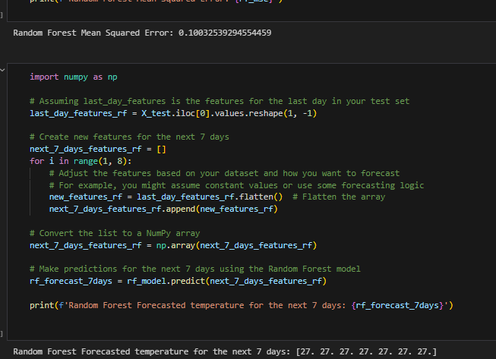
Literature review :
Aavishkar
Maharashtra State Inter-University Research Convention
Category: Agriculture and Animal Husbandry code no. : Level : Under Graduate
"Smart Weather Forecasting”
Integrating College Weather Station Data with Machine Learning for Enhanced Accuracy
Abstract
By utilizing existing infrastructure, the project eliminates the need for individual sensors, making advanced weather forecasting more cost-effective and accessible to farmers.
Integration of machine Learning enhances prediction accuracy, enabling farmers to make informed decisions on crop management, irrigation and pest control for optimized agricultural practices. . . Introduction
Initially, a hardware system is meticulously crafted using NodeMCU and Blynk cloud, offering a manual approach to gather essential metrics like temperature, humidity, rainfall, pressure, and light levels. However, the project doesn't stop there—recognizing the constraints of manual updates in terms of time efficiency and sensor cost, it boldly proposes a shift towards leveraging the existing weather station within the college. By tapping into the data stream of the College Weather Station, this research aims to usher in a new era of forecasting prowess. The introduction of machine learning techniques takes center stage, promising not only an acceleration in data acquisition but also a significant enhancement in the precision of predictions.
Literature Survey:
Block Diagram
Prototype Model
Title of the paper | Methodology | Specifications | Accuracy
[1] Integration of IoT in Weather Data Collection | Discusses the technical aspects of using NodeMCU, addressing issues related to data accuracy and real-time monitoring | Developed using NodeMCU and sensors like temperature and rainfall. | Manual Data Collection upto 78%
[2] Weather Forecasting Using Machine Learning | Approaches include data preprocessing, feature engineering, and model training. | Machine Learning Algorithms used – Linear Regression and Support Vector Machine. | 85%
Methodology

