Slide 1
BudgetWise AI based Expense Forecasting Tool
Presenting By
Rakshita

Slide 2
Content
Abstract
Introduction
Problem Statement
Methodology
Key feature
Results
conclusion

Slide 3
Abstract
BudgetWise is an intelligent expense forecasting and management tool that utilizes Artificial Intelligence (AI) to help users track, analyze, and predict their financial activities.
The system allows users to record income and expenses, categorize them automatically using Natural Language Processing (NLP), and visualize insights through dynamic dashboards.
It integrates Prophet, Meta’s forecasting library, to predict future expenses and spending patterns
By combining automation, visualization, and forecasting, BudgetWise empowers users to make smarter financial decisions and achieve their savings goals.

Slide 4
Introduction
Managing personal finances effectively is a crucial skill in today’s world, yet many people struggle to monitor their spending or plan for future expenses. Traditional expense trackers often provide only static records and lack predictive capabilities. BudgetWise addresses this limitation by leveraging artificial intelligence and machine learning to offer an intelligent financial assistant that combines secure authentication, real-time expense categorization, interactive visualizations, and predictive forecasting. This integrated approach enables users to gain deeper insights into their spending behavior, anticipate future financial trends, and manage their finances more proactively and efficiently.

Slide 5
Problem Statement
Most individuals struggle to effectively track daily expenses and manage budgets. Existing solutions mainly focus on manual entry and provide limited visual analytics without offering future predictions. Users require an intelligent system capable of analyzing and forecasting expenses to support smarter financial decisions and better planning.

Slide 6
Methodology
User Authentication & Data Entry
Automatic Categorization
Data Storage & Preprocessing
Analytics & Reporting
Expense Forecasting (Prophet Model)
Interactive Dashboard
Goal Setting & Tracking
Admin Management
Deployment (Docker)

Slide 7
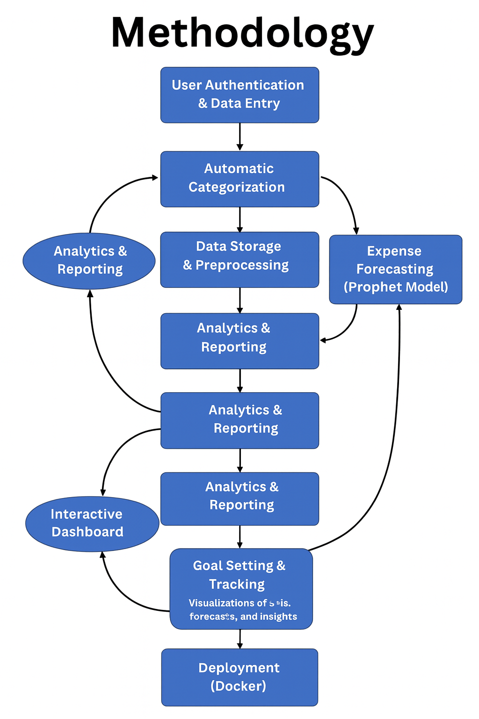
The diagram shows how the system takes user-entered transactions, automatically categorizes them, stores and processes the data, and generates reports. This data is then used for AI-based expense forecasting, and all results are displayed on an interactive dashboard, with admin controls and Docker deployment completing the workflow.

Slide 8
Key feature
User Authentication:
Secure login and registration using JWT (JSON Web Tokens) for protected access to financial data.
Manual & Automated Transaction Entry:
Users can manually input transactions or let the system automatically categorize them using NLP keyword matching.
Dashboard Visualization:
Real-time charts and graphs created using Matplotlib and Seaborn display income, expenses, and spending summaries.
AI Forecasting with Prophet:
Integration with Meta’s Prophet library allows forecasting of monthly or category-based expenses.
Financial Goal Setting:
Users can set and track goals (e.g., “Save ₹5000 this month” or “Reduce dining expenses by 10%”).
Interactive Reports:
Automatically generated summaries and reports provide clear insights into financial health.

Slide 9
Milestone 1
Weeks 1 : User Authentication & Basic Transaction Input
• User Registration: Implemented a secure user registration system with standard email/password and JWT (JSON Web Token) security.
• Login System: Developed a robust login mechanism to authenticate users.
• Profile Management: Created user profiles for managing their financial data.
• Manual Transaction Input: Designed a basic web interface allowing users to manually input individual dummy transactions (e.g., date, amount, description, type: income/expense).

Slide 10
Secure User Registration: A robust registration system was developed where users can sign up using their email and password, protected through JWT (JSON Web Token) authentication to ensure data security and privacy.
Login System: A reliable login mechanism was implemented to authenticate users and manage secure sessions, preventing unauthorized access.
Profile Management: Individual user profiles were created to store and manage personalized financial information, enabling customized tracking and data handling.
Manual Transaction Input: A simple and interactive web interface was designed, allowing users to manually enter dummy transactions with fields like date, amount, description, and type (income/expense).
Foundation for Future Modules: The core backend and frontend structure established in this phase provided the base for future modules such as automated categorization, data visualization, and AI-based expense forecasting.

Slide 11
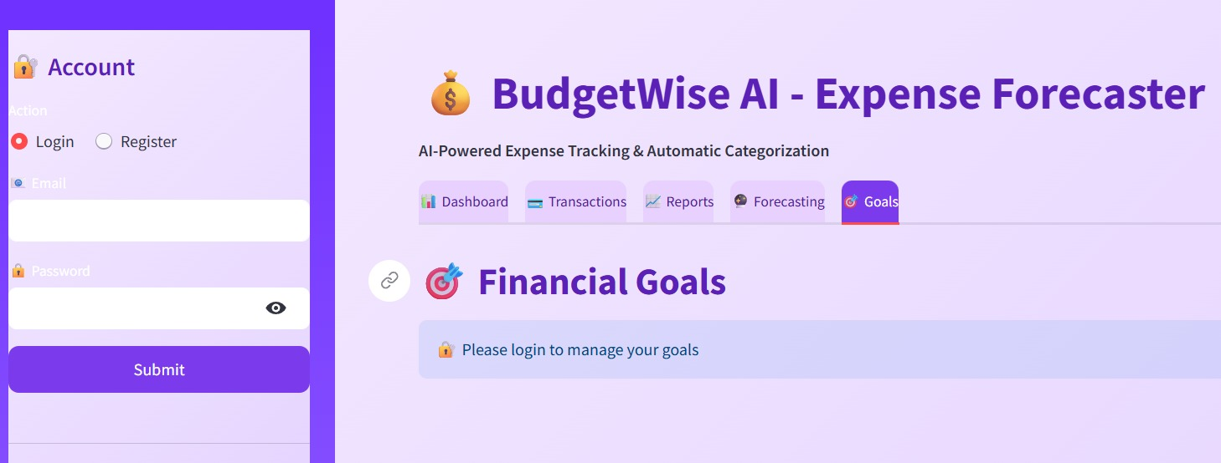
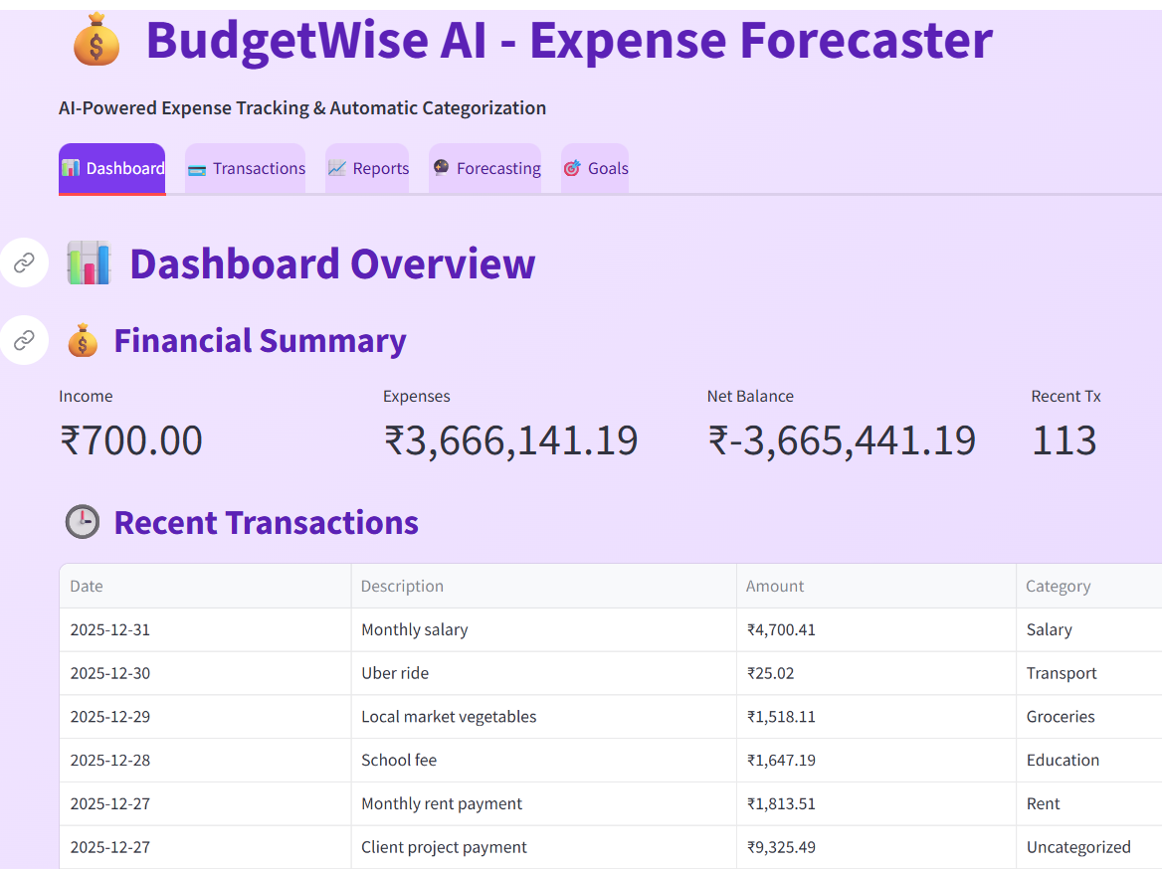
Login and Registration

Slide 12
Milestone 2
• Automated Categorization: Implemented a rule-based or simple NLP (e.g., keyword matching using NLTK) system to automatically assign categories (e.g., 'Groceries', 'Rent', 'Transport') to transaction descriptions. Allow manual override.
• Spending Summary Reports: Developed functionality to generate basic reports showing total spending per category, monthly spending summaries, and income vs. expense over a period using Pandas.
• Initial Dashboard View: Enhanced the Ul to display a summary of recent transactions and a basic breakdown of spending by category (e.g., a pie chart or bar chart using Matplotlib/Seaborn).

Slide 13
Automated Categorization: Implemented an NLP-based system using NLTK to automatically categorize transactions like Groceries, Rent, and Transport, with manual override options.
Rule-Based Logic: Used keyword matching (e.g., “bus fare” → Transport, “pizza” → Food) to ensure accurate and consistent expense classification.
Spending Summary Reports: Generated analytical reports with Pandas showing category-wise, monthly, and income vs. expense summaries.
Dashboard Visualization: Enhanced the UI dashboard to display recent transactions and spending breakdowns for better financial insights.
Data Visualization Tools: Integrated Matplotlib and Seaborn to create pie and bar charts, making expense trends easy to analyze visually.

Slide 14
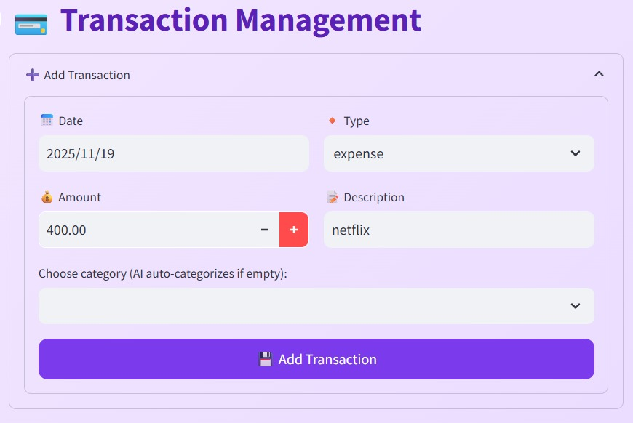
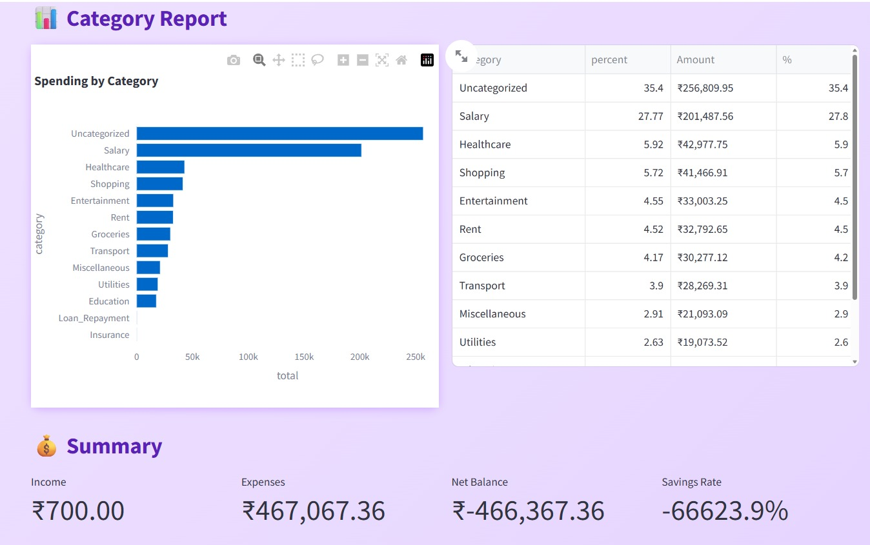
Automated Categorization and Data Visualization

Slide 15
Milestone 3
❖ Historical Data Preparation: Prepare historical transaction data in the format required by the forecasting model (e.g., time series of aggregated daily/weekly/monthly expenses per category).
❖ Prophet Integration: Integrate Prophet (Meta's forecasting library) to generate future expense forecasts for different categories or overall spending.
❖ Financial Goal Setting: Allow users to define financial goals (e.g., "Save $X by Y date," "Reduce spending in category Z by A%").
❖ Forecast Visualization: Update the dashboard to display the forecasted expenses alongside actual historical data (line chart using Matplotlib/Seaborn). Show projected savings based on forecasts.

Slide 16
Historical Data Preparation: Collected and formatted past transaction data into a time series structure (daily, weekly, or monthly) for each expense category. This organized dataset served as the foundation for accurate forecasting and trend analysis.
Prophet Integration: Integrated Meta’s Prophet library to generate future expense forecasts based on historical spending patterns.
Financial Goal Setting: Introduced a goal-setting module that allows users to define specific financial objectives such as “Save ₹5,000 by month-end” or “Reduce food expenses by 10%.” These goals helped users track progress and stay motivated toward better financial habits.
Forecast Visualization: Enhanced the dashboard with interactive line charts using Matplotlib and Seaborn to display actual versus predicted expenses. This visual comparison helped users understand future trends clearly.
Projected Savings Insights: Added dynamic visuals to show forecasted savings and spending trends, enabling users to anticipate upcoming expenses and plan budgets more efficiently.

Slide 17
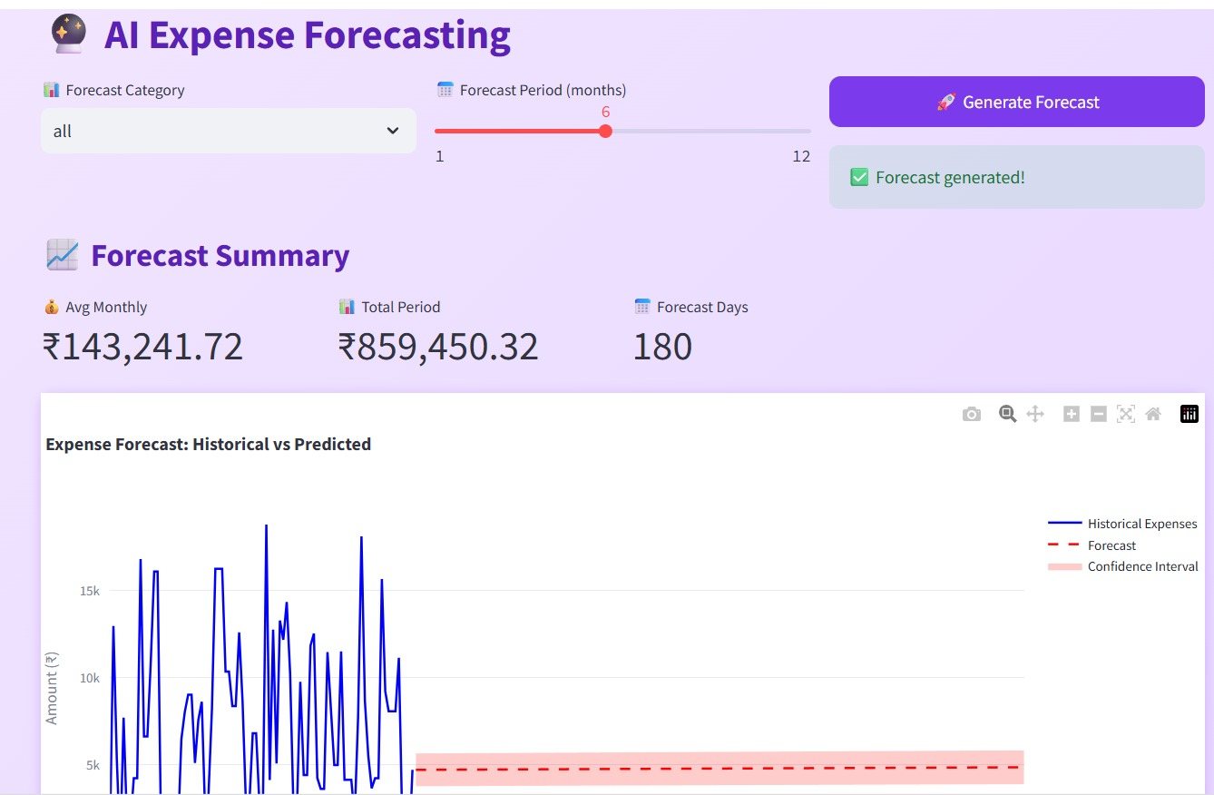
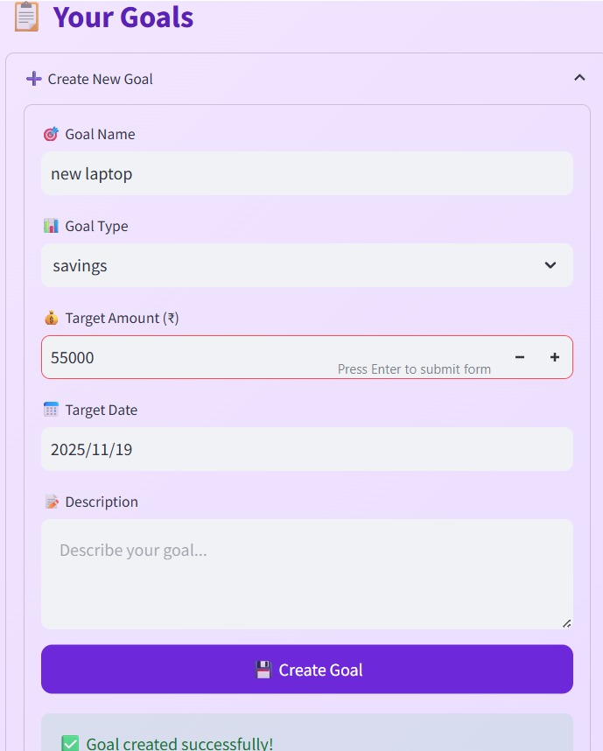
Forecast Visualization and Goals

Slide 18
Milestone 4: Advanced Visualization, Admin & Deployment
Interactive Financial Dashboard: Develop a comprehensive, interactive financial dashboard (using Streamlit/Dash with Plotly/Matplotlib/Seaborn) that includes:
○ Detailed spending breakdown by custom periods.
○ Income vs. Expense trends.
○ Forecasted cash flow.
○ Goal progress tracking.
Admin Dashboard: Develop a basic admin interface:
○ Managing predefined transaction categories and rules.
○ Monitoring system usage and data consistency.

Slide 19
Deployment Preparation: Containerize the entire application using Docker. Prepare for deployment on free cloud platforms (e.g., Streamlit Community Cloud, Render).
Documentation & Presentation: Finalize project documentation, code comments, and prepare for the final presentation.

Slide 20
1. Interactive Financial Dashboard (Front-End Visualization)
A fully interactive dashboard is created using Streamlit / Dash with visual libraries like Plotly, Matplotlib, and Seaborn. The dashboard helps users understand their financial patterns easily.
🔹 Key Features
Detailed Spending Breakdown (Custom Periods)
Users can choose any date range (week, month, year) to view spending category-wise.
Helps identify where most expenses occur.
Income vs. Expense Trends
A visual comparison of income and expenses over time.
Shows surplus or deficit instantly.
Forecasted Cash Flow
AI model (Prophet) predicts future expenses and cash flow.
Helps users plan their budget ahead.

Slide 21
Goal Progress Tracking
Displays how much of their financial goal is completed.
Motivates consistent savings and budgeting.
2. Admin Dashboard
A simple control panel for system management that ensures the app runs smoothly.
🔹 Key Features
Manage Transaction Categories & Rules
Admin can add/edit/delete categories and keyword rules used for auto-categorization.
Monitor System Usage & Data Consistency
Admin can monitor:
  Number of users, Total transactions, Category usage, Any irregularities in data and Ensures a stable and clean database.

Slide 22
3. Deployment Preparation
The entire application (frontend + backend + database) is prepared for deployment.
🔹 Key Activities
Docker Containerization
The complete project is converted into Docker containers.
Ensures easy deployment, portability, and no system compatibility issues.
Cloud Deployment
Preparing for hosting on free platforms like:
  Streamlit Community Cloud
  Render
  Makes the app accessible online for anyone to use.

Slide 23
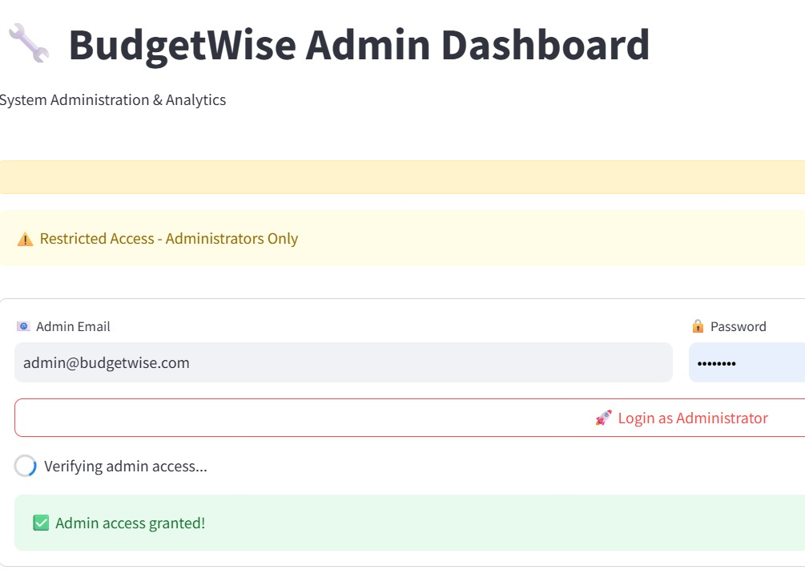
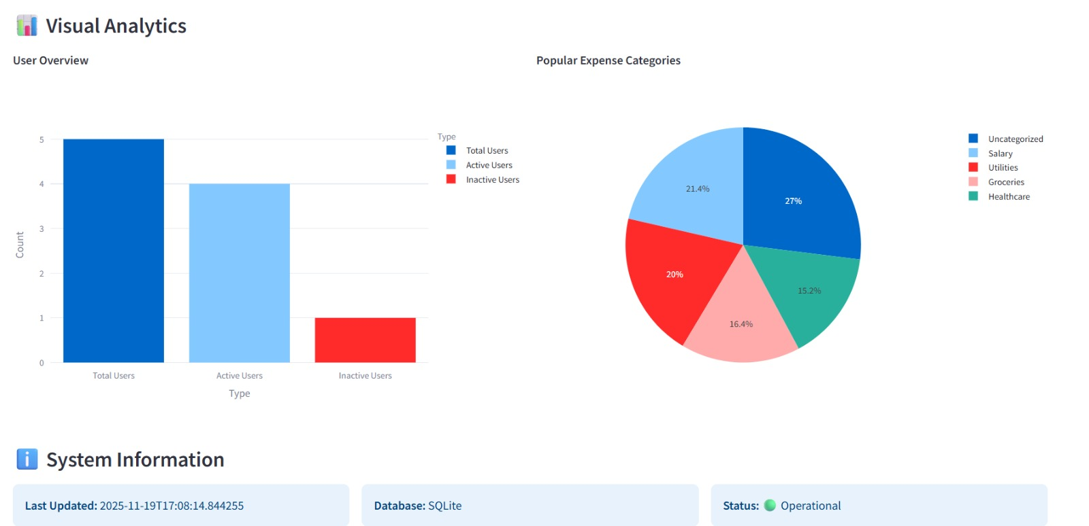
Admin dashboard and visual analytics

Slide 24
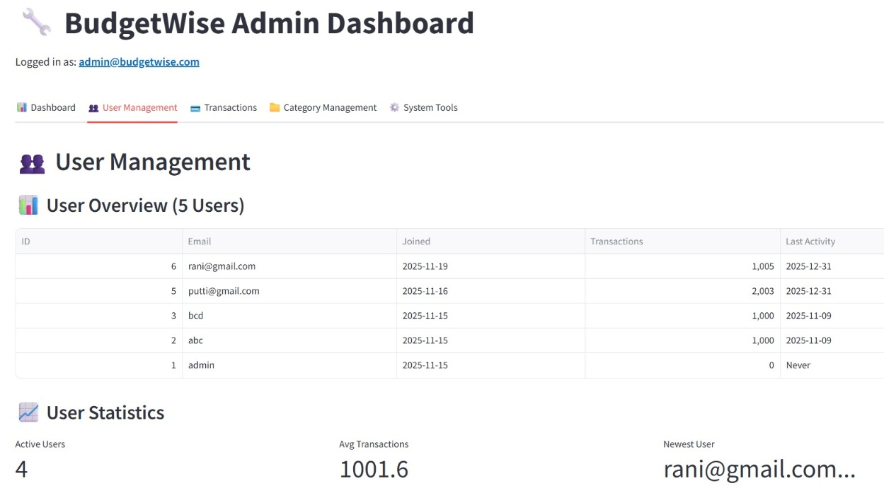
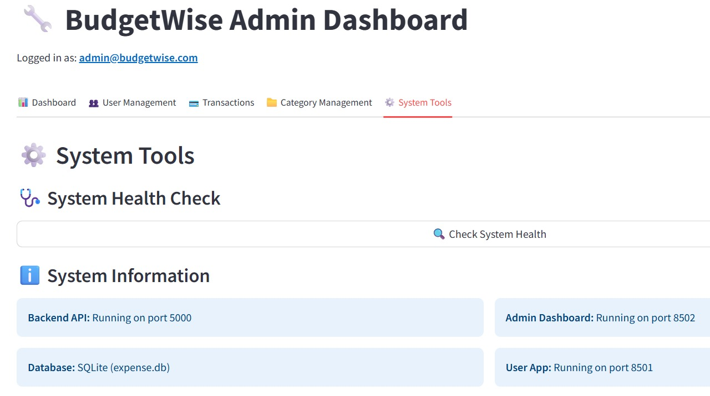
User management and system tools

Slide 25
conclusion
BudgetWise delivers a strong foundation for modern expense management and future AI-based forecasting. By integrating secure cloud storage, visual analytics, and a scalable UI, the tool enhances user experience and financial awareness. Future enhancements such as intelligent budget alerts and prediction models aim to transform BudgetWise into a complete smart financial assistant.

Slide 26
THANK YOU

