Slide 1
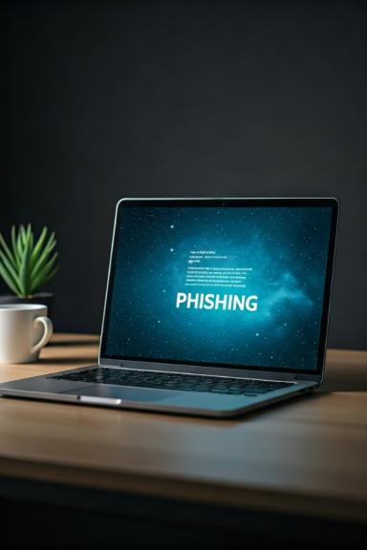
Phishing Attacks: Recognizing and Avoiding the Threat
Phishing attacks are a growing threat, targeting individuals and organizations alike. These attacks can lead to identity theft, financial loss, and damage to your reputation.
RS
by Rakshita Sondhia

Slide 2

What is Phishing?
Phishing is a type of cybercrime where attackers use deceptive tactics to trick victims into giving up sensitive information, like login credentials or financial data. These attacks often use email, text messages, or social media.
Goal
Methods
To steal your personal information for malicious purposes.
Email, text messages, social media, phone calls, and websites.
Impact
Identity theft, financial loss, and damage to your reputation.

Slide 3
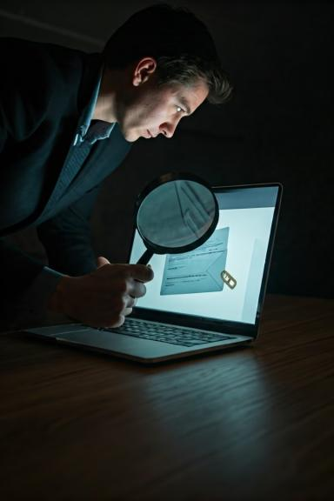
Common Phishing Tactics
Attackers use various tactics to make their phishing attempts seem legitimate. They often impersonate trusted organizations, create urgency, or use social engineering techniques.
1
Impersonation
2
Urgency
Attackers may pretend to be a bank, a government agency, or a trusted company.
Phishing emails often create a sense of urgency, pressuring victims to act quickly without thinking critically.
3
Social Engineering
4
Bait
Attackers may use social engineering techniques to manipulate victims into giving up information.
Attackers offer tempting rewards or deals to entice victims to click on links or open attachments.

Slide 4
Identifying Phishing Emails
Be vigilant when you receive emails, especially those that request sensitive information, appear urgent, or contain suspicious links. Look for clues that can indicate a phishing email.
Sender Address
Grammar and Spelling
Links
Check if the sender address is legitimate and matches the organization it claims to represent.
Look for typos, grammatical errors, or unusual formatting in the email.
Hover over any links to check the actual URL, and make sure it's a trusted website.

Slide 5
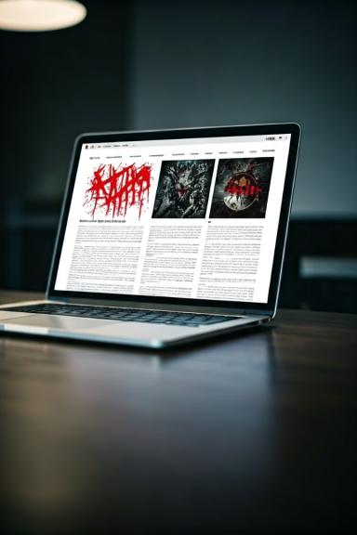



Spotting Fake Websites
When you click on a link, pay close attention to the website you are redirected to. Check the URL, website design, and content for any red flags.
Check URL
Make sure the URL is spelled correctly and looks legitimate.
Design and Content
Beware of websites that look unprofessional, have mismatched fonts, or contain strange or misleading content.
Security
Look for a secure connection (https://) in the address bar and a padlock icon next to the URL.

Slide 6

Social Engineering Tricks
Attackers often use social engineering techniques to manipulate victims into giving up information or taking actions that benefit the attacker.
Trick
Description
Authority
Pretending to be someone in a position of authority.
Scarcity
Creating a sense of urgency or limited availability.
Friendship
Using social connections to build trust and gain access to information.
Fear
Creating a sense of fear or panic to make victims more susceptible to manipulation.

Slide 7

Protecting Yourself from Phishing
Take proactive steps to protect yourself from phishing attacks. Implement strong security measures and develop good security habits.
1
Strong Passwords
Use unique and complex passwords for all of your accounts. Consider using a password manager to help you remember and manage them.
2
Two-Factor Authentication
Enable two-factor authentication (2FA) for all of your accounts to add an extra layer of security.
3
Be Skeptical
Don't click on suspicious links or open attachments from unknown senders. If something seems too good to be true, it probably is.
4
Keep Software Updated
Install security updates and patches for your operating system and software to protect yourself against vulnerabilities.

Slide 8




Reporting Phishing Attempts
If you receive a phishing email or encounter a suspicious website, report it to the appropriate authorities or organization.
Report to the Sender
If you believe the email came from a legitimate organization, contact them directly to report the phishing attempt.
Report to the Authorities
Report suspicious websites or phishing emails to the Federal Trade Commission (FTC) or the Internet Crime Complaint Center (IC3).
Block the Sender
Mark the sender as spam or block them to prevent future phishing attempts.

Slide 9


Staying Vigilant and Informed
Stay informed about the latest phishing threats and scams. Be vigilant and proactive in protecting yourself and your information online.
News Articles
Video Tutorials
Read news articles and blogs about online security to stay up-to-date on the latest threats.
Watch video tutorials and webinars to learn more about online security best practices and how to identify phishing attacks.

