Slide 1

AI-Powered Smart Farming Assistance
Khushi (2021a1r039)
Rakshit Gupta (2021a1r050) Ayushmaan Singh Jamwal (2021a1r052)
Ankush Raina (2021a1r059)

Slide 2
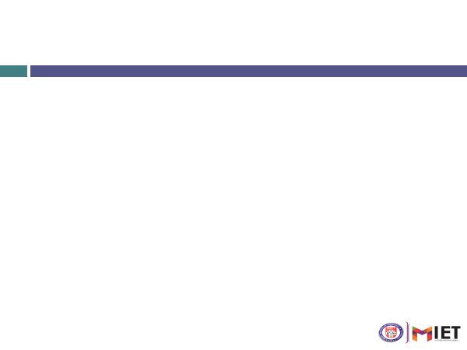

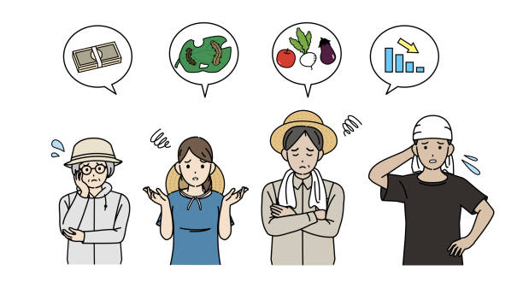
Problem Statement:
Small and marginal farmers face significant challenges such as climate change, resource constraints, soil degradation, and limited access to agricultural information. Traditional farming practices often rely on outdated methods, leading to low productivity, crop failures, and financial instability. Additionally, farmers struggle to access real-time market prices and detect crop diseases early, resulting in economic losses.

Slide 3

Proposed Solution
The AI-Powered Smart Farming Assistance portal offers a comprehensive, technology-driven solution to help small and marginal farmers overcome agricultural challenges. By leveraging AI and machine learning, the portal provides:
Crop Recommendations based on various factors.
Soil Health Analysis
Plant Disease
Market Price Insights
AI Chatbot for farmers

Slide 4

How It Works
User Authentication: Farmers sign up or log in securely.
Crop Recommendation: AI suggests optimal crops based on various.
Soil Health Analysis: Farmers upload soil images, and AI analyzes moisture, fertility, and deficiencies.
Plant Disease Detection: AI detects diseases from crop images and suggests treatments.
Market Price Insights: Displays current crop prices to help farmers sell at better rates.
AI Chatbot: Provides instant farming support and guidance.

Slide 5






Technology Stack Used
Frontend: Developed using HTML and CSS for styling.
Backend: Powered by Flask, a Python web framework.
Database: MongoDB is utilized for data storage.
Machine Learning: Algorithms like TensorFlow and Scikit-Learn for predictive analysis.
Image Processing: OpenCV for soil and plant image analysis.
Chatbot: GPT-4 and Rasa for farmer support and guidance.
Security: bcrypt for password hashing and secure authentication.

Slide 6



Alignment with SDG Goals
SDG 8: Decent Work and Economic Growth – The project empowers small and marginal farmers with AI-driven insights, helping them make informed decisions, increase productivity, and improve financial stability.
SDG 9: Industry, Innovation, and Infrastructure – By leveraging AI and machine learning, the project promotes technological innovation in agriculture, modernizing farming practices and enhancing efficiency.

Slide 7
THANK
YOU

