Slide 1

Smart IoT-Based Parking Management System Using ESP32-CAM and Custom ANPR Model
Khushi (2021a1r039)
Rakshit Gupta (2021a1r050) Ayushmaan Singh Jamwal (2021a1r052)
Ankush Raina (2021a1r059)

Slide 2
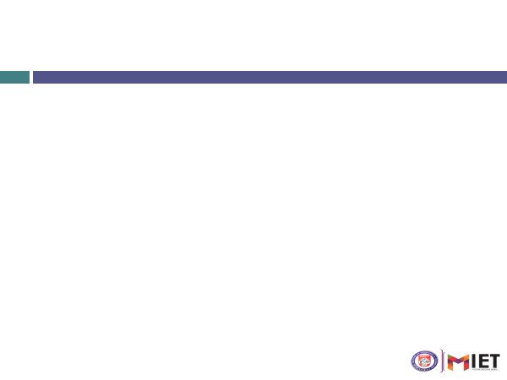

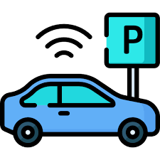
Problem Statement:
Traditional parking systems lack automation, real-time monitoring, and secure access control. They often depend on manual logging or external services, which can be unreliable in offline or low-connectivity environments. There's a need for a standalone, efficient solution that automates vehicle verification and optimizes space management.

Slide 3

Proposed Solution
The proposed system uses an ESP32-CAM and custom ANPR model to create an offline, automated smart parking solution. IR sensors detect vehicles at entry and exit points, triggering the ESP32-CAM to capture and locally process number plates without needing cloud services. Recognized vehicles are logged with timestamps, and a servo motor controls the barrier accordingly. A lightweight web server hosted on the ESP32-CAM displays real-time parking status and history, ensuring secure, efficient, and low-cost parking management ideal for private or institutional premises.

Slide 4

How It Works
Vehicle Detection: IR sensors placed at the entry and exit points detect approaching vehicles.
Image Capture: When a vehicle is detected, the ESP32-CAM captures an image of the number plate.
Local Plate Recognition: The captured image is processed using a custom ANPR model deployed locally (on-device or on a nearby server) to recognize the license plate.
Access Control: If the plate is successfully recognized, the system logs the vehicle details with a timestamp and controls a servo motor to open the barrier.
Real-Time Monitoring: A local web server hosted on the ESP32-CAM updates and displays the parking slot availability, recent vehicle entries/exits, and system status.
Offline Operation: The system works entirely offline after setup, ensuring reliability even in low or no internet environments.

Slide 5

Technology Stack Used (Hardware) :
ESP32-CAM Module — Captures vehicle number plates, processes images, and hosts the web server.
IR Sensors (x2) — Detect vehicles at entry and exit points.
Servo Motor — Controls the barrier for vehicle access.
USB-to-UART Converter — Programs the ESP32-CAM.
Breadboard and Jumper Wires — Used for building the circuit.
Computer Vision:
OpenCV — For image pre-processing and basic plate recognition.
EasyOCR — Lightweight OCR engine for extracting text from captured number plates.

Slide 6
Technology Stack Used (Software) :
Software and Libraries:
Arduino IDE — Platform used for writing and uploading code to the ESP32-CAM.
Python – Used for creating server
Flask Library – Used for hosting server
ESP32Servo Library — Controls the servo motor operation.
NTPClient Library — Synchronizes the real-time clock using NTP servers.
WiFiClientSecure Library — Enables secure HTTPS communication (optional if needed).
WebServer Library — Hosts a lightweight local web interface on the ESP32-CAM.

Slide 7
THANK
YOU

