Slide 1

Treasury Chain
TEAM: THREE RED ONE BLUE
Team Members:
NAVEEN
NITHISH
FAIYAZ
RAKSHITH

Slide 2
AIM
TreasuryChain is a blockchain-based treasury management system designed to provide transparent, real-time tracking of departmental fund allocations. Built on Hyperledger Fabric, it ensures secure, immutable records of all financial transactions while providing an intuitive interface for stakeholders.

Slide 3
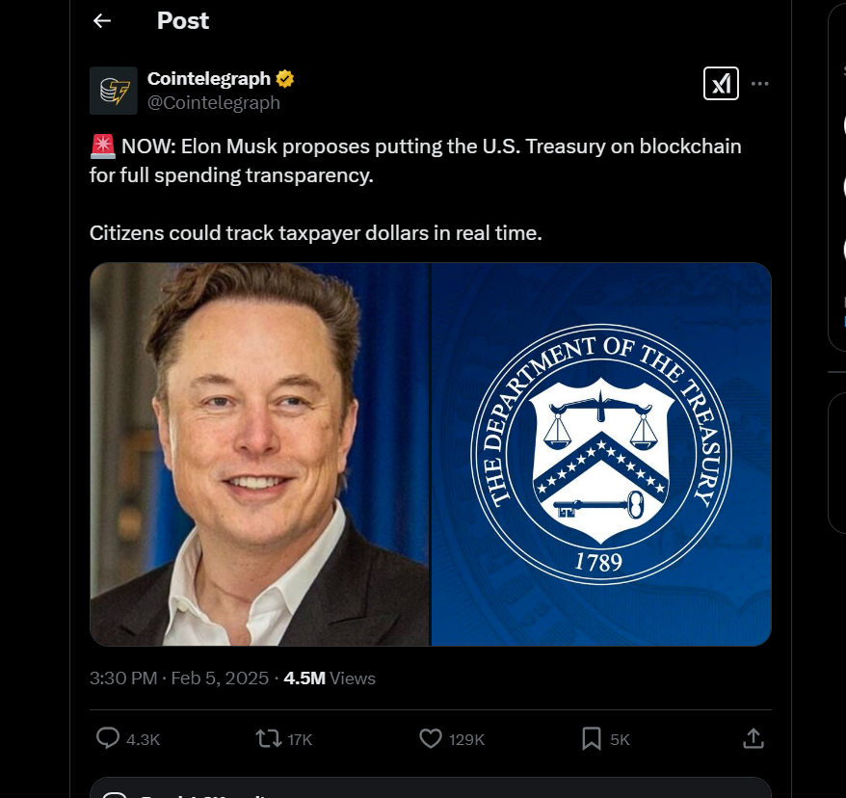
inspiration

Slide 4
Tech stack
Blockchain -> Hyperledger Fabric
ETL and Gen-AI -> Databricks
Frontend -> Next.js
Backend -> Nest.js
Authentication -> AuthO

Slide 5
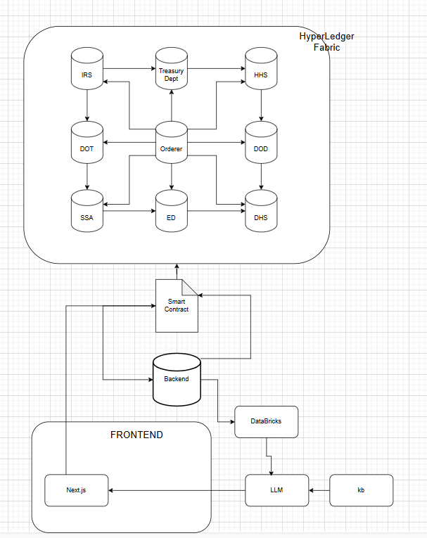
Dataflow

