Slide 1


“DeepSide: A Deep Learning Framework for
Drug Side Effect Prediction”
BATCH - 19
E.Somnath - 22N31A1259
G.Rakshith - 22N31A1260
D.Nishith - 22N31A1255
INTERNAL GUIDE
G. Likitha Reddy
Assistant Professor
Department of Information Technology
Malla Reddy College of Engineering & Technology
(Autonomous Institution- UGC, Govt. of India)
(Affiliated to JNTUH, Hyderabad, Approved by AICTE, NBA &NAAC with ‘A’ Grade)

Slide 2
AGENDA
ABSTRACT
INTRODUCTION
LITERATURE REVIEW
FUNCTIONAL AND NON-FUNCTIONAL REQUIREMENTS
SOFTWARE AND HARDWARE REQUIREMENTS
UML DIAGRAMS
SYSTEM DESIGN
IMPLEMENTATION
OUTPUT SCREENS
CONCLUSION
CCONC

Slide 3
ABSTRACT
Developing new medicines is expensive and time-consuming, especially when unexpected side effects show up during testing. These side effects can be harmful and cause the drug to fail, wasting time and money. To help solve this, our project uses a deep learning system called DeepSide to predict possible side effects of drugs before they reach the testing phase.
We used a large public dataset that includes how different drugs affect genes in human cells. By combining this information with the chemical structure of drugs, we trained several AI models. Among them, a special model using SMILES (a text format that describes molecules) worked the best and gave more accurate predictions than older methods.
This system helps researchers identify dangerous side effects early, improving drug safety and saving development costs..

Slide 4
INTRODUCTION
Making new medicines is a long and costly process. One big problem is that some drugs may cause harmful side effects that are not found until very late, sometimes even after people start using them. This can be dangerous and leads to failure of the drug.To avoid this, researchers are now using computers and artificial intelligence to predict side effects early—before testing on humans.
In this project, we created a system called DeepSide. It uses deep learning (a smart AI technique) to make better predictions by combining:Gene expression data (how cells react to the drug), and Chemical structure of the drug .
We used a big dataset called LINCS L1000, which has results from many lab tests on how drugs affect different types of human cells. We also used another dataset, SIDER, to check if our predictions were correct.We tested five deep learning models, and found that one using the SMILES format (a way to describe chemical structures) gave the best results.Our goal is to help scientists find harmful side effects early and make drug development safer and faster.

Slide 5
LITERATURE REVIEW
Title | Authors | Source | Citation | Methodology | Results | Future Enhancements
Deepside: A Deep Learning Framework for Drug Side Effect Prediction | Vaddi Srivallidevi, Sk. Ruhi | Sciencedirect Volume 14, Issue 05, May 2024, | Srivallidevi, V., & Ruhi, (2024). Deepside. Volume 14, Issue 05, May 2024. | Used full LINCS L1000 dataset; evaluated MLPs and CNNs; multi-model input (CS + GEX); SMILES for CNN input; metrics: accuracy, precision, recall, macro-/micro-AUC. | CNN with SMILES showed 13.0% macro-AUC and 3.1% micro-AUC gain; multi-model MLPs (CS + GEX) best among MLPs; CS more informative than GEX; model predicted previously undocumented but literature-supported side effects. | Extend to new datasets; personalize predictions for patient-level efficacy; integrate into clinical decision systems for real-world personalized treatment guidance.

Slide 6
FUNCTIONAL AND NON-FUNCTIONAL REQUIREMENTS
Functional Requirements:
Accept chemical structure data (e.g., SMILES strings, molecular fingerprints).
Train deep learning models (MLP, ResMLP, MMNN, MTNN).
Predict probability scores for multiple side effects per drug
Fuse multi-modal inputs using concatenation or summation strategies.
Generate side effect predictions with confidence scores.
Non-Functional Requirements:
Handle large-scale drug datasets with high-dimensional input features.
Optimize for both training speed and prediction accuracy.
Provide a user-friendly interface or API for researchers or developers.
Batch processing of drug data
Easy-to-use CLI for researchers

Slide 7
SOFTWARE AND HARDWARE REQUIREMENTS
Software Requriements :
Component | Specification
OS | Windows 7 Ultimate
Programming Language | Python 3.7
Front-End | Python
Back-End | Django-ORM
Designing | HTML, CSS, JavaScript
Data Base | MySQL(WAMP Server)
Hardware Requirements :
Component | Requirements
Processor | Intel i5(6th Gen or Later)
RAM | Minimum 4 GB
Hard Disk | 20 GB
Key Board | Standard Windows Keyboard
Storage | SSD with at least 50 GB free

Slide 8
UML DIAGRAMS
Class Diagram
Use Case Diagram
Sequence Diagram
SYSTEM DESIGN
Architecture/Blockdiagram

Slide 9
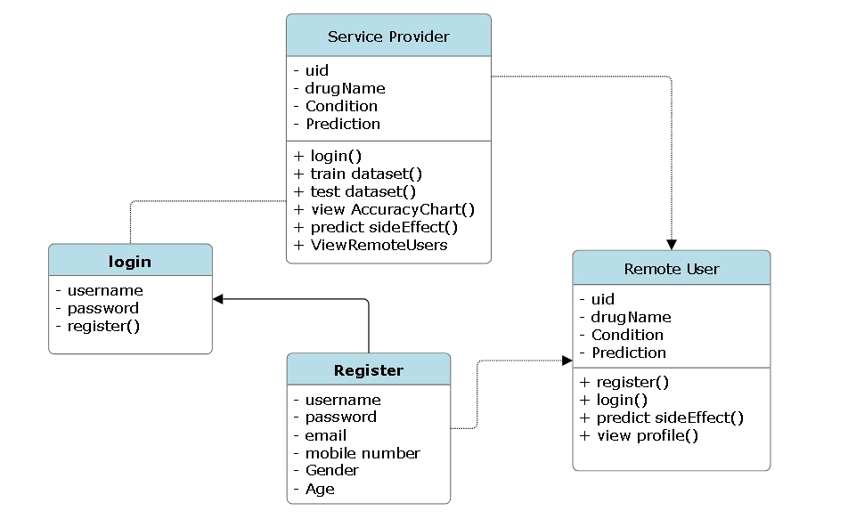
UML Diagrams
Class Diagram :

Slide 10
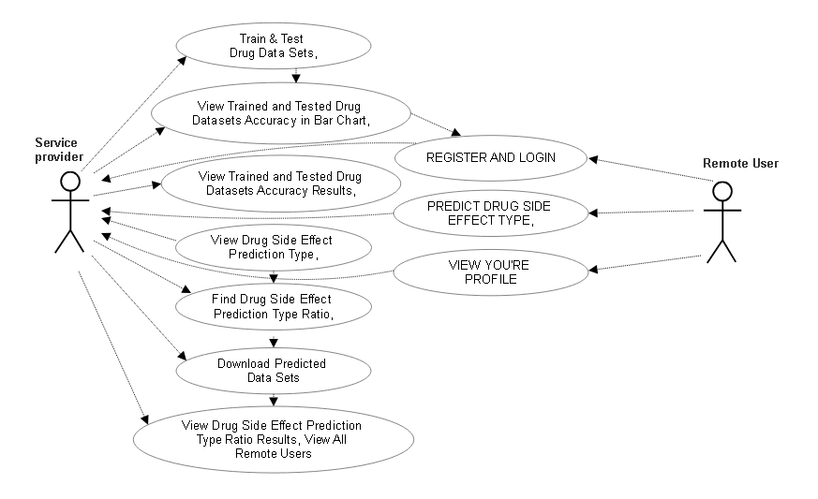
Use case:

Slide 11
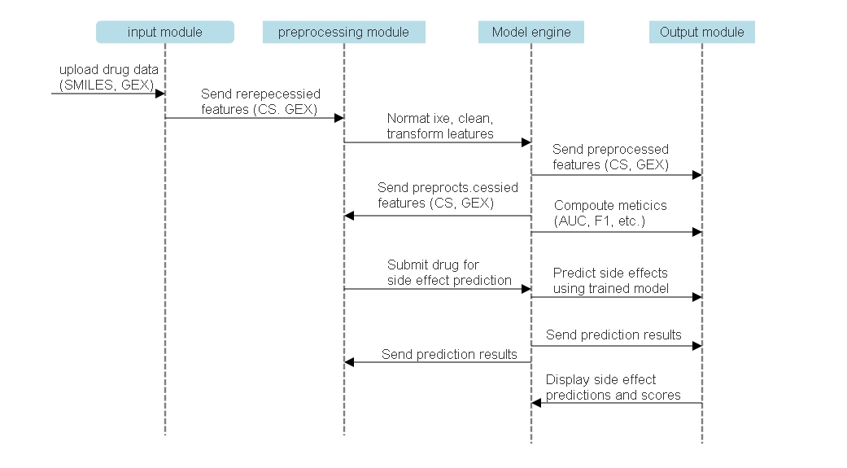
Sequence Diagram:

Slide 12
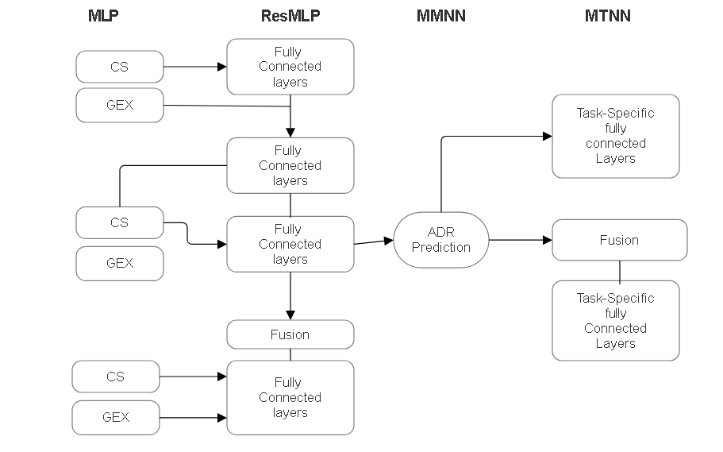
SYSTEM DESIGN
Architecture/Block diagram:

Slide 13
Implementation :
Views.py :
from django.db.models import Count from django.db.models import Q
from django.shortcuts import render, redirect, get_object_or_404
import pandas as pd
from sklearn.feature_extraction.text import CountVectorizer
from sklearn.metrics import accuracy_score, confusion_matrix, classification_report from sklearn.ensemble import VotingClassifier
from Remote_User.models import ClientRegister_Model,drug_side_effect_prediction,detection_ratio,detection_accuracy from sklearn.tree import DecisionTreeClassifier
if request.method == "POST" and 'submit1' in request.POST:
username = request.POST.get('username') password = request.POST.get('password’)
try:
enter = ClientRegister_Model.objects.get(username=username,password=password) request.session["userid"] = enter.id
return redirect('ViewYourProfile')

Slide 14
except:
pass
return render(request,'RUser/login.html') def Register1(request):
if request.method == "POST":
username = request.POST.get('username') email = request.POST.get('email') password = request.POST.get('password') phoneno = request.POST.get('phoneno') country = request.POST.get('country') state = request.POST.get('state')
city = request.POST.get('city') address = request.POST.get('address') gender = request.POST.get('gender')
ClientRegister_Model.objects.create(username=username, email=email, password=password, phoneno=phoneno,
country=country, state=state, city=city, address=address,
gender=gender)
obj = "Registered Successfully"
return render(request, 'RUser/Register1.html', {'object': obj})

Slide 15
else:
return render(request,'RUser/Register1.html')
def ViewYourProfile(request): userid = request.session['userid']
obj = ClientRegister_Model.objects.get(id= userid)
return render(request,'RUser/ViewYourProfile.html',{'object':obj})
def Predict_Drug_Side_Effect_Type(request): if request.method == "POST":
uid= request.POST.get('uid')
Drug_Name= request.POST.get('Drug_Name') Condition1= request.POST.get('Condition1')
df = pd.read_csv('Datasets.csv',encoding='latin-1') df
df.columns
def apply_results(Rating): if (int(Rating) <= 7):
return 0 # Low Side Effect else:
return 1 # High Side Effect
df['Results'] = df['Rating'].apply(apply_results)

Slide 16
cv = CountVectorizer()
X = df['UID'].apply(str) y = df['Results']
print("UID") print(X) print("Results") print(y)
cv = CountVectorizer()
X = cv.fit_transform(X) models = []
from sklearn.model_selection import train_test_split
X_train, X_test, y_train, y_test = train_test_split(X, y, test_size=0.20)
X_train.shape, X_test.shape, y_train.shape print("Multi-modal neural networks (MMNN)")
from sklearn.neural_network import MLPClassifier mlpc = MLPClassifier().fit(X_train, y_train) y_pred = mlpc.predict(X_test) print("ACCURACY")
print(accuracy_score(y_test, y_pred) * 100) print("CLASSIFICATION REPORT")
print(classification_report(y_test, y_pred)) print("CONFUSION MATRIX")
print(confusion_matrix(y_test, y_pred))
models.append(('MLPClassifier', mlpc))

Slide 17
print("SVM")
from sklearn import svm lin_clf = svm.LinearSVC() lin_clf.fit(X_train, y_train)
predict_svm = lin_clf.predict(X_test)
svm_acc = accuracy_score(y_test, predict_svm) * 100 print(svm_acc)
print("CLASSIFICATION REPORT")
print(classification_report(y_test, predict_svm)) print("CONFUSION MATRIX")
print(confusion_matrix(y_test, predict_svm)) models.append(('svm', lin_clf))
print("Logistic Regression")
from sklearn.linear_model import LogisticRegression
reg = LogisticRegression(random_state=0, solver='lbfgs').fit(X_train, y_train) y_pred = reg.predict(X_test)
print("ACCURACY")
print(accuracy_score(y_test, y_pred) * 100) print("CLASSIFICATION REPORT")
print(classification_report(y_test, y_pred)) print("CONFUSION MATRIX")
print(confusion_matrix(y_test, y_pred)) models.append(('logistic', reg))
classifier = VotingClassifier(models) classifier.fit(X_train, y_train)
y_pred = classifier.predict(X_test)

Slide 18
pred = str(predict_text).replace("[", "") pred1 = pred.replace("]", "")
prediction = int(pred1) if prediction == 0:
val = 'Low Side Effect Found' elif prediction == 1:
val = 'High Side Effect Found'
print(val) print(pred1)
drug_side_effect_prediction.objects.create( uid=uid,
Drug_Name=Drug_Name, Condition1=Condition1,
Prediction=val)
return render(request, 'RUser/Predict_Drug_Side_Effect_Type.html',{'objs': val})
return render(request, 'RUser/Predict_Drug_Side_Effect_Type.html')

Slide 19
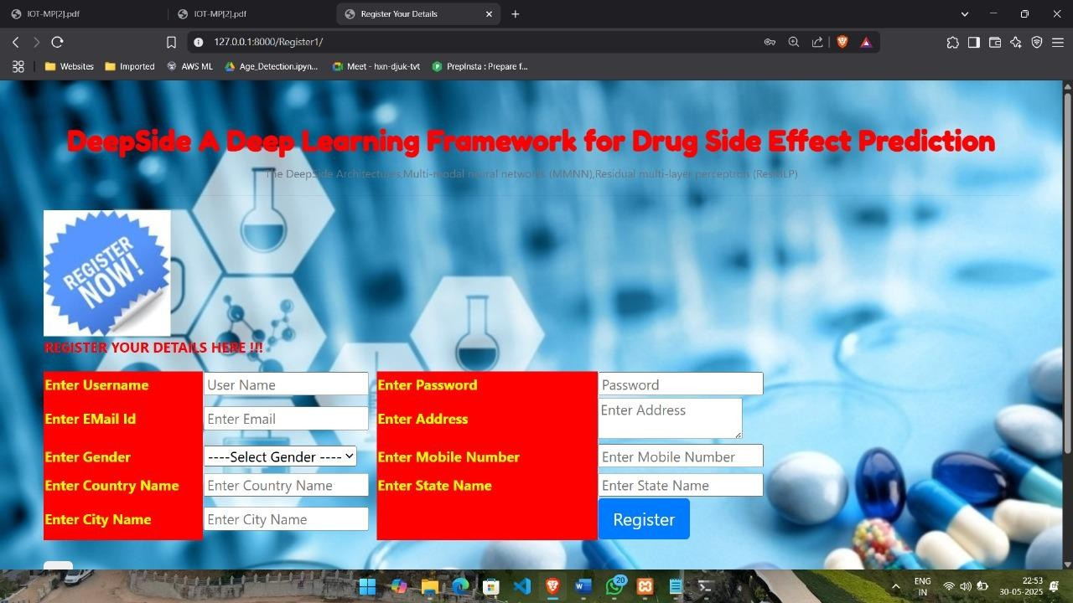
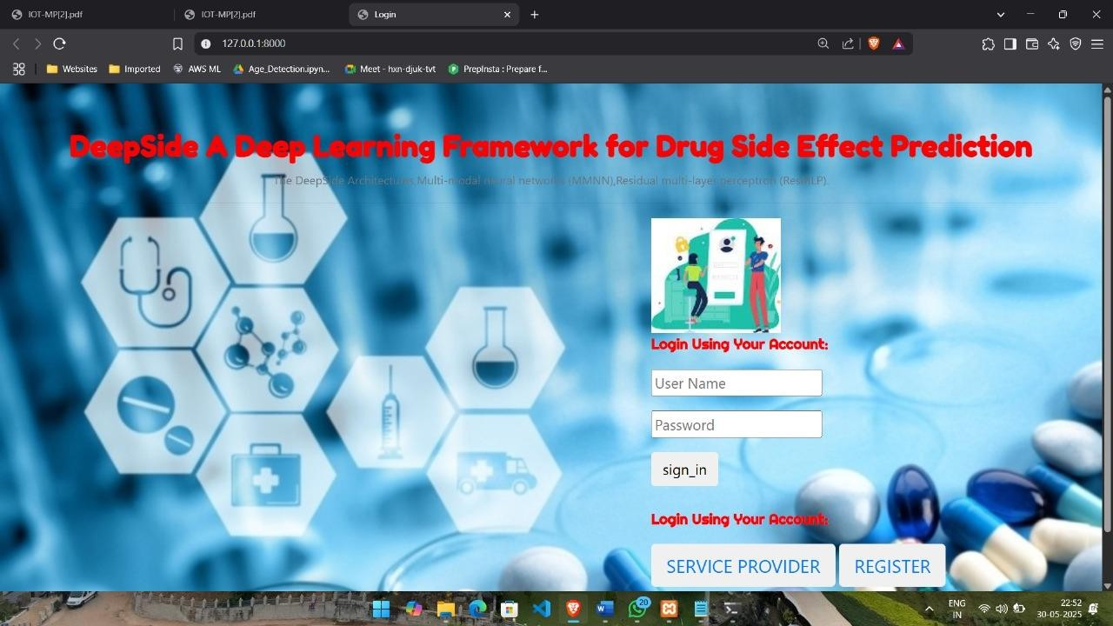
Output Screens :
Registration page:
Login page:

Slide 20
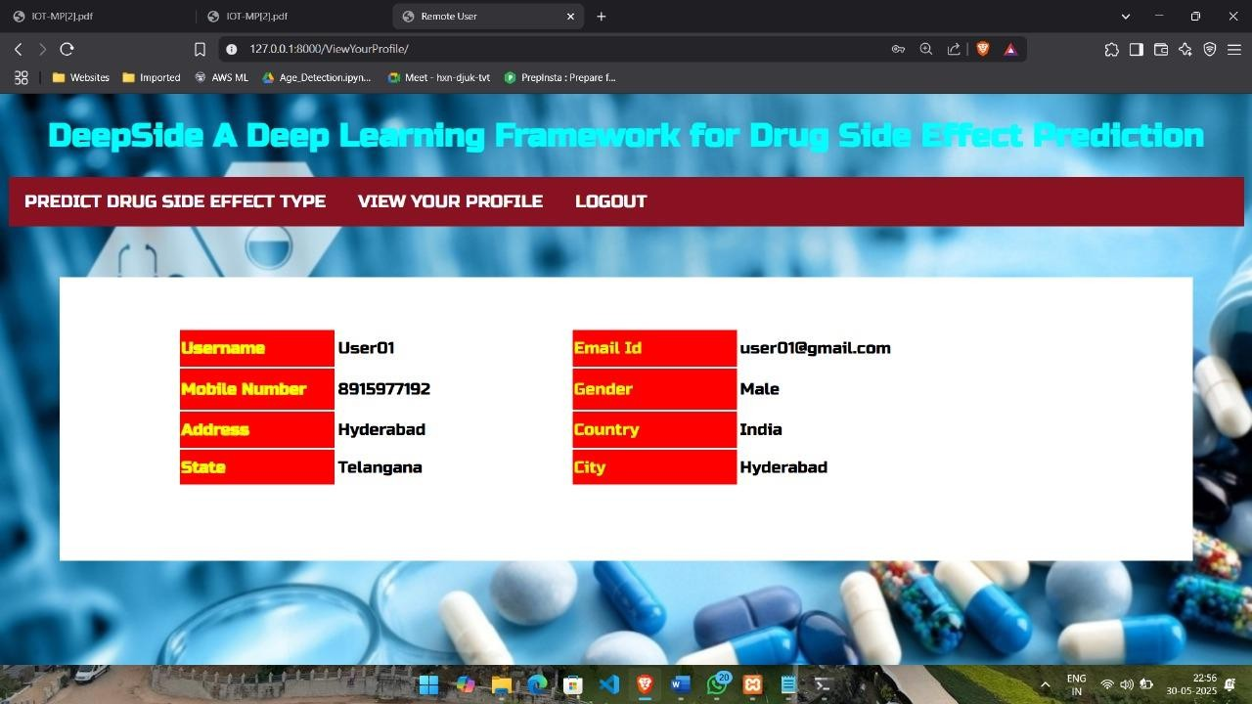
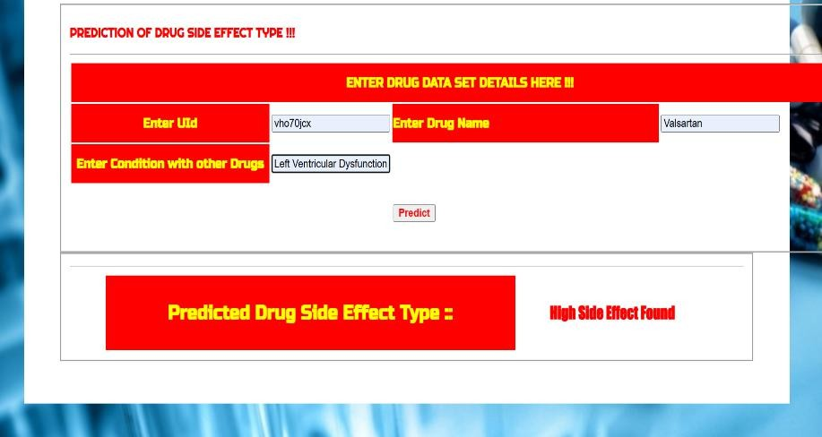
User Information:
Predict Drug Side Effect Type:

Slide 21
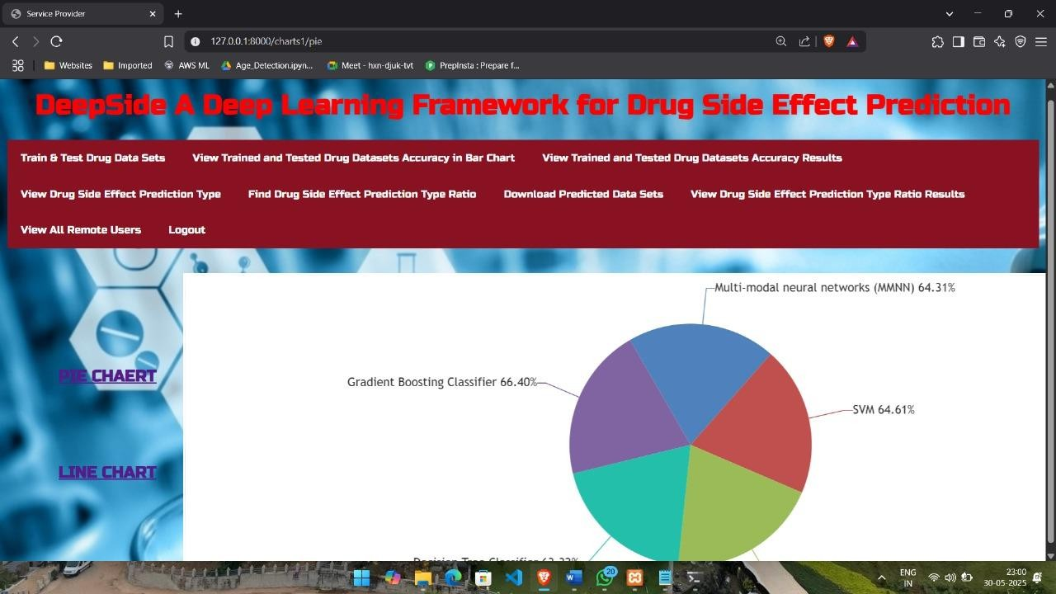
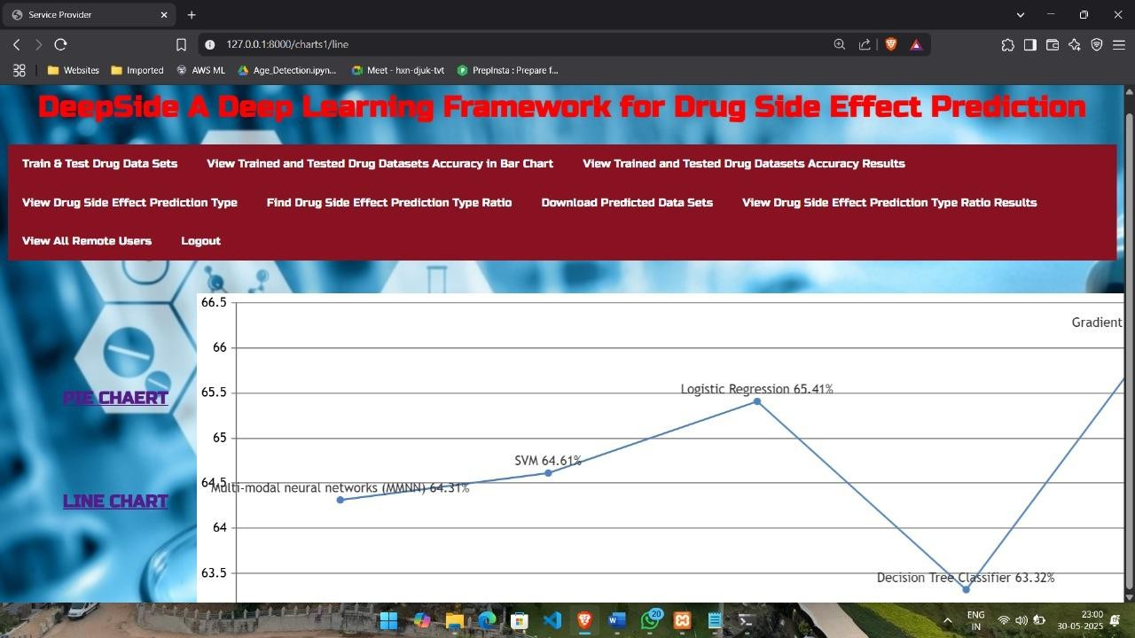
Pie Chart:
Line Chart:

Slide 22
CONCLUSION
The pharmaceutical drug development process is a long and demanding process. Unforeseen ADRs that arise at the drug development process can suspend or restart the whole development pipeline. Therefore, the a priori prediction of the side effects of the drug at the design phase is critical. In our Deep Side framework, we use context-related (gene expression) features along with the chemical structure to predict ADRs to account for conditions such as dosing, time interval, and cell line. The proposed MMNN model uses GEX and CS as combined features and achieves better accuracy performance compared to the models that only use the chemical structure (CS) finger- prints. The reported accuracy is noteworthy considering that we are only trying to estimate the condition-independent side effects. Finally, SMILES Conv model outperforms all other approaches by applying convolution on SMILES representation of drug chemical structure.

Slide 23
THANK YOU !

