Slide 1

Breast Cancer Prediction using Deep Learning Techniques Batch: G4:2020_CSE_02 Project Phase 2 Review 2 Presentation
Under the guidance of:
Dr. Aditya Pai H
Assistant Professor, Dept of CSE KSIT
Presented by:
Rohith K 1KS17CS062
Shri Harsha Kulkarni 1KS17CS077
Rakshith R 1KS17CS061

Slide 2
Contents
Introduction
Problem Statement
Aims and Objectives
Design
Technology used
Implementation
Demo
Conclusion
References
Blog and GitHub links

Slide 3
Introduction
Breast cancer is a malignant tumor that starts in cells of the breast. A malignant tumor is a group of cancer cells that spread into distant areas of the body.
Breast Cancer, one of the commonest malignancies, is a major cause of death among women in developed countries like UK, USA and in developing countries like India.
Sometimes an abnormal situation occurs, where a few cells may start growing abnormally. This abnormal growth of cells creates cancer, which can start from any part of the body and be distributed to any other part.
Different types of cancer can be formed in human body; among them breast cancer creates a serious health concern.

Slide 4
Problem statement
With the growth of developing countries grows the risk of suffering from diseases like breast cancer among its people.
An analysis has shown that survival rate is 88% after 5 years of diagnosis and 80% after 10 years of diagnosis.
Earlier detection of breast cancer reduces death rate and avoids it till reaches the chronic level.
The impact of breast cancer is increasing day by day, due to that the healthcare professionals are not in a condition to state the people affected at different stages earlier to save their lives.

Slide 5
Aims and Objectives
The Main objective of the project is to develop predictive model to identify the type of breast cancer as benign or malignant.
Design a system which helps oncologist in diagnosing the cancer type with in no time and then helps oncologist in decision making in treatment method for the same purpose.

Slide 6
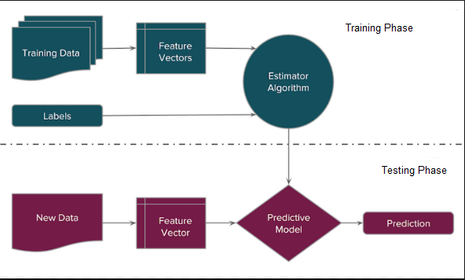
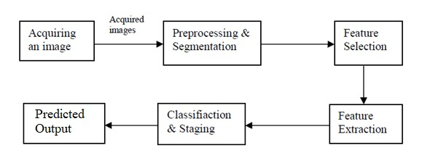
Design
Fig2. Architecture
Fig1. Design

Slide 7
The image is preprocessed by applying specific preprocessing techniques such as histogram equalization and median filter to remove noise and enhance the image.
Next, the preprocessed image is segmented for choosing the right portion of the infected region . then the selected features are extracted using algorithm and stored in the database for classification.
Then the selected features are extracted using algorithm and stored in the database for classification. The classification is based on growth of the cell and it is done using CNN. Based on the classification, the Breast cancerous identified which helps physician to give suitable therapy.

Slide 8
Technology used
Anaconda Navigator
Jupyter Notebook
Python and its libraries
ResNet-50
VGG-16

Slide 9
Implementation Transfer of Dataset to NumPy array.
The images in the dataset are converted to RGB format by using .convert() function of Pillow library.
Resize the image to a specific resolution.
And the image is Stored in the respective NumPy arrays.
And the same steps are repeated for testing and training data.

Slide 10
Label Creation
Before training and evaluation we go through,
Creating labels:
Since we are performing binary classification we have created labels for Malignant, Benign images and storing with 1 and 0 respectively for the test and train data.
Merge data:
Both the benign and malignant images of test and train data are concatenated and stored in a array respectively.
Shuffle data:
Both the data i.e., benign and malignant are shuffled and stored in the NumPy hence input for the model will be in random fashion.

Slide 11
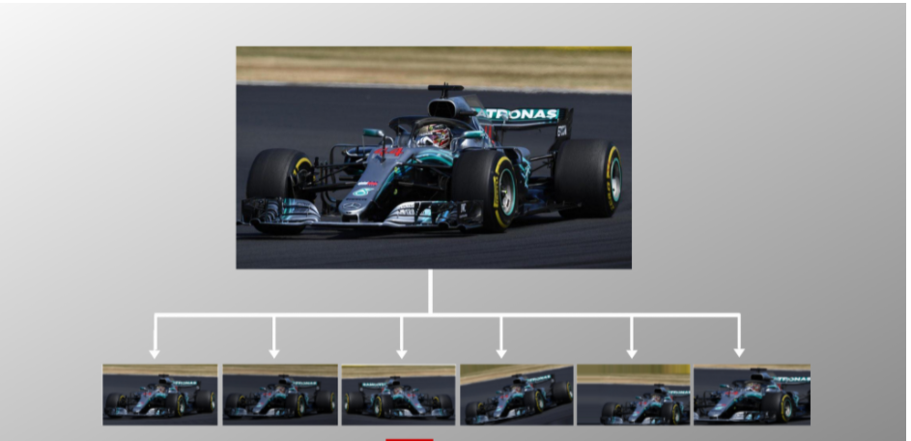
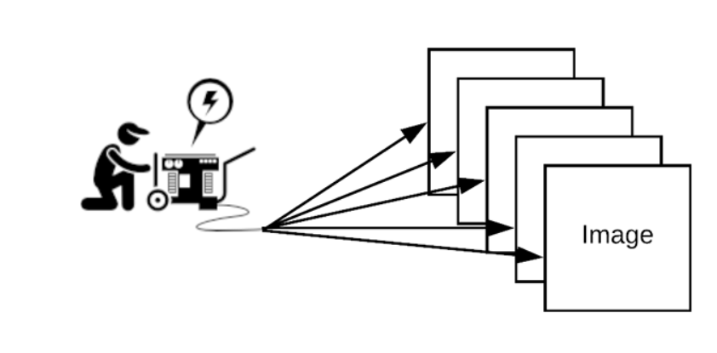
Image Data Generator
You can come up with new transformed images from your original dataset. ImageDataGenerator is a gem! It lets you augment your images in real-time while your model is still training.
We would have encountered a situation where you try to load a dataset but there is not enough memory in your machine. As the field of machine learning progresses, this problem becomes more and more common.
Fig. 8 & 9 Data augmentation

Slide 12
1. ResNet50
In Deep Learning, transfer is a technique whereby a neural network is first trained on a similar problem that is being solved. One or more layers from the trained model are then used in the new model in according to the user.
Hence, the time consumption is less.
The initial few layers of the network learns the very generic features from the model. To achieve this, initial layer weights of the pre-trained model are frozen. Higher layers of the model are used to realize the task-specific features. These can be fine-tuned.
This model also accepts the color images and must have a square-shaped input.

Slide 13
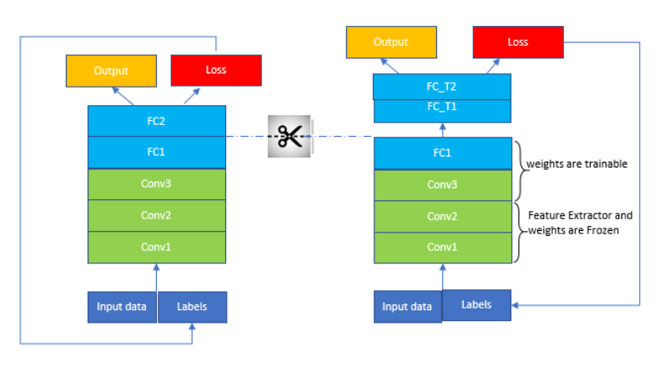
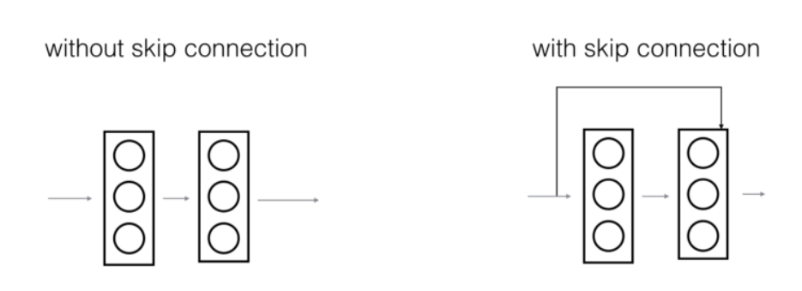
Deeper network doesn’t always produce favorable outcomes. A huge barrier to training huge neural networks is the phenomenon of vanishing gradients. Very deep networks often have a gradient signal that goes to zero quickly, thus making gradient descent slow.
Resnet makes use of skip connection to achieve the above issue.
Fig.4 ResNet architecture
Fig.5 ResNet feature

Slide 14
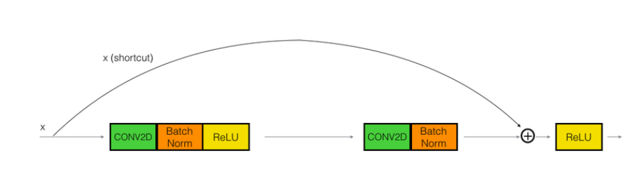
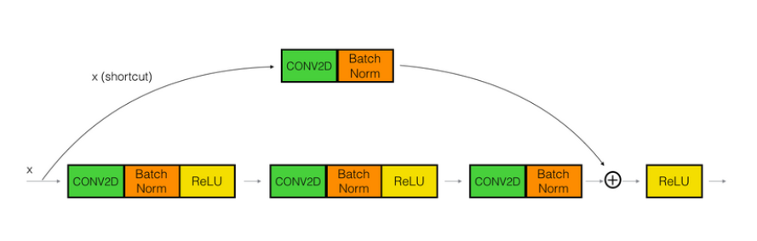
Identity block
Convolution block
Fig6. Identity block
Fig7. Convolution Block

Slide 15
ResNet 50
ResNet50 model can be used as,
Classifier
Standard feature extraction
Integrated feature extraction
Weight initialization
Advantages are that,
it uses fine tuning.
Don’t necessarily have to train the whole model, hence much data is not required.
Time required is lesser.

Slide 16
VGG16 Algorithm
The VGG Network architecture was introduced by Simonyan and Zisserman in their 2014 paper
The network is characterized by the fact that it uses a simple 3x3 convolutional layer stack, on top of each other in increasing depth
The number ‘16’ represents the number of weight layers of the Neural Network.
The Keras model of the network was used by the VGG Team in the ILSVRC 2014 competition, and at that time, a 16 – layered neural network was considered very deep

Slide 17
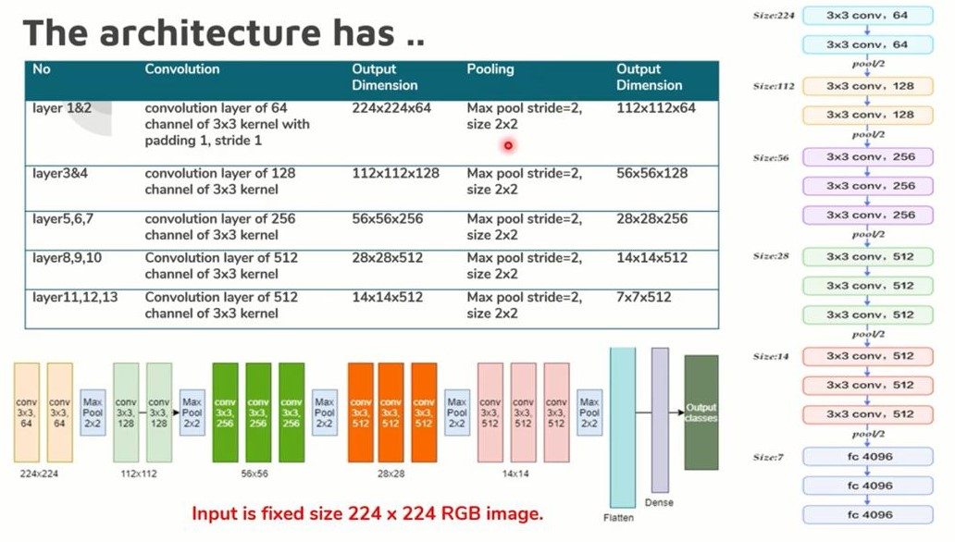
Fig8. Architecture of VGG-16

Slide 18
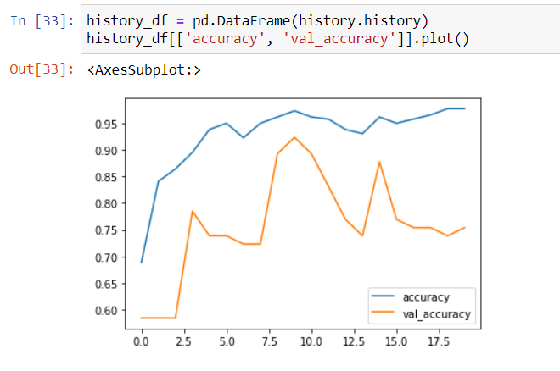
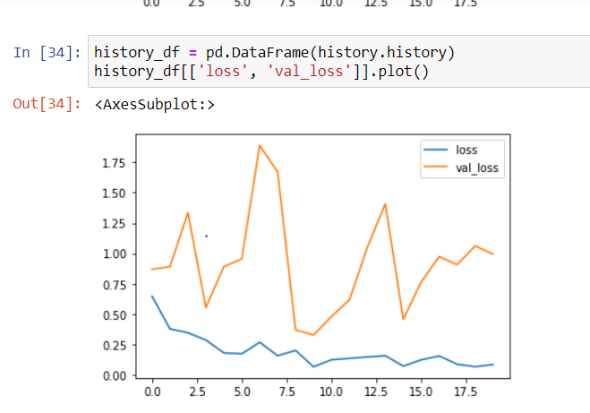
Snapshots
Fig9. Accuracy graph
Fig10. Loss graph

Slide 19
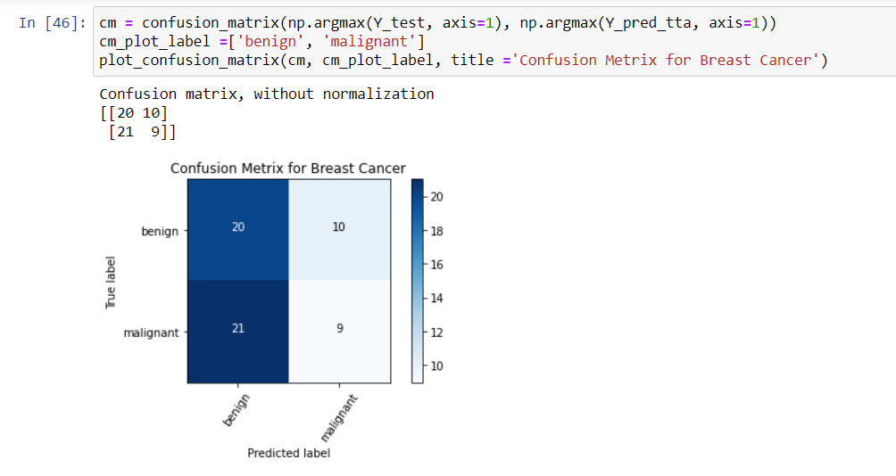
Fig11. Confusion matrix

Slide 20
Demo

Slide 21
Conclusion and future enhancements
We have implemented ResNet50 model and have evaluated its outcomes.
The accuracy we have obtained is about 96% with this architecture.
Further, we will try and implement the same with the VGG-16 architecture and compare the results with each other. And choose the model which results in better outcomes.

Slide 22
References
https://machinelearningknowledge.ai/keras-implementation-of-resnet-50-architecture-from-scratch/#Skip_Connection
https://machinelearningknowledge.ai/keras-implementation-of-resnet-50-architecture-from-scratch/#Early_Stoping
https://machinelearningmastery.com/how-to-use-transfer-learning-when-developing-convolutional-neural-network-models/
https://keras.io/api/utils/backend_utils/#floatx-function
https://www.analyticsvidhya.com/blog/2020/08/image-augmentation-on-the-fly-using-keras-imagedatagenerator/
Karthik Sekaran, Srinivasa Perumal Ramalingam, Chandra Mouli P.V.S.S.R. “Breast Cancer Classification Using Deep Neural Networks”. Research Gate, 2018. DOI: 10.1007/978-981-10-6680-1_12

Slide 23
Blog and GitHub
Blog: https://breastcancerprediction.blogspot.com/2021/04/cancer-prediction-using-deep-learning.html
GitHub: https://github.com/Rakshith1310/2020_CSE_02.git

