Slide 1

BLOOD BANK MANAGEMENT SYSTEM
SUBMITED BY:-
RAKSHITH HOLLA
MEGHARAJ M

Slide 2
INTRODUCTION
A Blood Bank stores blood of various blood groups. Many donors donate blood, each of different blood group/type. A donor may donate blood more than once and he is identified by a donor id (DID), name, sex, age, address and phone number. The blood donated by the donor is characterized by blood type, code and cost. Before each donor donates his blood, he is required to register him self as a donor with the receptionist who works at the Blood Bank. The receptionist is identified by employee id, name, address and phone number. The Blood Banks receives orders for blood from many hospitals for emergency purposes and other surgical requirements and each blood bank issues the same of required blood type. Each blood bank has its own blood bank number (BNO), issues, orders and blood types stored. The Blood Bank is managed by the blood bank manager who is identified by employee id, name, email_id and phone number .He is responsible for the proper management of the blood bank. The hospitals are identified by name, address and phone number.

Slide 3
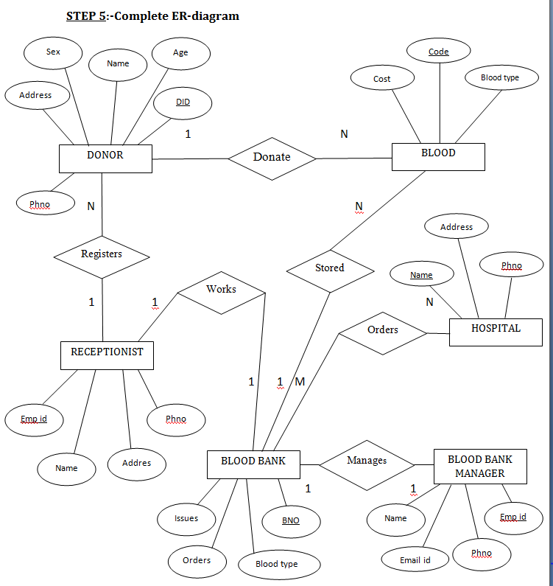
Complete ER-diagram

Slide 4
ENTITIES
Donor
Blood
Receptionist
Blood Bank
Blood Bank Manager
Hospital

Slide 5
RELATIONSHIPS
A donor may donate blood any number of times. So cardinality is 1:N.
Many donors may register blood donation with a single receptionist. So cardinality is N:1.
Blood of different type in large numbers is stored in a single Blood Bank. So cardinality is N:1.
Blood Bank is managed by an blood bank -manager. So cardinality is 1:1.
A receptionist works in a Blood Bank. So cardinality is 1:1.
Hospitals may order blood from different Blood Banks. So cardinality is N:M.

Slide 6
SOFTWARE REQUIREMENTS
OS : Windows.
Data base : My SQL.
Front end : WindowsFormApplication C#.

Slide 7
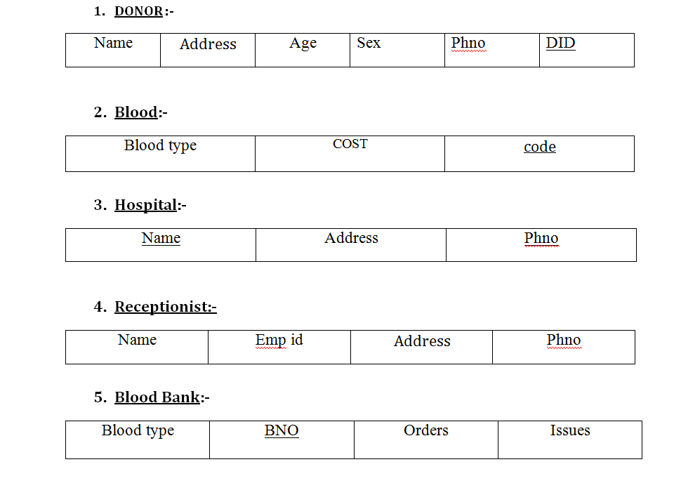
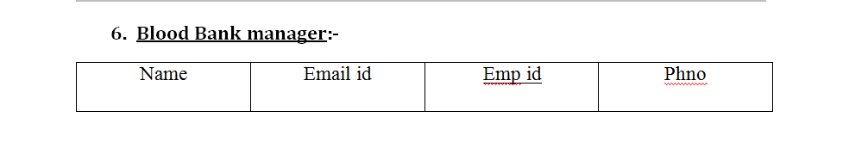
TABLES REQUIRED

Slide 8
Thank you

