Slide 1
Development of Innovative
Internet Of Things
Security System
RAKSHITH N M
4kv12ec063

Slide 2
Internet of Things ( IoT )
Description :
“A network of items-each embedded with sensors-which are connected to the Internet.”
Have identities, physical attributes and virtual personalities
A dynamic global network Infrastructure
With self configuring capabilities
Internet of Things
Use intelligent interfaces
Based on standard and interoperable communication protocols
And are seamlessly integrated
Where physical and virtual things
Into the information network

Slide 3
Actuators
Interrogator/ gateway device
Host information management system
ID and additional Object connected data.
Wider area communications and network
Actuators
Interrogator/ gateway device
Host information management system
Physical Interface zone
Internet +
Actuators
Sensory data carriers
Interrogator/ gateway device
Host information management system
Networked Data
Carriers
Further layers of Data Capture Technology
Internet of Things – The Inclusive Model

Slide 4






keywords : Interconnection-Internet-Identity-Ubiquity- Sensing or Actuating-Interoperable communication-Programmable.
Applications :
Smart cities
Health care
Building and Home Automation
Wearable's
Smart manufacturing
Automotive

Slide 5
IoT : How can it impact daily life.
1.Fire : Smoke alarm instructs Motion Sensor – checks for human presence - (no movement) – Smoke alarm – emergency message - Fire Brigade.
2.Supermarket : Milk fridge – Trolley display – message – “No milk in your fridge , would you like to purchase some?” – shopping done - smart gates – scan all products – charge credit card – email receipt.
3.Accident : sensor – calls out – bike ( to check if near-by[it’s not] ) – bike sounds emergency alarm , attracts passengers – sends exact location to ambulance – signals road sign – control speed of approaching vehicles.
4. Sleep : Sleep cycle monitor – if your sleep routine changes – the alarm sets itself and makes up for the lost sleep – if your next day schedule has no appointments in the morning.

Slide 6
Security Issues

Slide 7
Why IoT is vulnerable?
Digitally connected devices are encroaching every aspect of our lives.
Researchers estimate that by 2020, the number of active wireless connected devices will exceed 50 billion.
More connected devices mean more attack vectors and more possibilities for cybercriminals to target us.
Few vulnerabilities found :
Internet connected cars can be compromised and hackers can carry out any number of malicious activities, including taking control of the entertainment system, unlocking the doors or even shutting down the car in motion.
Wearable's also can become a source of threat to your privacy, as hackers can use the motion sensors embedded in smart watches to steal information you’re typing or they can gather health data from smart watch apps or health tracker devices you might be using.

Slide 8
IoT Architecture

Slide 9
IOT Layer and Sub-Layers
APPLICATION
LAYER
Local Applications
National Applications
NETWORK
LAYER
Wireless
Wired
PERCEPTION
LAYER
Multimedia
Text or Digital
Image
IoT architecture

Slide 10
IoT Security Architecture

Slide 11
IOT Security Architecture
Security of Application layer
Local Applications
National Applications
APPLICATION
LAYER
Security of Network Layer
Wireless
Wired
NETWORK
LAYER
Security of Perception Layer
Image
Text or Digital
Multimedia
PERCEPTION
LAYER
IoT Security Architecture

Slide 12
Suggested Security
Techniques

Slide 13
Encryption
Steganography
Application security Layer
Local Application
Authorization
Authentication
Application security Layer
Firewall
Intrusion detection
National Application

Slide 14
Identity based authentication
Anti-jamming
Network security Layer
Key-distribution
Faraday-cages
Wireless
Routing-Flirting
Congestion-control
Network security Layer
Resource Multiplication
Firewall
Wired

Slide 15
Time-stamp
Compression
Perception security Layer
Encryption
Time synchronization
Multimedia
Encryption
Cyclic Redundancy checks
Perception security Layer
Image Compression
Image

Slide 16
Encryption
Time synchronization
Perception security Layer
Multimedia

Slide 17
The simulation Scenario

Slide 18
start
Motion Sensor in active Mode
Motion Sensor receives infrared Signal
If the infrared signal >X
A

Slide 19
The Object is a person(intruder)
A
The motion sensor sends a packet to the local application
The local application sends a packet to the camera sensor
The camera sensor is focused to the intruder
Depending on the internet channels
The camera sensor sends a video or image to the local application
B

Slide 20
B
If the intruder is focused
The Local Application sends a control packet to another camera sensor
The camera sensor is focused to the intruder
The camera sensor adapts to the intruder depending on his axes
The International application takes an action
End

Slide 21
The simulation
results
Parameters :
Energy consumption
Cost
Time Consumption
Security Accuracy

Slide 22
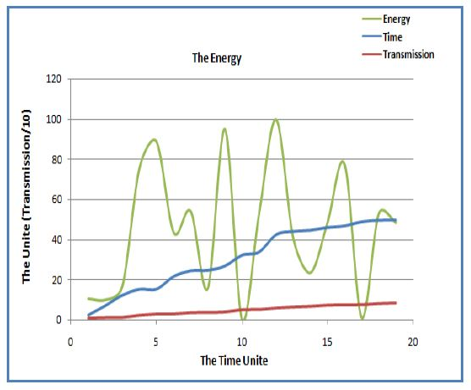
Energy consumption
Figure shows the relationship between the energy consumption and the transmission rate within an interval of time.
This relation is direct in most time slots (i.e. when the transmission rate increases the energy consumption increases). But, in some time slots such as 5,13, 10 and 18 the energy consumption is notably decreased. This is due to signal propagation distance and

Slide 23
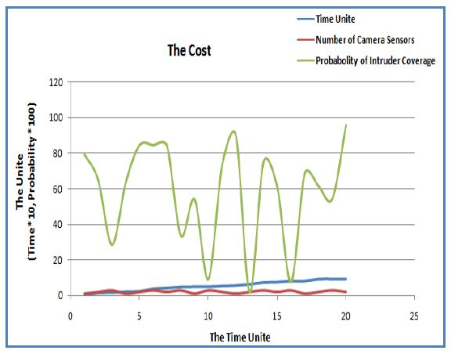
Cost
Figure shows that the cost parameter depends on the number of camera sensors,requirred to accomplish the intruder full coverage task.
If the number of camera sensors increases, the probability of full intruder coverage increases except at points 11, 13 and 16 of time axis.
The sudden decrease in the probability values(11, 13 and 16) is due to the intruder motion that is changed every simulation time periodically.

Slide 24
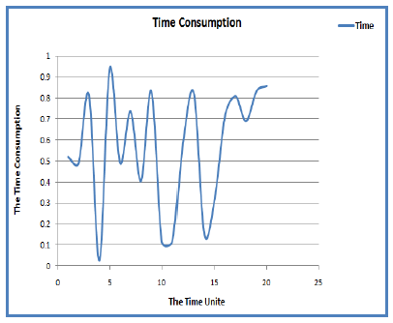
Time Consumption
The consumption of time parameter scales the time from entry of the intruder into his target environment until the completion of detection process.
Figure shows that the values of consumed time during simulation intervals are extremely different.
Reasons :
1.Different positions in target area different camera sensors are to be activated.
2.Motion sensor(s) may take a long time to detect the intruder.
3.If this camera sensor can’t cover the intruder activities, another message should be extracted from the local application to other cameras which represents additional time.

Slide 25
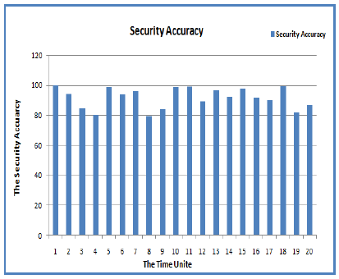
Security Accuracy
Determines the efficiency of the proposed security system.
Figure shows accuracy percentage for the proposed IoT security system.The percentage values are located in between 79% and 99%.

Slide 26
Conclusion

Slide 27
Internet of things
Description
features
model
Application
Security Issues
Iot Architecture
Iot Security Architecture (based on the architecture)
Suggested Security Techniques
The Simulation Scenario
The Simulation Results

Slide 28
In this paper, the architecture of IoT is introduced. Based on this architecture, a new security model for IoT is proposed. The proposed architecture idea is based on accurate determination of suitable security mechanisms for each IoT layer.
The proposed architecture divides:
The application layer into two security sub-layers, which are called local and national.
The network layer in the IoT architecture is divided into two sub-layers, which are called wireless and wired.
The perception layer is divided into three sub-layers, which are called multimedia, image, and text.
To test the proposed security architecture, a simulation environment is constructed using MATLAB and handmade C++ code.
Four parameters are used to scale efficiency of the proposed system;
the energy consumption,
the cost,
the consumption of time,
and the security accuracy.
The results showed that the system is efficient under the constructed simulation environment.

Slide 29
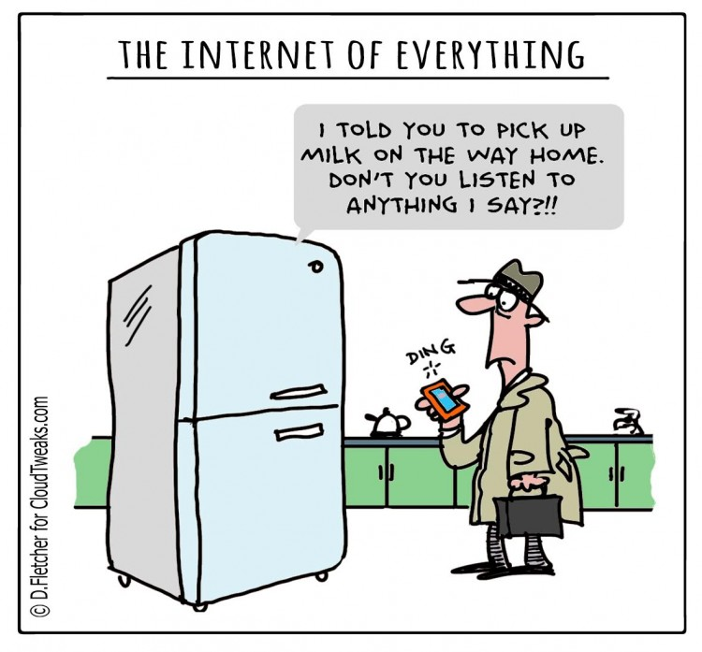
THANK YOU FOR YOUR PATIENT LISTENING

Slide 30
Question & Answer

