Slide 1
AI-POWERED HEALTHCARE POLICY PLATFORM
Policy Matrix
Intelligent Healthcare Policy Comparison
PREPARED BY
ASSESSMENT
DATE
Rakshith Vellulla
Cotiviti Hackathon
June 2026
Cotiviti Hackathon | June 2026 | Confidential

Slide 2





The Challenge
02
Healthcare organizations frequently update reimbursement and policy documents — creating significant operational burdens.
Manual Comparison
Time Overruns
Missed Changes
Admin Overhead
Reimbursement Errors
Tedious, line-by-line review of lengthy PDF documents
Review processes consume disproportionate analyst hours
Critical policy updates overlooked under document volume
Increased administrative effort across compliance teams
Billing inaccuracies due to untracked policy changes
These challenges reduce operational efficiency and increase compliance risks across healthcare organizations.

Slide 3






Policy Matrix
03 | Proposed Solution
An AI-powered web application that automates healthcare policy comparison — reducing manual effort while improving decision-making.
PDF Upload
Text Extraction
Diff Detection
Upload previous and updated policy documents instantly
Automatic extraction via PyMuPDF — no manual copy-paste
Precise identification of additions and removals
AI Summaries
Report Export
Dashboard
Google Gemini generates executive summaries and impact analysis
One-click professional PDF report generation
Interactive analytics dashboard for policy statistics

Slide 4




Technology Stack
04
Frontend
Backend
AI Engine
PDF Tools
React
FastAPI
Google Gemini API
PyMuPDF
TypeScript
Python
jsPDF
Tailwind CSS
Lightweight · Scalable · Production-Ready
Lightweight · Scalable · Production-Ready
Lightweight · Scalable · Production-Ready
Lightweight · Scalable · Production-Ready

Slide 5

Application Workflow
05 | System Design
01
02
03
04
05
06
Upload PDFs
Text Extraction
Diff Analysis
AI Processing
Dashboard Display
PDF Report
User uploads previous & updated policy documents
Backend extracts content via PyMuPDF
System identifies additions & removals
Google Gemini generates insights & recommendations
Results shown with statistics & visualizations
Professional downloadable report generated

Slide 6
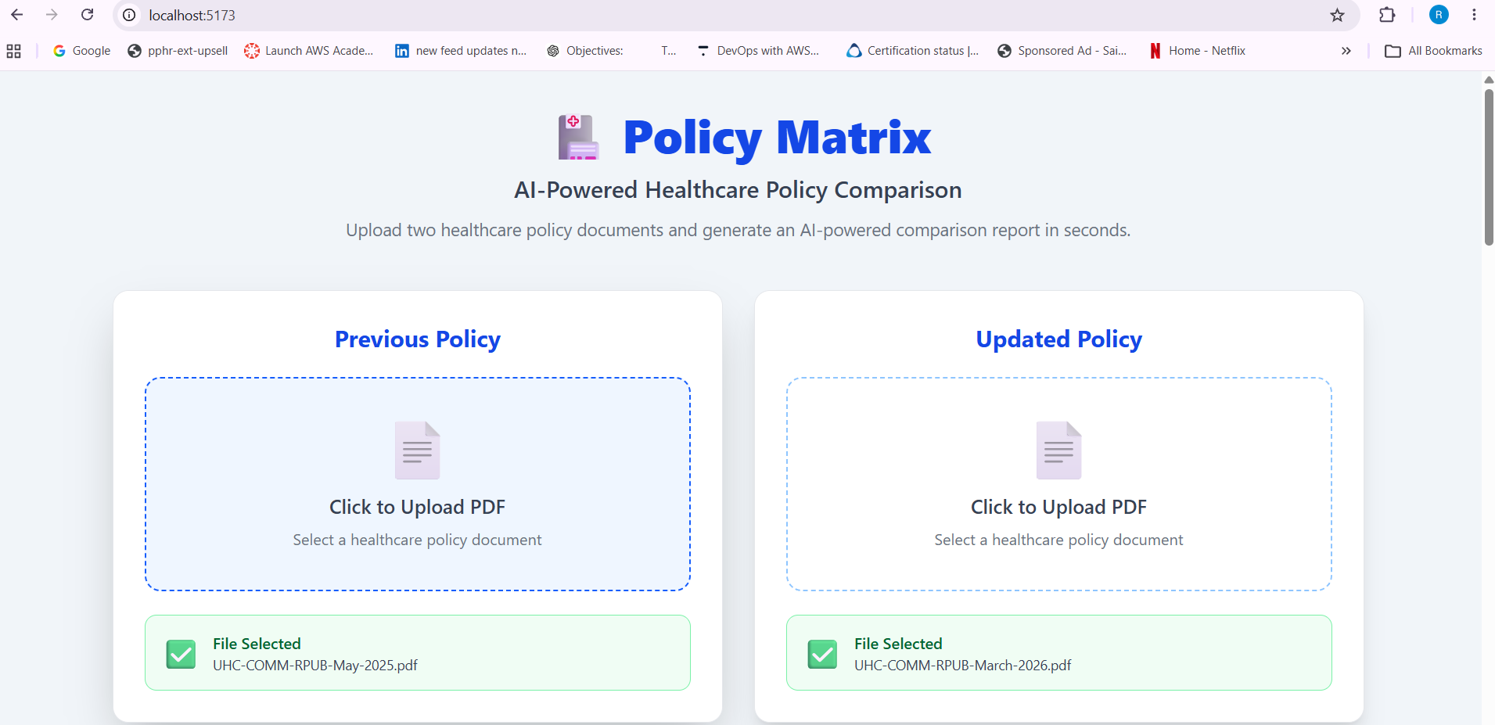
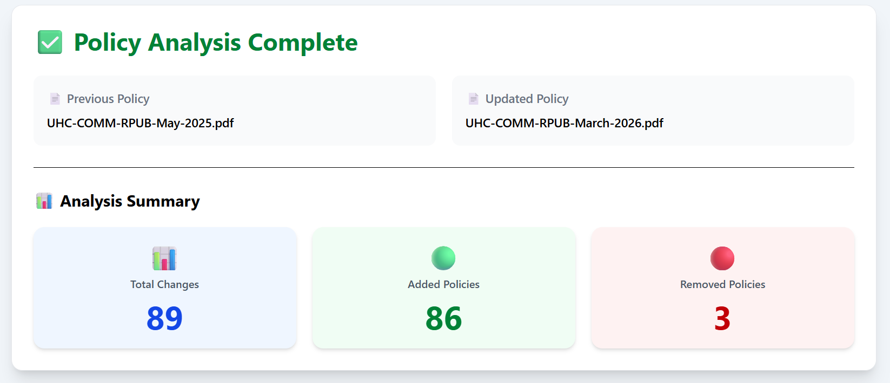
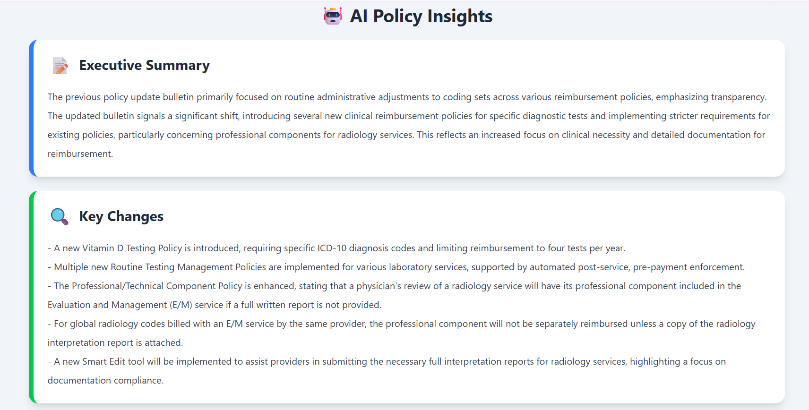
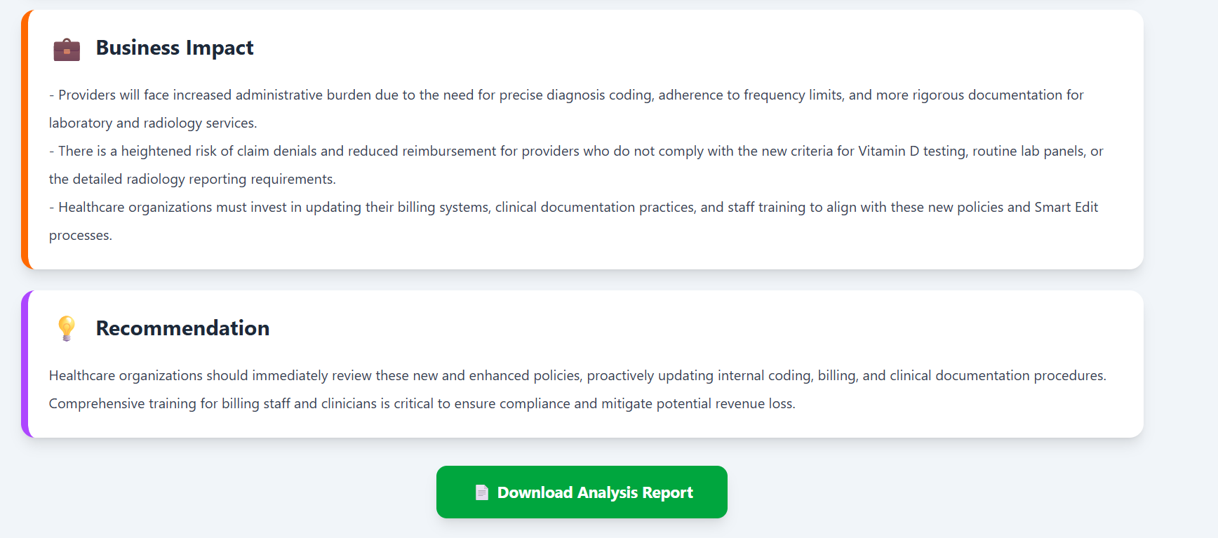
Live Demonstration
06
DEMO STEPS
📸
📸
1
Upload Previous Policy PDF
2
Upload Updated Policy PDF
Home Page
Analysis Dashboard
3
Click "Analyze Policies"
4
View policy statistics
📸
📸
5
Review AI-generated insights
AI Summary Panel
Generated PDF Report
6
Download the PDF report
http://localhost:5173/

Slide 7




Application Features
07 | Capabilities
PDF Upload
Text Extraction
Diff Detection
Drag-and-drop or browse to upload policy documents
Automatic extraction — no manual handling needed
Precise additions and removals identification
Executive Summary
Business Impact
Recommendations
AI-generated overview of policy landscape
Quantified impact analysis with recommendations
Actionable next steps powered by Gemini
Interactive Dashboard
PDF Export
Responsive UI
Statistics and visualizations at a glance
Downloadable professional analysis report
Works seamlessly across desktop and mobile

Slide 8




Business Value for Cotiviti
08
Faster Policy Review
Improved Accuracy
Reduced Manual Effort
Automated comparison replaces hours of manual document reading
Consistent diff detection reduces the risk of overlooked changes
Analysts focus on decisions, not document hunting
Increased Efficiency
Consistent Reporting
AI-Assisted Decision Support
End-to-end analysis completed in a single workflow
Standardized PDF output across every policy comparison
Gemini-generated insights help analysts act with confidence

Slide 9

Future Improvements
09 | Roadmap
Phase 1 — Near Term
Phase 2 — Mid Term
Phase 3 — Long Term
OCR support for scanned documents
Database integration
AI-powered risk assessment
User authentication & access control
Policy version history
Claims management system integration
Dashboard analytics
01
02
03

Slide 10

CONCLUSION
Policy Matrix
Simplifying Healthcare Policy Analysis with AI
Automates policy comparison end-to-end
Generates intelligent AI-powered summaries
Improves operational efficiency significantly
Supports healthcare decision-making at scale
Thank You | Questions?

