Slide 1

Title: Employee Payroll Management System Using java
Student Name: J Rakshitha
Student ID: 2520090212
Cluster:4
Section: 14
Under the Guidance
of
Supervisor Name: xxxxxxxx
Assistant Professor
Department of CSE

Slide 2
Abstract
The Employee Payroll Management System is developed to automate employee salary calculation and record management.
The system allows users to add employee details, calculate net salary, and manage records efficiently.
The FWD version is developed using HTML, CSS, and JavaScript to provide a responsive web interface.
The DSA version is implemented using Java, demonstrating data structures like ArrayList, Stack, Queue, HashMap, Searching, and Sorting.
This project demonstrates the practical application of web development concepts and data structure algorithms.

Slide 3
Existing System
• Payroll calculations are often done manually or using spreadsheets
• Manual systems are time-consuming and error-prone
• Employee records are difficult to maintain and update
• Searching employee details takes more time
• Lack of automation leads to inefficient payroll processing

Slide 4
Proposed System
Automated Employee Payroll Management System
Allows users to add, view, and search employee records
Automatically calculates Net Salary
Provides efficient data management using Java and Web technologies
Demonstrates DSA concepts like searching, sorting, stack, queue, and hashing

Slide 5
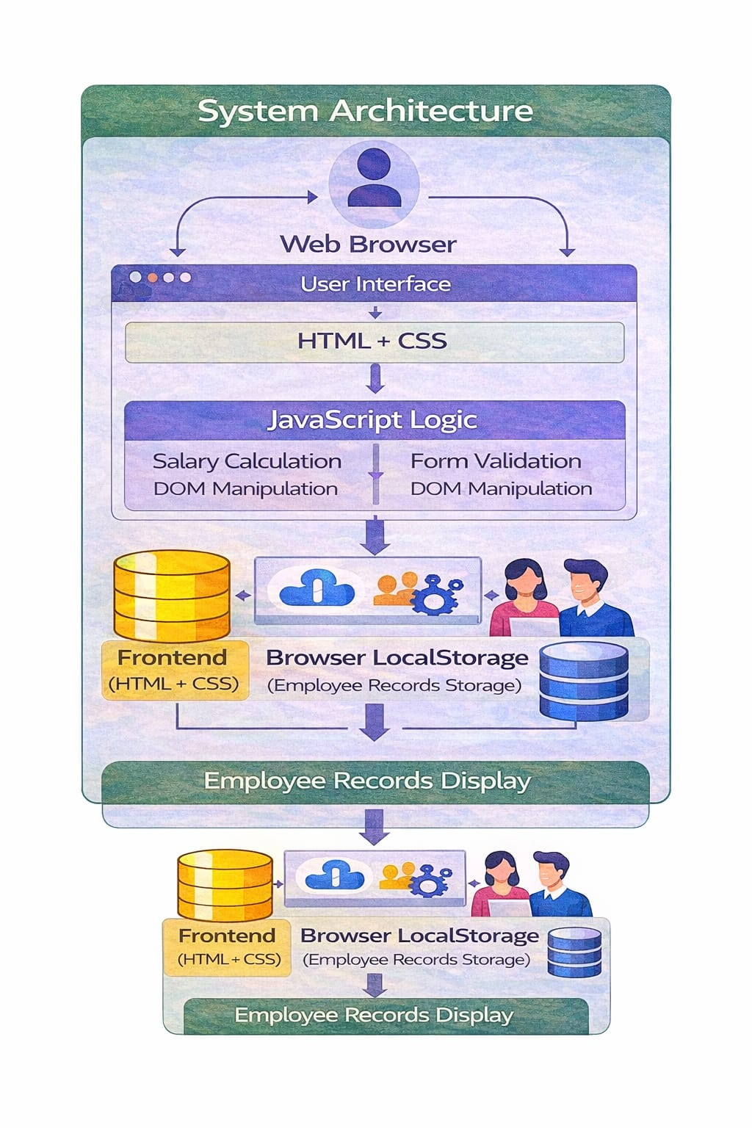
System Architecture

Slide 6
Project Modules
1. User Interface
Login & Signup pages
Responsive design
2. Employee Data
Add employee details
Store records
3. Payroll Calculation
Net salary calculation

Slide 7
Project Modules
4. Employee Records
Display employee data
Manage records
5. User Interaction
DOM manipulation
Dynamic updates

Slide 8
Objectives
Develop a Payroll Management System using Java and Web technologies
Implement salary calculation and employee record management
Demonstrate data structures and algorithms in a real application
Provide a simple and efficient interface for payroll processing
Improve understanding of DSA and Frontend Development

Slide 9
Co’s Attainments - FWD
CO | Description
CO 1 | Implementation of basic web pages using HTML structure and CSS styling.
CO 2 | Development of responsive forms and layouts for employee data input.
CO 3 | Application of JavaScript programming for salary calculation and data processing.
CO 4 | Use of DOM manipulation and event handling to update employee records dynamically.
CO 5 | Implementation of advanced web concepts like validation, storage, and deployment basics.

Slide 10
Co’s Attainments - DSA
CO | Description
CO 1 | Implementation of basic Java programming concepts and object-oriented programming.
CO 2 | Use of ArrayList for storing and managing employee records dynamically.
CO 3 | Application of searching and sorting algorithms such as Linear Search and Bubble Sort.
CO 4 | Demonstration of data structures like Stack and Queue for payroll operations.
CO 5 | Use of HashMap for efficient employee lookup and record management.

Slide 11
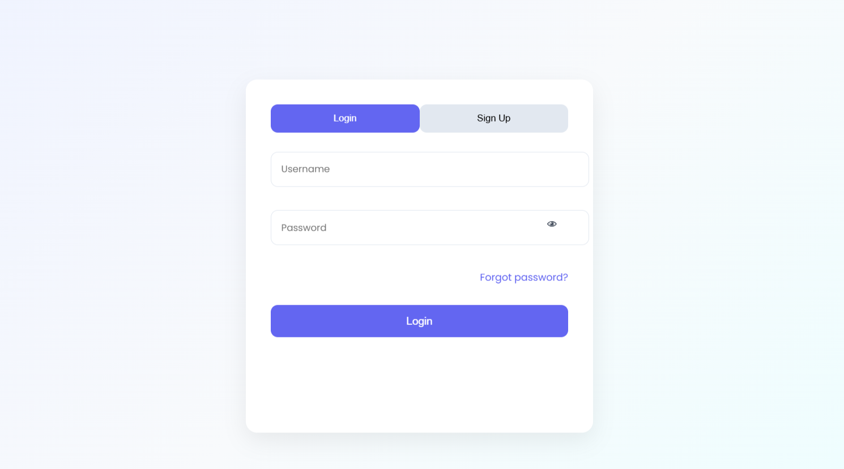
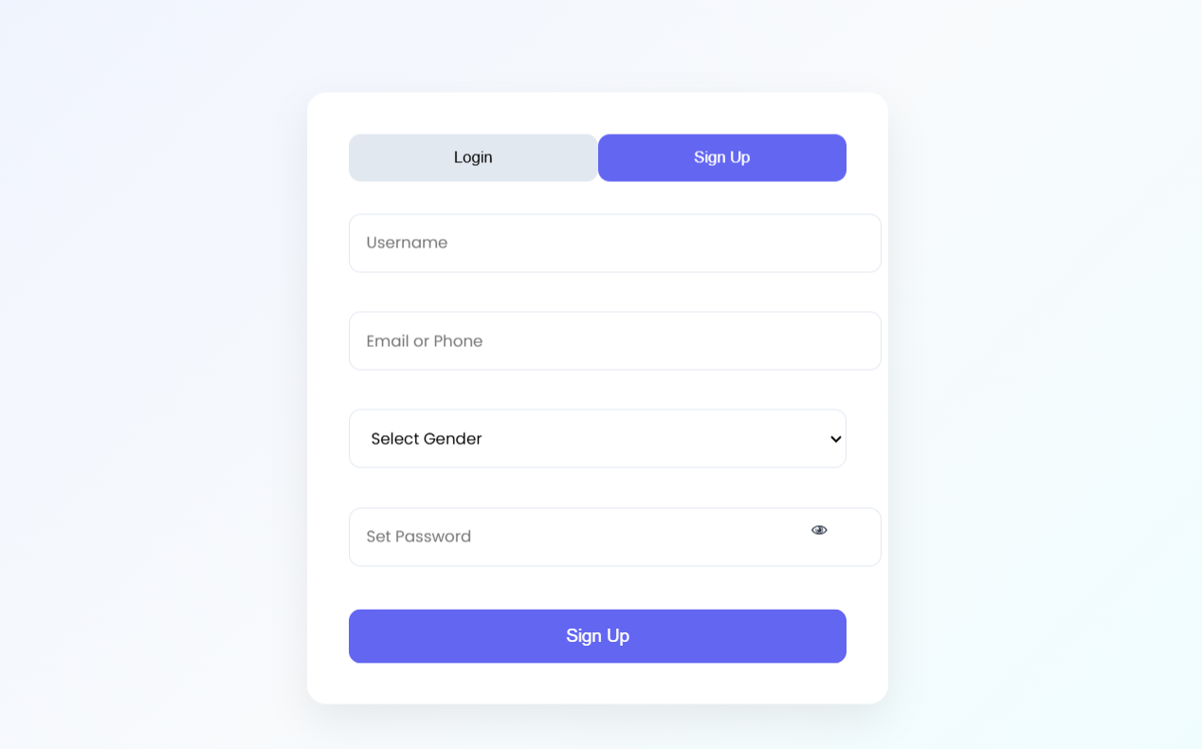
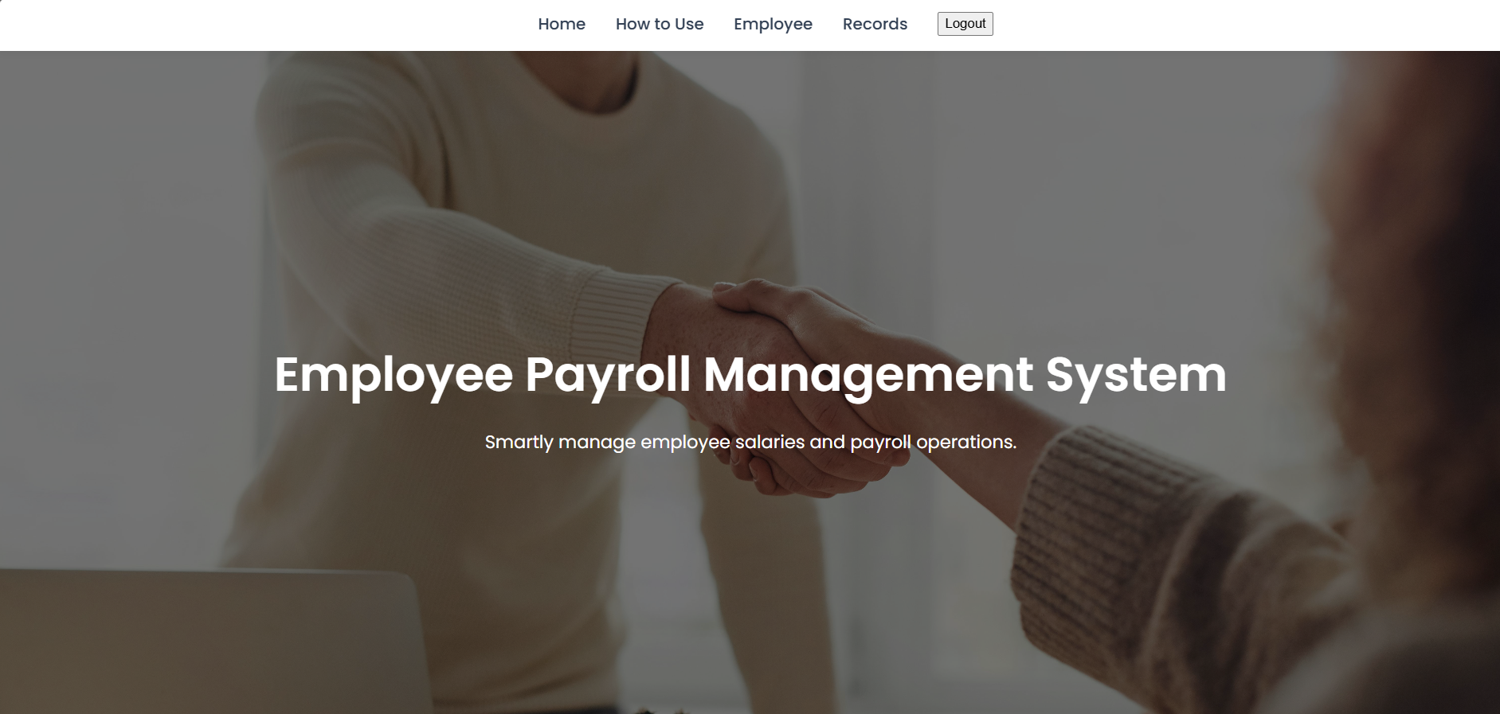
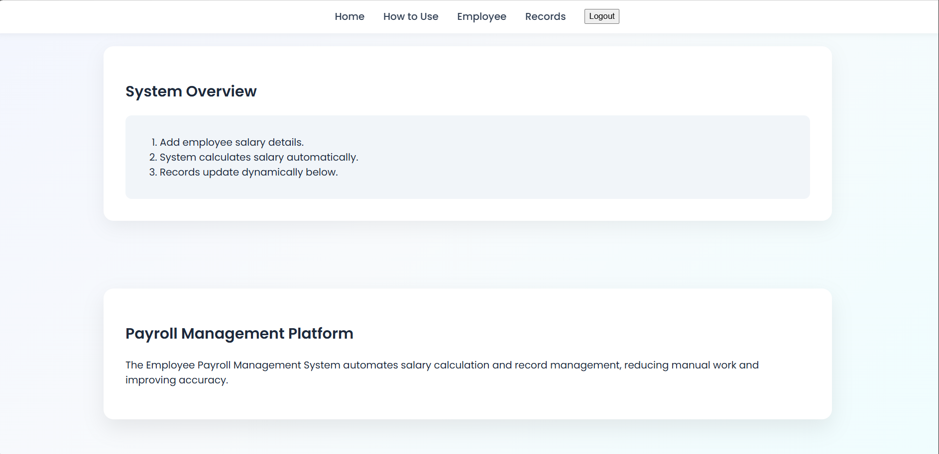
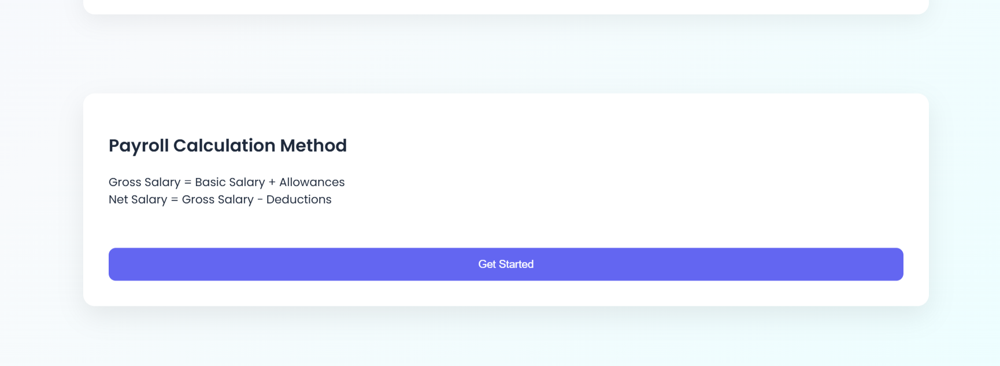
Screenshots for FWD & DSA

Slide 12
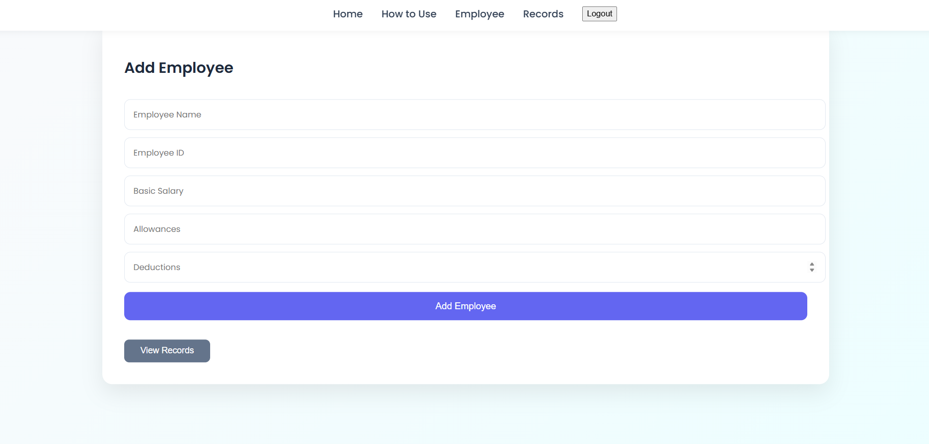
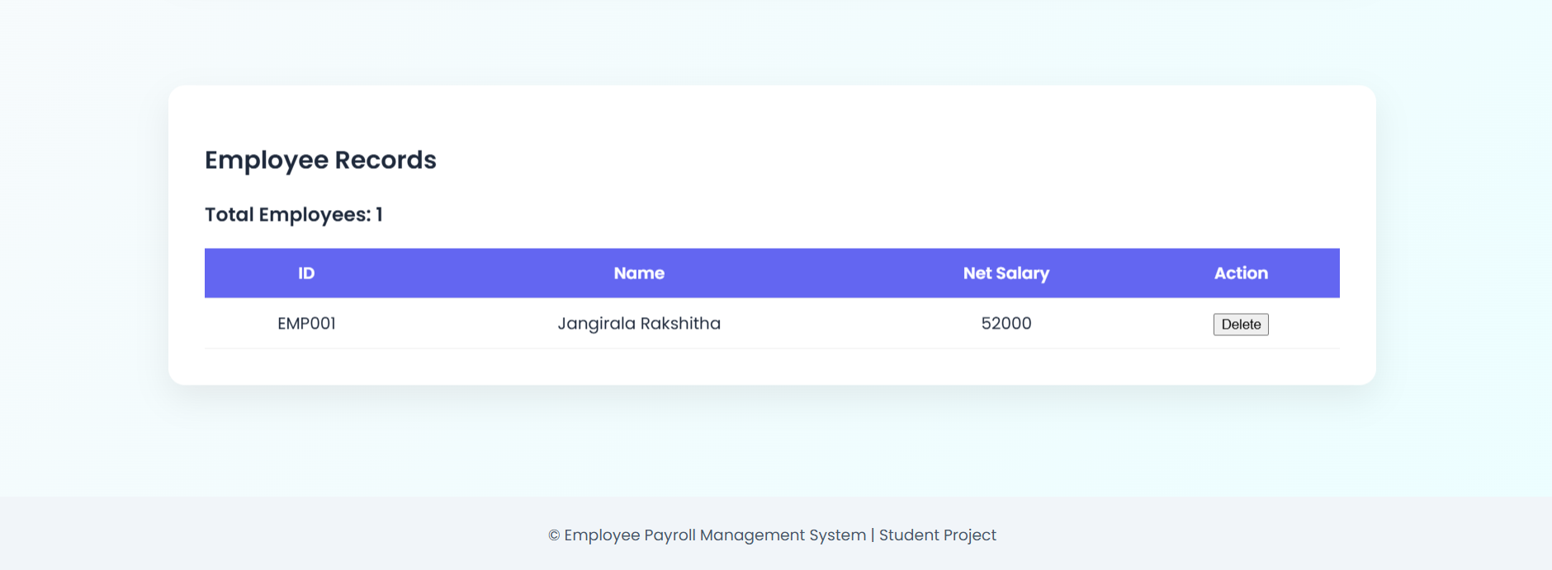
Screenshots for FWD & DSA

Slide 13
Conclusion
The Employee Payroll Management System automates employee salary calculation and record management.
The project demonstrates web development concepts and data structure algorithms such as searching, sorting, stack, queue, and hashing.
It provides an efficient solution for managing payroll data and understanding practical implementation of programming concepts.

Slide 14
Geo- Tag Photos

Slide 15
THANK YOU

