Slide 1
Travel agent
CAPSTONE PROJECT
Presented By:
Student name :M.V.N.Rakshitha
College Name & Department : Prasad V Potluri Siddhartha Institute of Technology&CSE(AI&ML)

Slide 2
OUTLINE
Problem Statement
Technology used
Wow factor
End users
Result
Conclusion
Git-hub Link
Future scope
IBM Certifications

Slide 3
Problem Statement
Planning a trip can be time-consuming and overwhelming, with too many choices, changing conditions, and scattered information. We propose TravelBuddy, an AI-powered travel planner agent that helps users create personalized, efficient, and real-time travel plans. It suggests destinations, builds smart itineraries, recommends transport and stay options, and adapts plans based on user preferences, budget, and live data like weather and local guides. It aims to turn complex planning into a smooth, enjoyable travel experience.

Slide 4
Technology used
IBM cloud lite services
Natural Language Processing (NLP)
IBM Granite model
IBM Weather API

Slide 5
IBM cloud services used
IBM Cloud Watsonx AI Studio
IBM Cloud Watsonx AI runtime
IBM Cloud Agent Lab
IBM Granite foundation model
IBM Weather API
IBM Cloudant

Slide 6
Wow factors
This agent will revolutionize travel planning by reducing manual research, saving time, and ensuring travelers make the most of their journeys. It adapts to individual preferences and offers smart, real-time solutions for seamless experiences.
Unique Features:
Personalized Destination Discovery based on budget, interests, and travel style
Dynamic Itinerary Planning auto-adjusted to user preferences and weather conditions
Hotel & Stay Suggestions with location and budget awareness
Smart Transportation Hints including local travel modes and estimated times
Live Weather Integration to avoid travel disruptions
Conversational Agent using Watson that understands and adapts to user queries
Multi-day Planning Support to organize complex trips with ease

Slide 7
End users
Casual Travelers
Business Travelers
Students & Backpackers
Travel Agencies
Senior Citizens
Event Planners
Remote Workers

Slide 8
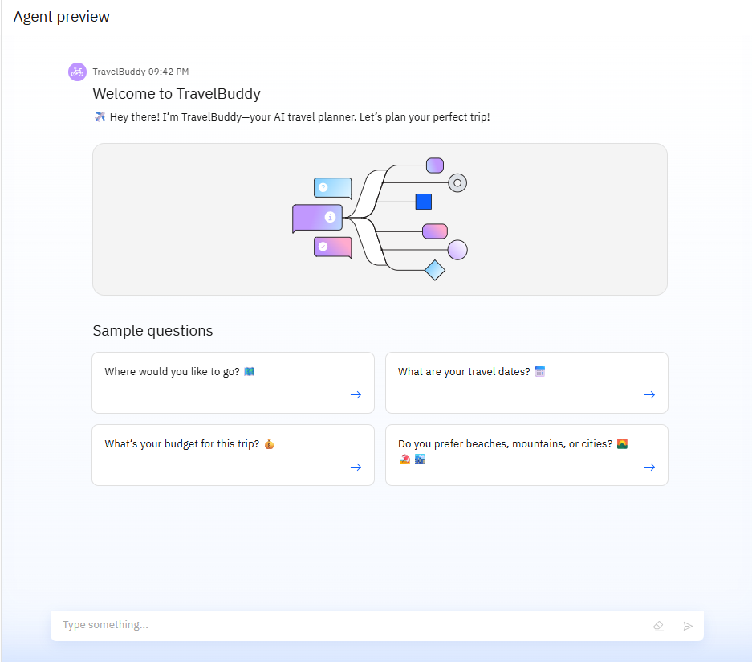
Results

Slide 9
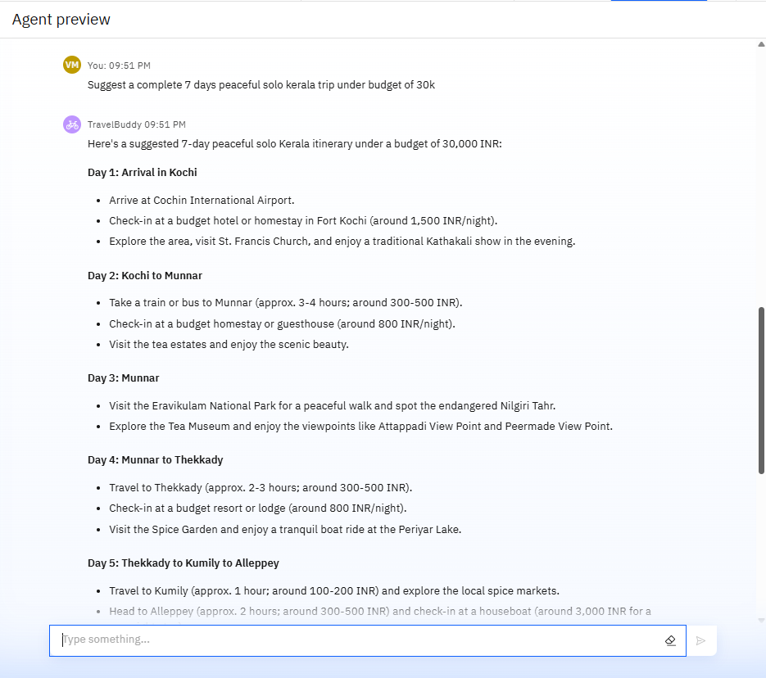
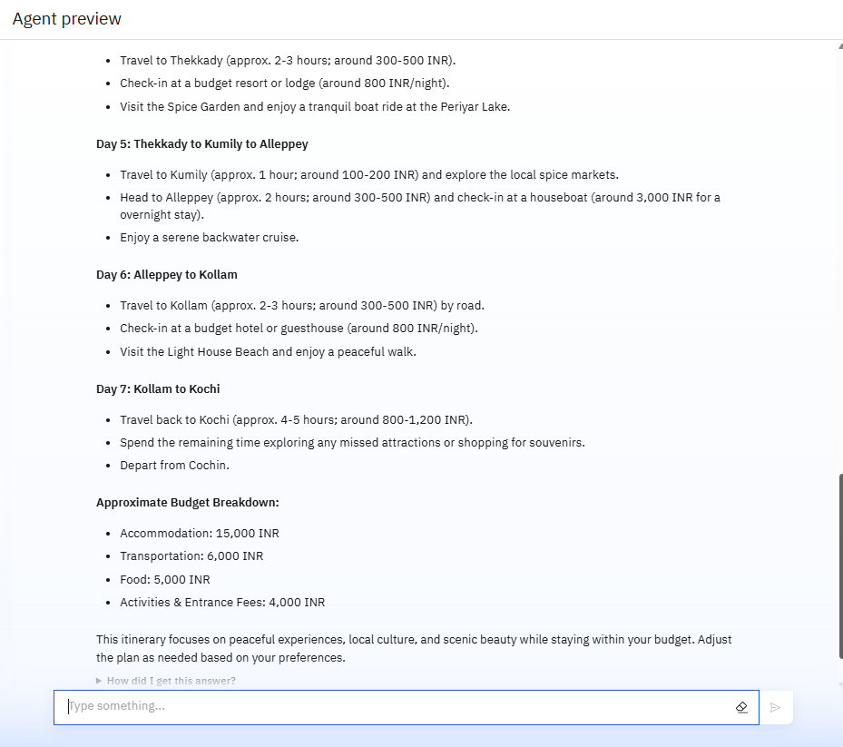
Results

Slide 10
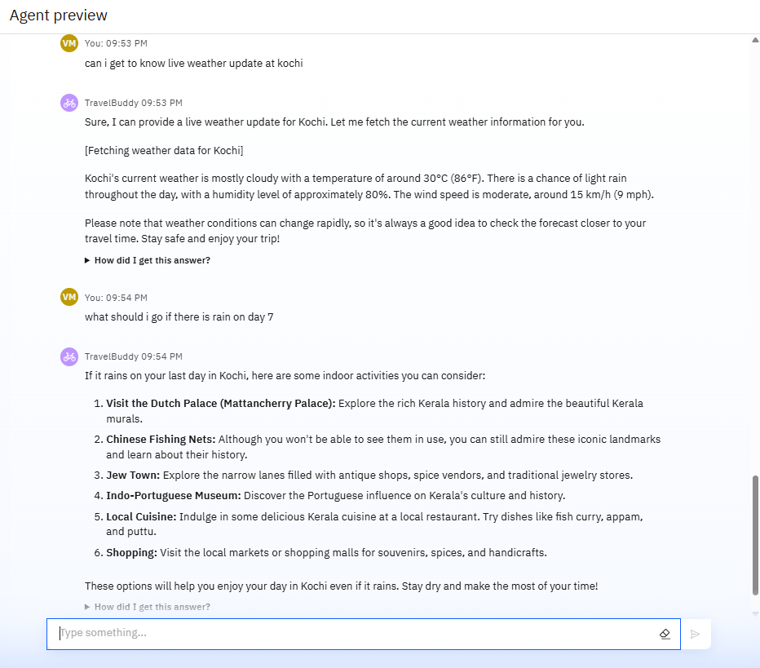
Results

Slide 11
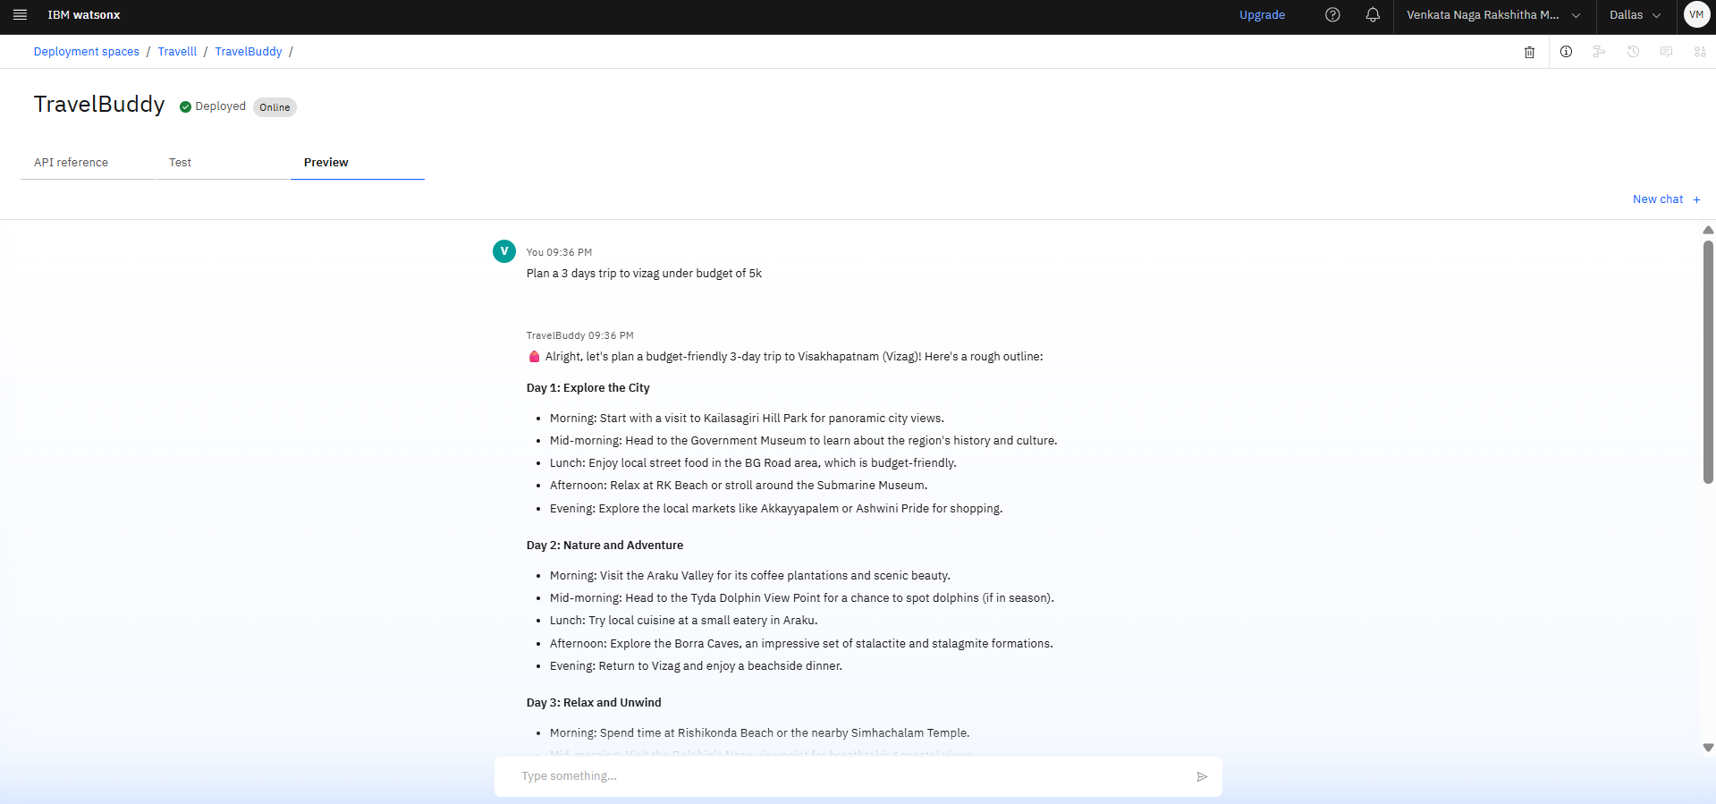
Results
Deployed AI Agent

Slide 12
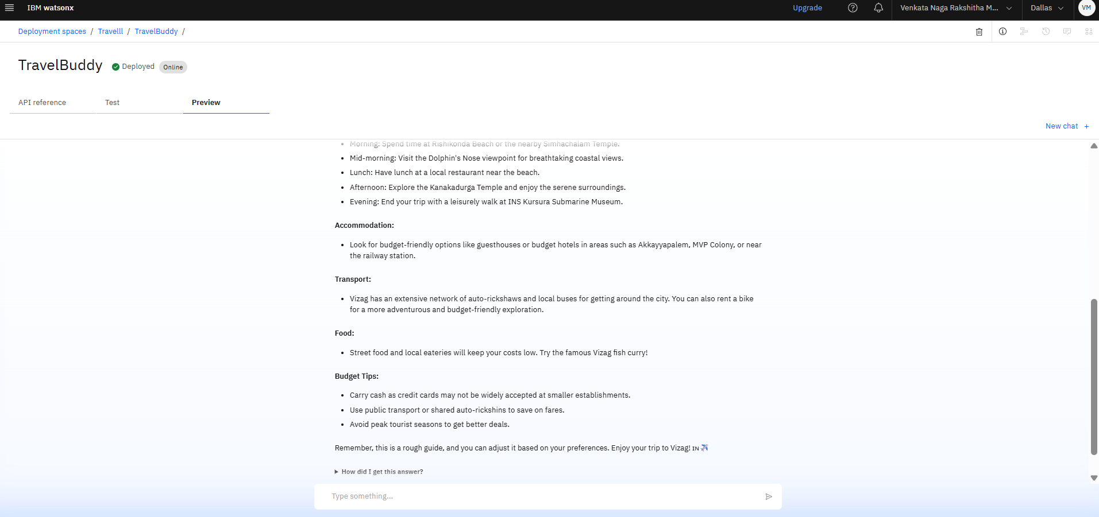
Deployed AI Agent

Slide 13
Conclusion
TravelBuddy can auto-generate itineraries, suggest destinations, and even assist with booking details.
It saves users time by automating trip planning, checking real-time weather, and offering personalized recommendations.
This intelligent agent boosts convenience, accuracy, and user satisfaction—making it a game-changer for modern-day travel planning.

Slide 14
Future scope
Multi-language Support
Smarter Personalization
Collaboration Features
Dynamic Budget Adjustments
AI-Powered Trip Planning & Replanning

Slide 15
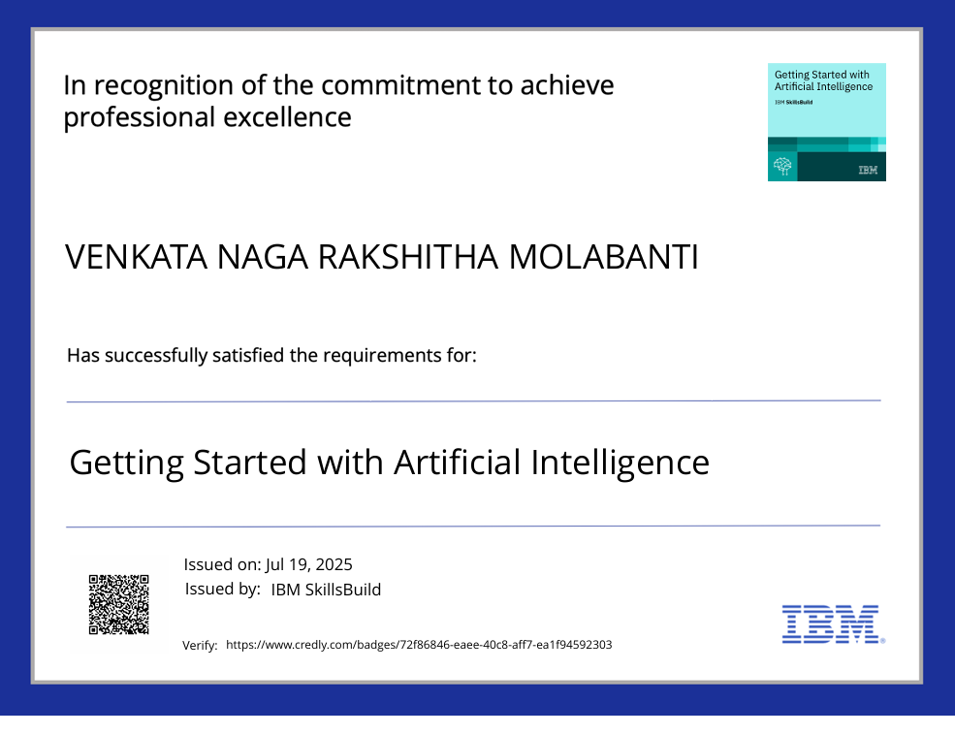
IBM Certifications

Slide 16
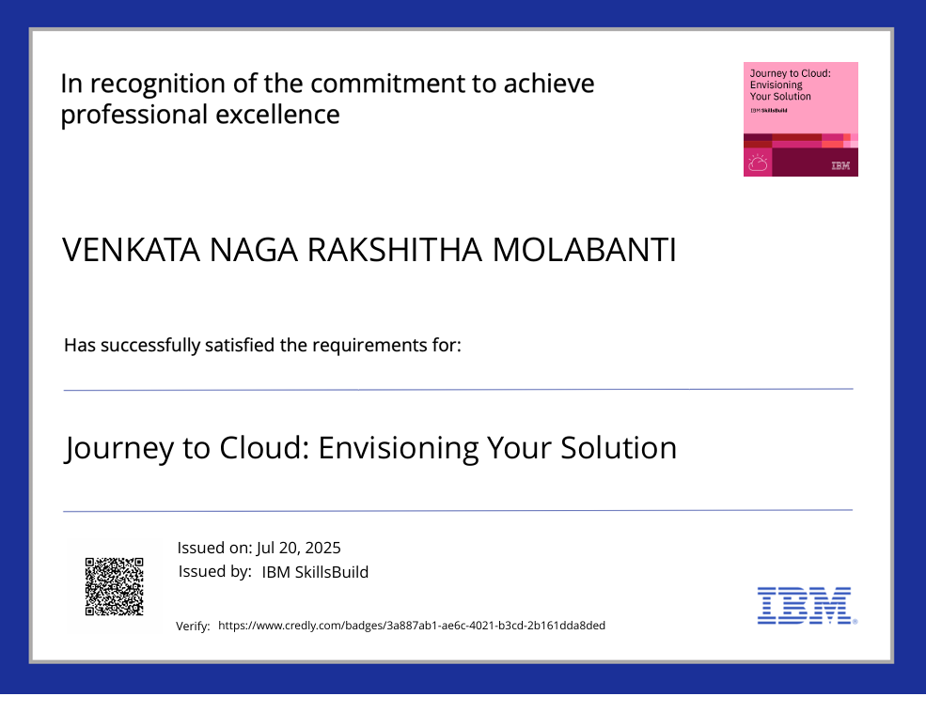

Slide 17
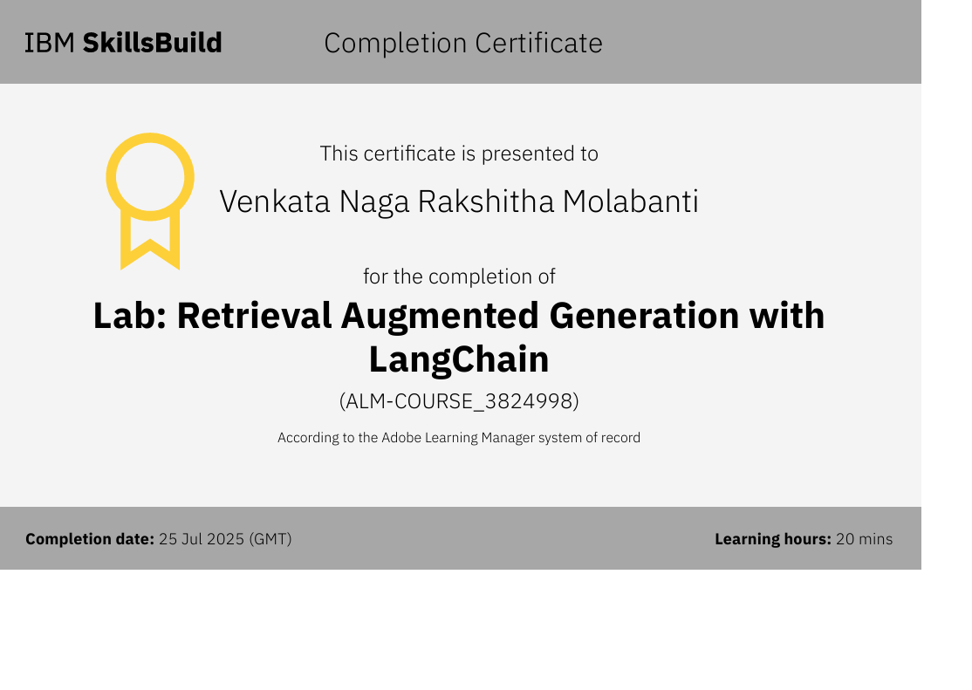

Slide 18
Git hub lik : https://github.com/AswiniKumar55/Nutrion_agent

Slide 19
THANK YOU

