Slide 1
Investigating Global Black Money Transactions

Slide 2
CONTEXT
Introduction and background
Dataset
Objective
Impact
Question Proposed
Visualization story
Dashboards
Insights
Conclusions

Slide 3
Introduction
Global Issue: Black money, hidden in offshore accounts and tax havens, undermines economic stability and deprives governments of vital tax revenue.
Exposed Networks: Scandals like the Panama Papers revealed extensive global financial secrecy, enabling tax evasion and corruption.
Ongoing Challenge: Despite global efforts, black money flows destabilize economies, widen inequality and erode public trust.
Our Aim: Use advanced data analytics to uncover patterns in black money flows across regions, industries, and risk factors, contributing to global financial transparency.

Slide 4
Dataset
Data source: Aggregated from global financial records, investigative journalism reports, and international financial crime data.
Dataset Size: Contains 10,000 records across 14 variables, offering a comprehensive foundation for analyzing hidden financial networks.
Data Coverage: Includes regional, industry-specific, and temporal data on illicit money flows, focusing on tax havens, high-risk industries, and key financial hubs.
Unique Insight: This dataset integrates multiple dimensions—geographic, industrial, and temporal—to reveal interconnected networks of illicit financial flows. It allows for advanced pattern recognition and risk profiling across regions and industries.

Slide 5
Objective
Analyze and Interpret Complex Financial Data Leverage advanced data analytics to uncover patterns and trends in global black money transactions.
Identify Key Players and Vulnerable Sectors Pinpoint countries, regions, and industries most involved in or susceptible to illicit financial flows.
Examine the Role of Shell Companies and Tax Havens Understand how these entities facilitate black money transactions and contribute to financial secrecy.
Uncover Temporal and Economic Patterns Analyze historical and recent trends in illicit money flows, linking them to global economic and political events.
Enhance Data Visualization and Insight Communication Utilize data visualization tools to effectively communicate insights that support anti-financial crime efforts.

Slide 6
Impact
Enhanced Economic Stability: Insights from the analysis will help policymakers address systemic risks posed by illicit financial flows, contributing to stronger and more stable economies.
Combatting Tax Evasion and Corruption: By uncovering hidden financial networks, this project supports efforts to recover lost tax revenues and reduce corruption globally.
Reducing Inequality: Identifying black money channels can enable more equitable wealth distribution by addressing illicit practices that disproportionately harm vulnerable populations.
Promoting Financial Transparency: The project advances global transparency by providing actionable insights into regions, industries, and practices that facilitate financial crime.
Supporting Global Policy Initiatives: Findings can empower governments, regulators, and international organizations to strengthen financial regulations and enhance anti-money laundering strategies.

Slide 7
Question proposed
Which countries and industries are involved in high-risk black money transactions, and how do these transactions change over time?
What patterns and trends can be observed in black money transactions over time and across tax haven countries?

Slide 8
Visualization Story
Data Acquisition → Data Cleaning → Exploratory Analysis → Pattern Recognition → Visualization Creation → Insights and Policy Recommendations

Slide 9
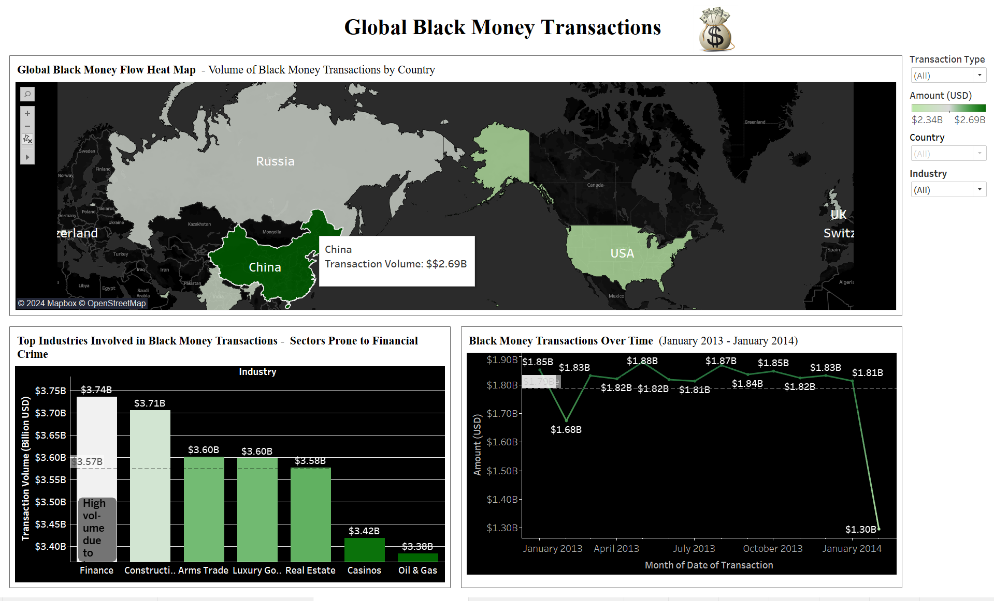
Dashboard-1: Global Black Money Transactions

Slide 10
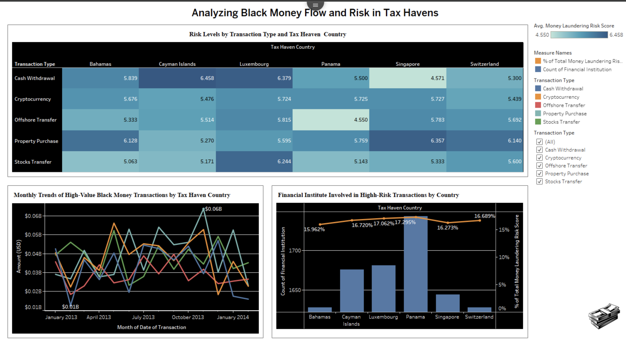
Dashboard 2: Analyzing Black Money Flow and Risk in Tax Havens

Slide 11
Insights for Dasboard-1
Countries such as China, USA, Brazil, and Singapore stand out for their significant involvement in black money transactions, suggesting a major role either as sources or destinations of illicit funds.
This indicates a high volume of transactions flowing through these regions.
The finance sector leads in terms of transaction volume, followed closely by construction, arms trade, luxury goods, and real estate.
This highlights these industries as particularly vulnerable to illicit financial activities due to their complex structures and high transaction values.
There are clear spikes and drops in black money transaction volumes over the course of 2013 to early 2014, with peaks in activity at certain points.

Slide 12
Insights for Dasboard-2
Different transaction types carry varying levels of risk in tax haven countries. Cash withdrawals and property purchases show higher risk levels in Cayman Islands, Luxembourg, and Panama.
This suggests certain types of financial activities pose more risks in specific tax haven regions.
High-value transactions show significant spikes and drops across months, reflecting distinct patterns in illicit financial flows across different periods.
Tax havens demonstrate varied transaction volume patterns, with some maintaining consistent flows and others showing noticeable peaks.
Countries such as Panama, Cayman Islands, and Luxembourg have a high number of financial institutions involved in high-risk transactions, indicating systemic weaknesses that facilitate black money flows.

Slide 13
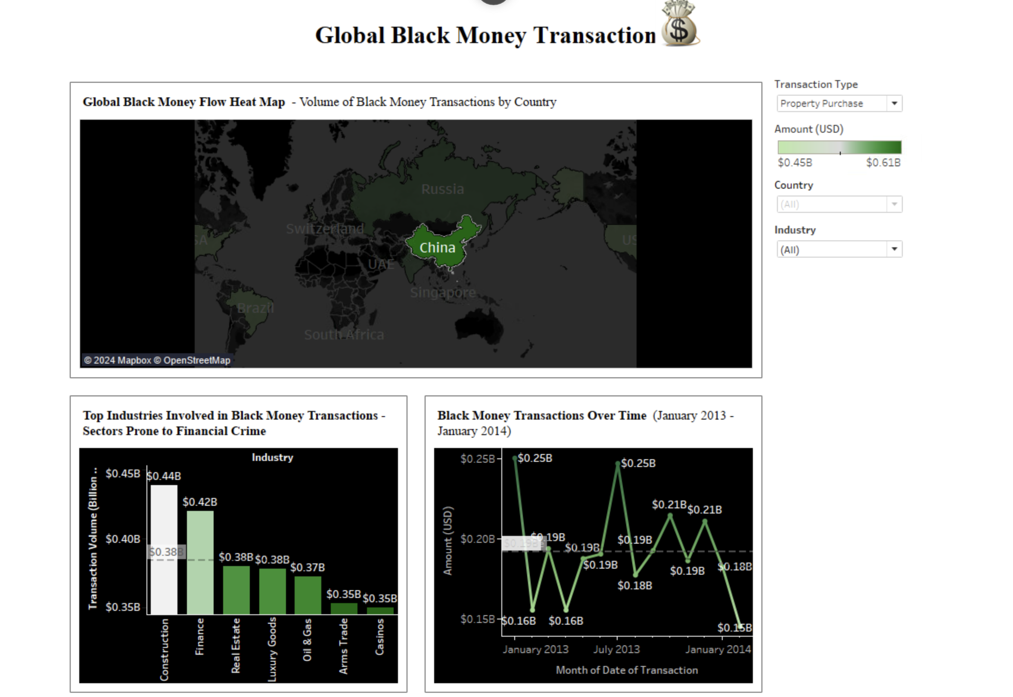
Unique Insights
Which country has the highest black money in property purchase transaction type and which industry plays major role and what are the monthly transactions of it

Slide 14
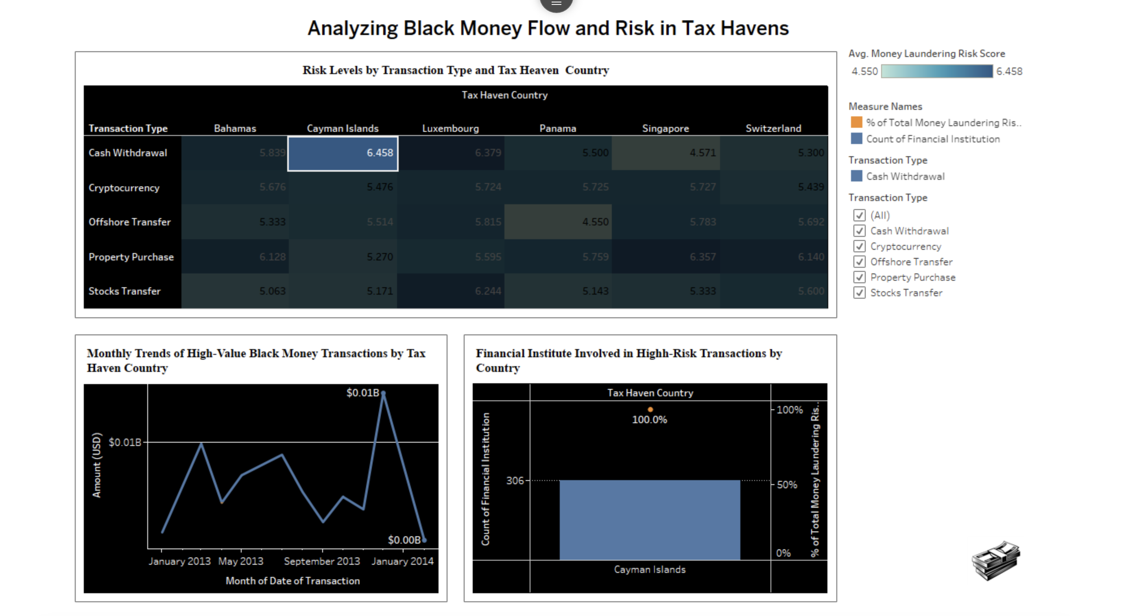
How do monthly transaction trends and the role of financial institutions in the Cayman Islands contribute to its high money laundering risk, particularly in Cash Withdrawals?

Slide 15
Conclusion
Focus on High-Risk Countries: Regulatory efforts should prioritize monitoring black money flows in countries like China, USA, Brazil, and key tax havens like Cayman Islands and Panama due to their major involvement in illicit activities.
Scrutiny on Risky Industries: Industries such as finance, construction, and luxury goods, along with high-risk activities like property purchases and cash withdrawals, need stronger regulations to reduce vulnerabilities.
Adaptable Regulatory Measures: Black money flows change quickly in response to external events, highlighting the need for flexible and responsive regulatory frameworks.
Role of Financial Institutions: Financial institutions in tax havens play a significant role in enabling black money flows, requiring stricter oversight and international cooperation to mitigate risks.
Global Cooperation Needed: The complexity of illicit networks across countries and sectors calls for international collaboration and specialized strategies to combat black money laundering effectively.

Slide 16
A project by Group-11 Likhith Killamsetty-11735539 Lavanya Manthri-11747205 Akshitha Veeravelli-11753207 Durga veerabadhrananda Dharani chand chavali-11753174 Rakshitha chintalapudi - 11814442
Thankyou

